Slide 1
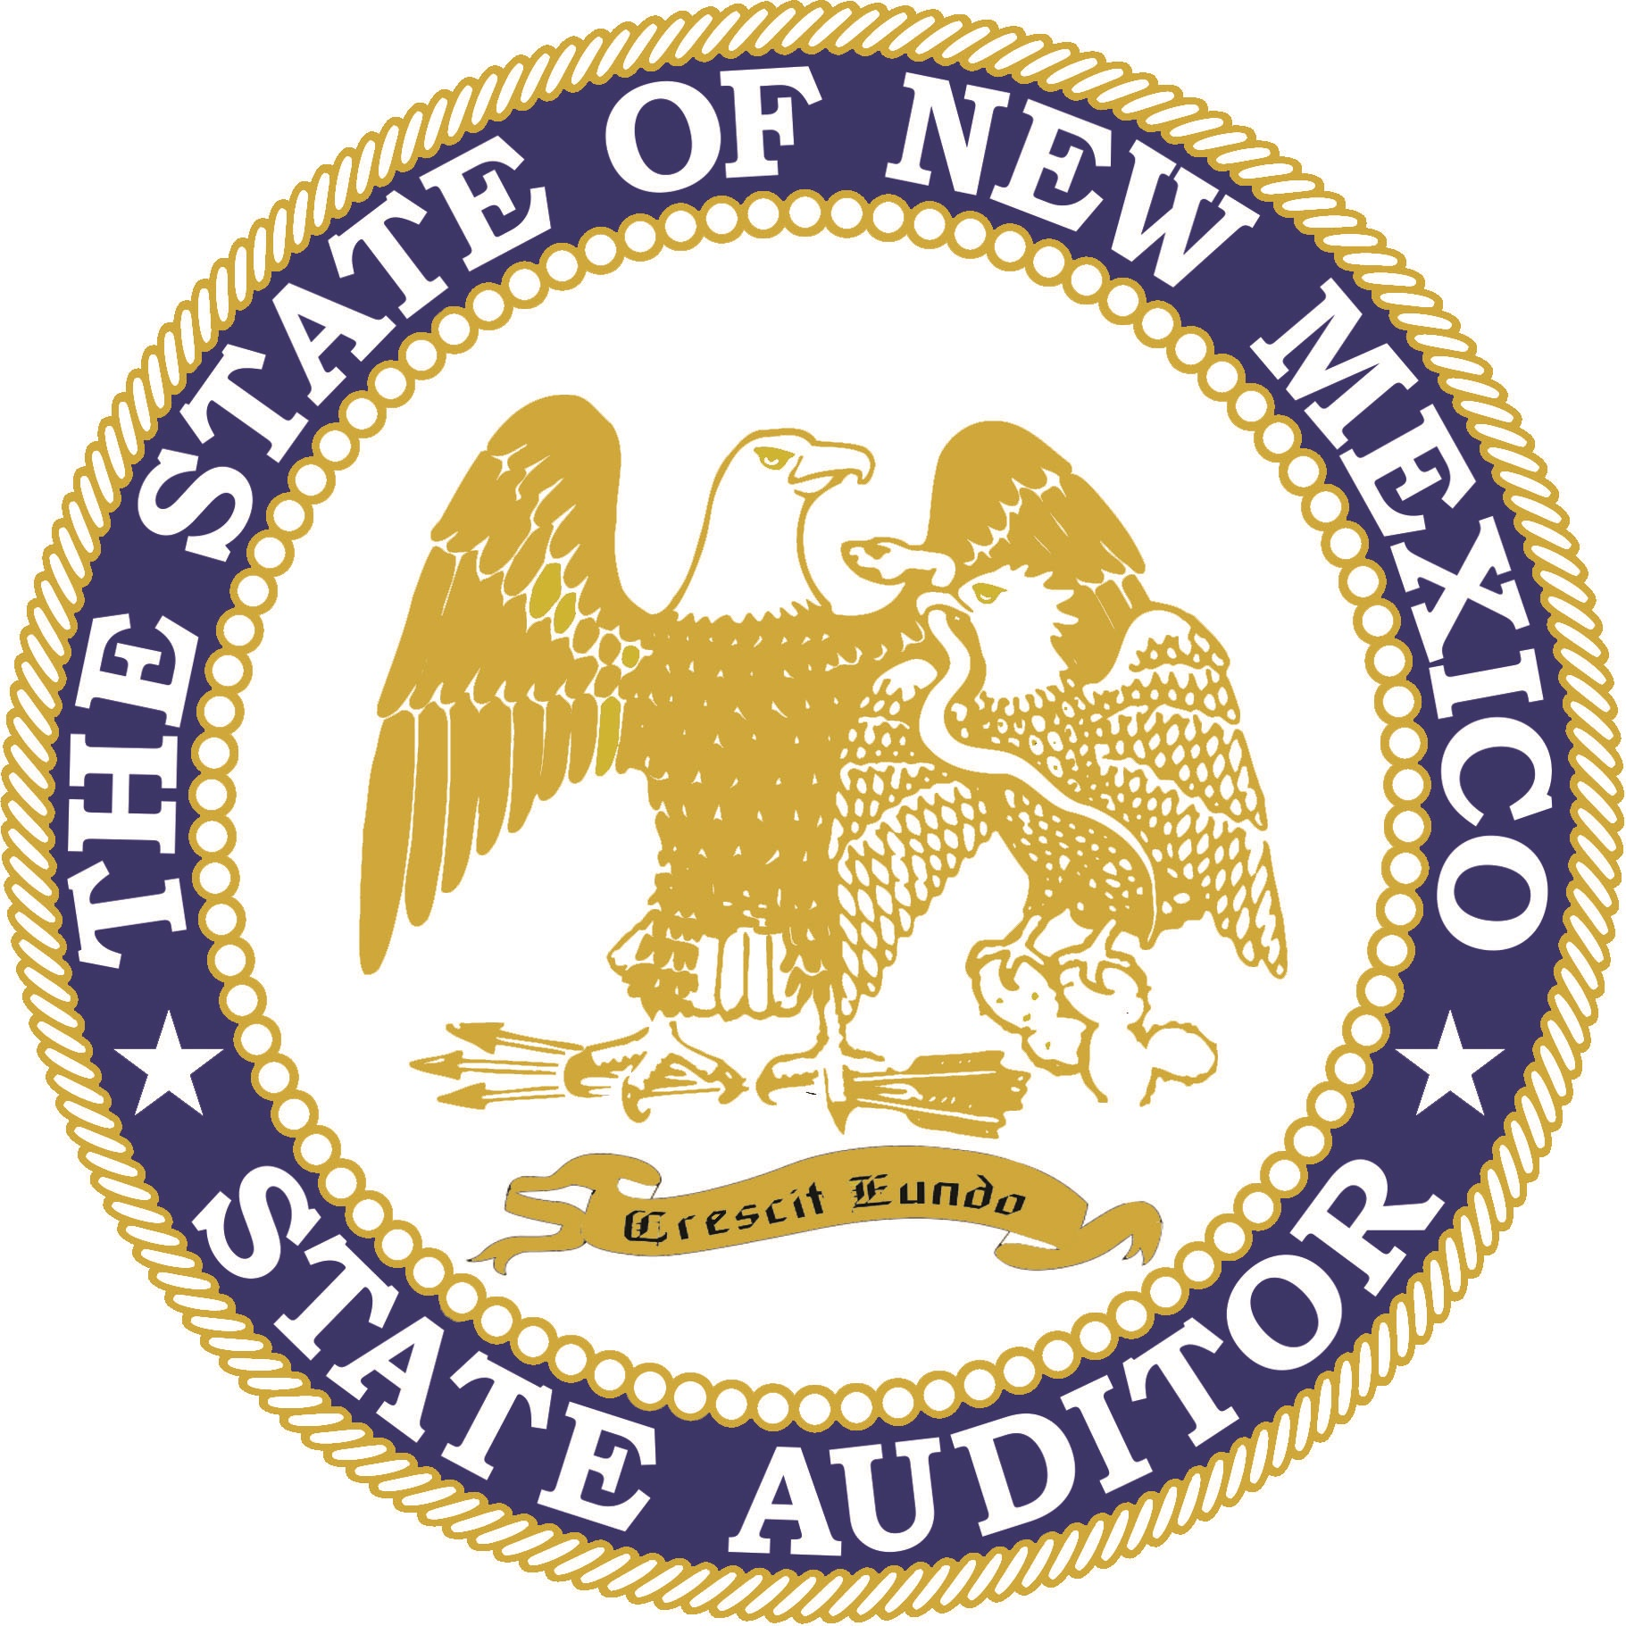
The Public Servant's Responsibility:
Trust And Fiduciary Duty
Brian S. ColóN, Esq., CFE
New Mexico State Auditor
Accountability, Transparency, and Excellence
April 6, 2021

Slide 2

Partnerships with Stakeholders
Working together to fight waste, fraud and abuse.
The OSA is defined and maintained through relationships.
Lifting up New Mexico together.
Notes:
OSA relationships with state agencies and local public bodies.
OSA relationships with approved IPAs.
OSA oversight of relationships between IPAs and agencies/local public bodies.
Nature of these relationships shaped by duties to public:
Constitutional authority
Statutes
Rules

Slide 3

Public Trust
The public trusts that state and local officials will act in their best interest.
  Public delegates governing authority to public officials.
  Participation in representative process.
Notes:
Concept of public trust with respect to relationship between public officials and citizens similar to fiduciary duties.
The public delegates governing authority to public officials to exercise discretion over the public treasury and to create laws that will impact their lives.
The public official, once elected, appointed, or hired, is in a superior position to that of the individual citizen due to specialized governmental knowledge and the ability to advise, deliberate, and participate in the representative process.
(For simplicity’s sake, please know that when we refer to public officials, we are referring to all public actors, be they elected, appointed or hired.)

Slide 4

Auditor Independence
In audit engagements, the independent auditor assumes a public responsibility that transcends any employment relationship with the client.
The “public watchdog” function demands that the accountant maintain total independence from the client at all times and requires complete fidelity to the public trust.
Notes:
Accountants who provide audit services generally cannot be held to a fiduciary standard given their duty to the public.
While an accountant normally is not considered to be a fiduciary to his or her clients, the AICPA Professional Code of Conduct embodies standards of conduct which are closely analogous to a fiduciary relationship — objectivity, integrity, free of conflicts of interest and truthfulness.
Limited case law; expanding duties; a fiduciary relationship may exist when the CPA offers services that extend beyond the normal accounting boundaries. A fiduciary relationship may be found to exist whenever a client justifiably puts special trust and confidence in an accountant to act in the client’s interest. Great importance should be placed on the careful characterization of the engagement that includes the meticulous drafting of an engagement letter that sets out what tasks will (and will not) be performed by the CPA. A separate engagement letter is suggested for every different type of engagement.

Slide 5

Fiduciary Relationships
A fiduciary relationship is one of trust or confidence between parties.
Fiduciary duties in government context:
  Duty of Care
  Duty of Loyalty
  Duty of Impartiality
  Duty of Accountability
  Duty to Preserve the Public’s Trust in Government
Notes:
A fiduciary is someone who has special responsibilities in connection with the administration, investment, monitoring, and distribution of property – in this case, public assets.
A fiduciary has a duty to act solely for the benefit of another on matters within the scope of the fiduciary relationship and is therefore strictly accountable for this stewardship.

Slide 6




Fiduciary Duties in Government
Duty of Care
Duty of Loyalty
Duty of Impartiality
Duty of Accountability
The duty of care requires that public officials completely and faithfully execute the duties of their respective office.
Public fiduciaries have an absolute obligation to put the public’s interest before their own direct or indirect personal interests.
Public officials have a duty to represent all of their constituents fairly. They must overcome any inherent bias that they possess.
Without a duty of accountability, the public’s ability to monitor the behavior of public fiduciaries would be severely limited.
Notes:
Under duty of care fall such obligations as the duty to manage assets competently and be good stewards of the public treasury, to use due diligence in the selection and supervision of staff, to follow the rules and to uphold the constitution and laws of the State of New Mexico.
Breach? Examples of breach of this duty include failure to attend meetings, failure to investigate, failure to engage in the deliberative process, and failure to vote.
Duty of Loyalty
The public fiduciary breaches this obligation when he or she benefits at the public expense.
Prohibited benefits can be financial (such as engaging in pay to play politics - or participating in decisions that favorably impact an official’s business, property, or investments), career related (such as using public office and/or public resources to obtain future employment or political position), or personal such as benefits to family members or close associates.
Note that when general ethical duties to family or friends conflict with duty to the public, the public duty must prevail.

Slide 7

Fiduciary Duties in Government
Duty to preserve the public’s trust in government
Without public trust, government doesn’t work. Trust in government is so important, public fiduciaries are charged with protecting and maintaining the public trust.
Notes:
Duty to preserve the public’s trust in government
The public is willing to delegate authority and sacrifice some freedoms in exchange for an orderly and civilized society, but only if it believes that government is acting in the public’s best interest.
When the public loses trust in government, public cooperation suffers, compliance with laws fail, and investors and consumers lose confidence.
As stewards of the public trust, public fiduciaries have a duty to avoid even the appearance of impropriety. That is to say, even if a particular course of conduct does not meet all of the elements necessary to constitute a violation of law, it nevertheless may be unethical if it creates the perception of wrongdoing that will harm the public trust.
Public officials should always ask themselves whether it would be a bad thing for a particular course of conduct to be reported on the front page of the local newspaper

Slide 8
Fiduciary Duties in Government
Act
Act at all times in good-faith and with the appropriate diligence, care, and skill required under the circumstances.
Maintain
Maintain complete confidentiality at all times, subject to State transparency laws.
Institute
Institute effective internal controls to achieve compliance and to identify and address problems.
Notes:
Core principles for effective conduct at issue here.
Act in a manner reasonably believed to be in the best interests of the office.
Faithfully pursue the interests of the office and its public purposes rather than one’s own interests or the interests of another person or organization.
Actively disclose existing or potential conflicts of interest and dual interests.

Slide 9

Agency Budget Responsibilities & Duties
Timely submission of a budget is critical
  Budget development timelines should be enacted in accordance with regulatory submission dates
  Information should be accurate and presented with sufficient time to review to make informed decisions
  Questions should be directed to appropriate oversight agencies in a timely manner (including but not limited to DFA-LGD)
Notes:
The public’s interest is best represented when rules and policies & procedures are developed for efficient and effective management and control of taxpayer funds.
Predictive quality of budgetary information is a key component to making informed decisions for maximum benefits to an organization.
In short, a well planned and executed framework concerning budget development and submission is critical for program management and overall agency operation and service to New Mexicans.

Slide 10

Essential Ingredients for
Effective Government
  Internal Controls
  Policies and Procedures
  Strict Compliance with Duties
Notes:
Management is responsible for internal controls!
Audit Committee and Internal Audit can provide – but not if the function isn’t what it was indented to be. Internal Audit should have ability to report independently.
Management of the Entity - Employees that make up management vary by organization. Organizations should self assess who management is when it relates to internal controls and the proper internal control structure. And who is in the best position with the proper expertise to craft and develop policies and procedures to best mitigate risk.
Develop and maintain a system of internal control
Audit committee can provide a monitoring function
Internal audit can provide information regarding internal control effectiveness
Compliance with entity policies and procedures
Strict Compliance starts with the Tone at the top - Tone at the top should be a strong message of commitment to ethical behavior and integrity. Set the example.

Slide 11

PUT PRINCIPLES INTO PRACTICE
Education (meaningful employee training and resources)
Self-evaluation
Policies and procedures as living documents
Notes:
Ensure understanding of fiduciary duties (provide employees adequate resources).
Self-evaluate through committees as to effectiveness in adhering to fiduciary duties.
Plan ahead. Update policies as necessary.

Slide 12

SUBMITTING A REPORT OR COMPLAINT
ALLEGATIONS OF GOVERNMENTAL WASTE, FRAUD, AND ABUSE
Reports may be made anonymously by submitting a compliant through our online portal at www.osafraud.org or by calling 1-866-OSA-FRAUD (1-866-672-3728).
You may also speak to an investigator by calling
505-476-3800
You may write to the office at:
New Mexico Office of the State Auditor
2540 Camino Edward Ortiz, Suite A
Santa Fe, NM 87505
10
Notes:
One of the most tried and true methods of combating waste, fraud, and abuse is by taking a more proactive approach to accountability and shift away from a reactive approach as much as possible. You can help the OSA by submitting complaints of governmental waste, fraud, and abuse to our office. ​
​
You can submit a complaint by calling, writing, or visiting us online. ​
​
​

Slide 13




Thank you!
Brian S. ColóN, Esq. CFE
New Mexico State Auditor
Brian.Colon@osa.state.nm.us
www.saonm.org
505-476-3800
2540 Camino Edward Ortiz, Suite A
Santa Fe, NM 87507
Notes:
Accountability, Transparency, and Excellence in action this year:
Rehoboth
Important actions with hospital and county governance
Municipalities
Santa Rosa
Espanola
Las Vegas
Counties
Travel Expenditures Alert
One resulted in repayment that had not yet occurred
Both resulted in changes in critical policies to protect taxpayer funds
My directive of complete office closure and mandatory telework for all employees is consistent with the current Public Health Order and the OSA’s Telework During Emergency Policy, which provides the “State Auditor, or designee, retains the right to determine work schedules and locations.” ​
​
The OSA is doing its part to protect New Mexicans by limiting social contact, and in turn limiting the spread of COVID-19 to the extent we can.​
​
If you have any questions do not hesitate to ask. The OSA is available and willing to discuss any concerns. We will continue to provide updates as more information becomes available and appreciate your understanding during these unprecedented times​

