Slide 1
ASSESSING COMPLIANCE RISK IN YOUR INTERNAL CONTROL ENVIRONMENT
Donna Trujillo

Slide 2
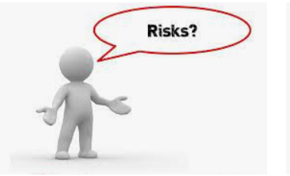
What is risk?
Risk is defined as exposure to danger, harm, loss.

Slide 3
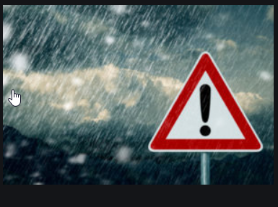
Hazards
A hazard is an something that can cause harm or damage to humans, property, or the environment. Risk is the probability that exposure to a hazard will lead to a negative consequence, or more simply, a hazard poses no risk if there is no exposure to that hazard.
“What’s the harm?”

Slide 4
What types of risk do we face in every day life?
We exist in a continual process of assessing risk.
Purposeful assessment
Subconscious/intuitive assessment.

Slide 5
What purposeful assessments do we face in our lives?
What types of risk are associated with the following:
Buying a house
Starting a business
Changing jobs
Not charging your phone
Not putting gas in your car

Slide 6
What type of risk do we face as accountants or fiscal staff?
Recording estimates
Forecasting shortfalls
Posting incorrect transactions
Incorrect payments made to vendors
Budget shortages
Insufficient documentation or support
What other risks can you identify?

Slide 7
LET’S TALK ABOUT AUDIT RISK!
The three types of audit risk are as follows:
Control risk. This is the risk that potential material misstatements would not be detected or prevented by a client's control systems.
Detection risk. This is the risk that the audit procedures used are not capable of detecting a material misstatement.
Inherent risk.

Slide 8
CONTROL RISK
Organizations must have adequate internal controls in place to prevent and detect instances of fraud and error.
Control risk is considered to be high where the audit entity does not have adequate internal controls to prevent and detect instances of fraud and error in the financial statements.

Slide 9
Assessing Risk
Risk assessment is a term used to describe the overall process or method where you: Identify hazards and risk factors that have the potential to cause harm.
Components of Risk
The probability of an incident occurring, and
The impact of the incident.
If any of these two increased, risk will increase.

Slide 10
What’s the harm?
Buying a house
Starting a business
Changing job
Not charging your phone
Not putting gas in your car

Slide 11
RISK MANAGEMENT

Slide 12
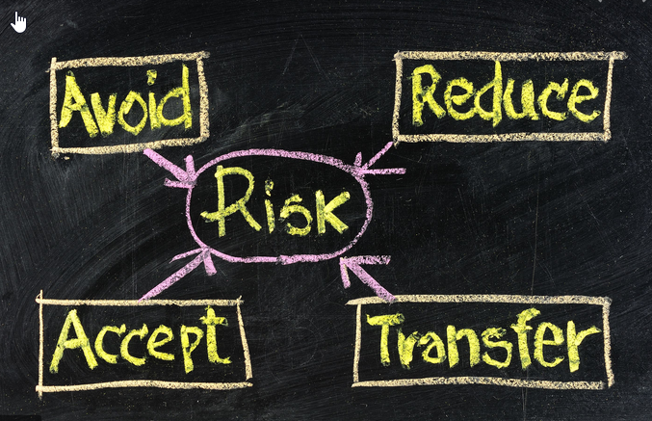
TAKING ACTION

Slide 13
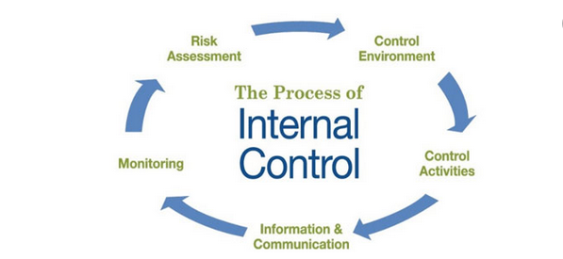
ACCEPT AND MITIGATE

Slide 14
Control Environment
ACCOUNTABILTY
RESPONSIBILITY
ETHICS
OTHERS?
“Tone at the Top!”

Slide 15
Control Activities
Physical controls
Documentation procedures
Independent verification
Segregation of duties
Human Resource controls
Establishment of responsibilities
Others?

Slide 16
Information and Communication
Code of Conduct
Job descriptions
Supporting documentation
Manuals
Agreements and contracts

Slide 17
Monitoring
Review of closing documents.
Predictive analytics
Audits
Testing
Corrective action

Slide 18
Compliance
Compliance
Rules
Standards
Policies
Laws
Regulations
Agreements

Slide 19
Grant Compliance
In accepting a grant (or subgrant), the recipient agrees to comply with the applicable requirements and to the prudent management of all expenditure and actions affecting the award.
Every submission (Grant application, performance and financial reports, periodic certifications) is a statement to a government official
Every request for payment is viewed as a certification that the awardee is complying with all material requirements and terms
Only Actual Authority will normally bind the government –beware of “guidance” from unauthorized government representatives

Slide 20
Risk Areas
Adequate program documentation
Travel documentation
Cost-sharing
Records retention
Separate financial administration for each awards
Violations of institutional conflict of interest rules
Sub-awardee monitoringResidual funds – accounting and disposition
Labor Charging (i.e., Timekeeping) – Direct v. Indirect– Allocation over Multiple Projects– Consistency with Approved Grant Budget

Slide 21
Strategies
Organizational Policies and Procedures
Accounting/Purchasing/Code of Conduct policies tailored to Grant requirements and Organization
Training for Key Managers and Grant Management Personnel
Grant Closeout and Records Retention
Subawards and Subcontracts
Flow-down required and desired Requirements
Actively manage and monitor performance
Regular Review of Above Items

Slide 22
Audit findings
What do audit findings mean?
How can audit findings help strengthen internal controls?
Are all findings alike?
How should I respond to a finding?

Slide 23
Questions

