Slide 1
ERP Implementation
Highlights for Planning, Solicitation, Implementation & Post Go Live

Slide 2
What is an ERP?
Financial
Human Resources
Asset Management
Utilities
Cashiering
An ERP stands for Enterprise Resource Planning System

Slide 3
Information Management
Utilities
Financial Reporting & Taxpayer Accountability
Notes:
Helen: Visual on interconnected core functionalities with HP Adding Utilities and IM as part of our core.
Culmination of our business operations that gets us to accountability to our taxpayers with our financial reporting.

Slide 5
What Problem Are You Trying to Solve?
Current State
Future State
Manual Processes?
Ease of Reporting?
Interfaces & multiple maintenance costs amongst several products?
Paper or Paperless?
End of life – upgrades?
Ability to telework?
Electronic Workflow
Ease of Data Download / Manipulation / Dashboards
Less Customization
Disparate Systems, Maintenance, Support, and End of Life Drivers
Leveraging Technology to Increase Efficiency - Paperless

Slide 6
Polling Question:
1. What does ERP stand for?
A. Enterprise Reward Program
B. Enterprise Resource Planning
C. External Requirements Policy
D. Exhausting Resource Project

Slide 7
Planning Phase
Budget
Governance
Resource Plan
Timeline
Change Management

Slide 8
Budget Be mindful and up-front about all costs – but itemize purpose of each necessary piece
Actual Software Cost
+ Ancillary Technology Needs
+ Resource Plan
+ Contingency
= Project Budget
$2M = $4.2M
Rule of Thumb, Price of your SW x 2!

Slide 9
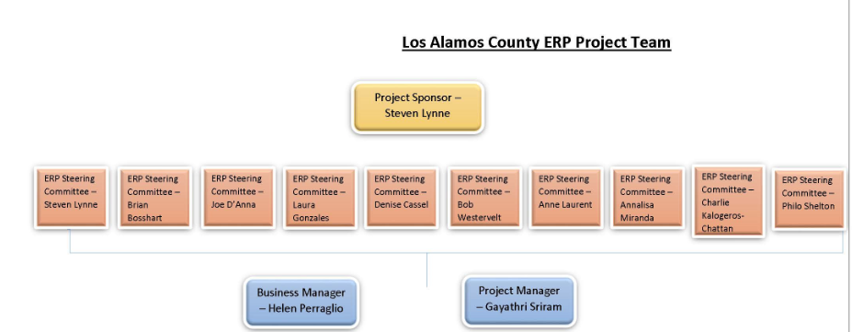
Governance
Need Strong Project Sponsorship & Leadership from Key Leaders in your Organization
Decision Making should not be top down but Steering Committee seeks input for ultimate decisions
Business Manager Represents Functional Leaders - They should make decisions on needs, leaders should support this team
Project Manager – Strong, assertive and deadline oriented

Slide 10
Resource Plan
What's the #1 key to success?
Functional Leads – The Real Leaders – Take Care of Them!
Provide Concrete Incentives – Think Outside the Box
Absolutely the most key resource for your project
Subject matter experts – doing the job today
Need to be empowered to make decisions
MUST be included in all impact decisions, timelines, change communications, & VALUED!
Hire Limited Term Positions – either for operations or project or both
Adopt Project Team Policy for Leave and Pay –
OT straight for Exempts
Extension of CT banks or AL rollovers
Administrative Leave at project completion (when they can actually take time off)
Tip: Provide food for working lunches, long nights, weekend BBQ's at work – but don't think this is all they need!

Slide 11
Resource Plan – In Context
Imagine you're building the new building while the roof is falling in – that's what your functional leaders are doing with this critical organizational infrastructure!
Make sure they are supported; they are the pillars of both operations and future implementation success!

Slide 12
Change Management
Manage Fears
Manage Expectations
Bring Your Solutions to Problems You Identify & Help Build Them!

Slide 13
Polling Question:
2. In order of importance when planning an ERP project what are some of the key areas that can help it succeed?
Governance, Change Management, Resource Plan, Budget
Budget, Change Management, Governance, Resource Plan
Resource Plan, Budget, Change Management, Governance
Budget, Governance, Resource Plan, Change Management

Slide 14
Solicitation Phase
Define the Team
Third Party Consulting Services – RFP (Don’t go it alone!)
Project RFP – Scope, Requirements, BoB or Out of Box, Evaluation Committee, & Scoring Criteria
Build the Evaluation Committee – Subject Matter Experts!!
Demos / Scripts
Make it Defensible / Confidentiality / Procurement Rules
Finalizing the Contract – Where the rubber hits the road
Hold them to their promises in the RFP and Demonstrations

Slide 15
Solicitation Phase - Project Team Must Have Co-Leadership
Business Manager
Ensures the Business Requirements are organized, addressed, and represents all SME stake holders
Empowers the Functional Team to make key decisions
Project Manager
Manages Timeline & Budget
Holds Vendor Accountable to Implementation Contract
Manages all Documentation & Team Schedule

Slide 16
Solicitation Phase – Third Party Assistance
Assist in Documenting Current State
Assist in Drafting RFP
Assist in Scope of Work for Implementation
Help to build requirements of each core function/module & Gap Analysis
Must Have, Very Desirable, Nice to have, Optional functionality
Assist in Demo Scripts
Assist in Evaluation and Scoring
Assist in Change Management

Slide 17
Evaluation Committee – How to Involve all Stakeholders and keep within Procurement Rules of Engagement
Breakout Scoring Committee by RFP evaluation criteria
Involve SMEs at distinct demos by area
Confidentiality agreements & strict rules of participation
Ensure all demos follow the same script
Don’t identify Solicitors – give generic name references

Slide 18
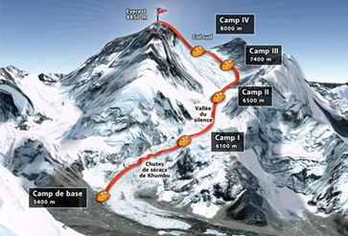
Mt. Everest Meter
Implementation Phase
Used with my team regularly
Each Camp represents major milestone
Everything Pre- Go Live = Summit
Post Go – Live is how you get back down (statistically the trek down is most fatal)

Slide 19
Implementation
Defining and Motivating the Project Team
*Incentives, Schedule Vacation Time, Hire Help, Empower
Design & Setup
* Schedule 3 / 2 days project to ops and assign homework
Conversion – Decisions on Legacy Data & Crosswalks
* We chose to store legacy in SQL Server & Clean Cutoff
Data Roles and Workflow
* Huge Investment of Mapping & Design but well worth it!
Training
* Need time for pre-go live, Record, and deliver SOPs
Change Management
* Preview key changes with the organization throughout, don’t wait!
Go – Live – Timing is everything
*Finance Drives - FY is a must!

Slide 20
Polling Question:
3. How do you keep a team motivated and engaged in a massive ERP project?
Leave the decisions to the project manager and steering committee
Provide incentives, promote buy-in of post-go-live, employee recognition, & give Functional Leads and SMEs decision making power
Mandate deadlines from the top down
Feed them pizza

Slide 21
Post Go Live
Why Choose Big Bang?
You can do it on time
You can do it within budget
You can avoid severe resource burnout (hopefully)

Slide 22
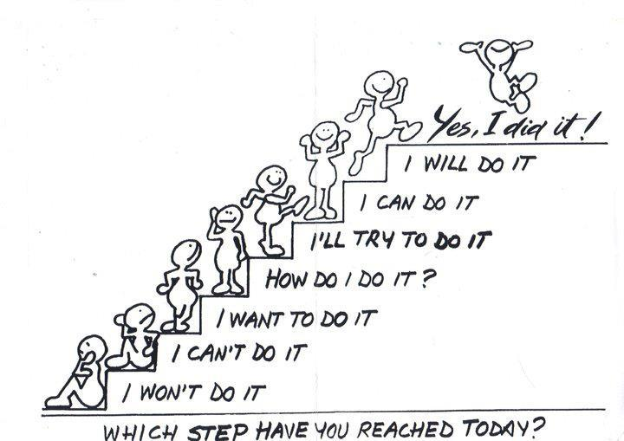
Invest in End User Tools
Online Learning
Job Aides
Standard Operating Procedures
FAQs – Constant Communication – Change Mgt Team High Gear
Functional Leaders Availability for Assistance
Focus Group Follow up (Sharpening the Saw)
Structure your Trainings by Data Role

Slide 23
Prepare for your Audit and Stakeholders
Prep – PBCs (Proactively)
Conversion Maps –
COA/General Ledger - Crosswalk
Employee History – Both Inactive & Active
Vendor History
Customer History
Identify How New Data & Reports will Look
Grantor Agencies
Internal Report Users
External Public Reports – Sunshine Pages
DFA – LGBMS Crosswalk
Auditors

Slide 24
Recognize Your Super Stars!

Slide 25
Maintaining Standards – A Tough Feat But Deserves Recognition!

Slide 26
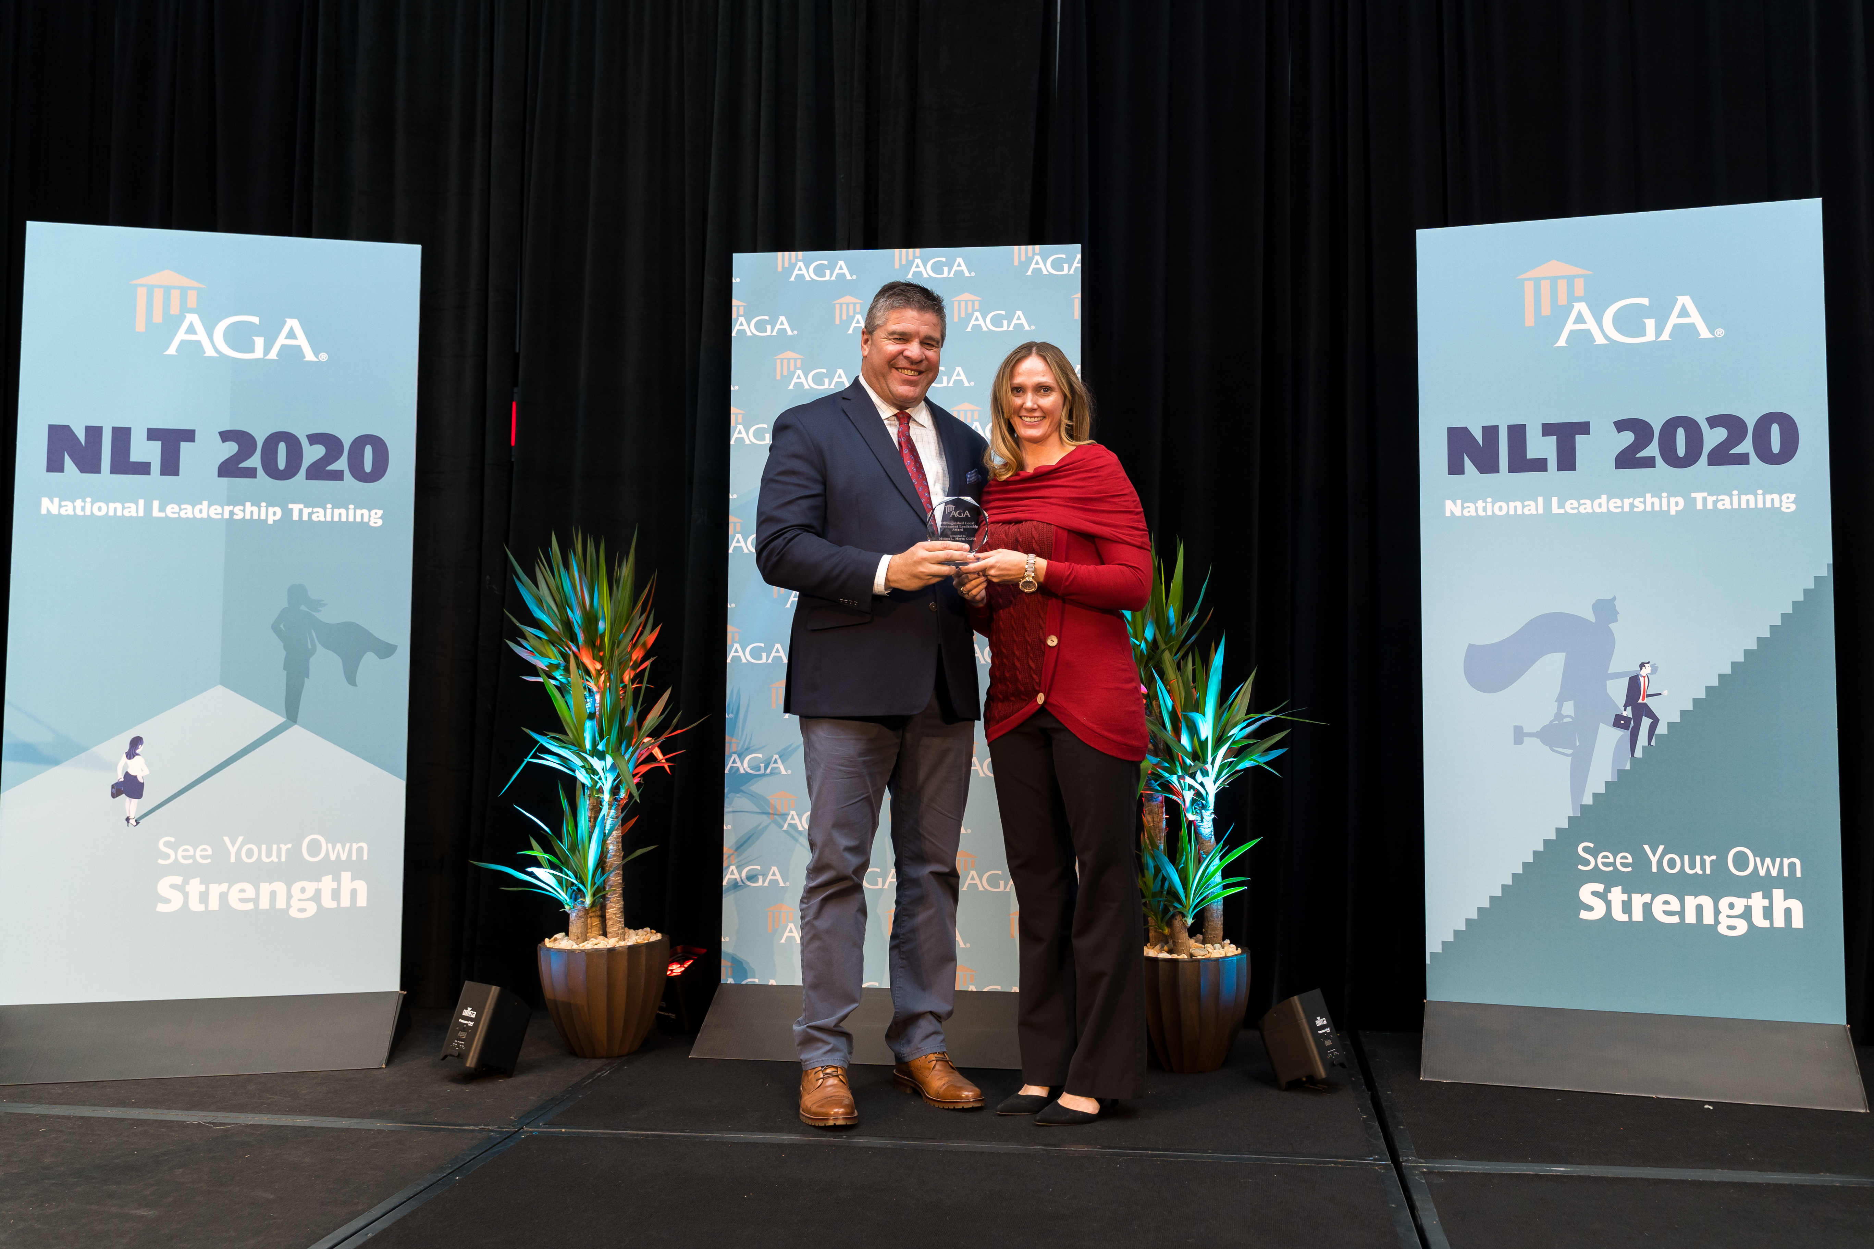
Melissa Dadzie, Deputy CFO Distinguished Local Government Leadership Award from the Association of Government Accountants
Nominated for her integral work on electronic workflows, data roles, and commitment to Standard Operating Procedures
Award recognizes exceptional leadership that led to improved financial management practices, policies, systems or operations and individuals that have consistently exhibited the highest personal and professional standards

Slide 27
You Did It!
Reward your Team!

Slide 28
Realizing Results – Benefits
What are some of the key take a ways?
What are some of the realized benefits?
Phase in pre-implementation work but go live together!
Too many interconnections to drag out – there’s never a good time but the same time!
Support, recognize, empower and reward your project team – the number one success factor!
Going live on a Fiscal Year will make for an easier transition post go-live and contribute to audit success.
What are you solving?
Streamline Maintenance Agreement, Timelines, and Interfaces and be proactive in maintaining procurement requirements or end of life products.
Electronic Workflows & Going Paperless Allowed for Seamless Telework during Pandemic:
Biggest ROI realized during Covid-19
Leveraged Technology for Efficiency
SOPs & Online Learning – Proven invaluable with new users, attrition, turnover, and baseline for all controls that have been mapped, designed, and maintained.
Maintain Functional Leads for an actively engaged ERP team that handles daily operations, training, testing, trouble shooting, & personal sense of accomplishment for the system they built!

Slide 29
Polling Question:
4. True or False: An ERP implementation can be done on time and under budget?
True
False

Slide 30
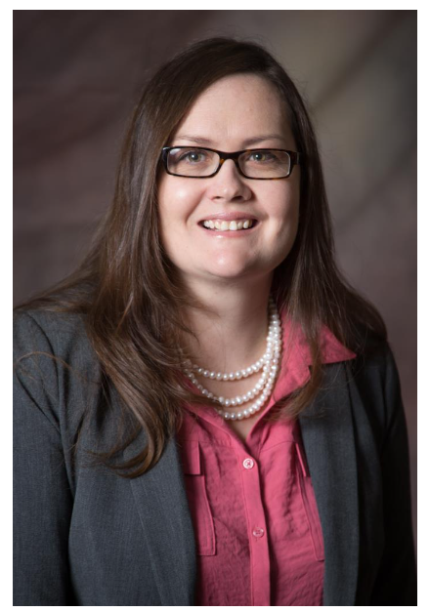
Thank you for attending!
Contact me with any questions, follow up, or for interest in joining our amazing and fun team!
Helen M. Perraglio, CPA
Chief Financial Officer
Los Alamos County - Finance
1000 Central Avenue, Suite 300 | Los Alamos, NM 87544
helen.perraglio@lacnm.us | (505)662-8360 Direct | (505)662-8069 Fax | (505)662-8060 Main Line| (505)709-7337 Cell Phone or Text
www.losalamosnm.us

