Slide 1
ETHICS WORSHOP

Slide 2
SPEAKER BIO
3
Audrey J. Jaramillo, CPA, CFE has been serving federal, state, and local Governments, non- profits, and commercial entities for 20 years throughout NM and is Managing Partner of Jaramillo Accounting Group LLC. She has served on the AICPA’s Taskforces on Training Young CPAs and Scholarships and has spoken on various topics for the AICPA, NM AGA, NM ASBO, NM GFOA, NMSBA, NM State Auditor, and other organizations. She is passionate about public service and served 8 years on her local school Board of Education and serves as Councilor for the Town of Edgewood.

Slide 3
SPEAKER BIO
2
Mark D. Bennett is the principal of Decision Resources, Inc., a consulting firm that specializes in decision-making training and coaching for leaders and managers. He has offered this method for more than 25 years and is the co-author of A Field Guide to Good Decisions: Values in Action. His diverse client list includes businesses in the US across sectors with 15-15,000 employees, family-owned businesses, large regional healthcare organizations, professional services firms (physicians, lawyers, accountants, engineers), non-profits and foundations, and major international organizations. As a regular presenter in the Vistage International organization, he presents to business leaders across the US and in Canada. His decision-making process was selected by the Center for Disease Control for its Global Public Health Leadership program. He recently completed a contract with the World Health Organization to offer this method to its leaders and managers around the world. He also teaches courses in decision making and organizational collaboration through the Executive and Professional Education Center of the Anderson School of Management.

Slide 4
SPEAKER BIO
2
Most discussions of decision making assume that only senior
executives make decisions or that only senior executives
decisions matter. This is a dangerous mistake.
Peter Drucker, leading authority on organization management
Strong Decisions By Design: Process, Values, Perspective, Results
Leaders and managers need a disciplined process for key decisions and recommendations that consistently deliver a positive R.O.D. (return on decision). At the heart of ethical key decisions are important values to be examined, understood, prioritized, and communicated clearly to stakeholders. An effective process framework engages multiple perspectives in productive conversation, aligns a choice with core values and beliefs, and develops a credible, persuasive message to stakeholders. Successful communication of a key decision anticipates and addresses concerns, generates acceptance and support, and builds trust in the integrity of the decision maker and the organization.

Slide 5
SPEAKER BIO
2
Value to Participants
* A clear, practical five-step framework to make the next key decision or recommendation
* Specific tools that will improve every decision conversation to learn from diverse perspectives
* Increased capacity to collaborate as a team
* Confidence and ability to for a decision maker to use the framework alone or guide a team of colleagues in a thoughtful, thorough process
* Ability to scale the process up for complex decisions and down for short time frames
* Ability to delegate to others so they can use the framework to develop clear, principled recommendations for leadership review

Slide 6
Why Are We Here?
You have attended classes, heard the warnings, and know strong ethics is critical to doing your job. But how do you actually take the theoretical into practical implementation? Compliance gives us the right to do (or not do) things, but what is the right thing to do? This class includes meaningful conversations and tools regarding creating actions in line with ethical principles and values.
6

Slide 7
The 3 E’s
ETHICS
ECONOMY
EDUCATION
7

Slide 8
NM ETHICS COMMISSION
NM ETHICS COMMISSION:
https://www.sec.state.nm.us/
NM ETHICS WATCH
http://nmethicswatch.org/

Slide 9
Integrity by DESIGN
Values
Process
Decision Architecture
Results
Perspective

Slide 10
All your business decisions
Fork in the Road & Current Path
Controversy
Impact/Risk Level
For Stakeholders
Morale
KEY
Decisions
Reputation LICENSES / CAREERS

Slide 11
THE Standard for Key Decision Design
Results (R.O.D.)
+ Benefits - Costs
Reputation
+ Credibility
Resilience
+ Decision Capacity
Notes:
WHY THIS MATTERS TO THEM
To improve decision making, we have to tap into the motivation of leaders at all levels to ‘Build it right the first time.’ WHY take the time?....
Because
CLICK… RESULTS..A dialogue process focused on integrity improves results by eliminating blind spots
CLICK…..REPUTATION..Good Decisions develop a reputation for integrity that strengthens leadership credibility and enables success…. credibility simplifies your communication and reduces the effort needed to persuade and influence others. When you most need it, you gain the benefit of the doubt
CLICK….RESILIENCE.. Key decisions well made develop the capacity to make tough decisions are more likely to last when they have the force of authentic ethical conviction>>> more backbone to face resistance >>>>more support>>>>> more acceptance, and >>>>less reflexive resistance
EXERCISE IN DYADS P. 1 3 MINUTES EACH TO TALK THROUGH A KEY DECISION
TRANSITION There is a hidden problem in the mindset inside many organizations that keeps decision makers from influence from becoming decision architects

Slide 12
INTEGRITY
what is right to do
>>Dialogue>>
..what you have a right to do..
Policy violation
Wrongdoing
Notes:
HOW DO YOU GET THERE
Think of integrity as decision making quality. Too often ethics is used directly or indirectly to mean what is not illegal or wrong, in violation of regulation or policy.
Avoiding wrongdoing is necessary but it is not sufficient. The true meaning of integrity….and ethics is not focused on legality, but doing what is right and good.
Ethical (Integrity) orgs. Seek to raise the bar beyond compliance to what is positive, principled, and practical, i.e. what is good to do in this situation.

Slide 13
Five Dialogue Questions to…
Generate clarity at each step
Point of view?
Importance to Stakeholders?
Priorities?
Alignment and Risk?
Credible Engagement?
…Decision Integrity
Notes:
HOW THE POWER OF QUESTIONS
EXERCISE WITH CASE STUDY
1. Snapshot round…. Just listen
2. Deep dive into importance
3. Advocate for the ‘heart of the matter’
4. Align priority with choice and check the downside
5. Overcommunicate clarity

Slide 14
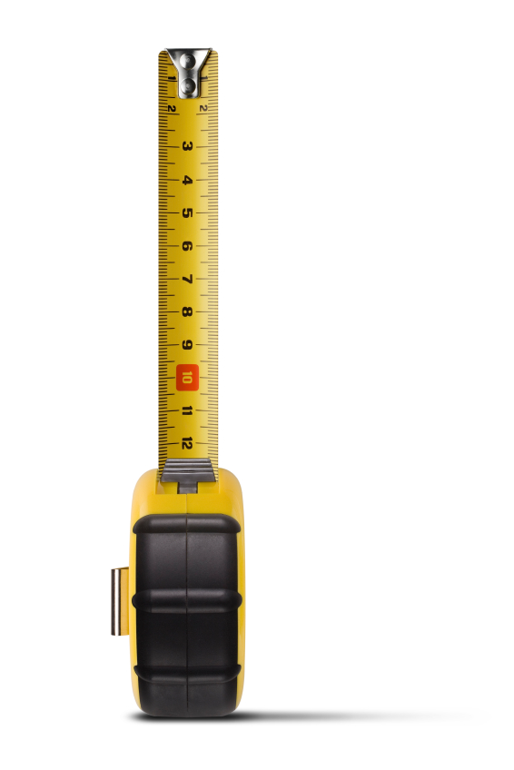
Scalable
Complex …
Full …
Brief …
‘On-the-Fly’…
4 hrs+
2 hrs
15-60 min
5-15 min
Notes:
HOW - ADAPT THE METHOD PP. 7 AND 8
To improve decision making, we have to tackle the universal challenge of limited time. One of the biggest dimensions of org. life that undermines org. integrity and ethical decision making is ‘time disease.’ It is hard to get the attention of leaders on improved decision-making process if they don’t see how it can fit within the pressurized time frames that they experience.
Therefore, this….or other approaches to this work…. Must be time-sensitive and adaptable…
1st answer to skepticism about the use of an approach like this…. “If you don’t have time to do it right, when do you have time to do it over.”
2nd answer…. It is simple to adapt the number of stops to the amount of time available to make the trip. P. 7 AND 8

Slide 15
Decision-Making Roles…
…That help shape….
Sole Decision Maker, Member of Decision-making Group
Advisor Who Makes Recommendation
Influencer 1 – Providing Information, Shaping Options
Influencer 2 - Persuading Stakeholders
Implementer / Impactee
…Decision Integrity
Notes:
HOW THE POWER OF FOCUSED QUESTIONS GENERATES DIALOGUE
EXERCISE WITH CASE STUDY
1. Snapshot round…. Just listen and recognize….where everyone starts the discussion… what perspectives are present
2. Deep dive into importance….. A 360 degree walk around the ‘plane’ before take off
3. Advocate for the ‘heart of the matter’….identify the guiding stars that point toward the best option
4. Align priority with choice and check the downside
5. Over communicate clarity

Slide 16
Vascular System
Respect
different perspectives
INTEGRITY
Key decisions always send a message
Notes:
CLOSING…. 1
VIA is a delegable
Organizational health…. The Advantage: Why Organizational Health Trumps Everything Else in Business Patrick Lenconi
Use P. 9 to develop the 2 way flow of decision integrity.
Integrity in a decision is not an accident and it is not something experienced only in the eye of the beholder. Integrity is a palpable characteristic built into into the decision by the effort of leaders and participants who make three commitments….
Develop a complete understanding of who is touched by the decision and what is important to them.
Make a sound connection between the actual guiding values with the choice made
Be authentic through transparency during the process and when you communicate the reasons for the decision and its downside
VIA provides a straightforward road map to model these commitments at each crossroads on the journey/….. ONWARD…..

Slide 17
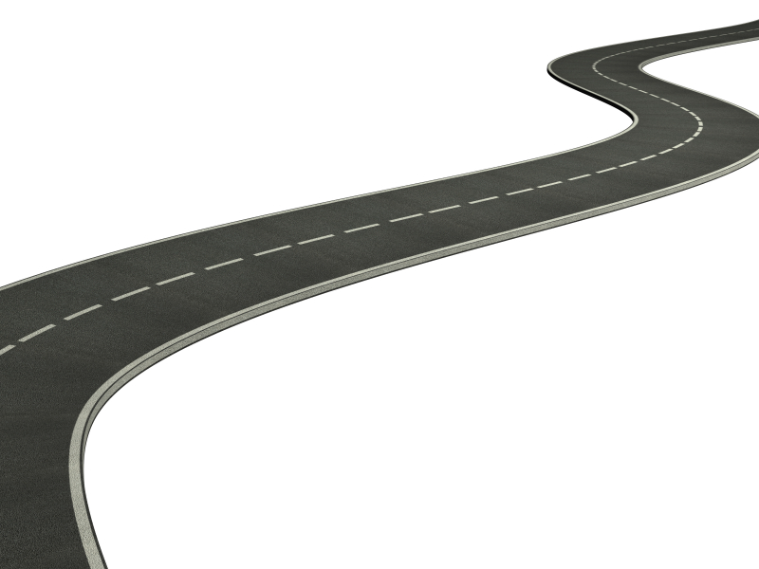
GOOD DECISION
5. Credibility
4. Choice
>>>Dialogue>>>
3. Priorities
2. Stakeholders
Integrity
By Design
1. Perspective
Notes:
HOW – THINK OF IT LIKE A JOURNEY
P. 4 There is a summary of the road in your materials .
There are five stops. Each stop has a focused question. The answer to each question contributes to one of the three integrity dimensions.
We are going to spend most of the rest of the session looking at each of these qualities by applying the five steps of VIA process to a case.
Values talk can drift easily into debate, crossing the conversational ‘rumble strips’ and heading off the road. This often leads to argument and downloading as people talk at each other not with each other. They also often get tangled up in their ability to communicate clearly and productively. The useful quality signal deteriorates as more argumentative noise takes over. SIGNAL-NOISE RATIO
In order to move forward, the structure should refocus win/lose, debate-oriented behaviors to win/learn, dialogue behaviors. All along the road, pay attention to the quality of the exchange.

Slide 18
“A leader is one who knows the way, goes the way, and shows the way.”
John Maxwell
Use a process to show others
HOW to..
..make good decisions
..demonstrate integrity, and
..maintain public trust
What
could be
What is
Notes:
CALL TO ADVENTURE…You are in VistageTEC to develop you leadership potential.
The process of making key decisions IS the formation of leadership
Consider the opportunity and the responsibility that comes with our experience with broken decision making to be a proactive force to facilitate the journey from WHAT IS to WHAT COULD BE.
There are challenges in every organization and degrees of this GAP between the way it is and the way it could be. Leaders are the ones…..

Slide 19
