Slide 1
AGA PDT 2021
GASB Statement No. 84 implementation
April 6, 2021

Slide 2
Alan D. “A.J.” Bowers, Jr.
505.883.2727 (o)
abowers@CRIcpa.com
Alan D. “A.J.” Bowers, Jr., CPA, CITP Partner Carr, Riggs & Ingram - Albuquerque, NM
Professional Affiliations
American Institute of Certified Public Accountants (AICPA)
New Mexico Society of Certified Public Accountants (NMSCPA)
Association of Government Accountants (AGA) – Albuquerque Chapter – President Elect
Government Financial Officers Association (GFOA’s) Special Review Committee (SRC) for the Certificate of Achievement of Excellence in Financial Reporting Program
Approved to answer questions for the AICPA’s Center for Plain English in the Government Area
AICPA PCPS Technical Issuance Committee Member

Slide 3
Today’s Agenda
1. GASB Statement No. 84 – Fiduciary Activities
3. Implementation – Agency and Local Government
2. Additional Guidance
4. Fiduciaries Activities Presentation – Old vs New Examples

Slide 4
Fiduciary Activities GASB Statement No. 84

Slide 5
Fiduciary Activities
The Board issued Statement 84 to clarify when a government has a fiduciary responsibility and is required to present fiduciary fund financial statements.
Existing standards require reporting of fiduciary responsibilities but do not define what they are; use of private-purpose trust funds and agency funds is inconsistent; business-type activities are uncertain about how to report fiduciary activities.
Effective for fiscal years beginning after December 15, 2018.
Early implementation is encouraged.
Delayed 1 year with issuance of GASB Statement No. 95.

Slide 6
Fiduciary Activities
Establishes criteria for identifying fiduciary activities and guidance on reporting those activities.
Establishes reporting standards for fiduciary activities
Clarifies that stand-alone business-type activities should report fiduciary activities

Slide 7
When Should a Government Report Assets in a Fiduciary Fund?
Four Paths to Determination
Component units that are postemployment benefit arrangements
Component units that are not postemployment benefit arrangements
Postemployment benefit arrangements that are not component units
All other activities
Notes:
What we will discuss today is Path 4 – All Other Activities – Custodial funds

Slide 8
When Should a Government Report Assets in a Fiduciary Fund?
Are the assets held by a component unit?
Yes
No
Are the assets held for a pension or OPEB arrangement?
Yes
No
Yes
No
1
2
3
4

Slide 9
Component Units That Are Postemployment Benefit Arrangements Are Fiduciary if…
1
1
A pension plan that is administered through a trust that meets the criteria in paragraph 3 of Statement 67
An OPEB plan that is administered through a trust that meets the criteria in paragraph 3 of Statement 74
A circumstance in which assets from entities that are not part of the reporting entity are accumulated for pensions as described in paragraph 116 of Statement 73
A circumstance in which assets from entities that are not part of the reporting entity are accumulated for OPEB as described in paragraph 59 of Statement 74.
GASB 84 paragraph 6
Notes:
Criteria – irrevocability criteria, dedication criteria, and protection criteria.

Slide 10
Other Component Units Are Fiduciary if…
2
2
The assets are:
(1) administered through a trust agreement or equivalent arrangement in which the government itself is not a beneficiary,
(2) dedicated to providing benefits to recipients in accordance with the benefit terms, and
(3) legally protected from the creditors of the government.
The assets are for the benefit of individuals and the government does not have administrative involvement with the assets or direct financial involvement with the assets. In addition, the assets are not derived from the government’s provision of goods or services to those individuals.
The assets are for the benefit of organizations or other governments that are not part of the financial reporting entity. In addition, the assets are not derived from the government’s provision of goods or services to those organizations or other governments.
GASB 84 paragraph 8
Notes:
Definitions of Admin Involvement and Direct Financial Involvement are on the next slide and come up throught the implementation

Slide 11
When Does a Government Have Administrative Involvement or Direct Financial Involvement?
Administrative Involvement
If it monitors compliance with the requirements of the activity that are established by the government or by a resource provider that does not receive the direct benefits of the activity
If it determines eligible expenditures that are established by the government or by a resource provider that does not receive the direct benefits of the activity
Direct Financial Involvement
If it provides matching resources for the activities
If it has the ability to exercise discretion in how assets are allocated
Notes:
Examples of administrative involvement
If it monitors compliance with the requirements of the activity that are established by the government or by a resource provider that does not receive the direct benefits of the activity
If it determines eligible expenditures that are established by the government or by a resource provider that does not receive the direct benefits of the activity
If it has the ability to exercise discretion in how assets are allocated
Example of direct financial involvement
If it provides matching resources for the activities

Slide 12
Postemployment Benefit Arrangements That Are Not Component Units Are Fiduciary if…
3
The government controls the assets of the arrangement and the arrangement is:
3
A pension plan that is administered through a trust that meets the criteria in paragraph 3 of Statement 67.
An OPEB plan that is administered through a trust that meets the criteria in paragraph 3 of Statement 74.
A circumstance in which assets from entities that are not part of the reporting entity are accumulated for pensions as described in paragraph 116 of Statement 73.
A circumstance in which assets from entities that are not part of the reporting entity are accumulated for OPEB as described in paragraph 59 of Statement 74.
GASB 84 paragraph 10

Slide 13
When Is a Government Controlling Assets?
Per GASB 84 paragraph 12, a government controls the assets of an activity if:
The government holds the assets.
The government has the ability to direct the use, exchange, or employment of the assets in a manner that provides benefits to the specified or intended beneficiaries.
Notes:
12. A government controls the assets of an activity if the government (a) holds the assets or (b) has the ability to direct the use,4 exchange, or employment of the assets5 in a manner that provides benefits to the specified or intended recipients. Restrictions from legal or other external restraints that stipulate the assets can be used only for a specific purpose do not negate a government’s control of the assets

Slide 14
All Other Activities Are Fiduciary if…
4
All three of the following are met:
4
The government controls the assets
Those assets are not derived either:
Solely from the government’s own-source revenues, or
From government-mandated non-exchange transactions or voluntary non-exchange transactions with the exception of pass-through grants and for which the government does not have administrative or direct financial involvement.
One of the following:
The assets are (1) administered through a trust agreement or equivalent arrangement in which the government itself is not a beneficiary, (2) dedicated to providing benefits to recipients in accordance with the benefit terms, and (3) legally protected from the creditors of the government.
The assets are for the benefit of individuals and the government does not have administrative involvement with the assets or direct financial involvement with the assets. In addition, the assets are not derived from the government’s provision of goods or services to those individuals.
The assets are for the benefit of organizations or other governments that are not part of the financial reporting entity. In addition, the assets are not derived from the government’s provision of goods or services to those organizations or other governments.
GASB 84 paragraph 11
Notes:
13. Own-source revenues are revenues that are generated by a government itself. They include exchange and exchange-like revenues (for example, water and sewer charges) and investment earnings. Derived tax revenues (such as sales and income taxes) and imposed nonexchange revenues (such as property taxes) also are included

Slide 15
Quick Assessment

Slide 16
Fiduciary Fund Types
New definitions for pension trust funds, investment trust funds, and private-purpose trust funds that focus on the resources that should be reported within each.
Trust agreement or equivalent arrangement should be present for an activity to be reported in a trust fund.
Custodial funds would report fiduciary activities for which there is no trust agreement or equivalent arrangement.
External portions of investment pools that are not held in trust should be reported in a separate column under the custodial fund umbrella
Notes:
External portions of investment pools that are not held in trust should be reported in a separate column under the custodial fund umbrella

Slide 17
Additional Guidance Implementation Guides and GASB Statement No. 97

Slide 18
Implementation Guides
Implementation Guide No. 2019-2, Fiduciary Activities
Separate guide specifically dedicated to implementation of Fiduciary Activities
55 questions and answers
Effective date aligned with GASB No. 84
Implementation Guide No. 2020-1, Implementation Guidance Update—2020
Fiduciary Activities – Questions 4.4 and 4.5
Phased implementation – 4.4 and 4.5 for periods beginning after June 15, 2021

Slide 19
GASB Statement No. 97
Certain Component Unit Criteria, and Accounting and Financial Reporting of Internal Revenue Code Section 457 Deferred Compensation Plans (an amendment of GASB Statements No. 14 and No. 84, and a supersession of GASB Statement No. 32).
Absences of a governing board in determining financial accountability
Applicability of the financial burden criterion in paragraph 7 of Statement 84.
Section 457 plans
Notes:
Absence of a Governing Board in Determining Financial Accountability -
In certain instances, a legally separate organization does not have a governing board. For purposes of determining whether a primary government is financially accountable for a potential component unit, except for a potential component unit that is a defined contribution pension plan, a defined contribution OPEB plan, or an other employee benefit plan (for example, certain Section 457 plans), if the primary government performs the duties that a governing board typically would perform, the absence of a governing board should be treated the same as the appointment of a voting majority of a governing board.
Applicability of the Financial Burden Criterion in Paragraph 7 of Statement 84.
The financial burden criterion in paragraph 7 of Statement 84 is applicable to only defined benefit pension plans and defined benefit OPEB plans that are administered through trusts that meet the criteria in paragraph 3 of Statement No. 67, Financial Reporting for Pension Plans, or paragraph 3 of Statement No. 74, Financial Reporting for Postemployment Benefit Plans Other Than Pension Plans, respectively.
Section 457 Plans
A Section 457 plan should be classified as either a pension plan or an other employee benefit plan, as follows:
A Section 457 plan that meets the definition of a pension plan in paragraph 51 of Statement 67 or paragraph 128 of Statement No. 73, Accounting and Financial Reporting for Pensions and Related Assets That Are Not within the Scope of GASB Statement 68, and Amendments to Certain Provisions of GASB Statements 67 and 68, is a pension plan for accounting and financial reporting purposes.
b. A Section 457 plan that does not meet the definition of a pension plan is an other employee benefit plan for accounting and financial reporting purposes.
Statement 84, as amended, should be applied to determine whether an arrangement organized under IRC Section 457 should be reported as a fiduciary activity in a government’s fiduciary fund financial statements.
Section 457 Plans That Meet the Definition of a Pension Plan
If a Section 457 plan that meets the definition of a pension plan (a) is included in the financial statements of another government or (b) issues standalone financial statements, all accounting and financial reporting requirements that are relevant to pension plans should be applied.
All accounting and financial reporting requirements that are relevant to pensions should be applied to benefits provided through a Section 457 plan that meets the definition of a pension plan. For example, an employer or a nonemployer contributing entity should apply the requirements of Statement No. 68, Accounting and Financial Reporting for Pensions, as amended, or Statement 73, as amended, to such benefits, as appropriate. The requirements that are applied should be based on the specific type of benefits that are provided through the Section 457 plan, for example, defined contribution pensions.

Slide 20
GASB Statement No. 97
Summary
Defined contribution plans are excluded from CU determination as there is no separate board (excludes paths 1 and 2)
Financial burden criterion in paragraph 7 of Statement 84 is applicable only to defined benefit pension and OPEB plans
Section 457 plans (know the plan, evaluate the plan)
Notes:
Is there an employer contribution?
Section 457 Plans
A Section 457 plan should be classified as either a pension plan or an other employee benefit plan, as follows:
A Section 457 plan that meets the definition of a pension plan in paragraph 51 of Statement 67 or paragraph 128 of Statement No. 73, Accounting and Financial Reporting for Pensions and Related Assets That Are Not within the Scope of GASB Statement 68, and Amendments to Certain Provisions of GASB Statements 67 and 68, is a pension plan for accounting and financial reporting purposes.
b. A Section 457 plan that does not meet the definition of a pension plan is an other employee benefit plan for accounting and financial reporting purposes.
Statement 84, as amended, should be applied to determine whether an arrangement organized under IRC Section 457 should be reported as a fiduciary activity in a government’s fiduciary fund financial statements.
Section 457 Plans That Meet the Definition of a Pension Plan
If a Section 457 plan that meets the definition of a pension plan (a) is included in the financial statements of another government or (b) issues standalone financial statements, all accounting and financial reporting requirements that are relevant to pension plans should be applied.
All accounting and financial reporting requirements that are relevant to pensions should be applied to benefits provided through a Section 457 plan that meets the definition of a pension plan. For example, an employer or a nonemployer contributing entity should apply the requirements of Statement No. 68, Accounting and Financial Reporting for Pensions, as amended, or Statement 73, as amended, to such benefits, as appropriate. The requirements that are applied should be based on the specific type of benefits that are provided through the Section 457 plan, for example, defined contribution pensions.

Slide 21
Pratical Application State Agency

Slide 22
State of NM - Agencies
State Agency Financial Statements
Some agencies act as a fiduciary for other agencies
Examples
Commissioner of Public Lands (land suspense fund, oil and gas royalty fund)
Office of the Secretary of State (notary fund)

Slide 23
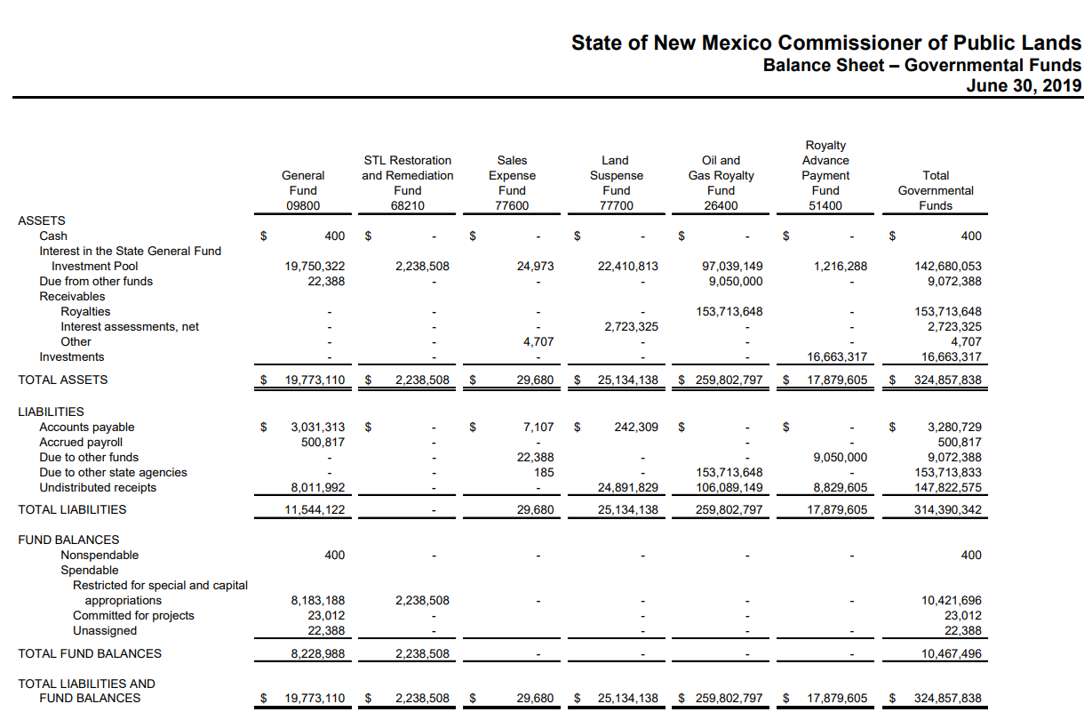
Commissioner of Public Lands

Slide 24
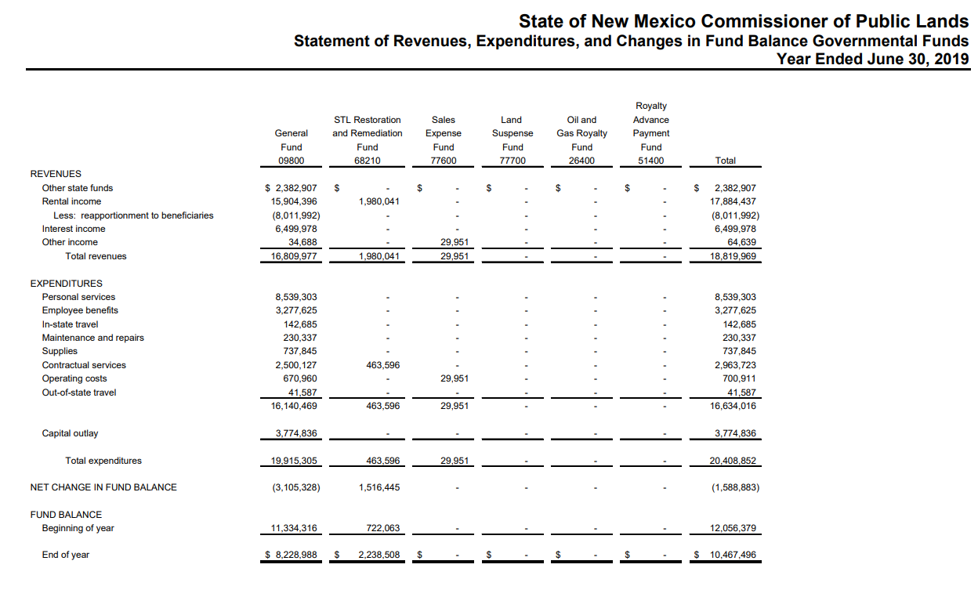
Commissioner of Public Lands

Slide 25
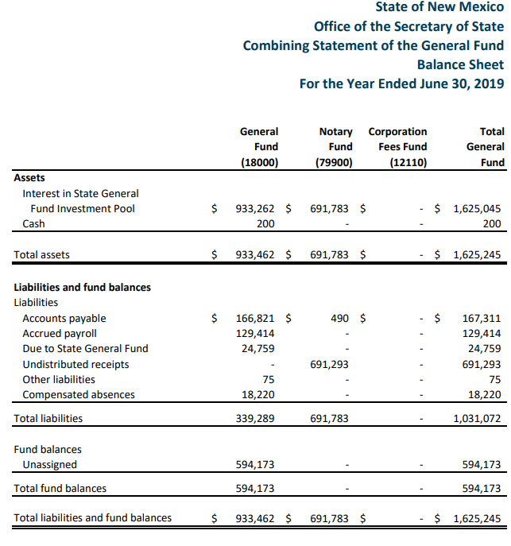
Office of the Secretary of State

Slide 26
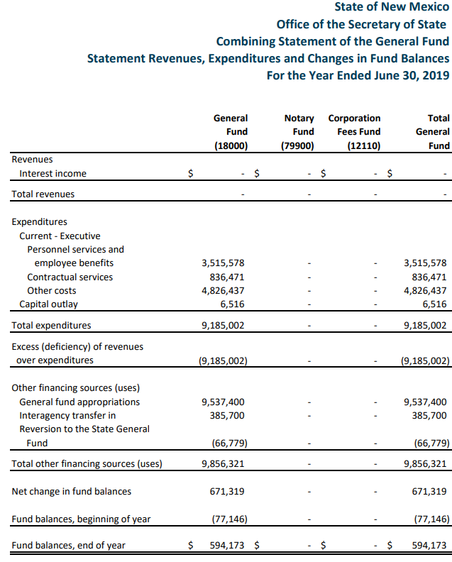
Office of the Secretary of State

Slide 27
State of NM - Agencies
CAFR unit
Budgetary differences
Revenue in and transfer out (most have changed, some haven’t)
GASB call on previous implementation
Think of your self as a state not all stand alone
GASB 68 and 75 are reported at state and not on individual agencies
Disclosure?
Notes:
Disclosure – may or may not have a disclosure related to this

Slide 28
Case Study on Implementation Local Government

Slide 29
Background on Case Study
Early Implementation of GASB 84 in June 30, 2018
Before implementation guidance
Change was only in presentation
Had 4 Agency funds which became 4 Custodial Funds (All presented as a fund in Statement of Fiduciary Net Position and Statement of Changes in Fiduciary Net Position)
Still want fund in question to be a custodial fund

Slide 30
Background on Case Study
Presentation
GFOA comment on presentation
Custodial funds should be a total with combining statement presented as SI
Significant comment – one that if not corrected could preclude the awarding of the certificate in future years

Slide 31
Background on Case Study
Fund has multiple participants
All participants contribute funds for projects.
Main contributions are from the government administering the fund not the external participate.
Agreements with 2 external participants require a Fiduciary Fund to be set up for these funds.

Slide 32
Background on Case Study
Revenue sources
External participants contribute funds for specific joint projects, i.e., the City provides $40k for a portion of a sidewalk and has the government do the work.
The local government provides some of their bond money to the fund for the joint project.

Slide 33
Background on Case Study
Fund Administration
Local government will hold the cash, receipt funds received from other participants, and make the payment.
Local government will oversee the procurement process.
One member of each participating entity is involved in Bid/RFP process
Project invoices go to other participants for agreement for payment as part of approval process.

Slide 34
Quick Assessment

Slide 36
Poll Question #1
Does the government control the asset?
Yes
No

Slide 37
Test One: Control
Does the local government control the assets of the fund?
GASB 84 paragraph 12: A government controls the assets of an activity if the government (a) holds the assets or (b) has the ability to direct the use, exchange, or employment of the assets in a manner that provides benefits to the specified or intended recipients.
Notes:
12. A government controls the assets of an activity if the government (a) holds the assets or (b) has the ability to direct the use,4 exchange, or employment of the assets5 in a manner that provides benefits to the specified or intended recipients. Restrictions from legal or other external restraints that stipulate the assets can be used only for a specific purpose do not negate a government’s control of the assets.
Answer: YES

Slide 38
Test Two: Revenues – Own Source Revenues
Are the assets derived from own source revenues?
GASB 84 paragraph 13: Own-source revenues are revenues that are generated by a government itself. They include exchange and exchange-like revenues (for example, water and sewer charges) and investment earnings. Derived tax revenues (such as sales and income taxes) and imposed nonexchange revenues (such as property taxes) also are included.
Notes:
Their funds are from GO Bond Money
Own Source revenues – not solely, but primarly.
Paragraph 11b states - assets associated with a activity are not derived solely from own-source revenues

Slide 39
Test Two: Revenues - Own Source Revenues Considerations
Does bond money count as own-source revenue?
Implementation guide does not address bond funds.
Bond revenue is an advancement of property taxes.
Property tax revenues are “imposed non-exchange revenues”.
Notes:
Bond Money isn’t explicitly mentioned, in guidance but is indirectly own-source revenue

Slide 41
Poll Question #2
Are the assets derived from own source revenue?
Yes
No

Slide 42
Test Two: Revenues - Gov’t mandate or voluntary non-exchange
Are the assets derived from Government mandated or voluntary non-exchange transactions?
GASB 84 paragraph 11 - From government-mandated non-exchange transactions or voluntary non-exchange transactions with the exception of pass-through grants for which the government does not have administrative involvement or direct financial involvement.
Notes:
Their funds are from GO bond money.

Slide 44
Poll Question #3
Are the assets derived from Government mandated or voluntary non-exchange transactions?
Yes
No
Notes:
I believe test 2 was not met, but an argument can be made.
Not solely their funds
Bond Money isn’t explicitly mentioned, in guidance but is indirectly own-source revenue
More defining and research needed

Slide 45
Test Three: Other – Trust
Is this a trust?
GASB 84 paragraph 11 - The assets are (1) administered through a trust agreement or equivalent arrangement in which the government itself is not a beneficiary, (2) dedicated to providing benefits to recipients in accordance with the benefit terms, and (3) legally protected from the creditors of the government.

Slide 47
Poll Question #4
Is this a trust?
Yes
No
Notes:
No

Slide 48
Test Three: Other – Benefit of Individuals
Is it for the benefit of individuals with no administrative or direct financial involvement, and not derived from government’s provisions of services?
Participants are all local governments not individuals
Client says the general public is the beneficiary of the projects from a public safety perspective; however, after further discussion, the improvements benefit the local governments.
Is there administrative or direct financial involvement? (See implementation guidance)
Not derived from government’s provisions of services.
Notes:
We worked to determine the administrative involvement, direct financial involvement, and government’s provisions of services.
Considered multiple implementation guide questions

Slide 49
Test Three: Other – Benefit of Individuals – Administrative Involvement – Implementation Guide
4.21. Q—
A school board establishes and approves a policy related to the disbursement of funds for various student clubs that are not legally separate from the school district. The policy includes specific guidelines related to how the funds raised by the clubs can be spent. Does the school district have administrative involvement, as discussed in paragraph 11c(2) of Statement 84?
Notes:
Really need question 4.22 which says to assume same facts as Question 4.21

Slide 50
Test Three: Other – Benefit of Individuals – Administrative Involvement – Implementation Guide
4.21. A—
Yes. The school district does have administrative involvement. The school district’s role is considered to be substantive because the school has established specific guidelines on how the resources can be spent in an approved policy.

Slide 51
Test Three: Other – Benefit of Individuals – Administrative Involvement – Implementation Guide
4.22. Q—
Assume the same facts as in Question 4.21, except that the policy that applies to all clubs only addresses issues such as the authorized account signers and the prohibition of spending for illegal activities. Does the school district have administrative involvement, as discussed in paragraph 11c(2) of Statement 84?

Slide 52
Test Three: Other – Benefit of Individuals – Administrative Involvement – Implementation Guide
4.22. A—
No. The school district does not have administrative involvement. The school district’s role is not considered to be substantive because the school has not established specific guidelines regarding how the resources of the clubs can be spent.
Notes:
Interpretation
- In between these 2 items, not a vague policy like noted in 22, but also not putting specific policies like in 21
Overseeing items like procurement for legal compliance, but if under threshold for BID/RFP, no direct involvement from other participants
Move on to another question

Slide 53
Test Three: Other – Benefit of Individuals – Administrative Involvement – Implementation Guide
4.25. Q—
A public university receives funds, which it controls, from an alumnus to provide a scholarship program for incoming freshman students who are majoring in a business-related field and have demonstrated financial need. The scholarship recipients are required to maintain a minimum 3.5 grade point average each semester to receive the scholarship funds. The university is responsible for selecting the scholarship recipients and monitoring the recipients’ compliance each semester. Does the university have administrative involvement with the scholarship program, as discussed in paragraph 11c(2) of Statement 84?

Slide 54
Test Three: Other – Benefit of Individuals – Administrative Involvement – Implementation Guide
4.25. A—
Yes. In that scenario, because the university is determining the eligible scholarship recipients and monitoring those recipients for compliance with the scholarship requirements, its responsibilities are considered to be administrative involvement.
Notes:
Interpretation
Not determining procurement on large items, but on small items
Monitoring compliance with laws and regulations

Slide 55
Test Three: Other – Benefit of Individuals – Administrative Involvement
Is there administrative or direct financial involvement?
Not a vague policy like noted in 4.22, but also not putting specific policies like in 4.21.
Overseeing items like procurement for legal compliance (4.25), but if under threshold for BID/RFP then no direct involvement from other participants.
Notes:
Preponderance of evidence?
Lean no

Slide 56
Test Three: Other – Benefit of Other Organizations or Governernments
Is it for the benefit of organizations or other governments not part of the reporting entity, and not derived from government’s provisions of services?
Participants are other governments (but also themselves)
Not derived from government’s provisions of services
We worked to determine the government's provisions of services
Considered multiple implementation guide questions

Slide 57
Test Three: Other – Benefit of Other Organizations – Implementation Guide
4.27. Q—
A public university holds funds received from a foundation that is a legally separate 501(c)(3) organization. The foundation is not a component unit of the university. The funds are for the sole purpose of granting science and engineering scholarships. The resources are contributed by foundation members to the foundation and are deposited with the university by the foundation and may be withdrawn by the foundation at any time. Students submit applications to the foundation. The foundation’s executive director, who is not a university employee, selects recipients based on the criteria established by the foundation and the recipients are not required to attend the university that holds the foundation’s resources. The recipients’ compliance with the scholarship criteria is monitored by the foundation. If a scholarship is awarded to a student of the university, the university applies the scholarship amount to that recipient’s student account. In determining whether those resources controlled by the university are fiduciary, are the requirements in paragraph 11c(3) of Statement 84 met?

Slide 58
Test Three: Other – Benefit of Other Organizations – Implementation Guide
4.27. A—
Yes. The university is holding the resources for the foundation and not the individual student scholarship recipients. The foundation is a legally separate entity that is not a component unit, so it is not part of the university’s reporting entity. Finally, the resources held are not derived from the university’s provision of goods or services to the foundation. As a result, the requirements in paragraph 11c(3) of Statement 84 are met.
Notes:
4.27 interpretation
Contributions by others are at their discretion and directed by them
Projects are partially determined by others (BID/RFP)
Other participants are not employees of or at discretion of local government
Majority of revenues are still own funds

Slide 60
Poll Question #5
Is it for the benefit of individuals with no administrative or direct financial involvement, and not derived from government’s provisions of services?
Yes
No

Slide 61
Test Three: Other – Benefit of Other Organizations
Is it for the benefit of other organizations or governments, and not derived from government’s provisions of services?
Participants are other governments (but also themselves). Other participants are not employees of or at discretion of local government as in 4.27.
Not derived from government’s provisions of services as in 4.27.

Slide 63
Poll Question #6
Is it for the benefit of other organizations or governments, and not derived from government’s provisions of services?
Yes
No

Slide 64
Is it a Custodial Fund?
Test One: Control Yes
Test Two: Revenues (not derived from)
Own source revenue – Gray area? Lean no
Government mandated or voluntary nonexchange transactions – Gray area? Lean no
Test Three: At least one of the following…
Trust No
Benefit of individuals – Applies? I don’t think so, but if does… Lean no
Benefit of other organizations – Majority of funds still local governments and they are direct beneficiary? Lean no
Notes:
Final outcome – client and auditor judgement
Preponderance of evidence
Doesn’t qualify as a custodial fund
Needs to be adjusted to be a capital projects fund
Will need to work with participants to update agreements
Will need to budget and report differently

Slide 65
Final Assessment
Sample Fund
✔
Doesn’t qualify as a custodial fund
?
?
✘
✘
✘
Notes:
Final outcome – client and auditor judgement
Preponderance of evidence
Doesn’t qualify as a custodial fund
Needs to be adjusted to be a capital projects fund
Will need to work with participants to update agreements
Will need to budget and report differently

Slide 66
Fiduciary Activities Presentation

Slide 67
GASB 84 Presentation Changes
 | Current Presentation | GASB 84 Presentation
Basic Financial Statement | Statement of Fiduciary Assets and Liabilities – Agency Funds | Statement of Fiduciary Net Position Statement of Changes in Fiduciary Net Position
Supplementary Information | Schedule of Changes in Fiduciary Assets and Liabilities – Agency Funds | Combining Statement of Fiduciary Net Position Combining statement of Changes in Fiduciary Net Position

Slide 68
Statement of Changes in Fiduciary Net Position
All fiduciary funds should be included in the statement of fiduciary net position.
Additions should be disaggregated* by source and, if applicable, separately display investment earnings, investment costs, and net investment earnings.
Deductions should be disaggregated* by type, and if applicable, separately display administrative costs.
*Disaggregation requirement applies to all fiduciary funds except custodial funds held for three months or less.

Slide 69
GASB 84 – Statement of Changes in Fiduciary Net Position– Opinion and Procedures
 | Current | GASB 84 Impact
Opinion | In Relation To | Audit Opinion

Slide 70
Presentation Examples Old vs. New

Slide 71
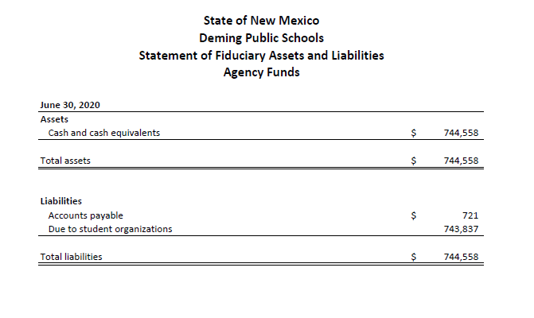
Presentation Prior to GASB Statement No. 84

Slide 72
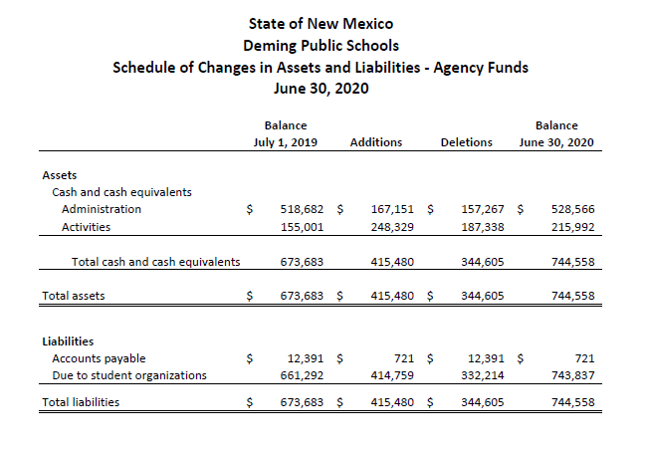
Presentation Prior to GASB Statement No. 84

Slide 73
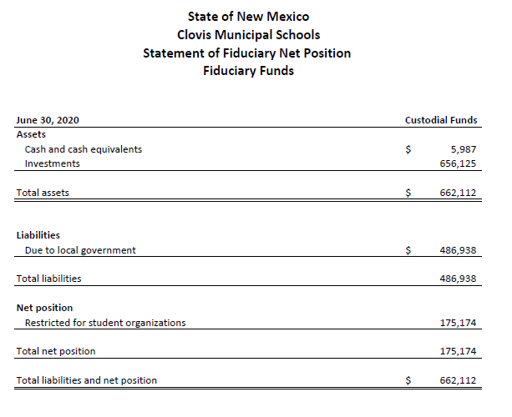
Presentation Under GASB Statement No. 84
Notes:
Clovis Schools Early Implemented GASB 84 – Basic Finanicals

Slide 74
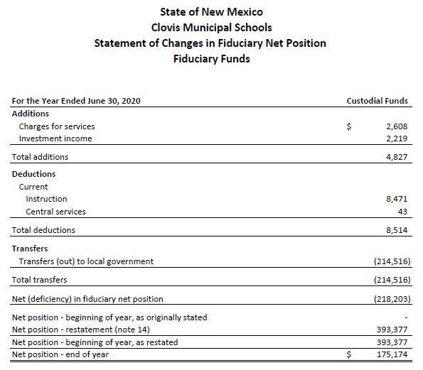
Presentation Under GASB Statement No. 84
Notes:
Basic Finanicals

Slide 75
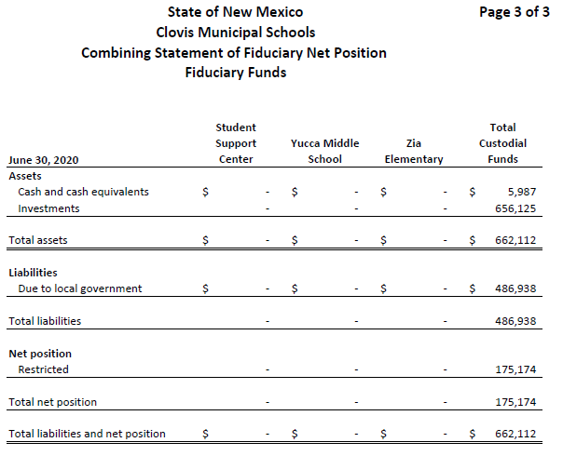
Presentation Under GASB Statement No. 84
Notes:
Supplementary Information

Slide 76
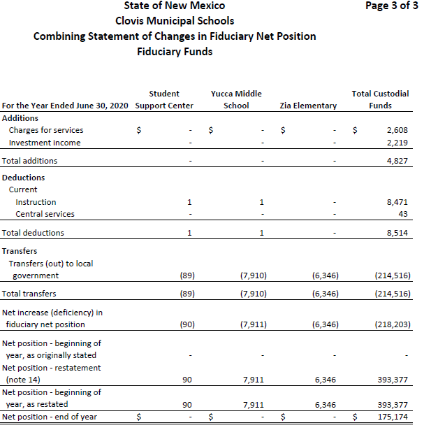
Presentation Under GASB Statement No. 84
Notes:
Supplementary Information

Slide 77
QUESTIONS?

Slide 78
Connect with CRI on Social Media
Notes:
We’d love to connect with you on Social Media! Search Carr, Riggs & Ingram or @CRIcpa.

Slide 79
- TODAY’S PRESENTER -
ALAN D. “A.J.” BOWERS, JR., CPA, CITP
Partner
abowers@CRIcpa.com
Albuquerque, NM
505.883.2727
Text CRI to 66866 to receive CRI News and Alerts | CRIcpa.com

