Slide 1
Understanding the Impact of Fraud in Business
2021 AGA Virtual Professional Development Training - April 6, 2021

Slide 2
Learning Objectives
At the end of this session, you will be able to:
Define fraud and list the eight important facts of fraud
List and describe the most common fraud schemes
Identify common red flags and indicators of fraud
Identify and describe fraud detection methods, fraud costs and awareness, and anti-fraud measures
Notes:
Questions are important!
If I do not cover please ask the question how can this be prevented how can this be uncovered

Slide 3
Introduction

Slide 4
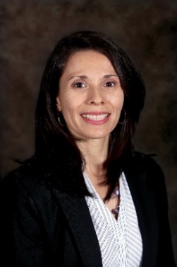
Speaker Introduction
Manager
CLA’s Forensic Practice
Over Seven years of experience performing forensic accounting engagements, fraud investigations, and internal control assessments for governmental, educational, and private entities.
Ana Rodriguez
CPA, CFE

Slide 5
Speaker Introduction
Senior
CLA’s Forensic Practice
Over six years of experience, including leading fraud investigations, litigation support, audits, and other specialized consulting work.
Kyle Shafer
CPA, CFE

Slide 6
Our Forensic / Fraud Team
CLA – Special Advisory Services – Forensics

Slide 7
Our Forensic / Fraud Team
Our team consists of CPAs, Certified Fraud Examiners (CFEs), Certified in Financial Forensics (CFFs), and Certified Information Technology Professionals (CITP), as well as former law enforcement, including the FBI.
In-house experts in the following:
Experience conducting:
Cyber security
Data analytics
Physical security systems
Fraud Risk assessments
Internal audits/Internal control assessments
Fraud investigations
Forensic accounting projects
Data analytics
Notes:
These are a few CLA engagements conducted for a few industries. The amount in parentheses is the amount of loss related to the fraud.

Slide 8
The Fraud Tree & Eight Key Facts of Fraud
Notes:
Today’s presentation is titled, Fraud Prevention and Detection so it is only fitting that we define fraud and share some key facts about fraud

Slide 9
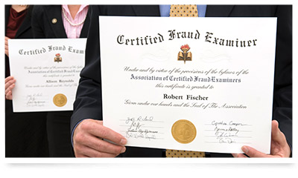
Association of Certified Fraud Examiners (ACFE)
World’s largest anti-fraud organization
Provides Certified Fraud Examiner (CFE) credential
Requires meeting professional, educational, and ethical standards and passing a rigorous exam on the four major disciplines that comprise the fraud examination body of knowledge: Fraud Prevention and Deterrence, Financial Transactions and Fraud Schemes,
Investigation, and Law
Headquartered in Austin, TX
85,000+ members
Local Chapters
From ACFE website: www.acfe.com
Notes:
But before I get into the Basic facts of fraud, let me introduce you to the Association of Certified Fraud Examiners (ACFE). Please take down this address – www.acfe.com
The ACFE is the world’s largest anti-fraud organization and it provides anti-fraud training and education.
It’s overall mission is to reduce business fraud worldwide
The ACFE provides the CFE credential
Many of us at CLA have this designation and are members of the ACFE, and are active in our local chapters. It safe to say that there is probably a local ACFE Chapter in your area!
Finally, the ACFE is an excellent resource for fraud awareness materials and education.
And I encourage you to take a look into their website – plenty of great material is available for you to access without being a member or a CFE!

Slide 10
ACFE Report to the Nations 2020
Report to the Nations 2020 Global Study on Occupational Fraud and Abuse
Bi-Annual Report
Analysis of 2,504 cases of occupational fraud across 125 countries
Results based on 2019 Global Fraud Survey opened to CFEs about their single largest fraud case investigation completed between January 2018 and September 2019
First ACFE Report to the Nations was issued in 1996
https://www.acfe.com/report-to-the-nations/2020/
Notes:
Every two years the ACFE publishes the Report to the Nations, this is a publication where the ACFE reports on Occupational Fraud and Abuse
Much of the information we are going to share with you today is from this report that was last published in 2020!
The results are based on the 2019 Global Fraud Survey that was open to CFEs and it asked about our single largest fraud case investigation completed between January 2018 and September 2019
If you are interested in reading this publication, See the link on the slide (the picture is also hyperlinked) to get access and free copy. – or you can email me and I’ll personally send you a pdf copy!
In the next few slides I want to walk us through seven Key Fraud Facts from the Report to the Nations and our experience

Slide 11
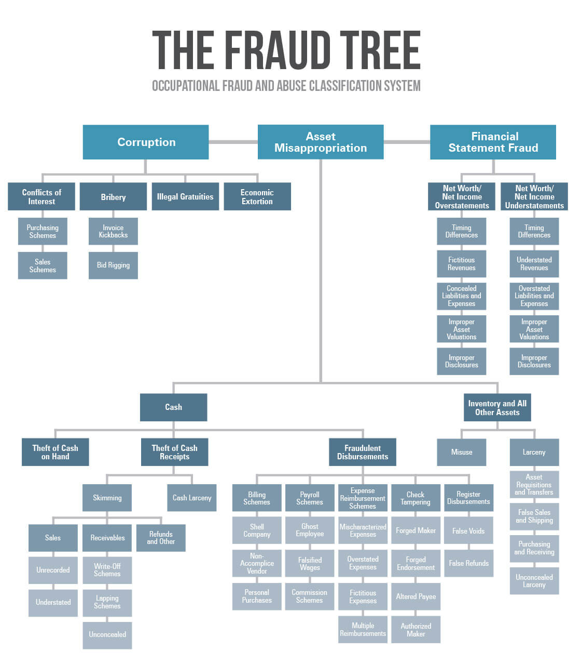
Notes:
The ACFE defines occupational fraud as the use of one’s occupation for personal enrichment through the deliberate misuse or misapplication of the employing organization’s resources or assets
The Fraud Tree has changed the nature of how occupational fraud has been codified. It shows that there are only so many ways that fraud is committed and the more familiar organizations are with them, the better equipped they will be to identify the organization’s risk.
The fraud tree identifies the three principal schemes — corruption, asset misappropriation and financial statement fraud. Each of these three principal schemes are further divided into sub-schemes as shown on the fraud tree.
Financial statement fraud is the deliberate misrepresentation of the financial condition of an organization that is accomplished through the intentional misstatement or omission of amounts or disclosures in the financial statements with the intent to deceive financial statement users
Corruption schemes involve employees’ use of their influence in a business transaction in a way that violates their duty to their employer for the purpose of obtaining a benefit for themselves or someone else
Corruption schemes often involve collusion between an internal employee and an outside party and we have a case study highlighting this.
One of the biggest issue with corruption is that it can be very difficult to detect
Financial statement fraud can be committed by management overriding controls using techniques such as:
Recording fictitious journal entries, particularly close to the end of an accounting period, to manipulate operating results or achieve other objectives
Inappropriately adjusting assumptions and changing judgments used to estimate account balances
Omitting, advancing, or delaying recognition of events and transactions that have occurred during the reporting period
Concealing or not disclosing facts that could affect the amounts recorded in the FS
Engaging in complex transactions that are structured to misrepresent the financial position or performance of the entity
Asset misappropriation is further divided into misappropriation of cash and inventory and all other assets. On this specific section of the fraud tree we wanted to include the image as there are a larger number of schemes that fall within asset misappropriation and also because it is the most common form of occupational fraud.
Misappropriation of assets involves the theft of an entity’s assets and is often perpetrated by employees in relatively small and immaterial amounts. However, it can also involve management, who is usually better able to disguise or conceal misappropriations in ways that are difficult to detect.
False or misleading records or documents often include techniques similar to those discussed for financial statement fraud and also by
Forging approval signatures
Use of supervisors log-in to approve transactions
Misrepresentation of facts on documentation (water district case example)
Falsified supporting documentation (Santa Barbara case example)
A significant number of the frauds we’ve investigated have been accomplished because of poor internal controls in the organizations such as:
Lack of management review
No monitoring of account activity
Lack of proper segregation of duties

Slide 12
Eight Key Facts from the Report to the Nations and Our Experience
Typical organizations lose 5% of revenue in a given year as a result of fraud
Fraud exists in every organization and every industry type – top 5 industries with the highest occurrence of fraud:
Banking and financial services (median loss: $100,000)
Government and public administration (median loss: $100,000)
Manufacturing (median loss: $198,000)
Health care (median loss: $200,000)
Energy (median loss: $275,000)
Prominent weakness – lack of internal controls
Notes:
So the first key fact is that CFE’s estimate that organizations lose 5% of revenue to fraud each year. So depending on your organization this could be thousands or this could be millions.
The second key fact: fraud is everywhere. There is no organization or industry that is immune to fraud. It doesn’t exist. So what are the top 5 most common industries report as victims of frauds? Number one is banking and financial services, which might not come as a surprise. It’s followed by government and public administration, manufacturing, health care, and energy in that order. It’s important to note that this doesn’t necessarily mean that more fraud occurs in these industries; it might simply indicate that organizations in these industries employ more CFEs than others.
Number three: the primary internal control weakness that contributes to occupational fraud is a lack of internal controls. In fact, in 32% of the cases, it was identified as the primary internal control weakness? How about override of existing controls? It comes in second place and was found to be the primary control weakness in about 18% of cases. So it’s important to have internal controls in the first place and second, have effective internal controls that cannot easily be overridden.

Slide 13
Eight Key Facts from the Report to the Nations and Our Experience
Most common form of occupational fraud – asset misappropriation
Check tampering and billing schemes represent the greatest risk
Most perpetrators are first time offenders (only 4% had prior convictions)
Frauds with highest frequency occur in operations, the accounting department, and in executive/upper management
The majority of occupational frauds are not material to the financial statements (frequent, small transactions taking place over an extended period of time)
Notes:
So the fourth key fact about fraud is that the most common occupation fraud is asset misappropriation. Ana gave us a an overview of this category in her discussion of the Fraud Tree. It’s a big category and can encompass anything from skimming cash, to falsifying time, to misusing inventory. It’s the most common for a reason – it presents a diverse range of fraud, waste, and abuse. It can also occur at any level of employment, but it’s important to note that it’s the type of fraud that is most accessible to non-management and non-elected employees. Financial statement fraud and corruption can be limited to certain people, but asset misappropriation really presents opportunity.
The fifth fact to take away today is that check and payment tampering and billing schemes are the most common form of asset misappropriation and also cause a high median loss, making these types of fraud a particularly significant fraud risk. Speaking from personal experience, we see check tampering and billing schemes constantly in our work.
The sixth fact for today is that most perpetrators are first time offenders. They don’t have a criminal record. In fact, 89% of perpetrators in the 2020 Report to the Nations never had a charge or conviction on there record. Conversely, only 4% of perpetrators had a prior conviction. I can also say from personal experience that a single criminal background check doesn’t always tell you about a person. I worked a case where the perpetrator had a prior conviction, but she found a new job so quick that the conviction was not on her criminal background check when she was hired.
The seventh key fact is that fraud most frequently occurs in operations, accounting departments, and in the executive and upper management levels. For example, the executive/upper management team and the accounting department were both associated with high frequency and median loss, which indicates that fraud risks in these areas should be carefully addressed in any anti-fraud program.
The eight and final fact from today’s presentation is that most occupation frauds are not material to the financial statements. That’s right most fraud is not some big money grab, it’s small, frequent transactions that most external auditors will never look at. But over time it can add up in a big way.

Slide 14
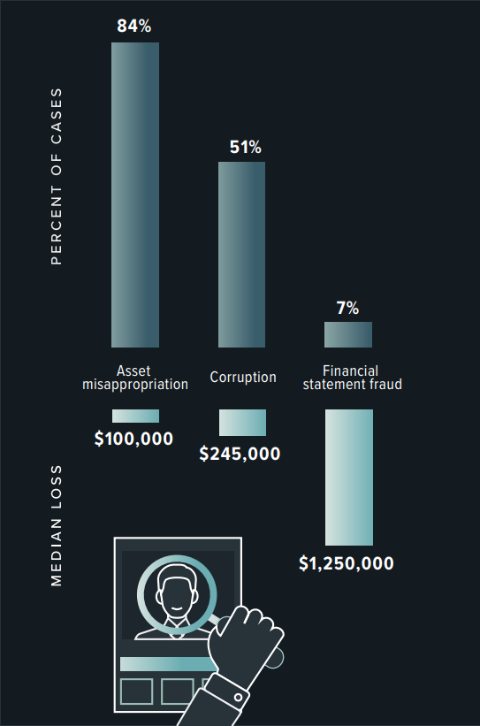
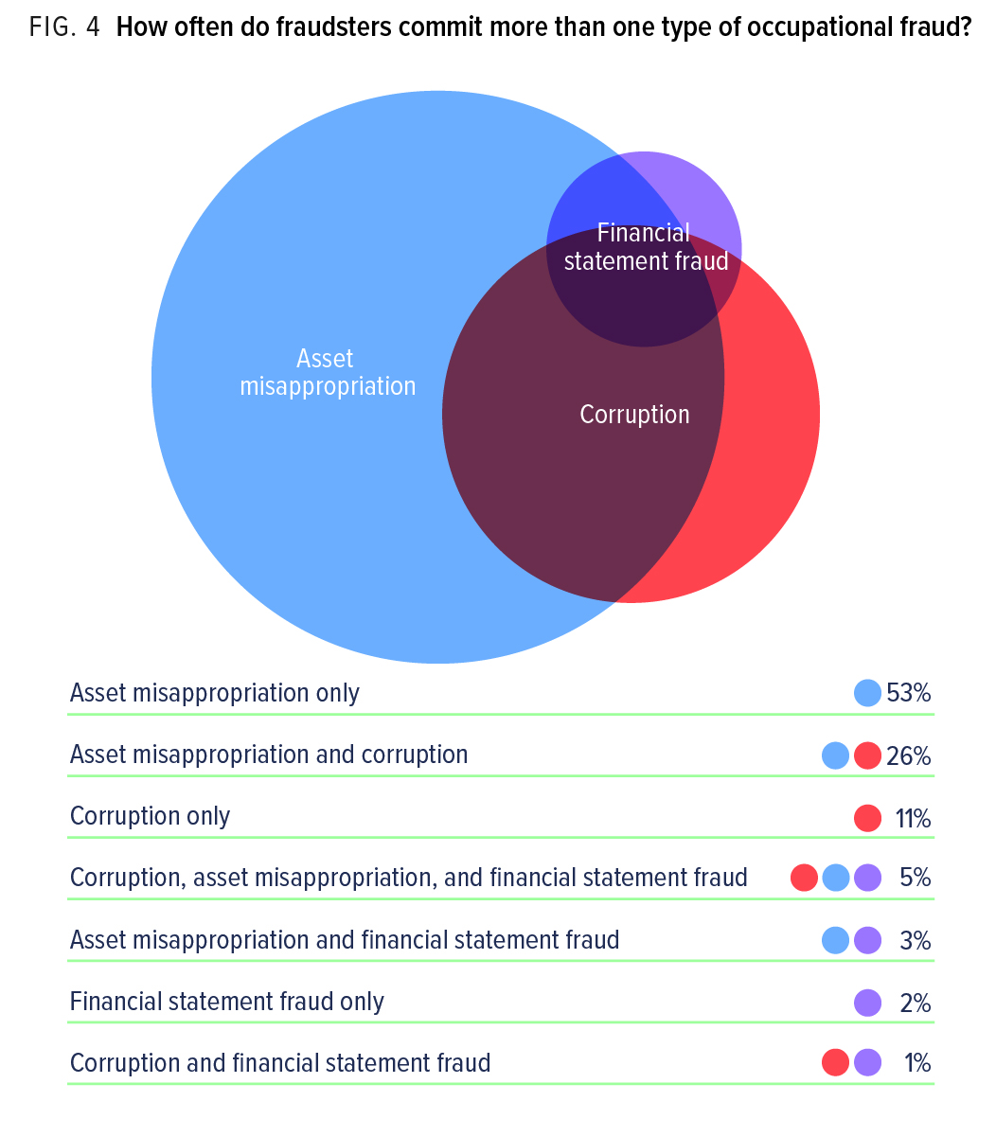
Occupational Fraud by Category - Frequency
Source: ACFE 2020 Report to the Nations
Notes:
Let’s take a look at a few ways to visualize what we’ve just covered. Let’s start with this chart on the left. Here we see the frequency of fraud by category for government organizations only. As I mentioned in fact number 4, asset misappropriation is most common, occurring in 84% of the cases. The median loss was $100,000. But less frequently is financial statement fraud, but the impact is far worse, the median loss from this type of fraud is $1.25 million dollars.
So what about more than just one type of fraud? We know fraudsters aren’t going to stick with only one method right? Well actually, the majority of perpetrators do -- in fact 53% of them commit just asset misappropriation. Take a look at the pie chart on the right. But if they do commit two types of fraud it’s most commonly a combination of asset misappropriation and corruption. Think about it this way -- a purchasing rep that takes a kickback from a vendor might, well, that person might also be overstating their hours or expense reimbursements.

Slide 15
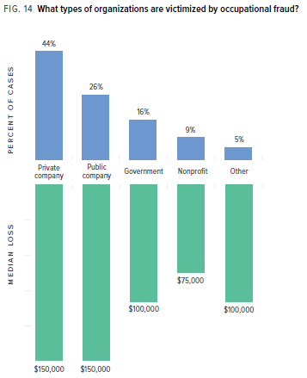
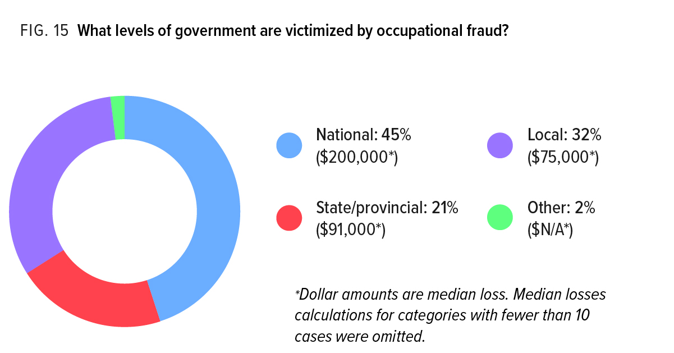
Occupational Fraud by Organization Type
Source: ACFE 2020 Report to the Nations
Notes:
A couple more charts to look at.
First, where does government rank in the percentage of organizations victimized by fraudsters. Well, they’re a bit lower than you think when we compare them to the private sector and publicly traded companies. They’re only 16%, as we can see in the chart on the left. How are the median losses? Well those are lower too than the private sector and publicly traded companies.
Let’s look at this chart on the right and examine government a little closer. It was only 16% overall, but what types of government are most frequently victimized? The federal government ranks first. But what if for purposes of this training we put state and local governments together? Now they represent the majority. You’ll also notice that state and local governments have lower median losses than the federal government. That might not be surprising but depending on the size of your organization these median losses could be significant to your communities.

Slide 16
Question #1
Polling Question
The ACFE defines occupational fraud as:
A knowing misrepresentation of the truth or concealment of a material fact to induce another to act to his or her detriment
The theft or misuse of a company’s resources and includes schemes such as skimming, check tampering, payroll fraud, expense reimbursements, and cash register disbursements, among others
The use of one’s occupation for personal enrichment through the deliberate misuse or misapplication of the employing organization’s resources or assets
Notes:
Answer is:
c. The use of one’s occupation for personal enrichment through the deliberate misuse or misapplication of the employing organization’s resources or assets

Slide 17
Profile of a Fraudster & the Fraud Triangle

Slide 18
What does a fraudster look like?

Slide 19
Who Can Commit Fraud?
Report to The Nations – Some Statistics on Perpetrators
Perpetrator’s level of authority has been strongly correlated with the size of the fraud
20% of frauds were committed by owners/executives, but the median loss in these cases was $600,000
Employees and managers were much more likely to commit occupational fraud, but the losses in these schemes were much lower—though still substantial
ANYBODY
is capable of committing
FRAUD
Source: ACFE 2020 Report to the Nations

Slide 20
Who Can Commit Fraud?
Report to The Nations – Some Statistics on Perpetrators
Correlation between the fraudster’s level of authority and the duration of the occupational fraud scheme
The typical fraud committed by an employee lasted 12 months before it was detected, whereas the typical fraud committed by an owner/executive lasted 24 months. Frauds committed by managers had a median duration of 18 months.
ANYBODY
is capable of committing
FRAUD
Source: ACFE 2020 Report to the Nations

Slide 21
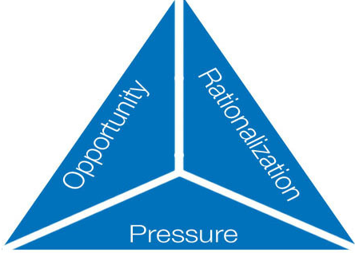
The Fraud Triangle
Understanding the Fraud Triangle is critical to:
Minimize the risk of abuse
Minimize the risk of fraud
Develop strong internal controls
Notes:
Pressure
Serious problem (financial) that requires immediate attention and cannot be resolved by ordinary financial resources:
Gambling, drinking, other addictions
Divorce, bankruptcy, medical issues
Unforeseen life change
Family emergency
Pressures from organization to perform well
Opportunity
Aware that financial problem can be solved by stealing from organization or falsifying organization’s records:
Weaknesses in internal control
Lack of or poor documentation
Lack of or poor supervision
Poor segregation of duties
Rationalization
Mindset that fraudulent action undertaken is justified:
“It’s just temporary, I’ll pay it back”
“Management doesn’t care”
“It’s just a little bit, no one will miss it”
“No one else is hurt”
“I deserve it”

Slide 22
Frauds that Have Occurred Recently within State and Local Governments
Notes:
So speaking of state and local communities let’s shift gears and talk about frauds in new headlines that have recently occurred within state and local governments.

Slide 23
Question #2
Polling Question
What is the leg of the fraud triangle that organizations can best control?
Pressure
Opportunity
Rationalization
Notes:
Answer is:
b. Opportunity
Organizations can play a part in Pressure if the fraud involves financial statement fraud.

Slide 24
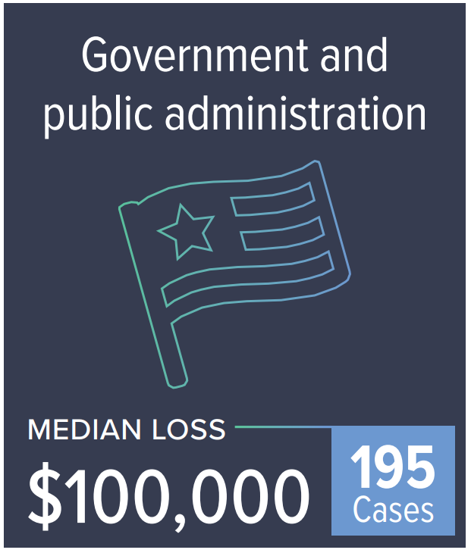
Fraud in State and Local Governments
Public Contracts
Purchasing Process
Payroll & Stipends
Utilities & Public Works
Public Safety
Transportation
General IT vulnerabilities including phishing emails (increased risk with remote work)
Public integrity & conflicts of interest
Source: ACFE 2020 Report to the Nations
Notes:
Before we jump into the recent headlines what are some of the areas in state and local governments where fraud can occur? Namely, public contracts. Ana and I know from first hand experience how often public contract code is involved in our investigations. How about some other areas? Purchasing is another big one especially if procurement or credit cards are issued. Payroll and stipends and ripe for abuse when internal controls are lacking or there is collusion. Utilities and Public Works, Public Safety, and Transportation each have there own unique fraud risks. The officer that collects parking revenues, well, there’s an opportunity for cash skimming. Ana has an interesting case study that involves a public utility that she’ll get into later.
How about the IT vulnerabilities? Government employees are just as likely to fall victim to phishing or spear phishing emails. Ransomware is often in the news too and shut down a state or local governments operations.
The last item here may not be an opportunity for fraud, but consider the public’s perception of the government when there is a lack of integrity or conflicts of interest are allowed to exist. Even the perception of a conflict of interest can be just as damaging as an actual conflict of interest.

Slide 25
Impact of Fraud – More than Just Money
Monetary
Actual loss
Costs and time spent by investigators/attorneys
Reputation
Loss of confidence by community, donors, etc.
Increased Costs
High risk audit / increased audit costs
Media attention (newspapers, social media)
Notes:
Fraud can go way beyond just the initial loss. There’s the time and money that has to be spent by investigators and attorney to uncover the fraud and quantify it. There’s also the possibility of law enforcement conducting there own investigation. Then you have to consider the time and money it takes to produce an insurance claim and possibly take the perpetrator to court. All of that adds up. We should note that in insurance plans, these costs can be covered.
There’s also things that don’t have a monetary impact but can be even more damaging. That’s the media attention caused by the fraud when it gets reported. This can damage relationships, friendship, and not to mention it undermines the public confidence in elected officials and government employees when fraud is found to exist. If you organization relies on donations, bad press can be the death of your organization and donors quickly fade away when your name is associated with fraud.
Down the rode there’s another financial cost to consider. Your fraud has increase which can cause your auditor to increase steps to mitigate that higher risk which may result in higher audit costs. Your insurance provider may raise your rates or drop you all together if they consider the fraud significant enough to warrant a reaction from them.
These are all important things to consider and go beyond just the dollar sign when we quantify fraud.

Slide 26
State and Local Government Fraud in the News
Police Sergeant Charged with Embezzlement
City considers internal financial controls after embezzlement
State ACO faces allegations of fraud and faulty data
State’s role in scandal paused as auditor issues an interim EB-5 report
City bribery investigation puts CEO in federal prison
Notes:
So at this point in our presentation I wanted to show you some headlines from newspapers around the country. In fact, all of these were headlines from this year. But it turns out that headlines are copyrighted and I wasn’t able to include the images in this slides. But take a look. [read the headlines]
Summaries
Prosecutors charged police sergeant with embezzlement and misappropriation of funds
19 years with the department and responsible for payroll functions
Police discovered discrepancies in funds and overtime requests
Fraudulent Disbursements (payroll scheme)
Former finance director suspected of embezzling upwards of $710,000
Wrote checks to fake vendor then deposited money into personal account.
City considering a forensic audit to provide assurance that city staff members have not missed anything.
Fictitious Invoices (billing scheme)
Whistleblower complaint alleges Vermont Accountable Care Organization (ACO) defrauded the state and federal government by relying on data systems that were "flawed" and "virtually useless."
Data systems were used to set physician benchmarks and track progress toward those goals, which determined how much ACOs and their physicians were paid.
U.S. Attorney's Office declined to intervene in the case.
Fraudulent Data (billing scheme)
State auditor probing state’s role in EB-5 investor fraud scandal.
Probe into the Vermont EB-5 Regional Center, which is related to the largest fraud case in Vermont’s history.
Involved a failed plan to build a biotechnology plant using $118 million raised through the EB-5 visa program, which encouraged foreigners to invest in U.S. projects that create jobs in exchange for a chance to earn permanent U.S. residency.
U.S Citizenship and Immigration Services terminated the state-run regional center.
Corruption & Fraudulent Disbursement
5. Bribery case has led to the CEO of an Atlanta business being sentenced to federal prison
Paid $20,000 in cash to a City of Atlanta Department of Procurement official in order to secure a contract at Hartsfield-Jackson Atlanta International Airport
Corruption (bribery scheme)

Slide 27
1 – Disbursement Fraud (Case Study)
Discussion

Slide 28
1. Disbursement Fraud
Scheme:
Deposits from customers were held in an agency fund
As services were provided, deposits were transferred to the department’s operating account
Unused deposits were refunded to customers
Employee misapplied deposits to ensure sufficient money available in agency funds
Employee created and approved claim requests for fictitious refunds
Employee created fictitious supporting documentation
Employee used a “one-time vendor” code that allowed manual entry of payee name and address
Employee picked up checks from accounting using her own name
Notes:
How exactly was this employee able to get away with stealing money? To start what we were told was that this case involved asset misappropriation. The first scheme that was uncovered involved the issuance of refund checks. In fact, the bulk of the money that was stolen was with this method. It is worth noting that this department brought in about 1.5 million annually.
In general, individuals receive refunds after county staff time is charged against their deposit. The Perpetrator would refund the money to the vendor from one of the three agency accounts. If you were looking to identify the opportunity, here it is. The opportunity to create refund checks.
But she couldn’t just create checks, she needed to submit a false claim on behalf of a non-existent customer and provide falsified supporting documents to make it appear legitimate. She was able to circumvent the internal controls over the master vendor list by exploiting the one-time vendor code which allowed her to manually enter the payee’s name and address. The idea behind this was it was one a one-time payment to a vendor and wouldn’t require the usual process of obtain a vendor’s W-4. On a side note, I’ve this same exploit used in other non-governmental frauds. Just beware, the one-time vendor code is a risk a to your organization.

Slide 29
1. Disbursement Fraud
Red Flags & Risk Areas:
Department leaders knew department operations were struggling, but did not fully understand cause
One-time (temporary vendor) number
Employees can route checks back to themselves or pick-up from accounting
Payments to individuals, new vendors, or unknown vendors
Round dollar payments, payments just below approval thresholds
Excessive use of one account type or vendor by a single employee
Lack of detail on the supporting invoice
Consecutively numbered invoices / duplicate invoice numbers
Lack of a physical address on the invoice
Separate systems to track customer deposits and projects
Notes:
Another red flag or risk area for the specific case study was that they used a separate system to track customer deposits and projects. And this system did not speak to the accounting system where the refunds were issued from. The fraudster was supposed to be reconciling these 2 systems, and she exploited the fact that no one else was comparing the 2. So the risk would be 2 separate systems used for one purpose, but the systems don’t speak to each other. Additionally, one employee with too much autonomy could be a red flag/risk too (no segregation).

Slide 30
Victim | Governmental| County
Check Misappropriation
Organization Size | County department with $1.5 million annual budget; serves over 190,000 customers
Perpetrator | Trusted long-term employee, female, late-40s, divorced, adult children Alleged drug addiction and family medical issues (Pressure)
Responsibilities | Prepared, created, and recorded deposits Requested and approved refund checks (Opportunity) Responsible for reconciling three different agency funds (Opportunity)
Schemes | Fictitious Refunds Created and approved claim request for fictitious refunds to customers Gained access to supervisor’s login credentials to approve the check requests (Opportunity) Originally mailed check directly to co-conspirators; later, picked up checks and deposited into a bank account for a community organizer of which she was the Treasurer and had access to the bank account Fictitious Vendor Invoices Created fictitious professional service invoices and submitted for payment Received permission to override proof of insurance requirement; request Purchasing approve the PO In total, nearly $2.05 million loss over a period of 9 years
Results of Investigation | Administrative: Employee was terminated Civil: No civil action taken; insurance claim filed to recover loss Criminal: Indicted by DA; pleaded guilty; sentenced to 9 years, 8 months prison term; ordered to pay $2.5 million in restitution
Notes:
the employee was the 1st level approver for all refund claim requests and they did not require a 2nd approval from her department if they were getting mailed. Accounting had to approve the payment for disbursement, but they just relied on the fact that there was supporting documentation attached. If she was going to pick up the check from accounting, then she had to mark the request for pick-up and it required the supervisor’s approval. This is when she’d log in as the supervisor and approve it so she could pick it up. The supervisor’s approval often happened within seconds to a minute of her approval.

Slide 31
1. Disbursement Fraud
Detection:
A temporary receptionist questioned why the subject was picking up so many checks for hand-delivery that normally would have been mailed
Analysis:
Review canceled check, check request, and supporting documentation
Examined perpetrator and co-conspirator’s bank statements to identify other possible misappropriation by perpetrator
Notes:
Her supervisor left the County for unrelated reasons, and she did not have the login for her new supervisor. So, she would not mark the check request for pick-up so that it would not have to go to her supervisor. She would then call accounting and tell them she “forgot” to mark the box and ask if she could pick it up. After this happened several times, this person got suspicious and called the County Auditor’s Office. They then ran a report of the one-time vendor payments and saw all these refunds to names/organizations associated to the employee. We got the bank statements of the perpetrator and her co-conspirators form the DA’s office.

Slide 32
1. Disbursement Fraud
Control Deficiencies:
Employee had access to checks after they were signed; checks should always be mailed immediately after being signed
No second department level approval required for mailed checks
Gained access to supervisor’s log-in credentials (to pick-up checks)
Inadequate purchasing documents (approved contract, purchase order, etc.)
No review of disbursements by higher level management
Accounting approval meant only that support matched check request information
No separate reconciliation of the project database to the accounting system and refunds issued
Ability to request (or enter) address or other information change for vendor
Notes:
These were not invoices that were being approved because they were customer deposit refunds. So she just had a project reconciliation sheet that showed the customer information, how much deposit was paid, total cost of the project, and then refund amount due. She attached this to her check requests. No one ever verified that the information was legitimate. It was all made up. So she was preparing the refund documentation, preparing the check request, approving the check request, and picking up the check from accounting. Technically, she was not preparing the check or signing the check. That was all through accounting.
Another weakness was that there was not a separate reconciliation of the project database to the accounting system and refunds issued. She did not have the ability to enter a change for a vendor, she used the one-time vendor number which allowed for manual entry of the payee name and address.

Slide 33
Question # 3
Polling Question
What was the most critical internal control weakness in this case?
Inadequate purchasing documents
No separate reconciliation
Employee had access to checks after they were signed
No review of disbursements by higher level management
Notes:
Answer is:
C. Employee had access to Check
Organizations can play a part in Pressure if the fraud involves financial statement fraud.

Slide 34
2 – Fictitious & Dormant Vendor Fraud
Discussion

Slide 35
2. Fictitious & Dormant Vendor Fraud
Scheme:
Employee causes a new (fictitious) vendor to be added to vendor list and the name and address are affiliated with the employee
Employee requests a change (e.g. address) to an existing vendor (dormant vendor) on the vendor list to cause payments to be sent to the employee
Third-party requests change to mailing address or banking information to cause payments to be diverted (Business Email Compromise: techniques include spear-phishing, social engineering, impersonation, e-mail spoofing and intimidation)

Slide 36
2. Fictitious & Dormant Vendor Fraud
Red Flags & Risk Areas:
Poor controls over vendor master list
AP personnel can add/revise vendors
Employees can request/submit changes to vendor information
No procedures to verify change requests to a vendor file
Vendor master list not cleaned up regularly
Dormant vendors not made inactive
One-time (temporary vendor) number
Employees can request that checks be routed back to themselves
Employees can pick-up checks from accounting
Payments to individuals (consultants), new vendors, unknown vendors
Round dollar payments, payments just below approval thresholds

Slide 37
Victim | Governmental| School District
FICTITIOUS & DORMANT VENDOR FRAUD
Org. Size | Annual Budget = $300 million
Perpetrator | Director; male; no known personal or family issues
Scheme | Submitted to purchasing a name and address change for an existing vendor (via a forwarded email that appeared to be from the vendor) Approved a new contract be executed with the vendor, and he made changes to vendor information on the draft contract He approved and submitted invoices from the vendor for payment Payments were mailed to new address (mail center) Wife created a DBA in the revised vendor name, opened a bank account, and deposited check Bank put a hold on the check and called the district
Results of Investigation | Employee resigned when he was notified of administrative leave (declined to be interviewed) Through background checks, original vendor appeared to be related to employee (conflict of interest) Payments totaled over $480,000 (31 payments) from FY2011/12 to FY2017/18 No current employees in department were familiar with vendor Initial 2 years – invoices based on specific services provided ($112,000 – believed to be legitimate) Last 5 years – changed contract to fixed fee, no detailed invoices ($369,000 – believed to be fictitious invoices)
Possible Audit Detection Methods | Review vendor change report for unusual changes (name change, tax ID change, etc.) and who made changes Inquire with personnel (particularly staff) about most frequent or common vendors used Search for round dollar payments
Notes:
The bank put a hold on the check because it was around $20,000, the payee name on the check was slightly different than the name on the account, and the check was dated prior to when the account was opened. The District was lucky in that the bank actually flagged the deposit and held it.
When the bank called the school, AP began looking into it. The business name on the account match the vendor name in the system. But then the bank shared with the District the person’s name that opened the account. When the District googled the name, they saw a picture of the Director with his wife.

Slide 38
2. Fictitious & Dormant Vendor Fraud
Detection:
Review report of new vendors, who created
Review vendor change report for unusual changes (name change, tax ID change, etc.) and who made changes
Perform address and tax ID/SSN match between vendor master list and employee listing
Inquire with personnel (particularly staff) about most frequently used vendors
Trend analysis of expenses by vendor (review for increases and inquire)
Identify vendor payments equal in amount or higher frequency than expected
Review canceled check images for unusual endorsements
Review vendor master list permissions by position

Slide 39
2. Fictitious & Dormant Vendor Fraud
Prevention:
Accounts payable should not be able to make changes or additions to the vendor master list
Verify vendor changes directly with the vendor using old contact information (phone number, email, address)
If possible, have separate purchasing function that interacts directly with vendor is procurement process
Do not allow individual departments to “tell” purchasing who they are going to use for a project

Slide 40
Process of a Fraud Investigation

Slide 41
Process of a Fraud Investigation
Scope out engagement through discussions with client
Obtain relevant financial data and documents
Interviews of employees or others with knowledge (excluding the suspected fraudster)
Request additional data or documents based on interviews
Conduct computer forensics, if appropriate and necessary
Conduct public record searches, if necessary
Perform appropriate analysis to reach conclusions
Prepare deliverable

Slide 42
Possible Deliverables and Outcomes
Report for management (oral or written)
Fidelity insurance claim (written report)
Referral to law enforcement (written report)
Civil claim against employee (deliverable could vary)

Slide 43
What does an Organization do when Fraud Occurs

Slide 44
Initiating a Fraud Investigation
When can an organization generally initiate a fraud investigation?
Predication must exist
What factors will the organization consider when faced with fraud within the organization?

Slide 45
Predication
“…the totality of circumstances that would lead a reasonable, professionally trained, and prudent individual to believe a fraud has occurred, is occurring, or will occur. Predication is the basis upon which a fraud examination/investigation is commenced. Fraud examinations should not be conducted without proper predication.”
Fraud examiners manual. (2011). Austin, TX: ACFE. (pg. 31)

Slide 46
Examples of Predication
Complaint from a “whistleblower” or other “tips”
Internal audit findings
External audit findings
Difficulties in financial reporting/information/disclosure
Issues involving customers or vendors
Potential “conflict of interest” concerns
Foreign Corrupt Practice Act (FCPA)
Responding to regulatory action
Unusual journal entries, transactions, or trends
Others?

Slide 47
Question #4
Polling Question
Which one of the following would be considered predication?
Employee John Doe seems to be living beyond his means.
Our insurance expense costs seem to have increased significantly yet our business model hasn’t changed.
The Board wants to get rid of the Superintendent, so take a look at all payments to him and find us some dirt.
None of the above
Notes:
Answer is:
d. None of the above

Slide 48
Fraud Investigations
When do companies call fraud investigators:
“I think we have a FRAUD”
Benefits of calling a fraud investigator:
Assistance to scope out the issues
Determination of fraud loss and identification of fraudster(s)
Assistance with completing proof of loss for insurance reimbursement
Assistance with providing human resources evidential materials for employee termination
A “suspicion of fraud” meaning possible embezzlement, misappropriation, financial wrongdoing, or financial irregularity by an employee(s) or third party
Notes:
The first type of service and probably the type of service we do most often and which we have an excellent reputation for is our FRAUD INVESTIGATIONS
This is when an organization – and that would be any type of organization and Industry – has a “suspicion of fraud” meaning possible embezzlement, misappropriation, financial wrongdoing, or some type of financial irregularity by an employee(s) or third party and the organization is the victim.
We have worked on many of these type cases and in many of these cases, the general fact pattern is similar:
the alleged FRAUDSTER is a long term trusted employee
the alleged FRAUDSTER is still employed with the organization
this is the first time the organization has encountered a possible embezzlement by one of their key employees
and the organization may or may not be a current client of CLA
A classic case we worked on involved a large school district where there was a suspicion that the CBO (Chief Business Officer) was maintaining a “dormant - slush” bank account in the name of the organization and embezzling funds utilizing this bank account for at least the last seven years. And he was still employed with the District
We were contacted by the school district as they were taken by complete surprise by this allegation that had come to their attention
First of all, at the very beginning we met with them in person and provided that Personal touch with client to help them sort and scope out the issues. One of the first actions they took was to put Employee put on administrative leave pending our investigation.
We then performed our investigation involving review and analysis of records, interviews, and determined the fraud loss and developed facts to identify the CBO as the alleged fraudster. No collusion. We prepared our Report and used for:
District had insurance coverage so we did a Proof of Loss and client received Insurance reimbursement for some of the fraud loss
Our Report was used by their HR Dept. for termination/resignation of employee(s) - Human resource issues
We worked with client in making a Criminal referral to law enforcement
The LADA’s Office took the case and the CBO ultimately entered a Plea Agreement and went to jail
We worked with client to assess whether to file a civil case against the CBO but none was filed against the CBO but a civil case brought against certain vendors for some irregular transactions related to the CBO
We then made Recommendations for internal control improvements to minimize risk of fraud
In summary, We have worked many Fraud Investigations involving many levels of employees: from Accounts payable Clerks, Office Managers, Supervisors, CFOs, and Operation types, such as Director of Facilities and Maintenance and Operations as some examples
Finally, in these type of Fraud situations, in addition to potential large financial losses, the organization suffers other potential negative consequences, such as: loss of reputation, negative publicity, loss of employee morale, disruption to day to day operations, people taking sides, and an overall loss of productivity. We are very good at working with organizations to help them minimize these other negative factors as we have been doing this for such a long time and quite extensive experience in these matters.

Slide 49
Fraud Investigations
Benefits of calling a fraud investigator (continued):
Recommendations for internal control improvements to minimize risk of fraud
Assistance with criminal referral to law enforcement
Assistance with civil litigation
Recommendations for regulatory compliance
Notes:
The first type of service and probably the type of service we do most often and which we have an excellent reputation for is our FRAUD INVESTIGATIONS
This is when an organization – and that would be any type of organization and Industry – has a “suspicion of fraud” meaning possible embezzlement, misappropriation, financial wrongdoing, or some type of financial irregularity by an employee(s) or third party and the organization is the victim.
We have worked on many of these type cases and in many of these cases, the general fact pattern is similar:
the alleged FRAUDSTER is a long term trusted employee
the alleged FRAUDSTER is still employed with the organization
this is the first time the organization has encountered a possible embezzlement by one of their key employees
and the organization may or may not be a current client of CLA
A classic case we worked on involved a large school district where there was a suspicion that the CBO (Chief Business Officer) was maintaining a “dormant - slush” bank account in the name of the organization and embezzling funds utilizing this bank account for at least the last seven years. And he was still employed with the District
We were contacted by the school district as they were taken by complete surprise by this allegation that had come to their attention
First of all, at the very beginning we met with them in person and provided that Personal touch with client to help them sort and scope out the issues. One of the first actions they took was to put Employee put on administrative leave pending our investigation.
We then performed our investigation involving review and analysis of records, interviews, and determined the fraud loss and developed facts to identify the CBO as the alleged fraudster. No collusion. We prepared our Report and used for:
District had insurance coverage so we did a Proof of Loss and client received Insurance reimbursement for some of the fraud loss
Our Report was used by their HR Dept. for termination/resignation of employee(s) - Human resource issues
We worked with client in making a Criminal referral to law enforcement
The LADA’s Office took the case and the CBO ultimately entered a Plea Agreement and went to jail
We worked with client to assess whether to file a civil case against the CBO but none was filed against the CBO but a civil case brought against certain vendors for some irregular transactions related to the CBO
We then made Recommendations for internal control improvements to minimize risk of fraud
In summary, We have worked many Fraud Investigations involving many levels of employees: from Accounts payable Clerks, Office Managers, Supervisors, CFOs, and Operation types, such as Director of Facilities and Maintenance and Operations as some examples
Finally, in these type of Fraud situations, in addition to potential large financial losses, the organization suffers other potential negative consequences, such as: loss of reputation, negative publicity, loss of employee morale, disruption to day to day operations, people taking sides, and an overall loss of productivity. We are very good at working with organizations to help them minimize these other negative factors as we have been doing this for such a long time and quite extensive experience in these matters.

Slide 50
Factors Organizations Must Consider when Faced with Fraud
Administrative: human resource issues – possible termination
Hiring an Attorney – is this necessary?
Insurance: proof of loss – get reimbursed!
Civil litigation: suit against fraudster for recovery of fraudulent funds
Criminal referral: see that “justice” is done
Internal controls: implement internal controls so fraud doesn’t happen again
Contract dispute with vendor: performance of contract
Regulatory compliance

Slide 51
Anti-Fraud Program - Best Practices

Slide 52
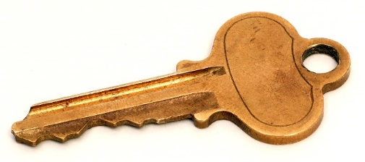
Anti -Fraud Program Best Practices
Management ethical commitment.
Fraud Hotlines, reporting procedure and protection.
Fraud awareness training.
Zero tolerance policy and Code of Conduct (recommend a specific senior management code of conduct).
Key Policies and Procedures
Completion of a fraud risk assessment.
Conflict disclosure process.
Key Human Resources policies and procedures (e.g. background checks).
Investigation Process.
Notes:
tone at top ethical commitment—code conduct, conflict disclosure process
Have a hotline—make sure all know
Training, training, training,
Key HR process—background checks,
Testing of your internal controls
Why is it important to have an investigation process??

Slide 53
Thank you!
Ana Rodriguez, CPA, CFE
Manager
626-387-8256
Ana.M.Rodriguez@CLAconnect.com
Kyle Shafer, CPA, CFE
Senior
626-857-7300
Kyle.Shafer@CLAconnect.com

