Slide 1
Project & Time Management – Tips for Success
Presented by:
Chris Bitakis, CPA, CGFM, CGMA
Principal, Audit and Consulting
Emily Wilson, CPA, CFE
Manager, Audit and Consulting
April 7, 2021

Slide 2
Today’s Topics
Workplace Considerations
The 5 Phases of a Project
Time Management
Tips and Tricks for Project and Time Management

Slide 3
Work Place Considerations
Fantasy - You envision that perfect 50/50 balance point, where you magically finish everything you need to do for work and still have time left over for going to hot yoga, making homemade bone broth, getting 8 hours of sleep, and everything else Instagram tells you to do to be a well-rounded human.
Reality - You’re working on that report but you have to stop work early because you haven’t been to the dentist in an embarrassingly long time. Or you’re trying to meal prep at home when an important email comes in, and next thing you know you’ve burned everything and you’re stuck eating instant ramen for lunch tomorrow.

Slide 4
Work Place Considerations Stats
An American Sociological Review study found that 7 out of 10 US workers struggle with the work/life challenges
“Meetings and presentations, errands and appointments, conference calls and research, laundry and takeout, pets and sippy cups — they’re all threads in the fabric of this little thing called life”

Slide 5
Polling Question #1
How would you describe your workplace mindset?
a.) Work Life Balance
b.) Work Life Integration
c.) Work Life Blend
Notes:
No wrong answer

Slide 6
Work Place Considerations
Work Life Balance
Work Life Integration
Work Life Blend

Slide 7
Work Place Considerations – Work-Life Balance
Brief History
Roots trace back to the “First” Industrial Revolution
Majority of U.S. workers working 100 hours a week
Fair Labor Standards Act
The actual term “work-life balance” – 1980’s
Defining Work-Life Balance Today
Effective time management
Burnout prevention and stress management
Disconnect between HR and employees

Slide 8
Work Place Considerations – Work-Life Integration
Brief History
By-product of changes in society
Credited to Millennials and Generation Z
Defining Work-Life Integration Today
Not about managing conflicting demands
Making constant accommodations for the rapid pace of change

Slide 9
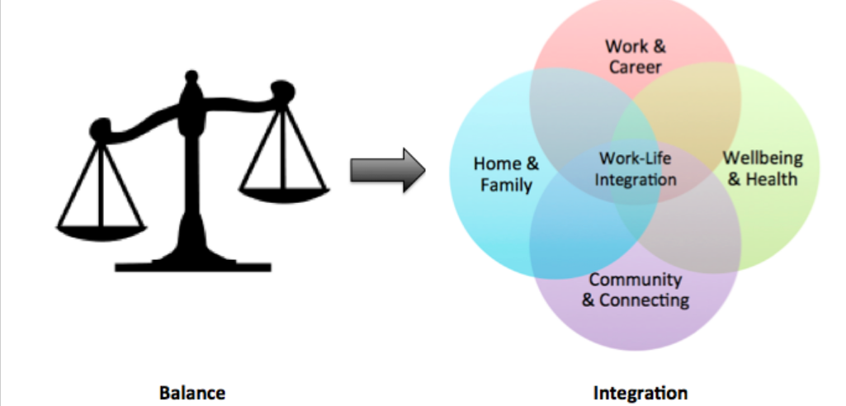
Balance vs. Integration

Slide 10
Work Place Considerations – Work-Life Blend
Brief History
Forbes published this concept in 2012
Finding a better way to fit it all together
Defining Work-Life Blend Today
Doesn’t mean everything is happening at the same time
Requires some boundaries but can’t be rigid
Allow for overlap (miss a family dinner) but can’t turn into routine

Slide 11
Work Place Considerations – Post Pandemic
Harvard Business School
The need to prioritize face time at the office
More honest conversations with employees
Weigh the risks of loneliness
Consider flexible hybrid approach
Reject virtual work at your Company’s peril
Make work inspiring – at the office or not
Be fair when deciding who works remotely

Slide 12
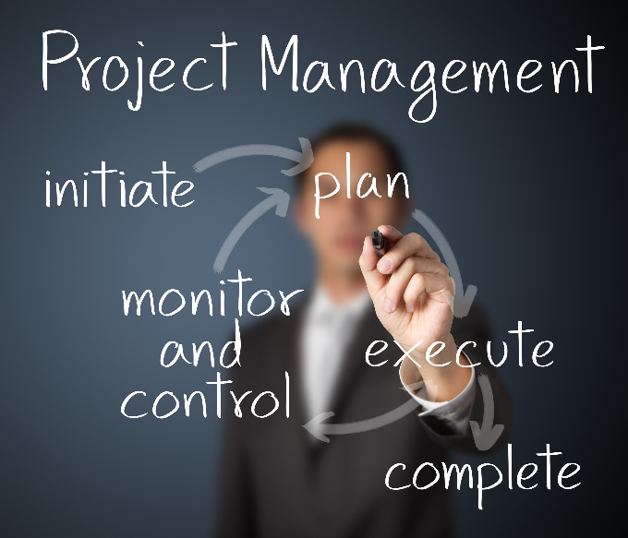
What is a project?
What is a project?

Slide 13
What is a project?
A temporary endeavor undertaken to create a unique product, service or result. A project is temporary in that it has a defined beginning and end in time, and therefore defined scope and resources.
PMBOK, 5th Edition, Chapter 1, Section 1.2, p3

Slide 14
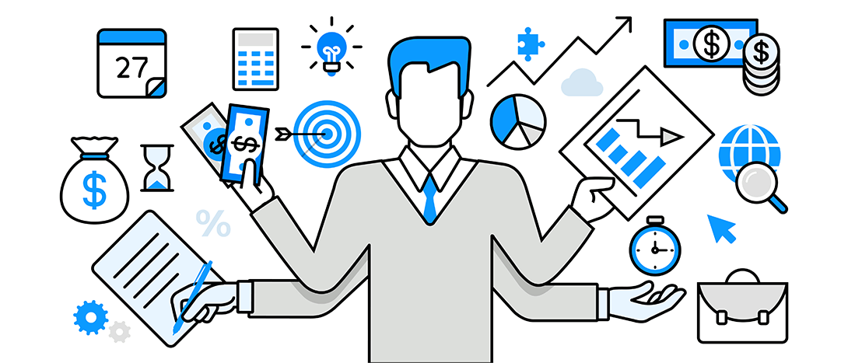
What is a Project Management?
Project Management
The application of knowledge, skills, tools, and techniques to meet project requirements.
The discipline of initiating, planning, executing, controlling, and closing the work of a team to achieve specific goals and meet specific success criteria at the specified time.

Slide 15
Project Management: Why is this Important?
Vision
Creating an inspiring vision of the future
Motivate
Motivating and inspiring people to engage in that vision
Manage
Managing delivery of the vision
Coach
Coaching and building a team, so that it is more effective at achieving the vision
Achieve
Uphold the goals of the project to achieve results

Slide 16
Examples of Projects
Procuring a contract
Implementing new policies and procedures
Software upgrade
Preparing a CAFR
Preparing for an audit
Going to Disney World
Your day

Slide 17
5 Phases of Project Management
INITIATING
PLANNING
Needs of project formally accepted
Project ideas carefully examined
Project manager appointed
PM selects team members based on experience and skills.
Research whether project is feasible
Goal setting
Outline objectives of the project
Communicate objectives and goals to team
Effective planning is vital to success
Ongoing process and never ends during life of project
EXECUTING
MONITORING & CONTROLLING
CLOSING
Project start to take shape
Project plan put into action
Tasks occur in executing project
Team adheres to mapped out plan
Coordination amount team members and resources
Project deliverable developed and completed
Project closing process often overlooked
Consists of processes performed to complete project
Once completed, “post mortem” meeting held to evaluate what went well and identify project failures
Measure progression/ performance
Ensure alignment w/project plan
Observe, evaluate, document & report on progress/limitations
In this phase, we react/adjust to issues, inefficiencies, ineffectiveness that arise

Slide 18
Polling Question #2
You are hosting a Family Barbeque (with social distancing and masks): Which of the following tasks would fall into the planning phase of project management?
a.) Create a grocery List
b.) Discussion on what to make next year
c.) Project manager “Executive Chef” appointed
d.) Executing tasks/timeline

Slide 19
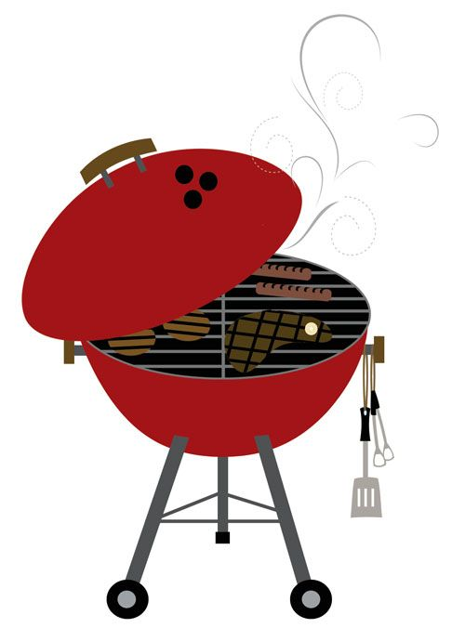
5 Phases Example: Family BBQ
INITIATING
PLANNING
1
2
You agree to host a family barbeque
Project manager aka “Executive Chef” appointed
Who is going help you?
What dishes are you going to make
Research recipes, cooking times, etc.
Goal setting: Don’t burn the burgers
How many people attending?
Assign tasks to other family members
Have a backup plan?
Create a grocery List
Timeline
EXECUTING
MONITORING & CONTROLLING
CLOSING
3
4
5
Grocery shopping
Food prep
Cooking
You execute tasks/timeline
Checking in on timeline: Will dinner be ready by 5pm?
Burgers burned?
Dinner is served
What did everyone like?
What could you do without next time?
Close out meeting: next barbeque we are getting takeout/cooking something different

Slide 20
Time Management
What is time management and why is it important?

Slide 21
Polling Question #3
Do you feel like you manage your time well?
a.) Yes
b.) No
c.) Sort of but I could do better
Notes:
Based on the definition of time management, do you feel like you manage your time well?

Slide 22
Time Management
Basic skill as a project manager
Decrease the time spent on unproductive activities
Develop more accurate estimates for turnaround time on projects
Improve execution of project plan

Slide 23
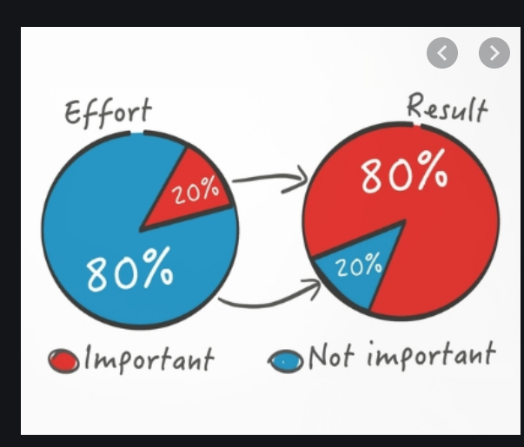
Time Management - The 80/20 Principle
Pareto Principle – 80/20 Rule

Slide 24
Time Management - 80/20 Principle
20% of the sales reps generate 80% of total sales.
20% of customers account for 80% of total profits.
20% of the most reported software bugs cause 80% of software crashes.
20% of patients account for 80% of healthcare spending (and 5% of patients account for a full 50% of all expenditures!)
On a more personal note, you might be able to relate to my unintentional 80/20 habits

Slide 25
Polling Question #4
What is your preferred method for time management?
a.) To-Do Lists
b.) Microsoft Planner
c.) Outlook Calendar
d.) All of the above
e.) I just wing it
Notes:
No wrong answer

Slide 26
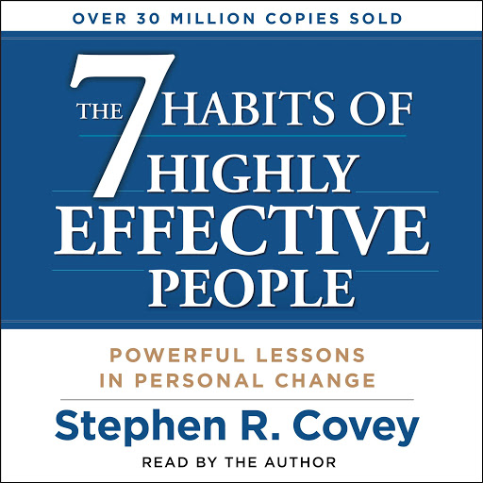
Time Management - 7 Habits of Highly Effective People
Habit #1 – Be proactive
Habit #2 – Begin with the end in mind
Habit #3 – Put first things first
Habit #4 – Think win-win
Habit #5 – Seek first to understand, then to be understood
Habit #6 – Synergize
Habit #7 – Sharpen the saw; growth

Slide 27
Time Management
Urgent
Not Urgent
Quadrant 1
Quadrant 2
Crisis
Preparation
Pressing problems
Prevention
Important
Deadline –driven projects
Values Clarification
Meetings
Planning
Relationship Building
Quadrant 3
Quadrant 4
Interruptions
Busywork
Some phone calls, mail, reports
Some phone calls
Not Important
Pressing matters
Irrelevant mail
Some meetings
Pleasant activities
Social media/web surfing

Slide 28
Polling Question #5
Which quadrant do you identify most with on a daily basis?
a.) Quadrant 1
b.) Quadrant 2
c.) Quadrant 3
d.) Quadrant 4
Notes:
No wrong answer

Slide 29
Time Management - Managing the Quadrants
Where should you be spending your time?
The average person spends 25% in category 1, 15% in category 2, 57% in category 3 and 3% in category 4.
The average goal would be to spend approximately 20% in category 1, 64% in category 2, 15% in category 3 and 1% or less in category 4.

Slide 30
Time Management Activity
Take a few minutes and think of the busiest day you’ve had in the last week.
From 8am to 8pm list activities you engaged in each hour
Examples: work, CPE, parenting, hobbies, watching Netflix, browsing social media, cooking dinner, etc.
Next to each item, put the quadrant # each tasks falls into

Slide 31
Mine
Urgent
Not Urgent
Quadrant 1
Quadrant 2
Replacing hot water heater
Preparing for this presentation
Children crying
Planning for next project
Important
Exit presentation (24 hours notice)
Exercise
Proposals/fee quotes
Meal Planning
Relationship Building
Quadrant 3
Quadrant 4
March Madness
Busywork
Family interruptions
Some phone calls
Not Important
Some meetings
Irrelevant mail
Phone notifications
Pleasant activities
Social media/web surfing
Notes:
Anyone willing to share? This is an example that Emily and I put together

Slide 32
Techniques and Tips for Time Management
So how do I change my time management habits?
Remember, “the key is not to prioritize your schedule, but to schedule your priorities”
Hold yourself accountable to others
Plan ahead
Protect your time and recognize when it may be okay to say no to something in the immediate future but shift it to a later date
Align the level of energy with the level of impact

Slide 33
Techniques and Tips for Project Management
“Plans are worthless, but Planning is Everything” – Dwight D. Eisenhower
Leadership
Communicate, Communicate, Communicate
Creating budgets/schedule
Avoid multiple touches
Express Gratitude
Debrief/Reflect

Slide 34
Techniques and Tips for a Better Workday
Focus on high reward tasks
Don’t over plan
Learn to manage email
Learn shortcuts
Question what is not clear
Don’t stress
Get organized

Slide 35
Questions

