Slide 2
RED TEAM: DIGITAL ATTACK SIMULATION
Presented by:
Cindy Boyle, CPA, CIA, CITP, CISA, CCSFP BKD Cyber National Practice Leader
Dwayne Tucker, CISSP - Lead Red Team Pen Tester

Slide 3
Key Takeaways
Types of Penetration Testing
Red Team Exercise
Breach Life Cycle
Case Study

Slide 4
Types of Penetration Testing
Vulnerability Scans
Social Engineering (Phishing)
Penetration Testing – Internal/External
Red Team: Digital Attack Simulation

Slide 5
Polling Question

Slide 6
Types of Penetration Testing
Vulnerability Scans
Vulnerability scanning employs software that seeks out security flaws based on a database of known flaws, testing systems for the occurrence of these flaws and generating a report of the findings that an individual or an enterprise can use to tighten the network's security.

Slide 7
Types of Penetration Testing
Social Engineering (Phishing)
Phishing is the act of sending an email to a user falsely claiming to be an established legitimate enterprise in an attempt to scam the user into surrendering private information that will be used for identity theft.

Slide 8
Types of Pentration Testing
Penetration Testing
Penetration Testing tests the overall strength of an organization’s defense (the technology, the processes, and the people) by simulating the objectives and actions of an attacker.

Slide 9
Red Team Exercise
Red Team: Digital Attack Simulation
Uses all of the previous offerings (Vulnerability Scans, Phishing, Penetration test)
An attack simulation that mimics the real activities a hacker would take in an environment
Collects data & information a hacker would want
Ability to place malware & threats
Used to check Client’s Incident Response

Slide 10
Red Team Exercise
Red Team: Digital Attack Simulation
Differences from a Penetration Test
Penetration Tests do not
Collect Client Data
Use targeted Phishing attacks to gain access
Deploy malware and other types of backdoors for future access
Tests Incident Response from Client
(Red Team exercise Clients have a limited amount of knowledge about the test)

Slide 11
Polling Question

Slide 12
Breach Life Cycle
Attacks are generally carried out in four stages
These four stages are often referred to as the “breach life cycle”
The further the progression, the greater the risks
Infiltration: breaking in & establishing foothold
Propagation: in the network & moving around
Aggregation: collecting data & critical information
Exfiltration: taking the information outside of the organization
Infiltration
Exfiltration
Propagation
Aggregation

Slide 13
Breach Life Cycle
Leadership engages red team
Red team hackers break in (infiltrate)
Red team propagates & aggregates
Once detected, red team shows exfiltration data
Provides feedback to security team
Publishes the report
Compromised
Data
LEARN
Notes:
In a controlled environment we try to infiltrate, we hack
We don’t do this to make the security team feel bad, hackers are getting better all the time, we provide feedback to help make security teams better. There are a lot of things you can do at different stages, like if you determine someone has infiltrated a company may do mass password changes so that might stop the hacker or slow them down because they just lost all the passwords they hacked. Next slide for some benefits

Slide 14
Red Team Case Study
Setup of environment
Rules of Engagement
Types of data recovered

Slide 15
Data Recovered: Proprietary Data Source Code

Slide 16
Data Recovered: Proprietary Data Tax Status Information

Slide 17
Data Recovered: Proprietary Data Schematics

Slide 18
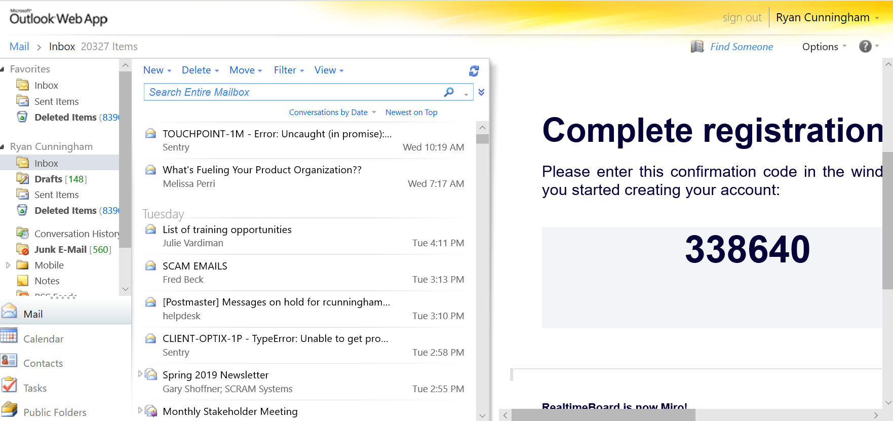
Data Recovered: Proprietary Data Email

Slide 19
Data Recovered: Proprietary Data SharePoint Site

Slide 20
Polling Question

Slide 21
Red Team Benefits
Simulated attack scenarios from real-world threats
Demonstrates true offensive techniques to organizations
Identify return on investment for cybersecurity solutions
True ‘quantitative’ risk analysis
Focuses on what’s valuable, data & assets
Designed to improve a security team
Still get the penetration test report plus more

Slide 22
Questions?

Slide 23
Thank you! @BKDAdvisory www.bkdcyber.com
Cindy Boyle
501.372.1040
cboyle@bkd.com
Dwayne Tucker
501.372.1040
dtucker@bkd.com

