Slide 1
Presentation to the Association of Governmental Accountants New Mexico Chapter 2021 Legislative Session Review, and Tax and Fiscal Update April 6, 2021
Stephanie Schardin Clarke, Secretary of Taxation and Revenue

Slide 2
Executive Leadership Team
Office of the Secretary Cabinet Secretary: Stephanie Schardin Clarke
Deputy Cabinet Secretary: Emily Oster, CPA
Tax Policy Director: Mark Chaiken, JD, LLM
Chief Legal Counsel: Vacant
General Counsel: Elizabeth Korsmo, JD
Director of Communications: Charlie Moore
Chief Risk Officer: Vacant
Taxpayer Advocate: Tiffany Smyth
Chief Economist: Lucinda Sydow
Local Government Liaison: David Montieth
Property Tax Division
Director: Santiago Chavez
Deputy Director: Michael O’Melia
Revenue Processing Division
Director:
Charlene Trujillo
Deputy Director: Rick Lopez
Information Technology
CIO: Mike Baca
Deputy CIO: Darshana Kanabar
Administrative Services
Director:
Denise Irion
Deputy Director: Miranda Ntoko
Audit & Compliance
Director: Aysha Mora
Deputy Director: Audit: Aaron Brown
Deputy Director: Compliance: Vacant
Tax Fraud Investigation
Director: Vince Mares
Deputy Director: Greg McCormick
Motor Vehicle Division Director: Vacant
Deputy Director Field Operations: Htet Gonzales
Deputy Director Central Admin: Gerasimos Razatos

Slide 3
TRD Mission and Vision
MISSION: The mission of the Taxation and Revenue Department is to serve New Mexico by providing fair and efficient tax and motor vehicle services
VISION STATEMENT - The Taxation and Revenue Department:
Promotes a culture of integrity, respect, and innovation
Earns the trust of our customers through our actions
Empowers customers through outreach, education, and ease of compliance
Offers flexible and secure solutions to improve customer experience
Administers tax and motor vehicle laws efficiently and transparently
Maintains a skilled, knowledgeable, and service-oriented workforce

Slide 4
TRD’s Core Values and Guiding Principles

Slide 5
TRD’s 2020 3-Year Strategic Plan Overview
Goal 1: Enhance Customer Experience and Customer Service |  | Goal 2: Cultivate Workforce Excellence |  | Goal 3: Improve Efficiency, Security and Transparency of Operations
1.1 Expand customer outreach efforts |  | 2.1 Provide training and education opportunities to grow and develop our managers |  | 3.1 Implement process governance framework
1.2 Expand customer education opportunities |  | 2.2 Provide training and education opportunities to grow and develop our employees |  | 3.2 Preview and balance agency processes for efficiency and internal control
1.3 Expand and improve customer channels and choices |  | 2.3 Recruit and retain skilled, qualified employees |  | 3.3: Ensure Department Regulations are Current, Comprehensive, Consistent, and Informative
1.4 Simplify and streamline processes to balance enforcement and customer service |  | 2.4 Create a safe and fair workplace |  | 3.4 Implement and monitor disaster recovery and business continuity plans
1.5 Serve state, local and tribal customers through strong enforcement and collection |  | 2.5 Promote cross-divisional communication that builds interconnectedness and coordination |  | 3.5 Ensure robust oversight of contract expenditures

Slide 6
Fiscal and Economic Outlook

Slide 7
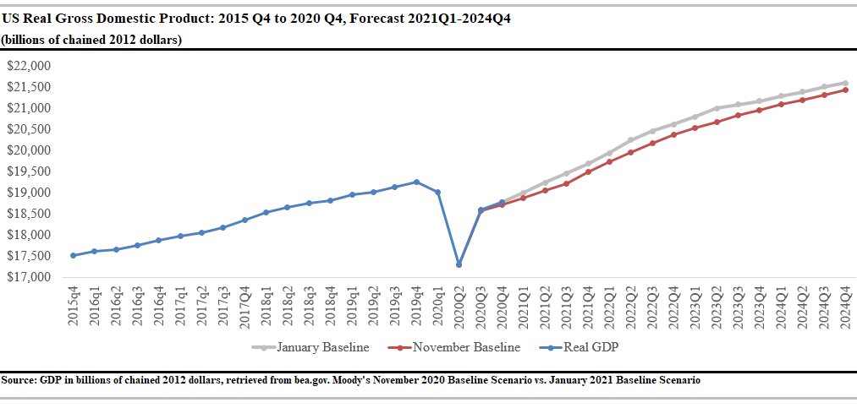
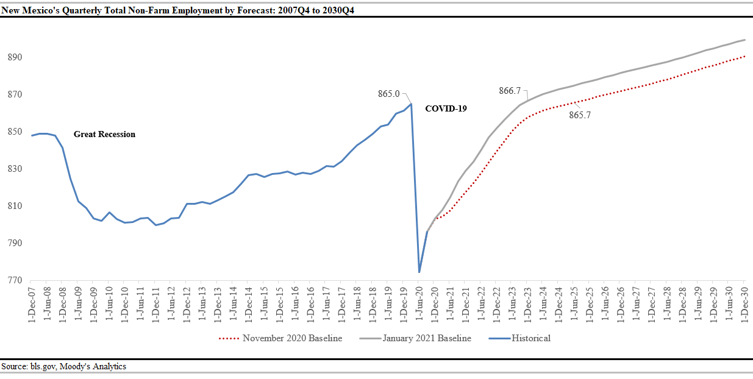
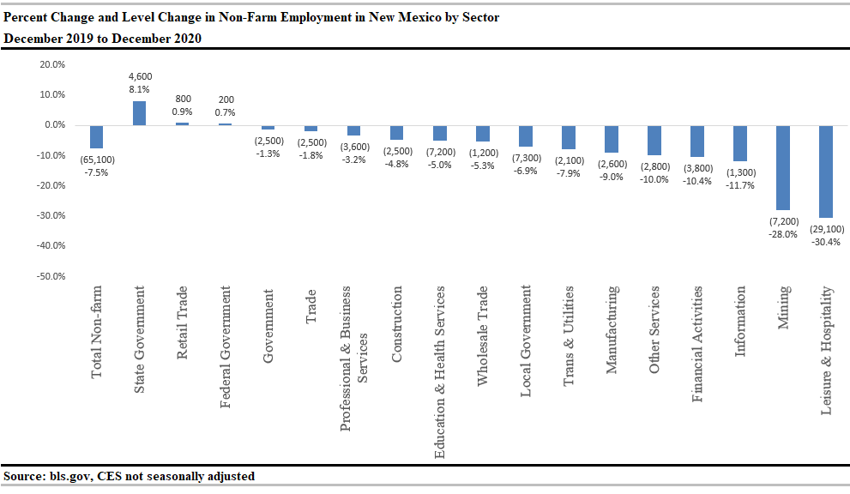
Macroeconomic Outlook – GDP and Employment

Slide 8
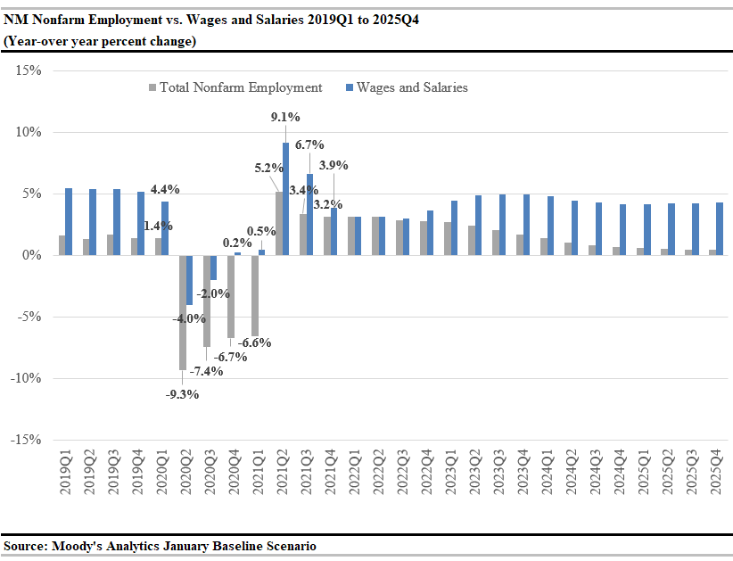
“K-Shaped” Recovery with Wages Recovering Faster than Jobs Props Up Higher Wage Earners
Wages and salaries contracted less sharply than employment and will recover more quickly
This suggests a widening income gap between high and low wage workers
In New Mexico, Retail and Accommodations & Food Services are large lower-wage sectors that are not forecasted to return to pre-recession levels during the forecast outlook

Slide 9
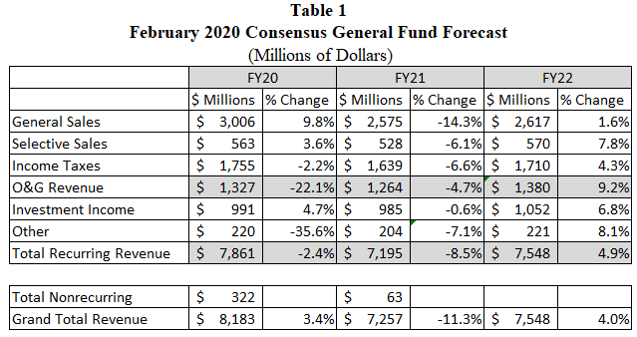
Consensus Revenue Summary
Total recurring GF revenue is estimated to decrease by 8.5% in FY21 due to the widespread impact of COVID-19.
Total recurring General Fund revenue is estimated to grow in FY22 by 4.9% over FY21
Risks to the forecast:
COVID – continued outbreaks
Vaccine efficacy and adoption
Drilling and permitting on federal lands
FY20 general fund ending reserves were $2.5 billion or 35.4% of recurring appropriations
2021 legislation (some pending Governor action) are preliminarily expected to bring reserves to 21.6% and end of FY21 and 23.5% at end of FY22
Reserves have stayed strong in large part due to influx of federal funding

Slide 10
Reminder: Changes Already Underway in Tax Administration (Mark your calendars for July 1, 2021)

Slide 11
Internet Sales GRT Continues to be Implemented
Internet Sales (2019 HB6) – two step implementation
Step 1 – July 1, 2019: internet sellers began remitting flat State rate of 5.125%.
“Engaging in business” redefined to include sellers without a NM physical presence having, in the previous calendar year, total taxable gross receipts of at least $100,000 (threshold in Wayfair decision)
GRT on receipts collected by marketplace providers for sales to New Mexico customers that the marketplace provider facilitates for marketplace sellers
Step 2 – July 1, 2021: internet sellers begin remitting both State and local GRT based on reporting location. Change to destination-based sourcing
GRT location for goods is buyer’s delivery location
GRT location for services is seller’s place of business, except construction services and real estate commissions (still at buyer’s location)
Clarifications to Internet Sales (2020 HB326)
Clarifies “professional services” for purposes of destination-based sourcing after July 1, 2021. Professional services are services other than in-person services that require either an advanced degree or a license from the state to perform

Slide 12
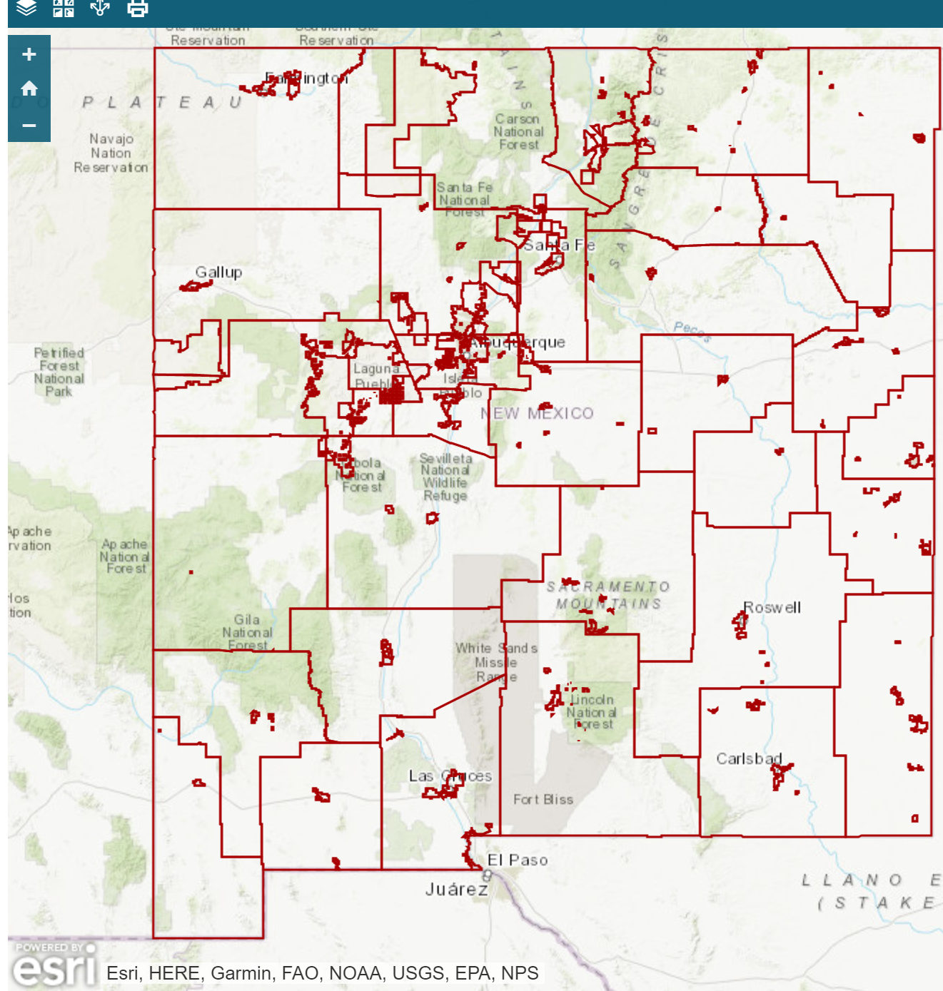
Internet Sales GRT: TRD Location and GRT Rate Database
From TRD homepage (tax.newmexico.gov), click on Businesses/NM Business Taxes/Gross Receipts/Overview.
Under “Links”, choose Gross Receipts Tax Rates and scroll down the page to see interactive GRT Rate map
Direct link: http://www.tax.newmexico.gov/gross-receipts-tax-historic-rates.aspx

Slide 13
Internet Sales GRT: Origin vs. Destination-Based Sourcing
Until June 30, 2021: GRT is reported at seller’s place of business (origin-based sourcing)
Exceptions for construction services and real estate commissions – these are already reported at the destination/construction site/property location
July 1, 2021 and After:
GRT location for goods and general services is buyer’s delivery location (previously seller’s business location)
GRT location for in-person services is the place the service is performed
GRT location for professional services (excluding in-person services) is seller’s place of business (origin-based sourcing), except construction services and real estate commissions (still the construction site/property location)
Proposed rules were published in NM Register March 23, 2021 and a rulemaking hearing is scheduled for April 29, 2021

Slide 14
Local Option Compensating Tax
Takes effect on July 1, 2021
Similar to local option GRT – local comp tax rates will be added to State rate
Not expecting there to be a lot of comp tax filers after GRT moves to destination-based sourcing because more sellers will remit GRT on property shipped into New Mexico
Compensating tax may now be enforced against individuals
TRD is upgrading TAP as of July 1, 2021
The new version of TAP will feature a more intuitive and user-friendly filing experience
Improved search function, help tools, and ability to personalize each user’s favorites
Enables self-service changes to registration details such as adding new accounts and changing addresses
New “Accountant’s Center” will support tax practitioners who work on behalf of multiple clients
New option to receive email notifications and retrieve correspondence electronically
Will improve the refund process – when a taxpayer submits an amended return through TAP, they will automatically be prompted to request a refund. Currently, many taxpayers amend a return but do not know to request a refund
Upgraded Taxpayer Access Point (TAP)

Slide 15
Combined Reporting System Redesign
On July 1, 2021, TRD will complete the process of redesigning CRS to separate out taxes that have previously been filed on a combined return
“CRS ID Number” will be renamed “Business Tax ID Number” (BTIN)
CRS was intended to simplify filing and paying, but has resulted in a more complicated single return
Combined return results in taxpayer burden: amending returns and providing supplemental information
Combined return requires manual processing by TRD: correcting payments posted incorrectly
Ex: GRT return might be unintentionally overwritten/erased when a separate withholding return is filed; partial payments are unintentionally prorated across all CRS tax programs; refund process is highly complex
Starting July 1, 2021, there will be separate and simpler forms for GRT, wage withholding, non-wage withholding, compensating tax, governmental GRT, leased vehicle surcharge and GRT, and interstate telecom GRT
Each form and instructions will be tailored to include information relevant only to that tax program
90% of taxpayers only pay GRT and/or wage withholding
The vast majority of taxpayers will continue to file 1 or 2 returns (GRT and wage withholding). Many already file these 2 separately due to outsourcing of payroll services
For more information: http://www.tax.newmexico.gov/crs-redesign-project.aspx

Slide 16
2021 Regular and Special Session Review

Slide 17
HB291: Expansion of Working Families Tax Credit and Low Income Comprehensive Tax Rebate
Expected to benefit over 500,000 New Mexico tax filers
Low Income Comprehensive Tax Rebate Expansion
Increases LICTR and indexes the rebate for inflation for future years
Restores erosion of LICTR that has occurred due to inflation since 1998
Increases rebates to low-income taxpayers by up to $48.8 million in FY22
Average rebate amount increases from $78 to $195 for the existing population who claims LICTR
Expands Working Families Tax Credit
Increases WFTC from 17% to 20% of federal Earned Income Tax Credit for tax years 2021 and 2022 and to 25% of EITC for tax years 2023+
Allows taxpayers who file using an ITIN rather than Social Security Number to claim WFTC for first time
Allows working adults aged 18 – 25 to claim WFTC for first time
WFTC amount claimed expected to increase by $24m in FY22, $23m in FY23, $49m in FY24+

Slide 18
SB1: $600 Rebates and Restaurant and Bar Tax Holiday
$600 Rebates
Based on 2020 tax returns
Eligibility requires taxpayer to receive WFTC, to not be a dependent, to be a NM Resident, and to have income less than $31,200 (single filers) or $39,000 (married, head of household)
$109.4 million expected to be rebated to about 182,000 low-income New Mexico working families
Restaurant and Bar GRT Holiday
From March 1 through June 30, 2021, allows restaurants, bars and food trucks to collect GRT on food receipts but to deduct all receipts and keep the tax that was collected
Not available for fast food or packaged liquor sales
State holds local governments harmless from revenue losses – entire relief absorbed by State general fund
$90.3 million relief expected to go to New Mexico restaurants and bars

Slide 19
Liquor Reforms: HB255 and SB2
HB255
Creates new restaurant liquor license type. Currently, restaurant licenses allow only beer and wine. Restaurant licenses will now be allowed to sell spirits without first obtaining a dispense license from an existing license holder
Will allow additional licenses in rural areas
Deductions for PIT, CIT and GRT for existing liquor license holders in recognition for their investment in a liquor license that was previously more costly
Waives certain liquor license renewal fees for a period of time
Allows for delivery of alcoholic beverages
Removes restriction to sell alcohol before noon on Sundays
Prohibits sale of miniatures with a few exceptions (hotels, airplanes)
Prohibits sale of wine and spirits at convenience stores in McKinley County
SB2
Waives liquor license renewal fees for 2021
Estimated to save restaurants and bars $3.5 million in 2021

Slide 20
SB317: Health Care Affordability Fund and Premium Surtax Increase (awaiting Governor action)
Replaces a federal fee on insurance companies that was recently phased out; increases New Mexico insurance premium surtax from 1% to 3.7%
90% of the revenue generated comes from Medicaid MCOs, with 72% of the total revenue coming from the federal Medicaid match
New revenue is split between a new Health Care Affordability Fund and the General Fund
Reduces health care costs for New Mexicans: reduces premiums, deductibles and out-of-pocket costs for up to 94,000 New Mexicans, including 23,000 who are currently uninsured. Plans available through the NM Health Insurance Exchange
By insuring 23,000 more New Mexicans, risk pool is broader, bringing down costs for everyone
Health Care Affordability Fund will support reduced health care costs for small businesses and their employees.
Will ensure health care providers get paid for their services – less uncompensated care

Slide 21
HB98: TRD Administrative Clean Up Bill (awaiting Governor action)
Cleans up the tax code to make several minor but important administrative changes to prevent tax disputes, close loopholes, and make TRD more efficient
Fiscal impacts are a mix of small negatives and small positives, though none will be material
Some of the provisions include:
Clarifies GRT is not charged on delivered groceries
Clarifies leasing vs. licensing in GRT and Compensating Tax Act to prevent disputes
Clarifies that various medical-related GRT deductions are available for physician practice groups
Allows TRD to approve innocent spouse relief for taxpayers defrauded by a spouse or ex-spouse if the IRS approves the same request
Allows low-income delinquent taxpayers to keep more of their income from TRD wage garnishment
Allows TRD to mandate electronic payment (previously could only mandate electronic filing)
Closes potential unintended loopholes in Rural Job Tax Credit
Technical changes to Renewable Energy Production Tax Credit to ensure it can be claimed for the full 10 years intended

Slide 22
Special Session HB2 and SB2: Cannabis (awaiting Governor action)
Cannabis Regulation
Legalizes commercial cannabis for adults 21 and older
New Cannabis Regulation Division of the Regulation and Licensing Department will license, adopt rules, and regulate the industry
Sales will begin no later than April 1, 2022
Medical sales will continue uninterrupted but duties to oversee medical program will move from Department of Health to Regulation and Licensing Department
Cannabis Taxation
Medical cannabis will no longer be subject to GRT and will not be subject to new Cannabis Excise Tax
New Cannabis Excise Tax starts at 12% in FY22-FY25, increasing by 1% per year from FY26 to FY31 to a final rate of 18%
66.67% of revenue to the State general fund - additional $20 million expected in FY23, less $11 million from exempting medical cannabis sales
33.33% to the municipality or county where the sale occurs, additional $6.7 million expected in FY23, less $8.8 million from exempting medical cannabis sales
TRD may deduct 3% administrative fee on local distributions
SB2 – Separate bill provides for expungement of criminal records related to cannabis

Slide 23
Special Session SB1: Local Economic Development Act Changes (awaiting Governor action)
Expands LEDA to allow 50% of GRT and compensating tax from certain large LEDA projects to be distributed back to the LEDA fund
To be eligible for this tax sharing, project must have $350 million in construction and infrastructure costs
Only GRT on construction will be redirected to LEDA fund
Economic Development Department and all local governments must agree by entering project participation agreement
EDD will report on the projects
Revenue is clawed back from LEDA fund if project doesn’t meet $350 million requirement in 10 years

Slide 24
Other Tax and Fiscal Legislation (some awaiting Governor action)
HB15: Sustainable Business Tax Credit – creates PIT and CIT credit for tax years 2021 through 2029. Credit is for construction of a sustainable building and certain renovation and installations to save energy. Energy, Minerals and Natural Resources Dept. certifies the credit. Credit is transferable. Credit is refundable if the taxpayer’s income is below 200% of federal poverty level
HB278: Manufacturing Equipment Deduction – new GRT and GGRT deduction of receipts from selling manufacturing consumables to a manufacturer or a manufacturing service provider. Receipts from selling or leasing equipment may be deducted if sold to a manufacturer or manufacturing service provider
SB42: Increase Educational Retirement Contributions – to improve funded ratio of the pension, increases employer contributions to educational retirement by 2% over two years. Extends sunset of return to work provision from FY22 to FY24
SB218: Technical changes to ensure market-based sourcing reforms to CIT enacted in 2019 (HB6) are mandatory
SB410: Amends Tax Administration Act to conform with federal changes to partnership audit rules. Allows taxpayer to request refund from TRD if a federal adjustment affects state taxes
SB345: Per Diem & Mileage Act Changes: Updates the Act to contemplate per diem for physical and virtual attendance

Slide 25
Thank you!
Stephanie Schardin Clarke
StephanieS.Clarke@state.nm.us
http://www.tax.newmexico.gov/
Notes:
NMSCPA Meet & Greet Luncheon April 26th- all invited to participate!

