Slide 1
Envisioning the future of DoD Financial Management
Our objective today:
Using insights from key events in the history of DoD financial management, develop an understanding of the challenges and opportunities for Future FMs and the enablers that will help us shape that future.

Slide 2
Setting the Stage
A personal introduction
The framework for our conversation today
  Where we have been as an organization…learning from the past
  Where are we going……how do we ensure we can continue to meet our mission
  What we will need to get there…..some key enablers

Slide 3
Where have we been as an organization?
Historically, DoD is organized as a hierarchy, using a strong HQ function along with decentralized execution.
The Post WWII decades have seen significant growth and changes in the way we conduct our business:
1960s-70s—Computers allow us to automate; PPBE provides the framework for resource planning
1980s—Concerns with stewardship of federal dollars bring more legislation
1990s—More requirements in law (CFO Act, GMRA, GPRA) and seeking the Cold war Peace dividend
2000s– Various attempts to improve the automated environment and streamline the “back office”

Slide 4

PPBE SYSTEM
The PPBE System is the fundamental process by which the DoD makes budgeting decisions and requests appropriations from the Congress.
PLANNING
PROGRAMMING
BUDGETING
EXECUTION REVIEW
General allocation of resources by program and mission area over a number of fiscal years (Future Years Defense Program (FYDP).
Identify long range requirements based on known and anticipated national defense policy and military strategy.
Detailed estimating and costing of individual programs.
Review of prior years’ performance. Plan vs. actual review. Achieving program/budget goals?

Slide 5
Where are we going?
Assessing our external environment
  Continued resource constraints and concerns for fiscal sustainability
  Continued need for a strong National Defense
  Demands for innovation and agility
  Competitive market for talent
  Assessing the internal organization (varies by command)
    Culturally resistant to change
    Often risk averse in back-office operations
    Overly bureaucratic
    Effective but not always very efficient

Slide 6
The Key enablers for the future
The Roadmap—The FM Functional strategy
Data and Data Analytics

Slide 7
FM Functional strategy— March 2022
Five Strategic Goals
  Cultivate a skilled and inspired financial management workforce
  Optimize taxpayer dollars for the highest value outcomes
  Increase the integrity of financial results
  Simplify and optimize our End-to-End business processes
  Empower Data Driven, fiscally informed decision-making

Slide 8
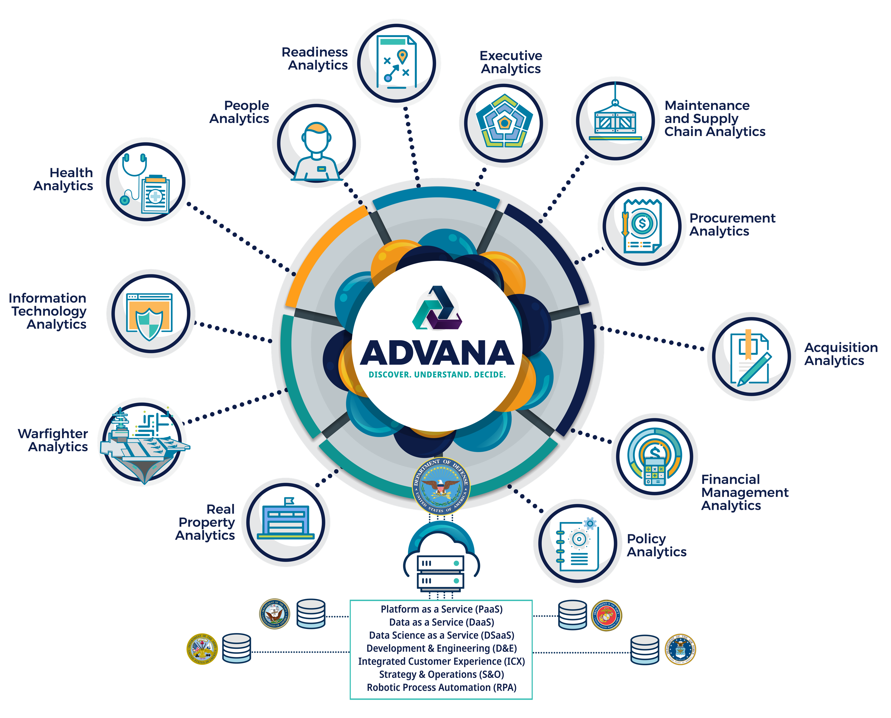
What is Advana?
Who we are
Advana – a mash-up of the words “Advancing Analytics” – is our technology platform, which, in addition to housing a collection of enterprise data, is pushing beyond simply being a data warehouse; we are arming military and business decision makers across the Department with decision support analytics, data management and data science tools, and associated support services.
Our vision
Change decision-making behavior across the DoD enterprise using data and analytics.
Our mission
Make data widely accessible, understandable, and actionable across the DoD enterprise by translating common enterprise data into profound yet actionable insights, decisions, and outcomes.

Slide 9








Advana provides real business value to the Department of Defense
Customer-centric Design
Product design is driven by customer business and mission needs, based on customer input feedback at all organizational levels
Open Architecture with No Vendor Lock-in
Best of breed open source and COTS tools
are built on an open architecture, hosted on
AWS Cloud, with the ability to pull government,
public, and commercial data feeds
Government Owned and Secured
DoD accredited system which can serve as a
long-term steward of business, mission, and
crisis related analytics on NIPR and SIPR
Something for Everyone
Range of ready-built visualizations and self-service options makes Advana relevant and impactful for ALL DoD users – from senior and mid-level decision-makers to analysts, developers, and data scientists
Scaled Agile Flexibility
Program resources leverage Scaled Agile (SAFe)
methodology for planning and delivery, which allows
for collaboration across our team and our
customers as we iterate on solutions together
Single Source of Truth
Thousands of users have access to over 390+
DoD data sources across business domains
(e.g., Personnel, Finance, Supply Chain)
Foundation Built Upon Audit
Improved Data Quality for Trusted Insights
Our platform began as the Universe of Transactions for purposes of financial statement audit, and grew from there. The same audit principles that instill trust in our data for purposes of better decision making are applied to everything we do as a platform. This foundation leads to better business and mission decisions and outcomes via the ability to improve data quality, ask better questions of our data, and in turn, support decision making that creates value for the warfighter

Slide 10
Linking the Operational and Business domains through Data
Operational
Business

Slide 11
Some Final thoughts
The world is changing……and we need to adapt
People are, and will always be our most valuable resource
Data and our ability to use data will be the key to meeting our future challenges
  Doing more with less
  Attracting and retaining a skilled workforce
  Increasing our efficiency and agility
  Making us better business partners

