Slide 1



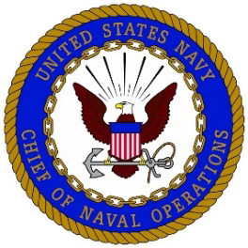
Department of the Navy, Office of Financial Operations
April 22, 2021, Presentation to the NOVA AGA Chapter on
DON Financial Management Transformation

Slide 2
Agenda:
Department of the Navy Goals
FM Workforce Readiness
Enhancing Our Value
Data Analysis
Examples of Obligation and Execution Data Analytics
RPA Center of Excellence
RPA Examples
Return on Investment
Question & Answers

Slide 3
DON Financial Management Transformation
Primary goals
AUDIT
Execute to the targeted auditability timeline Prioritize and remediate findings Strengthen internal controls Produce compliant and accurate financial reports
BUDGETARY REFORM
Rigorously execute the budget Improve budget execution performance and transparency Increase responsiveness to dynamic operations
CONSOLIDATION OF SYSTEMS
Consolidate and reduce feeder and general ledger systems Standardize Navy ERP processes

Slide 4
VISION FOR THE FUTURE OF FINANCIAL MANAGEMENT:
FM Workforce Readiness
Navy FM&C's aims to drive value for BSO customers, staff, and managers by realigning to a target state focused on insights and analytics
Resulting FM Workforce of the Future
Improved service levels offered to customers by prioritizing the highest value add activities
Enabled staff through standardized reporting and accounting procedures and by performing transactional activities through automation, AI, and shared services
Empowered managers to focus on value-adding activities (e.g., budget formulation/execution, internal controls, financial analysis)
FM&C to continue providing overarching vision and policy guidance in addition to support functions
Optimize systems by modernizing tools and leveraging technology
Enhance processes by standardization, reducing duplication, and improving auditability
Invest in workforce through upskilling and "CFO of the Future" best practices

Slide 5

VISION FOR THE FUTURE OF FINANCIAL MANAGEMENT:
Enhancing our value
Fix the Foundation
Standardize business processes
Get control over financial operations
Focus on Performance
Establish performance metrics aligned to strategy
Tie execution performance & cost data to planning
Harness the Power of Data
Get to a single, visible source of truth
Leverage accelerators (e.g., Advana, automation)

Slide 6
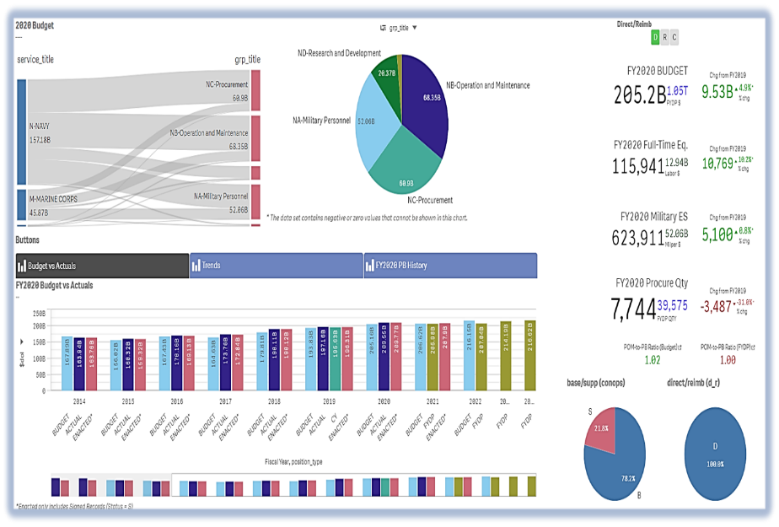
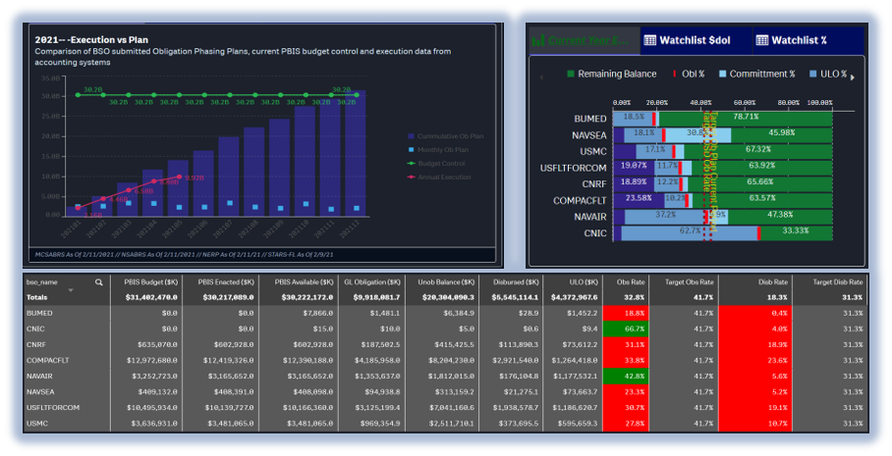
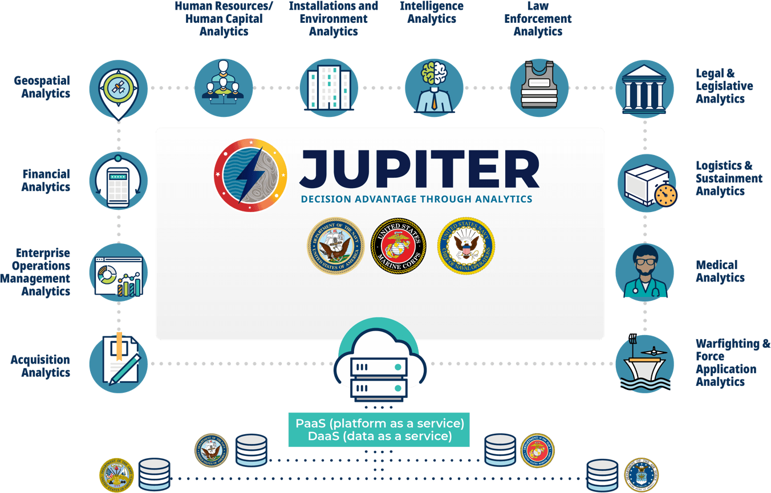
DON Financial Management Transformation
Data analysis
The Opportunity: DON data has been siloed in disparate systems and organizations, making it nearly impossible to conduct simple enterprise-wide analysis.
The Value Proposition: FM Standard Enterprise data with Speed of Relevance (near real time) –
  The DON requires an agile FM systems architecture that fast, efficient, and provides real-time access to financial information to enable data-driven decisions that can rapidly evolve to meet the demands of constantly changing operations.
  Deploy user driven analytics prioritized to meet pressing business and audit needs
President’s Budget Application
CFO Dashboard Application

Slide 7
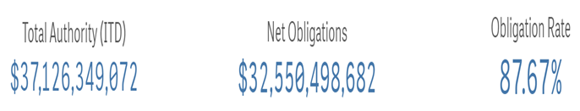
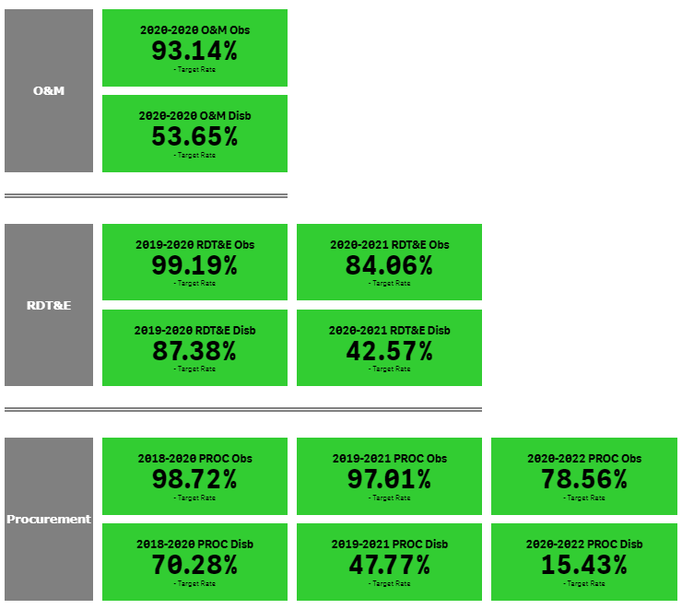
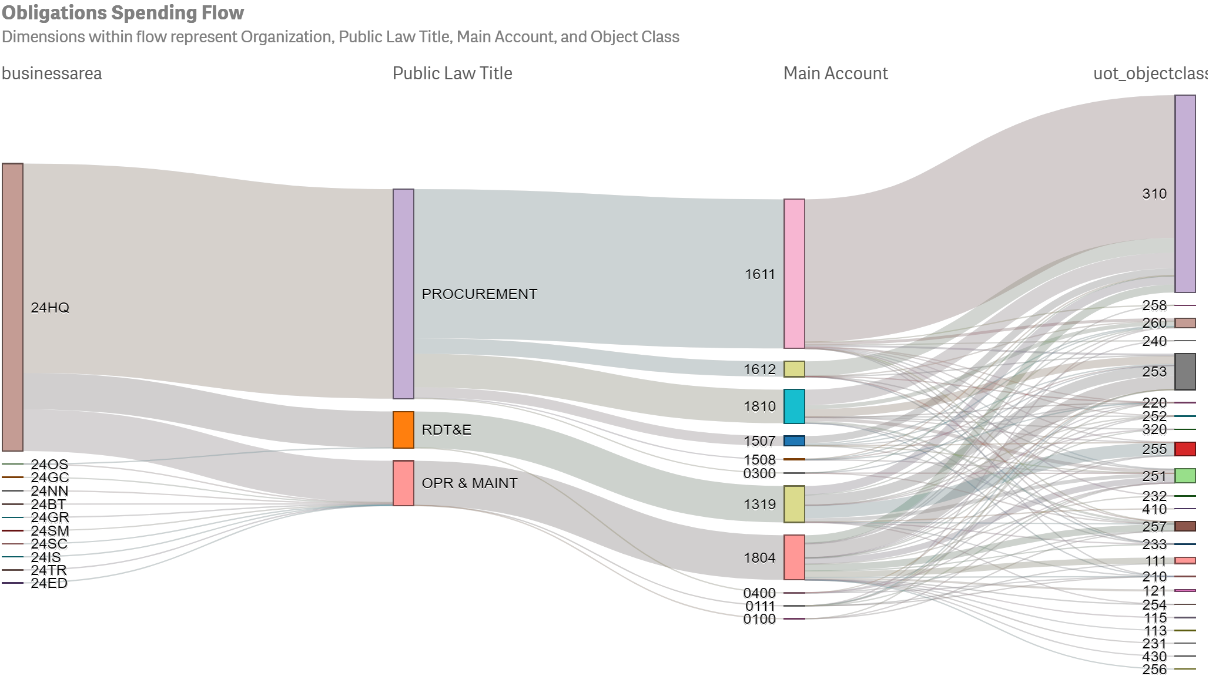
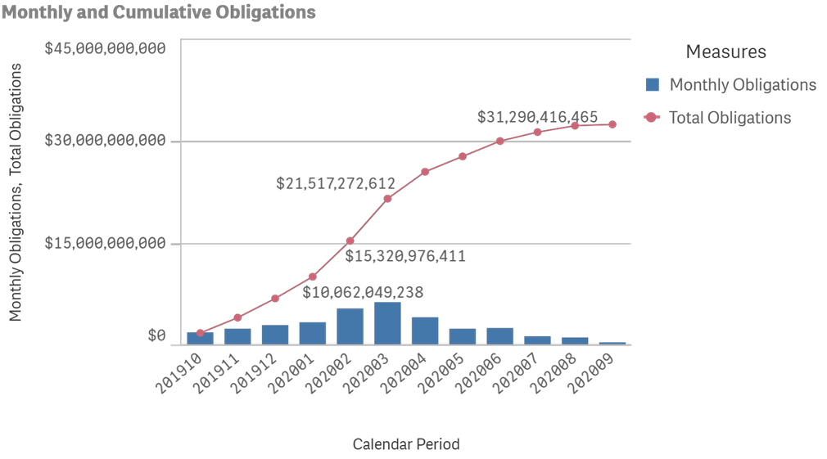
Sample execution review (FY20)
Our
Goal

Slide 8
FMS RPA Center of Excellence (CoE)
The RPA program is aligned with the Financial Management and Comptroller (FM&C)’s goals of Audit, Budgetary Reform, and Consolidated Systems and serves as governing body for financial management automation implementations across DON.
Govern & Develop FM Bots
Drives the lifecycle of automation efforts for use cases submitted to the CoE through development to production. In addition, the CoE offers bots as a service across Commands, BSO(s), and Syscoms for applicable use cases.
Mission
To promote the use of intelligent automation tools across the DON that enables agile business operations which enhance mission capability of the warfighter.
Change Management & Strategic Communications
Coordinate with and inform Commands, Syscoms, and BSO(s) of current automations to identify areas where automations can be scaled and training needs across organizations.
Maintain Bot Inventory
Manage intake and prioritization process for use cases received for FM automation opportunities.
Center of Excellence
Vision
Business operations, powered by intelligent automation, provides strategic advantage to warfighter.
Stakeholder Coordination
Manage Vendor Relationships
Coordinate across Commands, Syscoms, and BSO(s) and DoD RPA leaders to share and gather lessons learned and best practices.
Community of Practice
Collaborate with vendors to ensure software issues are addressed in a timely fashion and requisite license needs are met.
Drive Navy RPA CoP to share best practices and avoid duplication of efforts.

Slide 9
Robotic process automation efforts
The DON implemented Robotic Process Automation (RPA), or “bots,” to increase efficiency and accuracy within audit efforts, as well as ERP migration efforts. RPA increases back-office efficiency and capacity to directly support the Warfighter and mission needs. Automating manual and repetitive processes allows our workforce to focus their time on critical analysis and perform more interesting and meaningful work.
As of March 2021, 29 DON bots have been deployed, of which nine are FM&C with an additional three automations to be deployed in April 2021.
As of 6 April 2021, the DON has deployed 29 RPA bots achieving an estimated savings of 70k labor hours. The DON has an additional 81 automations in development with an additional anticipated labor hour savings of 67K hours.
To support audit, the Navy developed bots to assist remediating auditor findings. For example, one bot helps Navy respond timely to auditor’s requests for key supporting documentation. This bot addresses an audit finding that Navy is unable to respond timely to audit inquiries.

Slide 10
RPA Example:
Accountable Property Systems of Record (APSR) Bot at FMO
Process Description: Bot to support quarterly Budget Submitting Office (BSO) reconciliations of asset listings from their APSRs or supporting (Feeder) systems against their Trial Balance values.
High Level Process
Navigate to ARC Website
Navigate to Folder Location
Select and save each file for the current quarter
Transfer Data to APSR Reconciliation Workbook
Save APSR Reconciliation Workbook
Bot navigates to the ARC website to download the Asset Listings and supporting documentation.
Bot navigates to the Asset Universe tab to retrieve the files for the current quarter and fiscal year.
Bot navigates to the Asset Listings, Trial Balances Certification letters for each BSO and saves each file to a local folder.
Bot copies data pulled from each asset listing and supporting documentation into the APSR Reconciliation Workbook
Bot saves the workbook to the shared location for process owners, FMO stakeholders and auditors to perform their reviews.
Impact
Ability to quickly download over 200+ files in a timely manner on a quarterly basis
Improved financial management across (BSO)s
Increased Data Readiness
81% Time Savings
VS
Bot
3 hours /Quarter
Human
16 hours / Quarter

Slide 11
RPA Example:
Defense Departmental Reporting System budgetary (DDRS-B) at FMO
Process Description: Bot to support the process for DDRS-B report pull on a quarterly basis. This process often requires staff to stay beyond normal working hours waiting for DDRS-B to load, in order maintain the reporting timeline.
High Level Process
Navigate to DDRS-B
Download Report
Access Report to Retrieve Link
Save Reports
Email Reports
Bot navigates to DDRS to access requisite PDF reports for download.
.
Bot downloads and saves PDF files to the process owner’s local drive.
Bot navigates to the downloaded PDF files and extrapolates requisite links to download the financial reports.
Bot zips all the financial reports and saves them within their respective folder on the process owners’ local drive.
Bot creates new outlook emails and attaches requisite zip files containing the financial reports and sends them to the respective POC(s).
Impact
Increased processing capacity downloading quarterly reports
Improved time saving which provides more opportunity focus on analysis
Reduced risk for manual errors when reconciling the reports
Improved financial management reporting
91% Time Savings
VS
Bot
85 minutes
Human
960 minutes

Slide 12
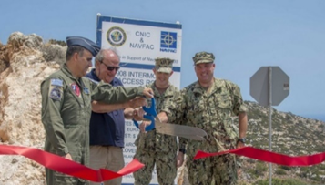
DON Financial Management Transformation
Return on Investments
Returns through cost savings and cost avoidance have exceeded the costs of audit,
enabling re-investment in operational readiness and lethality.
PROPERTY MAINTENANCE FUNDS REINVESTED
100%
Inventory
RP 100% inventory resulted in improved accuracy of inventory records, redeployed maintenance and replacement dollars.
425 non-utility buildings/structures and 504 utilities removed from the inventory and funds earmarked to maintain or replace them repurposed to other projects.
$29M
Found and repurposed
FOUND MATERIAL ENHANCES WARFIGHTER POSTURE
Inventory clean-up initiatives (e.g., NMAC) have identified $2.78 billion in materials to-date for redeployment.
$50 million items used to fill +12 thousand requisitions.
$3.2B
Material identified for redeployment
“Bird in a box” – NAS Patuxent River
OPTIMIZED OBLIGATION MANAGEMENT
BUMED & CNRF increased control over obligations by implementing risk-based contract close-out controls tools to cancel aged obligations, zero out canceled vouchers, and repurpose reimbursable obligations.
$119.3M
Obligations optimized, greater buying power
Super Hornet Tailhook sub-assemblies turned in for repair

Slide 13


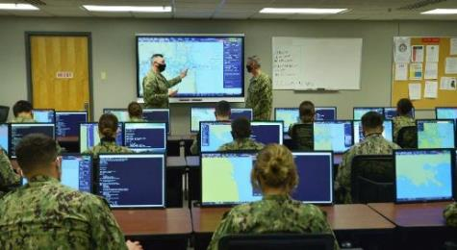
DON Financial Management Transformation
Return on Investments
Returns through cost savings and cost avoidance have exceeded the costs of audit,
enabling re-investment in operational readiness and lethality.
IMPROVED PROCESSES, INCREASED BUYING POWER
Process to Improve Expenditure Efficiency (PIEE)
Budgetary Reform initiative
$3.406 billion in Program Objective Memorandum 19 reductions across appropriations.
Ensured spending power is optimized by reducing the
de-obligation of cancelled or expired funds.
$3.4B
Greater buying power
IMPROVED MANAGEMENT STRETCHES MILITARY PCS FUNDS
BUPERS used statistical analysis and historical Permanent Change of Station (PCS) data to compare estimated & actual costs, which identified unliquidated obligations for re-use.
$36M
De-obligated & reused
ENHANCED EFFICIENCY OF IT BUSINESS SYSTEMS
(STARS-HCM, DIFMS, AND DWAS SHUTDOWNS)
Consolidated IT systems to reduce complexity, improve data flow, and improve internal controls. $19 million saved in recurring maintenance costs for legacy systems.
$19M
Greater buying power

Slide 14
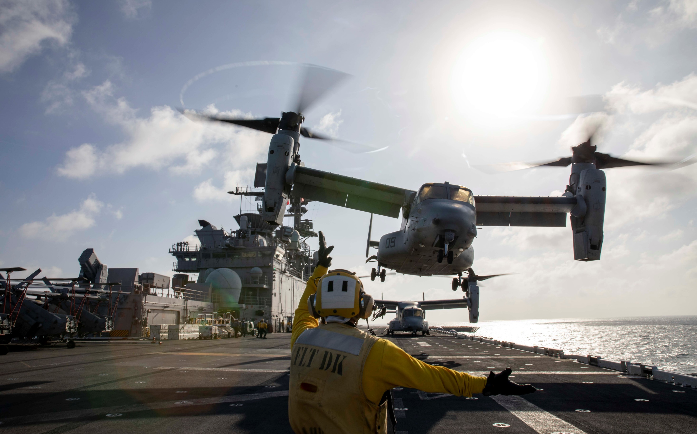
Questions?
Back-Up

Slide 15
DEPARTMENT OF the NAVY Roadmap
2020
2021
2022
2023
2024
2025
2026
2027
Navy General Fund
Aircraft
FBWT
OM&S-Ordnance
A/P-Public
General Equipment Remainder (GE-R)
Leases
Financial Reporting
Audit Opinion
Vessels
CIP
Other Liabilities
A/P-Intragov
OM&S-R
Internal-use Software (IUS)
ELCs
EDL
Buildings & Structures / Utilities
Accounting System Consolidation
LOG IT System Consolidation
Contract Writing System Consolidation
Budget Execution
OM&S - UAE
OM&S - Tridents
Other Liab.: Contingent Legal Liab.
G-Invoicing Implementation
IT General Control Remediation (Navy ERP & NSABRS)
Completed – Prior to FY2020
Accrued Unfunded Annual Leave
Federal Employee & Veteran Benefits
DON Working Capital Fund
Contract Authority
FBWT
Other Liabilities
A/P-Public
General Equipment
Leases
Financial Reporting
Audit Opinion
Other Liab.: Contingent Legal Liab.
Accounting System Consolidation
CIP
A/P-Intragov
Inventory
IUS
ELCs
EDL
Other Assets: Contract Financing Payments
A/R-Intragov
LOG IT System Consolidation
Contract Writing System Consolidation
Budget Execution
G-Invoicing Implementation
Legend
IT General Control Remediation (Navy ERP)
Key FM Transformation Effort
Completed
In-Progress
Behind Schedule – Targeting Completion of Recovery Plan in FY 21
Goal: Obtain USMC Audit Opinion in FY21

Slide 16
Command deployed automations *
# | Name | Description | ABC Alignment | Org. | ROI/Impact
1 | EDW ("Hanz") | Download reports from EDW to refresh data in QlikSense. | Audit | NAVAIR | 89% Reduction in processing time
2 | OMPF BOT | The automation reads the listing of sampled entitlements, accesses MILPAY document repositories, downloads supporting documentation, saves the documentation with unique naming convention. | Audit | BUPERS | Manual process required 20 FTEs reduce to 1 attended Bot runner Bot improves audit response time during external/internal audits and reduces number of FTEs used to pull doc’s
3 | Travel Claims | This automation will perform the intake portion of the travel claim processing function. | Audit | BUPERS | Yearly ROI of 2,158 hrs Facilitates and expedite the intake, upload, and transfer portion of blocks and claims requisite system
4 | Transcript Processing | When a school transcript is received, information needs to be manually entered into a spreadsheet and multiple systems. The bot will automate and expedite the data input in OPINS. | Audit | BUPERS | Yearly ROI of 416 hrs Increased processing capacity and reduction of manual error
5 | FIAR- KSD 1 | Screenshot Load Data for Purchase Requisitions. | Audit | NAVAIR | Yearly ROI of 171 hrs in support of Audit/4 FTEs Increase audit response accuracy and reporting time
6 | FIAR- KSD 2 | Screenshot Load Data for Purchase Orders. | Audit | NAVAIR | Yearly ROI of 25 hrs/4 FTEs Increase audit response accuracy and reporting time
7 | Civilian Discrepancy Report | Bot accesses Business Objects, grabs recent DCPDS and TTFMS reports, updates per specific parameters and to delivers updated BSC / Discrepancy Report to customer. | Audit | NAVAIR | Yearly ROI of 338 hrs
8 | ROSR Document Closeout | Document closeout form automation for ROSR, ROFL, and 448-2 forms. Automation to generate .pdf forms for each type vice manual creation and data entry. | System Consolidation | NAVWAR | Awaiting update from Command
9 | Record of Emergency Data/Dependency Application (RED/DA) Manager Bot | Triages records of Emergency Data/Dependency Application (RED/DA) records; approves/recycles simple records, and leaves pay-impacting records in the queue for humans. | Audit | PSD Norfolk | Awaiting update from Command
10 | Closeout: Form Generator | Generates three types of forms required for the closeout process (ROSR, ROFL & 448-2). | System Consolidation | NIWC LANT | Manual process took 5 minutes to process 1 form Automated process completes 100 forms in 1 minute
* NOTE: The number of deployed bots changes each month as Commands utilize RPA more steadily. Data depicted herein is as of March 2021.

Slide 17
Command deployed automations (continued)
# | Name | Description | ABC Alignment | Org. | ROI/Impact
11 | TRIM BOT | This bot downloads supporting documentation and saves the documentation with unique naming convention to support monthly WINiats testing. Bot will improve audit response time during external/internal audits and reduces number of FTEs used to pull documents. | Audit | BUPERS | Manual process took around 3 days to complete for monthly testing, 2 weeks for audit testing with 20+ FTEs performing the process Automated solution can be run by 1 individual
12 | XK03 RPA | XK03 RPA - Lookup bot to find Vendor assigned to Chare Code. (This is a Lookup "Only"). | Other | NAVSEA | 90% time savings
13 | Open Obligation Clearing | RPA clears outstanding obligations on Purchase Orders with a final Sales Order and the SO amount matches the PO amount. | Audit | NAVSEA | Yearly ROI of 180 hrs
14 | ERP Direct Projects Automation | This BOT automates the creation of Direct Projects for the Spend Plan build. The automation performs data entry for CJ20N transactions based on a template. | Audit | NAVWAR | Awaiting update from Command
15 | Navy ERP Budget Structure Automation | The BOT automates data entry for building out Level 5 Budget Structures and Cost Plans in NERP as part of the Spend Plan Development process. This automates CJ20N and CJ40 ERP transactions based on a template. | Audit | NAVWAR | Awaiting update from Command
16 | Navy Purchase Requisition for Processing | This Bot automates input all data required to initiate contract purchase requisitions (SPS PR) into NERP from an Excel template. Updated in FY20 to add capability to accommodate any Plant, APPN, procurement type, Basic and Amendments. This automates ME51N and ME52N ERP transactions. | Audit | NAVWAR | Awaiting update from Command
17 | eMASS Data Extraction & Data Visualization | Automates the extraction of data from eMASS that is not exposed to the inherent reporting function. Bot logs into eMASS and systematically browses to a specified set of systems and extracts associated RMF data (e.g., CCI compliance, POA&M entries). This data is then used to develop Data visualizations for leadership awareness and decision-making. | Audit | NAVWAR | Awaiting update from Command
18 | PCAP Data Transformation | Automates the data transformation of raw packet capture (PCAP) data so it can be visualized and analyzed to identify bottlenecks in network traffic. Previously this data transformation relied on user input to a SQL database that took nearly 8 hours. | Other | NAVWAR | Awaiting update from Command
19 | Project Performance Metrics | Daily automation pull from SharePoint to update internal CIC performance metrics. | Other | Navy BUMED | Utilized to track internal performance of projects regarding KPIs
20 | Message Traffic Consolidation | Daily automation pull from the OIX Message Traffic to collect all messages to/from Navy BUMED from the previous day. | Other | Navy BUMED | Yearly ROI of 640 hrs Candidate as POC for unattended implementation

Slide 18
FM&C deployed automations
# | Name | Description | ABC Alignment | Org. | ROI/Impact
21 | Accountable Property Systems of Record (APSR) | Bot to support quarterly Budget Submitting Office (BSO) reconciliations of asset listings from their APSRs or supporting (Feeder) systems against their Trial Balance values. | Audit | FMO 4.1 | 81 % increase in processing capacity Ability to quickly download over 200+ files in a timely manner on a quarterly basis Improved Financial Management Budget Submitting Offices (BSO)s Increased Data Readiness
22 | Unmatched Transactions (UMT) Automation | The automation supports BSO identification of the authoritative source of inaccurate data that causes a transaction to fail a systemic three-way match control. | Audit | BUPERS | 99% increase in processing capacity Ability to process weekly 20,000 Unmatched Transactions Allows BUPERS to process all transactions vs prioritizing a select few Increased Auditability
23 | Inventory Audit Home Guard | Bot to support the on hand, due-in quantity and transaction history for Existence and Completeness NIIN(s) selected by the IPA during quarterly audits. | Audit | NAVSUP | 50% increase in processing capacity Elimination of risk of manual errors transposing NIIN numbers Reduced risk for incomplete responses Standardized documentation for IPA Improved financial management reporting
24 | Electronic Document Access (EDA) Extraction | The EDA extraction automation performs daily contract downloading, parsing, and searching for DoDAAC’s. A report is created and then emailed out to different POCs if there is a matching contract identified per requirements. | Audit | NSMA | 50% increase in processing capacity Improved throughput of EDA contracts Decreased processing time allowing for process owners to focus on high value tasks
25 | Pre-Validation | The Pre-validation automation searches for and prints denied accounting pre-validation authorization requests. | Audit | NSMA | 50% increase in processing capacity Improved throughput of completed pre-validation authorized requests Decreased processing time allowing for process owners to focus on other high-value tasks
26 | Step 1 Table Updates | The BUPERS Step 1 Table Updates automation updates the Change of Station report in preparation for submission to the Enlisted Assignment Information System (EAIS) or Officer Assignment Information System (OAIS). | Audit | BUPERS | 90% increase in processing capacity Improved throughput of completed table updates Significant reduction and/or elimination of manual entry errors Increased auditability of all contract closed/de-obligated
27 | SMARTS Daily Reports | The automation daily report downloads reports from CFMS and SMARTS to use in the tracking, correction, and budgeting of funds for the entire BSO. Each report provides a different level of visibility of funds and can be tied to multiple accounting systems | Audit | FMB-7 | 40% increase in processing capacity Ability to download multiple reports for multiple FYs on a daily basis Provides key supporting documentation and data for audit reviews Supports budgeting of funds for FMB-7
28 | STARS-FL Contract De-obligation | Bot to support the close out of and de-obligation of dormant contracts in STARS-FL which will result in time savings for contracting specialists, eliminate old obligations from the DARQ report, and enable DON’s effort in the consolation of General Ledger systems | Consolidated Systems | NAVSUP | 97% increase in processing capacity Accelerate and improve the accuracy of the completion of over 8,000 contract closeouts through automating the STARS-FL data cleansing efforts across more than 10 Budget Submitting Offices (BSOs) Reduce manual error rate
29 | DDRS-B GF/WCF Report Download | Bot to support the process for DDRS-B report pull on a quarterly basis. This process often requires staff to stay beyond normal working hours waiting for DDRS-B to load, in order maintain the reporting timeline. | Budgetary Reform | FMO 4.1 | 91% increase in processing capacity Increased processing capacity downloading quarterly reports Improved time saving which provides more opportunity focus on analysis Reduced risk for manual errors when reconciling the reports

