Slide 1


2014 ANNUAL CONFERENCE
Best Practices For Those In Charge Of Governance
& Top Management
Presented by
Marty Mathisen, CPA, CGFM

Slide 2
Protecting Directors, Officers, and Nonprofit Executives From Potential Liability
1. NM Statutory Provisions
  New Mexico statutes provide significant protection for the directors and officers of nonprofit corporations.
  (i) Section 53-8-25 provides that “the directors, officers, employees and members of the corporation shall not be personally liable for the corporation’s obligations.”
  (ii) Section 53-8-25.2 further provides:
  (A) No director of the corporation shall be personally liable to the corporation or its members for monetary damages for breach of fiduciary duty as a director unless:
  (1) the director has breached or failed to perform the duties of the director’s office in compliance with § 53-8-25.1 NMSA 1978; and
  (2) the breach or failure to perform constitutes willful misconduct or recklessness.

Slide 3
53-8-25.1 Duties of Directors
A director shall perform his duties as a director including his duties as a member of any committee of the board upon which the director may serve, in good faith, in a manner the director believes to be in or not opposed to the best interests of the corporation and with such care as an ordinary prudent person would use under similar circumstances in a like position. In performing such duties, a director shall be entitled to rely on factual information, opinions, reports or statements including financial statements and other financial data in each case prepared or presented by:
One or more officers or employees of the corporation whom the director reasonably believes to be reliable and competent in the matters presented;
Counsel, public accountants or other persons as to matters which the director reasonably believes to be within such person’s professional or expert competence; or
A committee of the board upon which the director does not serve, duly designated in accordance with a provision of the articles of incorporation or the bylaws as to matters within its designated authority, which committee the director reasonably believes to merit confidence, but the director shall not be considered to be acting in good faith if the director has knowledge concerning the matter in question that would cause such reliance to be unwarranted.
History: 1978 Comp., § 53-8-25.1, enacted by Laws 1987, ch. 238, § 5.

Slide 4

Section 1 – Oath Of Office
Every person elected or appointed to any office shall, before entering upon his duties, take and subscribe to an oath or affirmation that he will support the constitution of the United States and the constitution and laws of this state, and that he will faithfully and impartially discharge the duties of his office to the best of his ability.

Slide 5
Governmental Conduct Act
A legislator or public officer or employee shall treat the legislator’s or public officer’s or employee’s government position as a public trust. The legislator or public officer or employee shall use the powers and resources of public office only to advance the public interest and not to obtain personal benefits or pursue private interests.
Legislators and public officers and employees shall conduct themselves in a manner that justifies the confidence placed in them by the people, at all times maintaining the integrity and discharging ethically the high responsibilities of public service.
Full disclosure of real or potential conflicts of interest shall be a guiding principle for determining appropriate conduct. At all times, reasonable efforts shall be made to avoid undue influence and abuse of office in public service.
No legislator or public officer or employee may request or receive, and no person may offer a legislator or public officer or employee, any money, thing of value or promise thereof that is conditioned upon or given in exchange for promised performance of an official act.

Slide 6
Governmental Conduct Act
Any person who knowingly and willfully violates the provisions of this subsection is guilty of a fourth degree felony and shall be sentenced pursuant to the provisions of Section 31-18-15 NMSA 1978.
A public officer or employee is prohibited from:
directly or indirectly coercing or attempting to coerce another public officer or employee to pay, lend or contribute anything of value to a party, committee, organization, agency or person for a political purpose;
be threatening to deny a promotion or pay increase to an employee who does or does not vote for certain candidates, requiring an employee to contribute a percentage of the employee’s pay to a political fund, influencing a subordinate employee to purchase a ticket to a political fundraising dinner or similar event, advising an employee to take part in political activity or similar activities; or
violating the officer’s or employee’s duty not to use property belonging to a state agency or local government agency, or allow its use, for other than authorized purposes.

Slide 7
Fiduciary Definition
The term fiduciary derives from the Latin fiducia, meaning “trust” and it means that a person acting as a fiduciary for you has a legal or moral obligation to put your needs and interests before any needs or interests of themselves.
“A fiduciary duty is a legal duty to act solely in another party’s interests. Parties owing this duty are called fiduciaries (http://topics.law.cornell.edu/wex/fiduciary). A fiduciary duty is the strictest duty of care recognized by the US legal system.”

Slide 8
Manifestations Of Fiduciary Duty
Minutes approval
Clarity in job descriptions
Defining policies and procedures
Implementing all other controls
Budget adoption
Budget and financial management
Annual external audits
Strategic Plan
Time and talent (Resources)
Utilize specialists and experts
Extended procurements

Slide 9
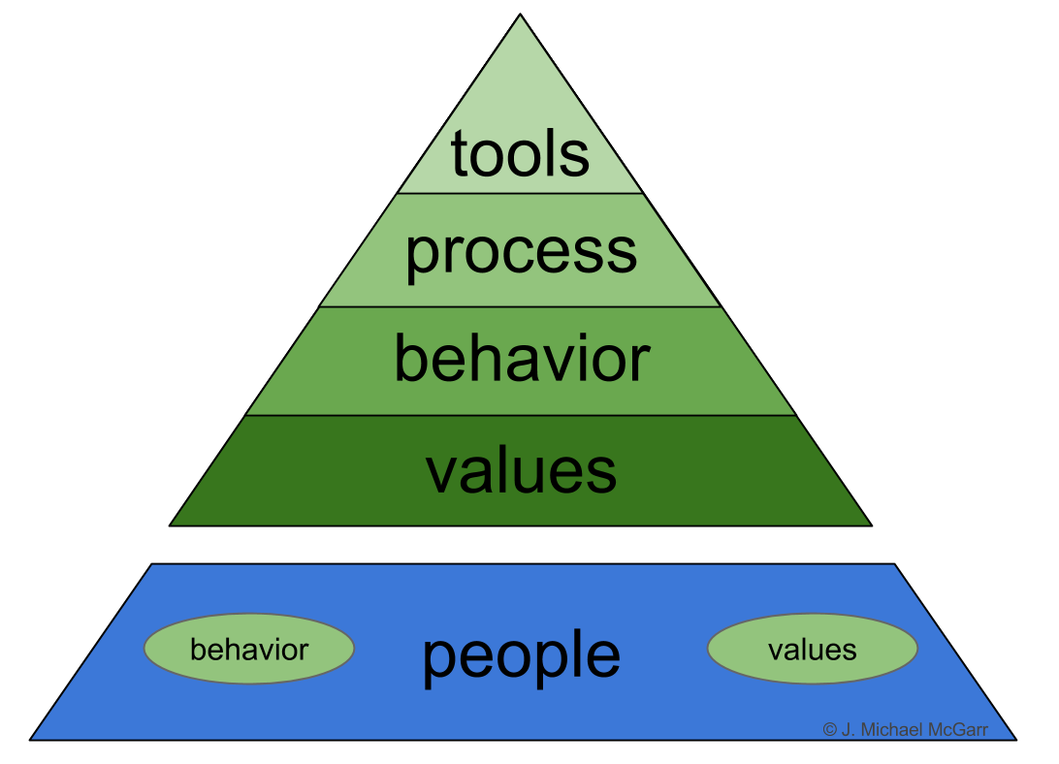
Our Best Asset
Many assets we need to safeguard are not on the balance sheet.
Another asset is your organization’s reputation and brand, perhaps your biggest asset that must be protected.
One of the big assets of an organization is its intangibles including an organization culture. Internal control can help you build an organization culture that is disciplined and that employees appreciate. It literally spells out how you, as an organization, will conduct yourselves.

Slide 10
Board Of Directors And Governance
Role Of The Board
Like a Football Coach in relation to the team – Big picture review of organization
Positively challenge management’s plans and strategies—yet advise and counsel management
Monitor performance and implementation of organization priorities
Understand risks of organization (including internal control risks)
Consult on special transaction deals
Consider Code of Conduct
Establish and protect whistleblower channel
Review upload of information from audit/finance committee
Select chief executive officer and other needed talent
Ensure effective organization planning
Ensure adequate resources
Assess Board performance

Slide 11
Board Of Directors And Governance
Linkage between strategic plan and annual plan
Recruit well and boldly
Urgency - 1% better every month
Remain respectful
Focus on solutions
Practice twice as much – positive thinking rather than flaw finding
Monitor risk periodically
The ability to read financial statements
Put aside any personal interests
Make decisions in the organization and stakeholders interests

Slide 12

What Really Matters In Business Success
Information flows
Decision making process
Many executives make gut decisions and filter data to support the decision

Slide 13
Timely Decision Making: Some Principles
“You can’t wait for all possible information…just enough information to give you confidence in the likely outcome of decision. All decisions are educated guesses”

Slide 14
What You Must Have - Tone At The Top
Everyone looks to the leaders for cues, leadership, behavior
5-year olds testing the Tone at the Top
Edward Deming consulting projects demands top management buy-in
Comes down to the CEO
The only way that works is Top Down
The Board takes a hard look at the Tone at the Top
The Board should fulfill its responsibility to evaluate the CEO annually
Code of Conduct and increased communication on other policies

Slide 15
Directors Need To Know
Fine print on many Director’s Errors and Omissions Policy - If fraud occurs, the E&O Policy goes out the window
Statutorily, the Board has a fiduciary responsibility to the organization
Internal control if strong is a framework that allows the Board to exercise additional oversight
Audit Committees helps ensure the Board will hear “bad news” from auditors
Board has a responsibility for the “Tone at the Top” (wouldn’t want to be a Board member with a crummy “Tone at the Top”)

Slide 16
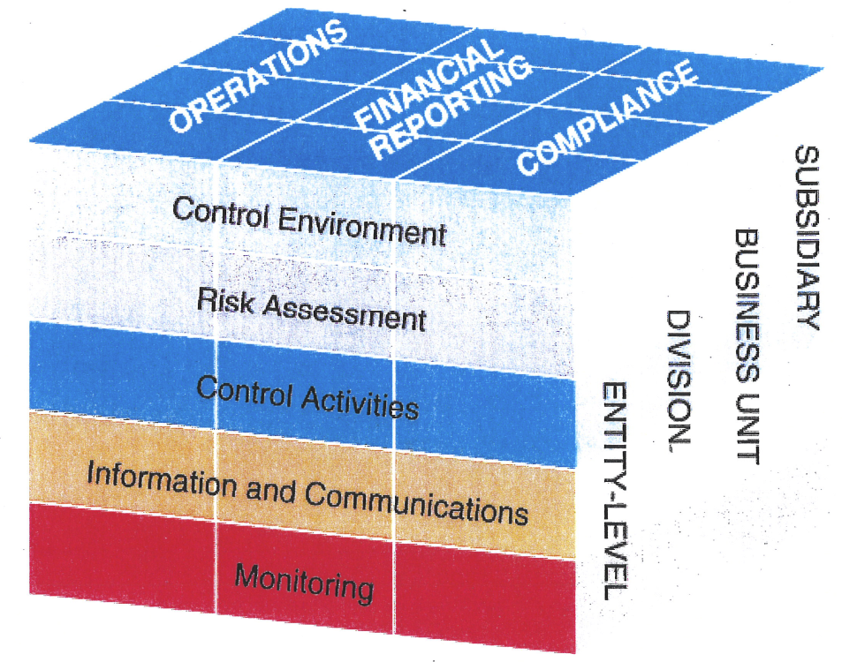
Internal Controls are the Boards best friend

Slide 17
What You Must Have!
Must have controls over controller, CFO (main accounting person) in instances of fraud 44 out of 50 times it is the controller, must plug in the hole
Controller should not sign checks
Reporting package should be received by clockwork
AJEs approved by someone who can provide effective oversight
What You Do
Give absolute priority to adopting the controls over the controller or CFO

Slide 18
What You Must Have!
Must have controls over cash
Signatures
Text confirmations, ACH Positive Pay
Daily reconciliation between receipts, GL totals and bank deposits
Excessive number of voids, discounts or returns – must account for these documents
CEO or Board member opens bank statement
Independent bank reconciliation approved
If you can automate controls – This is the strongest control
What you do
Focus on daily reconciliation, accounting for all related documents
Take advantage of everything the bank offers in terms of cash controls

Slide 19
Anti-Fraud Culture
If You Had The Following, Could Top
Management Or Others Commit Fraud?
Audit Committee
Bank statements opened first by CEO
Preventative controls
Thorough review of budget variances and metrics
Segregation of duties
Two signatures on checks and wire transfers
Anti-fraud policies and procedures presented to employees
Background checks and bonding
Fraud training program – what could happen and what would it look like
Fraud hotline
Follow Federal sentencing guidelines
Internal Auditor
Strong Board oversight
Controls over the controller

Slide 20
Framework For Decisions
Federal Governments
State Governments
Nonprofits
Strategic Plan
Don’t start with controls
Don’t even start with risk
Start with objectives
Objectives
Risk
Controls

Slide 21
Control Environment
Positive and supportive attitude toward internal control and conscientious management (“Tone at the Top”)
Integrity and ethical values demonstrated by management and staff
Demonstrated commitment to competence
Managerial philosophy and operating style
Organizational structure (lines of authority, responsibility, and reporting)
Human capital policies and practices
  Codes of conduct

Slide 22
Commitment To Competence
Commitment to qualified staff
The right people are in the right positions
Controller is an integral part of the management team
Job descriptions - who really knows their job duties and how to advance
Succession Plan in place for all positions
Are evaluations getting at the core issue of competency?
We have to commit to attracting and retaining the brightest and best

Slide 23
Risks
Reputation
Black swan
Trends – Changes
Business risk
Fraud risk
Competition
Controls, capabilities, competence
R
I
S
K

Slide 24
Are We Quantifying And Prioritizing Our Risks?
Magnitude
3
2
1
6 9
4 6
2 3
1 2 3
Probability
Do we have our objectives clearly defined?
Risk should be on the Board Meeting agenda every time
Risk assessment is owned by the business units with oversight by Board
Both external and internal information coming into the risk assessment
Can get overwhelming with risk identification, need a methodology – review by financial statement line item – what could go wrong
Risk responses – Accept, Insure, Prevent, Minimize & Share

Slide 25
 | Management | Board Governance
Policy | - | 100%
Strategic Direction | - | 100%
Oversight | - | 100%
Management | 100% | -
Administration | 100% | -
Operations | 100% | -
Adhere to Mission | - | 100%
Ultimate high authority responsibility | - | 100%
Information feedback status | 100% | -
Human Resources | 100% | -
Direction to CEO | - | 100%
Tone at the Top | 100% | -

Slide 26
Areas Of Focus
 | Management | Those In Charge Of Governance
Priorities of our Organization | - | -
Mission of our Team | 20% | 80%
Time, talent and resources | 100% | 100%
Retention of employees | 75% | 25%
Strength of Internal Controls | 50% | 50%
Concern with quality of information | 50% | 50%
Strategic Plan | 30% | 70%
Risk Assessment | 70% | 30%
Policies and Procedures | 70% | 30%
Tone at the Top | 70% | 30%
Qualitative/Quantitative Results | 70% | 30%
Commitment to Competence | 70% | 30%

Slide 27

QQQs
Do you have a handle on crucial transaction cycles and risks?
Do you have an overall knowledge of the condition of your organization’s operating strengths and weaknesses?
What are the constraints holding you back?

Slide 28

The Effective Executive
by
Peter Drucker
The Effective Executive
What is the most important thing I can contribute?
What needs to be done?
Are we really taking the best actions based on the purpose of our organization?

Slide 29
Non Regular Agenda Items
Strategic Plan status accomplishments
Gains to the organization
Risk management on every agenda
Link agenda items to goals
Follow up on previous action items
Pareto principle
Consent agenda
agenda

Slide 30

Committees - Functions
Recruitment
Finance/Audit
Executive
Development

Slide 31

Newspaper Test
How would your actions, decisions look in the paper next day?

Slide 32
Ten Building Blocks For Success
Have a clear mission, vision and strategy
Follow the highest ethical standards
Organize according to best practices in governance and management
Attract and reward the best people possible
Actively seek support from sponsors and donors
Focus on quality – get it done right the first time
Have sufficient resources to accomplish each task
Face externally into the world; avoid an inward focus – your organization exists to serve others not itself
Value institutional memory – learn from your successes and failures
Become and remain transparent to all of your stakeholders
E
S
C
S
U
C
S

Slide 33
The Definition Of Responsibility
Who is on the line if something goes wrong?
Taking steps to ensure a positive outcome

Slide 34

Systems Approach To Business
When something bad happens, the usual response is “who is to blame”
The better response is “what is it about our systems that allows that to happen?”
You will get what your systems will deliver

Slide 35

Dashboard Or Report Card Of Key Metrics
Thoroughly investigate any result you get that is unexpected and significant
Don’t settle for surface explanations – get to granite level – Root cause!
Drama is a circumstance that should be identified and on alert
Relevant metrics – If the metric reports positive – Company is succeeding

Slide 36
Thoroughly Investigate Budget Variances
Detection control
Get down to granite – Root cause!
Test to support on some not just to responses
Inspect don’t expect

Slide 37

Board Diversity
Board should diversify its experience, skills and ethnicity
Maximize Resources
Consider Stakeholders
Different Perspective

Slide 38
As A Board Member I will:
listen carefully to my colleagues.
respect the opinion of fellow board members.
respect and support majority decisions of the board.
recognize that all authority is vested in the full board only when it meets in legal session.
keep well-informed about developments relevant to issues that may come before the board.
participate in board meetings and actions.
bring to the attention of the board any issues I believe will have an adverse effect on those we serve.
attempt to interpret the needs of those we serve, and interpret the actions of those we serve.
refer complaints to the proper level in the chain of command.
recognize that my job is to ensure that my organization is well-managed, and not to manage its staff.
represent all those whom we serve, not just a particular geographic area or interest group.
Consider myself a “trustee” and do my best to ensure that my organization is well maintained, financially secure, growing and always operating in the best interest of those we serve.

Slide 39
As A Board Member I Will:
always work to learn how to do my job better.
declare conflicts of interest between my personal life and my position on the board and abstain from voting or discussion when appropriate.
As A Board Member I Will Not:
criticize fellow board members or their opinions, in or out of the board room.
use my organization for my personal advantage or that of my friends and relatives.
discuss the confidential proceedings of the board outside the board room.
promise before a meeting how I will vote on any issue.
interfere with the duties of the administrator’s authority with staff members.

Slide 40
Operating Policies & Procedures
Minimize Risk
Clarifies expectations
Documents intent to comply
Great orientation tool
Can allow for quick action when noncompliance identified
Can help define control environment
Can strengthen internal controls
Once established – every person should comply to the greatest extent possible.

Slide 41

  Where does 85% of your results come from?
  It comes from the first 15% of the process
  So how important is:
  Training
  Planning
  Telling employees why???
  Identifying barriers to success
  Building consensus

Slide 42
Federal Grant Forum
Session 5: Updating Your Policies & Procedures
NFE Must Develop A Business Management System Infrastructure
Personnel policies and procedures
Property policies and procedures
Procurement policies and procedures
Travel policies and procedures
Financial Management policies and procedures
Add a Program Management Plan (PMP) for program/project management.

Slide 43

Governance And Ethics Questionnaire
Long term planning |  | Effective working relationship
Develop and approve policy |  | Community collaboration
Resource development targets set |  | Board generation
Financial reports reviewed |  | Board diversity
Budget approval |  | Risk review
Program reports

Slide 44
Thank You

