Slide 1
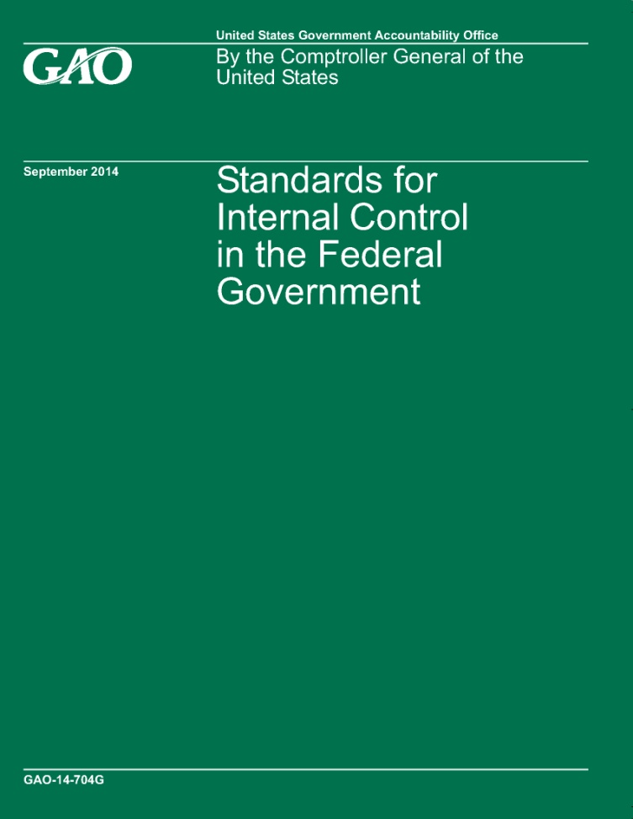
What’s New in Government Internal Control Standards?
Going Green

Slide 2
Session Objective
To discuss GAO’s revision to the Standards for Internal Control in the Federal Government (Green Book)

Slide 3
What’s in Green Book for the Federal Government?
Reflects federal internal control standards required per Federal Managers’ Financial Integrity Act (FMFIA)
Serves as a base for OMB Circular A-123
Written for government
Leverages the COSO Framework
Uses government terms

Slide 4
What’s in Green Book for State and Local Governments?
Is an acceptable framework for internal control on the state and local government level under OMB’s Uniform Guidance for Federal Awards
Written for government
Leverages the COSO Framework
Uses government terms

Slide 5
OMB’s Uniform Guidance for Federal Awards
§ 200.61 Internal controls.
Internal controls means a process, implemented by a non-Federal entity, designed to provide reasonable assurance regarding the achievement of objectives in the following categories:
(a) Effectiveness and efficiency of operations;
(b) Reliability of reporting for internal and external use; and
(c) Compliance with applicable laws and regulations.

Slide 6
OMB’s Uniform Guidance for Federal Awards
§ 200.303 Internal controls.
The non-Federal entity must:
(a) Establish and maintain effective internal control over the Federal award that provides reasonable assurance that the non-Federal entity is managing the Federal award in compliance with Federal statutes, regulations, and the terms and conditions of the Federal award. These internal controls should be in compliance with guidance in ‘‘Standards for Internal Control in the Federal Government’’ issued by the Comptroller General of the United States and the ‘‘Internal Control Integrated Framework’’, issued by the Committee of Sponsoring Organizations of the Treadway Commission (COSO).

Slide 7
What’s in Green Book for Management and Auditors?
Provides standards for management
Provides criteria for auditors
Can be used in conjunction with other standards, e.g. Yellow Book

Slide 8
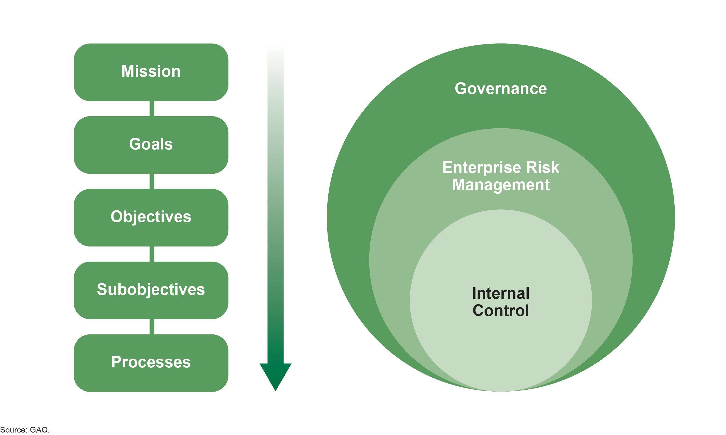
Relationship of Internal Control to the Strategic Plan and Governance

Slide 9
Green Book Through the Years
1983
Present

Slide 10
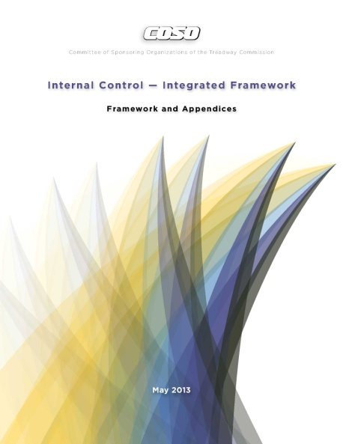
Updated COSO Framework
Released May 14, 2013

Slide 11
From COSO to Green Book: Harmonization
COSO
Green Book

Slide 12
Core Concepts of the Green Book
Relationship of Objectives and Components
Direct relationship between objectives (which are what an entity strives to achieve) and the components (which represent what is needed to achieve the objectives)
The Internal Control Cube depicts the
relationship of:
Three objectives: columns
Five components: rows
Organizational structure: third dimension
Source: COSO, GAO

Slide 13
Revised Green Book: Standards for Internal Control in the Federal Government
Overview
Components

Slide 14
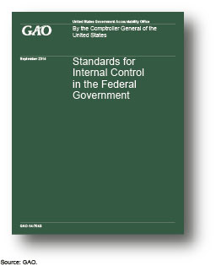
1999 Green Book & 2014 Green Book
All requirements from the 1999 Green Book have been incorporated in the 2014 revision.
The 2014 revision provides more detail of the requirements to help management better understand and implement the standards.

Slide 15
Revised Green Book: Overview
Explains fundamental concepts of internal control
Addresses how components, principles, and attributes relate to an entity’s objectives
Discusses management evaluation of internal control
Discusses additional considerations
Overview
Components

Slide 16
Fundamental Concepts
What is internal control in Green Book?
Internal control is a process effected by an entity’s oversight body, management, and other personnel that provides reasonable assurance that the objectives of an entity will be achieved (Para. OV1.01).
What is an internal control system in Green Book?
An internal control system is a continuous built-in component of operations, effected by people, that provides reasonable assurance, not absolute assurance, that an entity’s objectives will be achieved (Para. OV1.04).

Slide 17
Fundamental Concepts (cont.)
Put simply, internal control is a process to help entities achieve objectives.

Slide 18
Fundamental Concepts (cont.)
Management groups objectives into one or more of the following three categories (Para. OV2.18):
Operations - Effectiveness and efficiency of operations (Para. OV2.19)
Reporting - Reliability of reporting for internal and external use (Para. OV2.21)
Compliance - Compliance with applicable laws and regulations (Para. OV2.22)

Slide 19
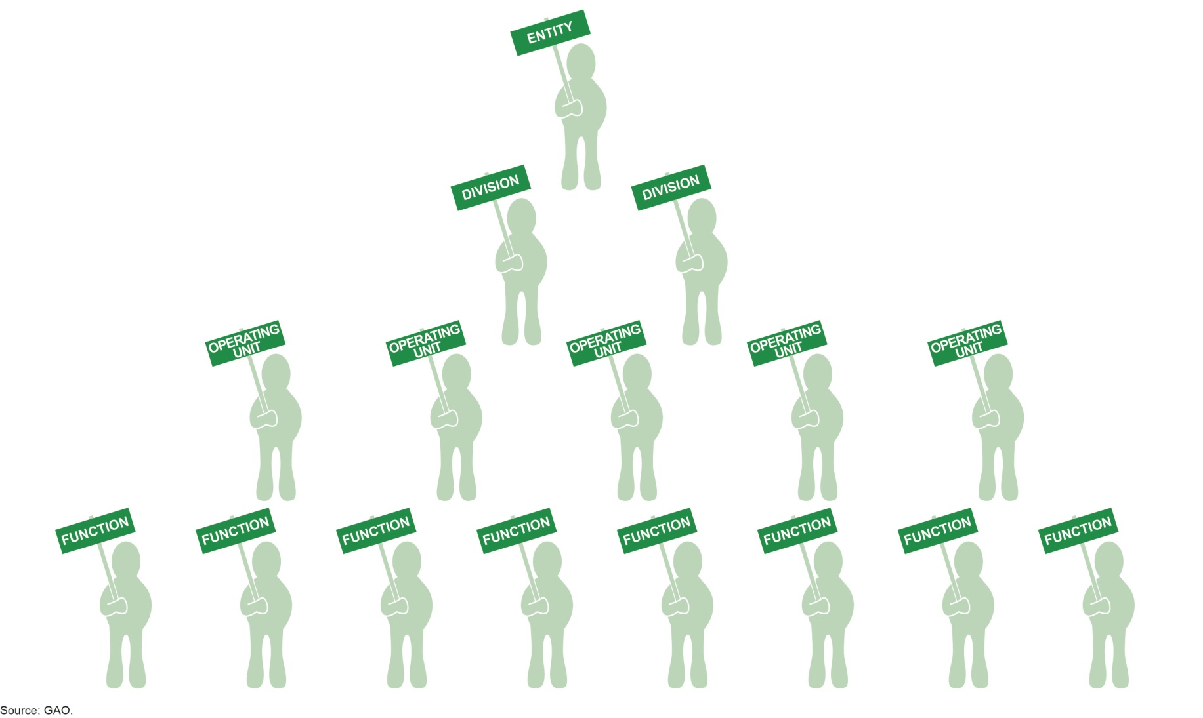
Fundamental Concepts (cont.)
Organizational Structure encompasses the operating units, operational processes, and other structures management uses to achieve the objectives. (Para. OV2.10)

Slide 20
Overview: Components, Principles, and Attributes
Achieve Objectives
Principles
Attributes
Components
Overview
Components

Slide 21
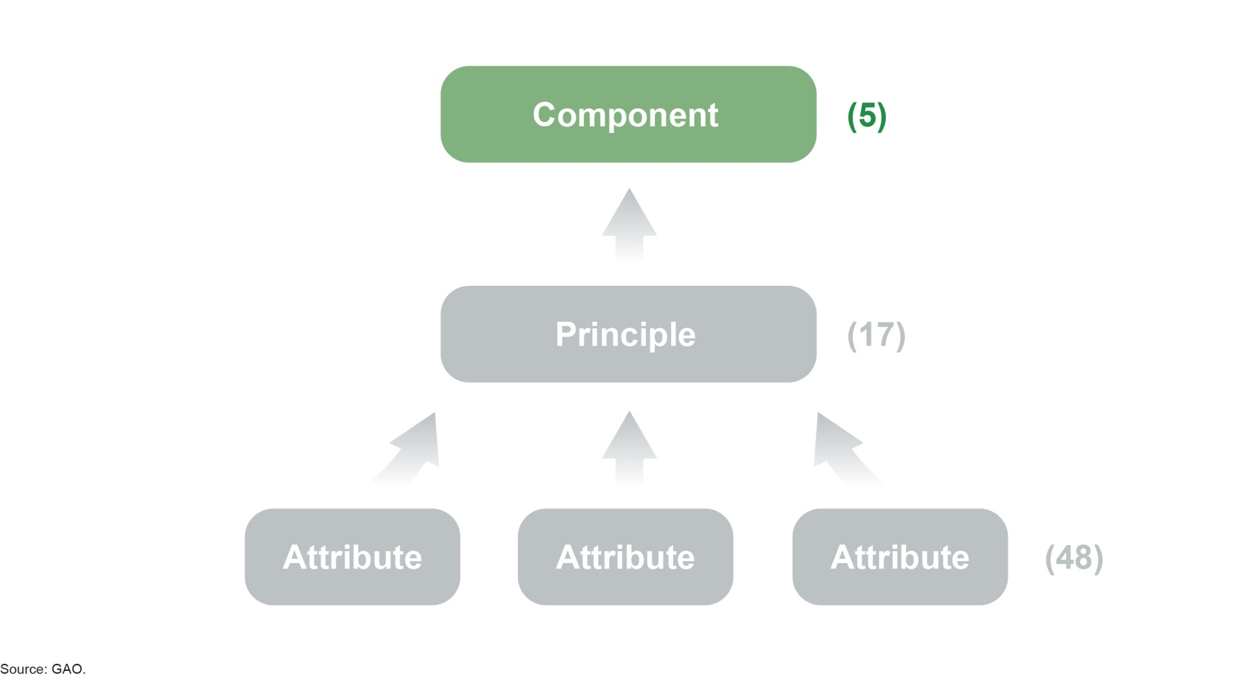
Overview: Components
Components - The five components represent the highest level of the hierarchy of standards for internal control in the federal government and must be effectively designed, implemented, and operating together in an integrated manner, for an internal control system to be effective. (Para. OV2.04)

Slide 22
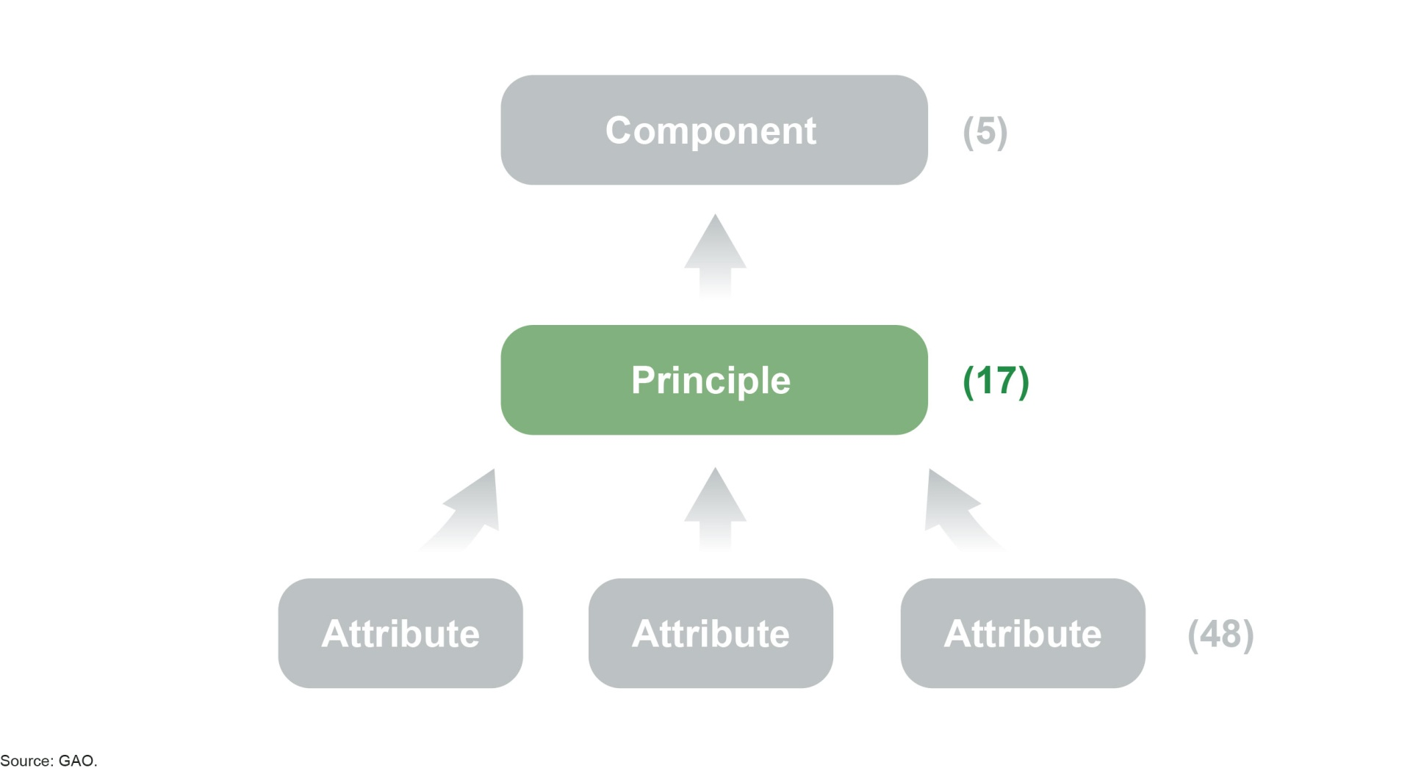
Overview: Principles
Principles - The 17 principles support the effective design, implementation, and operation of the associated components and represent requirements necessary to establish an effective internal control system. (Para. OV2.05)

Slide 23
Revised Green Book: Principles

Slide 24
Components and Principles

Slide 25
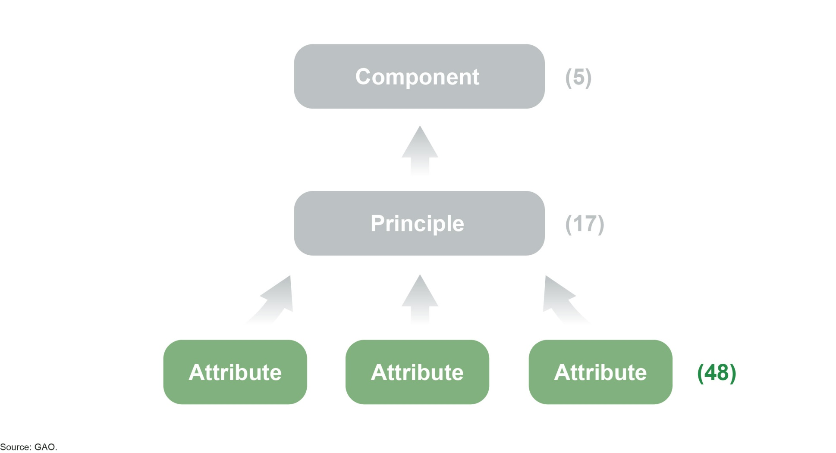
Overview: Attributes
Attributes - Each principle has important characteristics, called attributes, which explain principles in greater detail. (Para. OV2.07-8)

Slide 26
Component, Principle, Attribute

Slide 27
Overview: Components and Principles
In general, all components and principles are
required for an effective internal control system
Entity should implement relevant principles
If a principle is not relevant, document the rationale of how, in the absence of that principle, the associated component could be designed, implemented, and operated effectively
OV2.05: The 17 principles support the effective design, implementation, and operation of the associated components and represent requirements necessary to establish an effective internal control system.
Overview
Components

Slide 28
Overview: Management Evaluation
Overview
An effective internal control system requires that each of the five components are:
Effectively designed, implemented, and operating
Operating together in an integrated manner
Management evaluates the effect of deficiencies on the internal control system
A component is not effective if related principles are not effective
Overview
Components

Slide 29
Overview: Management Evaluation
Overview
Effectiveness of Controls
A control cannot be operating effectively if it was not
effectively designed and implemented.
A deficiency in design exists when:
A control necessary to meet a control objective is missing or
an existing control is not properly designed so that even if the control operates as designed, the control objective would not be met.
A deficiency in implementation exists when a properly designed control is not implemented correctly in the internal control system.
Overview
Components

Slide 30
Overview: Management Evaluation
Overview
Significance of Internal Control Deficiencies
Management evaluates the significance a control
deficiency by considering:
Magnitude of impact: the likely effect a deficiency could have on the entity achieving its objectives and is affected by factors such as size, pace, and duration of the impact.
Likelihood of occurrence: the possibility of a deficiency impacting an entity’s ability to achieve its objectives.
Nature of deficiency: degree of subjectivity involved and whether fraud or misconduct is involved.
Management considers the correlation among different deficiencies or groups of deficiencies when evaluating their significance.
Overview
Components

Slide 31
Overview: Management Evaluation
Overview
Management’s overall determination on control
effectiveness
Management concludes on the design, implementation, and operating effectiveness on each of the five components of internal control by:
Developing a summary determination on the design, implementation, and operating effectiveness of each control principle (related attributes may also be considered) and
Determining the Impact of deficiencies.
The internal control system is ineffective if:
One or more of the five components is ineffective or
The components are not operating together cohesively.
Overview
Components

Slide 32
Overview: Additional Considerations
The impact of service organizations on an entity’s internal control system
Discussion of documentation requirements in the Green Book
Applicability to state, local, and quasi-governmental entities as well as not-for-profits
Cost/Benefit and Large/Small Entity Considerations
Overview
Components

Slide 33
Revised Green Book: Standards
Control Environment
Risk Assessment
Control Activities
Information and Communication
Monitoring
Overview
Components

Slide 34
Revised Green Book: Standards
Explains principles for each component
Includes further discussion of considerations for principles in the form of attributes
Overview
Components

Slide 35
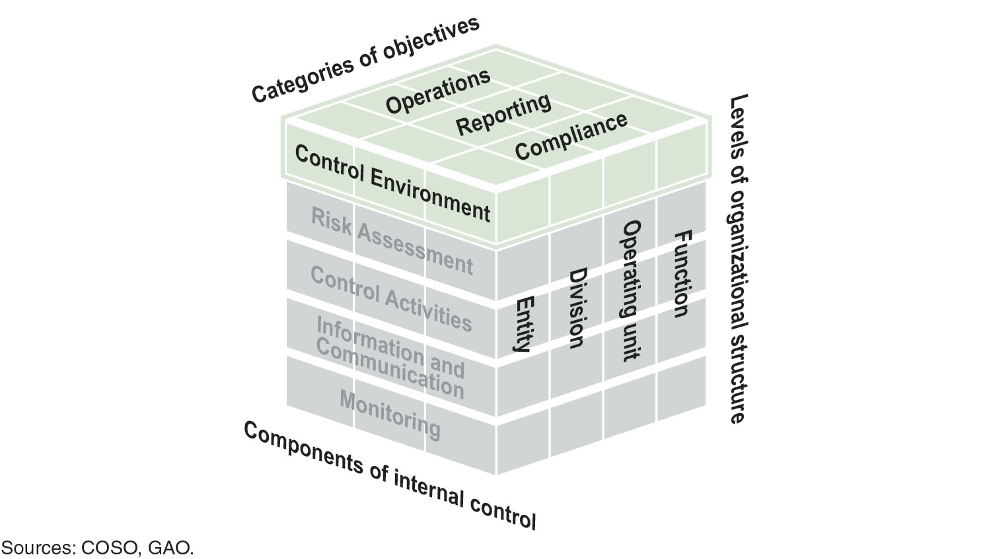
Control Environment
Control Environment - The foundation for an internal control system. It provides the discipline and structure to help an entity achieve its objectives. (Para. OV2.04)

Slide 36
Control Environment

Slide 37
Control Environment Examples that could indicate either effective or deficient internal control
Green Flags:
Management has a developed organizational structure with clearly defined roles.
Programs are in place to train personnel and reinforce standards of conduct.
Internal control is adequately documented and reflects the current operating environment.
Red Flags:
Personnel do not understand what behavior is acceptable or unacceptable.
Top management is unaware of actions taken at the lower level of the entity.
It is difficult to determine the entities or individuals that have responsibility for programs or particular parts of a program.
The entity’s structure is inefficient or dysfunctional.

Slide 38
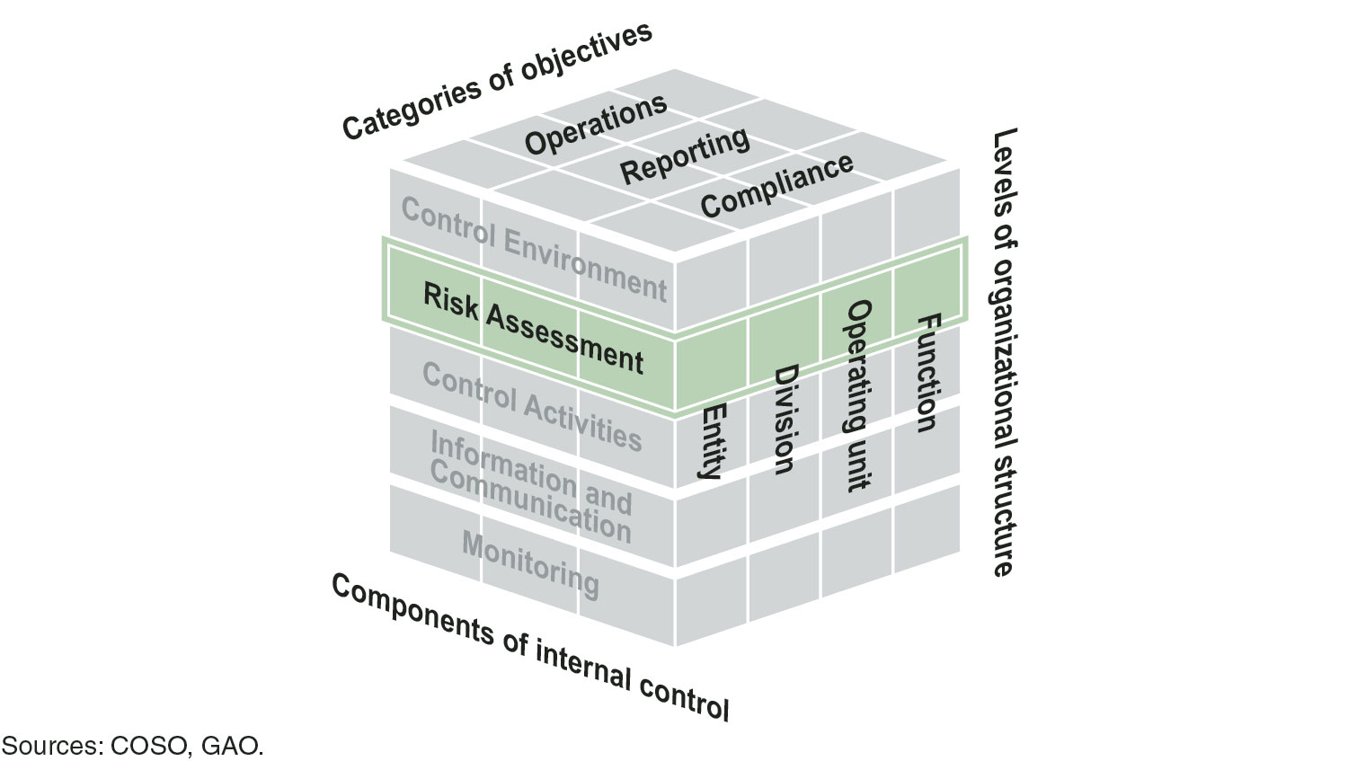
Risk Assessment
Risk Assessment - Assesses the risks facing the entity as it seeks to achieve its objectives. This assessment provides the basis for developing appropriate risk responses. (Para. OV2.04)

Slide 39
Risk Assessment

Slide 40
Risk Assessment - Defining Objectives
Management is to define objectives in specific and measurable terms to enable the design of internal control for related risks. (Para. 6.02)
Specific - Specific terms are fully and clearly set forth so they can be easily understood.
Measurable - Measurable terms allow for the assessment of performance toward achieving objectives.

Slide 41
Risk Assessment - Internal and External Changes
An entity’s risk assessment process needs to capture significant changes that occur both externally and internally. (Para. 9.03)
Internal changes include changes to the entity’s programs or activities, oversight culture, organizational structure, personnel, and technology.
External changes include changes in the governmental, economic, technological, legal, regulatory, and physical environments.

Slide 42
Risk Assessment Examples that could indicate either effective or deficient internal control
Green Flags:
The agency has defined objectives that are easily understood at all levels.
Management acknowledges risk exists and assesses and analyzes risk throughout the agency.
The agency has programs in place to combat fraud, waste, and abuse.
The agency plans for and quickly adjusts to internal and external changes.
Red Flags:
The agency or program does not have well-defined objectives.
The agency or program does not have adequate performance measures.
The agency is unable to prioritize work appropriately.
The agency is unaware of obstacles to its mission.
The agency is not able to overcome obstacles to its mission efficiently or at all.

Slide 43
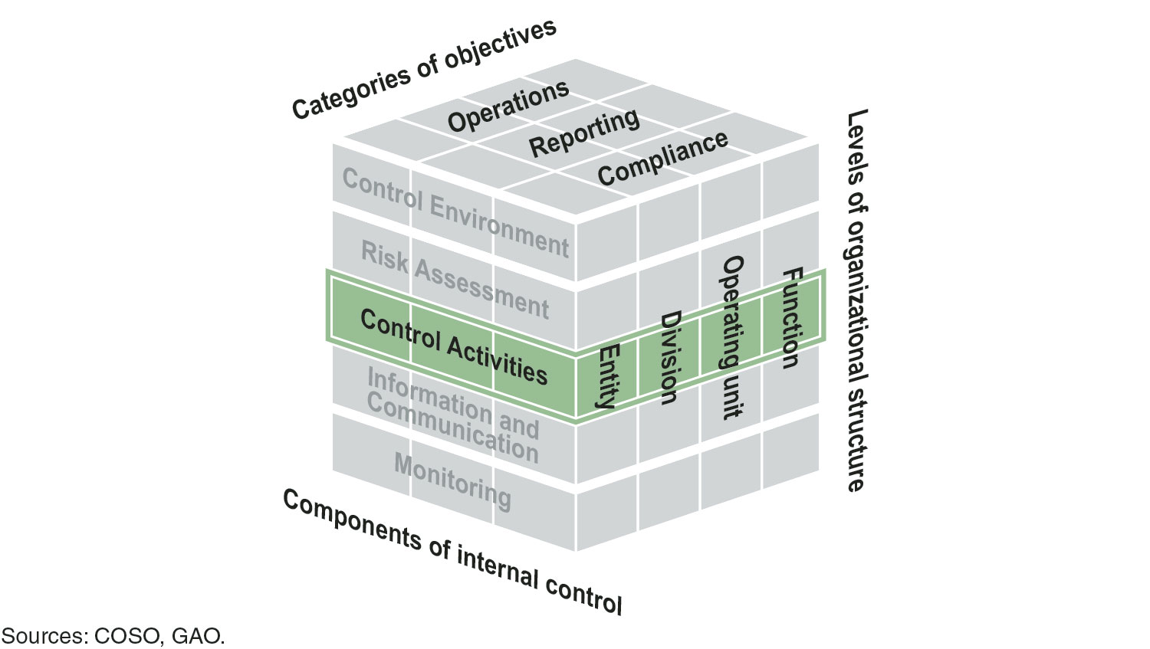
Control Activities
Control Activities - The actions management establishes through policies and procedures to achieve objectives and respond to risks in the internal control system, which includes the entity’s information system. (Para. OV2.04)

Slide 44
Control Activities

Slide 45
Control Activities Examples that could indicate either effective or deficient internal control
Green Flags:
The agency has proper segregation of duties of key duties and responsibilities.
The agency has policies and procedures in place to ensure the safeguarding of assets.
Transactional data is promptly recorded and supported by sufficient documentation.
Policies and procedures are routinely reviewed and updated.
Red Flags:
Employees are unaware of policies and procedures, but do things the way “they have always been done.”
Operating policies and procedures have not been developed or are outdated.
Key documentation is often lacking or does not exist.
Key steps in a process are not being performed.

Slide 46
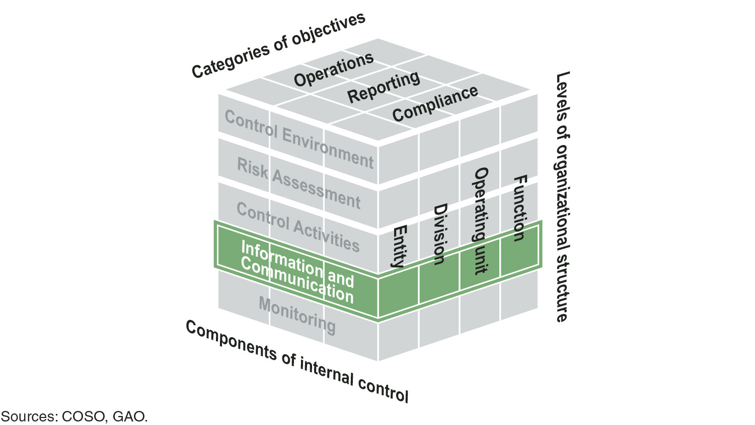
Information and Communication
Information and Communication – The quality information management and personnel communicate and use to support the internal control system. (Para. OV2.04)

Slide 47
Information & Communication

Slide 48
Information and Communication
Quality Information - Information from relevant and reliable data that is appropriate, current, complete, accurate, accessible, and provided on a timely basis, and meets identified information requirements. (Para. 13.05)
Management communicates quality information internally and externally through reporting lines in order to help the entity achieve its objectives and address related risks. (Paras. 14.02-14.03 and 15.02-15.03)

Slide 49
Information and Communication Examples that could indicate either effective or deficient internal control
Green Flags:
Management continually evaluates sources of data to ensure information is reliable and accurate.
Information is accessible and reliable for use internally and externally.
Policy changes implemented by management are known to and implemented by staff.
Red Flags:
Management is using poor quality information or outdated information for making decisions.
Staff are frustrated by requests for information because it is time-consuming and difficult to provide the information.
Management does not have reasonable assurance that the information it is using is accurate.

Slide 50
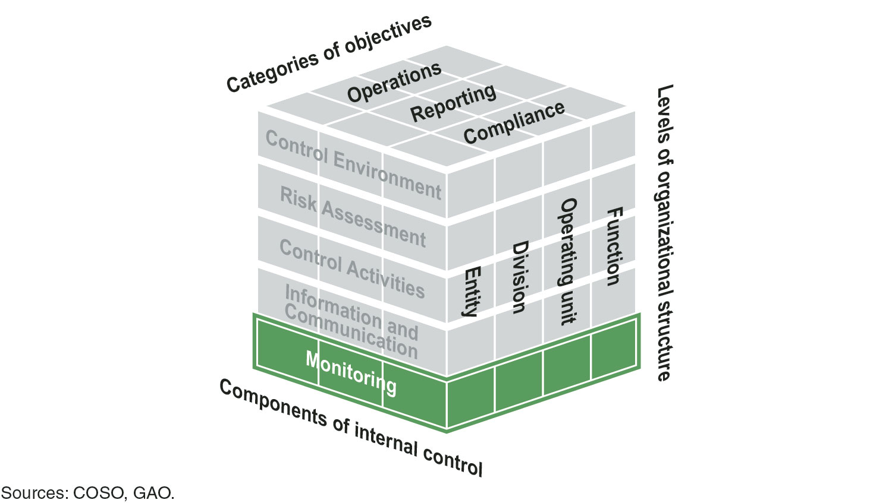
Monitoring
Monitoring - Activities management establishes and operates to assess the quality of performance over time and promptly resolve the findings of audits and other reviews. (Para. OV2.04)

Slide 51
Monitoring

Slide 52
Monitoring
Issue vs. Deficiency
An issue is an unexpected result from a process. Management evaluates issues identified through monitoring activities or reported by personnel to determine whether any of the issues rise to the level of an internal control deficiency. (Para. 17.05)
A deficiency exists when the design, implementation, or operation of a control does not allow management or personnel, in the normal course of performing their assigned functions, to achieve control objectives and address related risks. (Para. OV3.07)

Slide 53
Monitoring Examples that could indicate either effective or deficient internal control
Green Flags:
Management implements changes to control structure to enhance efficiency and effectiveness of procedures.
Documented evaluations exist related to internal control issues.
Corrective action plans are documented and implemented by management to ensure control deficiencies are addressed.
Red Flags:
Management does not evaluate a program on an ongoing basis.
Significant problems exist in controls and management is unaware of problems until a bigger problem occurs.
There are unresolved problems with the other components: control environment, risk assessment, control activities, and information and communications.

Slide 54
Controls Across Components

Slide 55
Documentation Requirements
Documentation is a necessary part of an effective internal control system and is required for the effective design, implementation, and operating effectiveness of the internal control system.
The level and nature of documentation will vary depending on the size and complexity of the entity’s operational processes.
Management uses judgment to determine the extent of documentation needed to meet requirements.
To document an understanding of an entity’s internal control, management may consider developing documents such as:
Policies and procedures manuals
Flowcharts
Tables

Slide 56
Documentation Requirements
Excerpt from OV2.06: If management determines a principle is not relevant, management supports that determination with documentation that includes the rationale of how, in the absence of that principle, the associated component could be designed, implemented, and operated effectively.

Slide 57
Documentation Requirements (cont.)
Control Environment
3.09: Management develops and maintains documentation of its internal control system.
Control Activities
12.02: Management documents in policies the internal control responsibilities of the organization.

Slide 58
Documentation Requirements (cont.)
Monitoring
16.09: Management evaluates and documents the results of ongoing monitoring and separate evaluations to identify internal control issues.
17.05: Management evaluates and documents internal control issues and determines appropriate corrective actions for internal control deficiencies on a timely basis.
17.06: Management completes and documents corrective actions to remediate internal control deficiencies on a timely basis.

Slide 59
Accessibility of Green Book
Comments raised during exposure identified new need:
How do we make the Green Book more accessible to our user community?

Slide 60
The Green Book Layout
Changed the layout of the Green Book itself to make it more user friendly:
Introduced a highlights page
Facsimile page
Graphics throughout the overview and standards

Slide 61
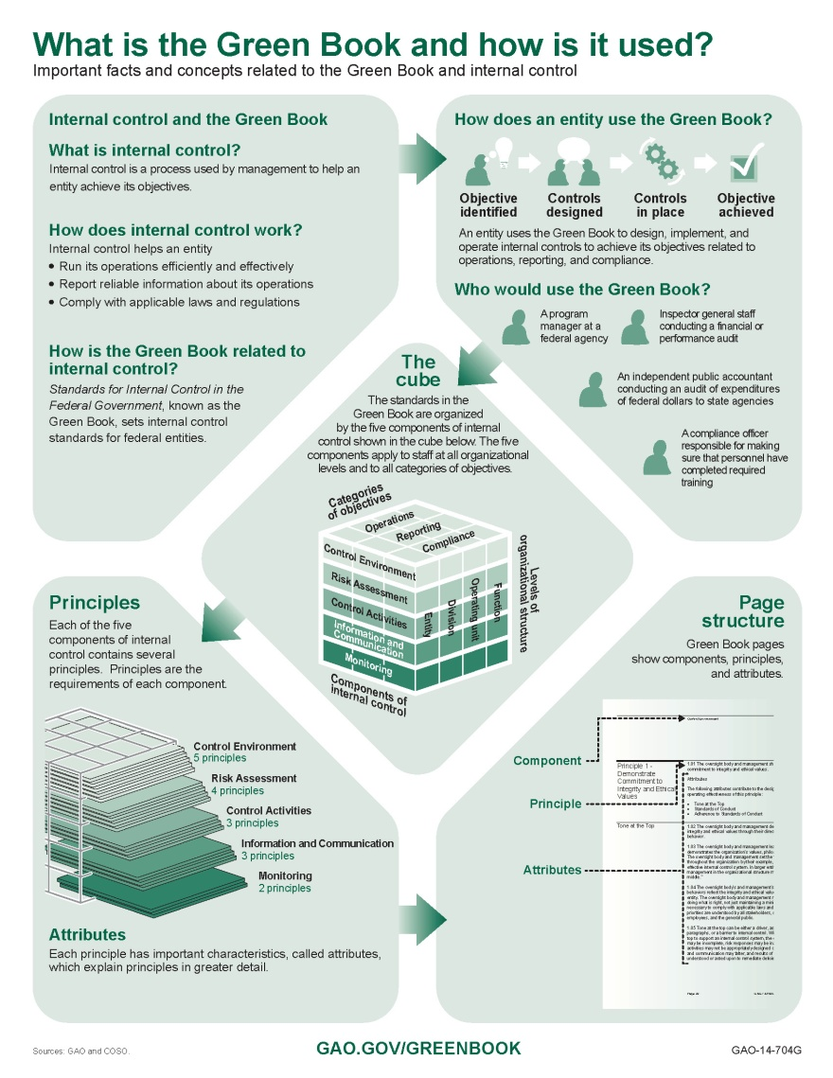
Highlights Page

Slide 62
Facsimile Page

Slide 63
Cube as Navigation Aid

Slide 64
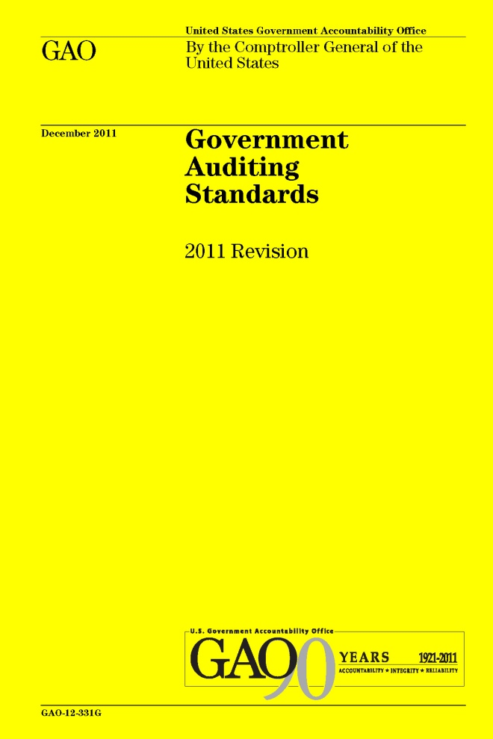
The Green Book in Action
Relationship between the Green Book and Yellow Book
Notes:
64

Slide 65
Green Book and Yellow Book
Can be used by management to understand requirements
Can be used by auditors to understand criteria

Slide 66
The Yellow Book: Framework for Audits
Findings are composed of:
Condition (What is)
Criteria (What should be)
Cause
Effect (Result)
Recommendation (as applicable)

Slide 67
Linkage Between Criteria (Yellow Book) and Internal Control (Green Book)
Green Book provides criteria for the design, implementation, and operating effectiveness of an effective internal control system

Slide 68
The Yellow Book: Framework for Audits
Findings are composed of:
Condition (What is)
Criteria (What should be)
Cause
Effect (Result)
Recommendation (as applicable)

Slide 69
Linkage Between Findings (Yellow Book) and Internal Control (Green Book)
Findings may have causes that relate to internal control deficiencies

Slide 70
Auditor Assessment - Evaluating Design of Internal Control
When evaluating design of internal control, management determines if controls individually and in combination with other controls are capable of achieving an objective and addressing related risks. (Para. OV3.05)
A deficiency in design exists when (1) a control necessary to meet a control objective is missing or (2) an existing control is not properly designed so that even if the control operates as designed, the control objective would not be met. (Para. OV3.05)
There is no need to determine implementation if a control is not effectively designed.

Slide 71
Auditor Assessment - Determining Implementation and Testing Operating Effectiveness of Internal Control
Determining implementation of controls is verifying the existence of design of controls by obtaining evidence.
A deficiency in implementation exists when a properly designed control is not implemented correctly in the internal control system. (Para. OV3.05)
In evaluating operating effectiveness of controls, management [analyst or auditor] determines if controls were applied at relevant times during the period under evaluation, the consistency with which they were applied, and by whom or by what means they were applied. (Para. OV3.06)
A deficiency in operation exists when a properly designed control does not operate as designed, or when the person performing the control does not possess the necessary authority or competence to perform the control effectively. (Para. OV3.06)

Slide 72
Auditor Assessment - Summary of Internal Control Assessments
Evaluating design of controls will not allow you to conclude on internal controls beyond the point of design.
Determining implementation of controls does not provide assurance for a time period of effectiveness. It provides assurance of effective implementation for a point in time when you reviewed documentation (e.g., on March 31, 2016).
A control cannot be effectively operating if it was not effectively designed and implemented. (Para. OV3.06)

Slide 73
Auditor Assessment - Significance of Internal Control Deficiencies
Evaluate the significance of a deficiency by considering the magnitude of impact, likelihood of occurrence, and nature of the deficiency. (Para. OV3.08)
Significance refers to the relative importance of a deficiency to the entity achieving a defined objective. (Para. OV3.08)
Deficiencies are evaluated both on an individual basis and in the aggregate. (Para. OV3.09)
Analysts' and auditors' professional judgment is used in the evaluation.

Slide 74
Effective Date
Green Book effective beginning fiscal year 2016 and for the Federal Managers’ Financial Integrity Act reports covering that year

Slide 75
GAO Green Book Tool
GAO is currently at work on developing an auditor tool as a companion piece to the Green Book.
The Green Book Tool will be designed to assist auditors of federal agencies, as well as other governmental entities, in assessing auditee’s effective internal control and, providing helpful recommendations to agencies.

Slide 76
Where to Find Us
The Yellow Book is available on GAO’s website at:
www.gao.gov/yellowbook
The Green Book is available on GAO’s website at:
www.gao.gov/greenbook
For technical assistance, contact us at:
yellowbook@gao.gov or greenbook@gao.gov
or call (202) 512-9535

Slide 77
Thank You
Questions?

