Slide 1
Preparing for Upcoming GASB’s
The views expressed in this presentation are those of the speaker(s). Official positions of the GASB are reached only after extensive due process and deliberations. Special thanks to GASB for the material in this presentation.

Slide 2
Alan Bowers, CPA
Partner
Carr, Riggs & Ingram, LLC
abowers@cricpa.com
Danny Martinez, CPA, CGFM
Partner
Carr, Riggs & Ingram, LLC
dmartinez@cricpa.com

Slide 3
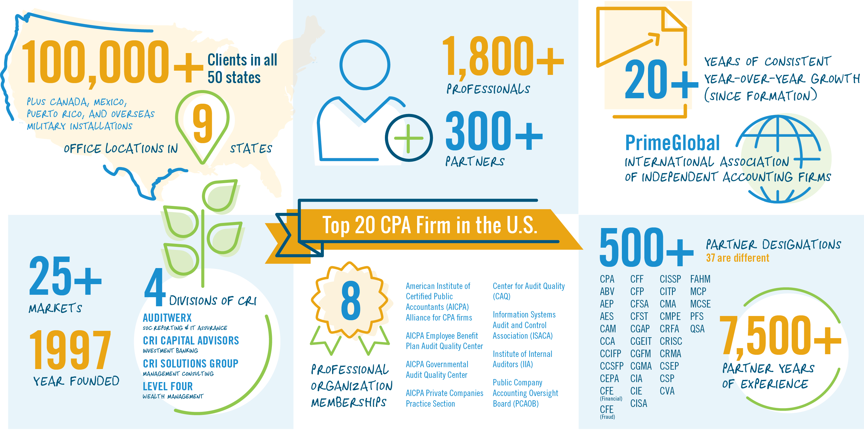
CRI: Statistics

Slide 4
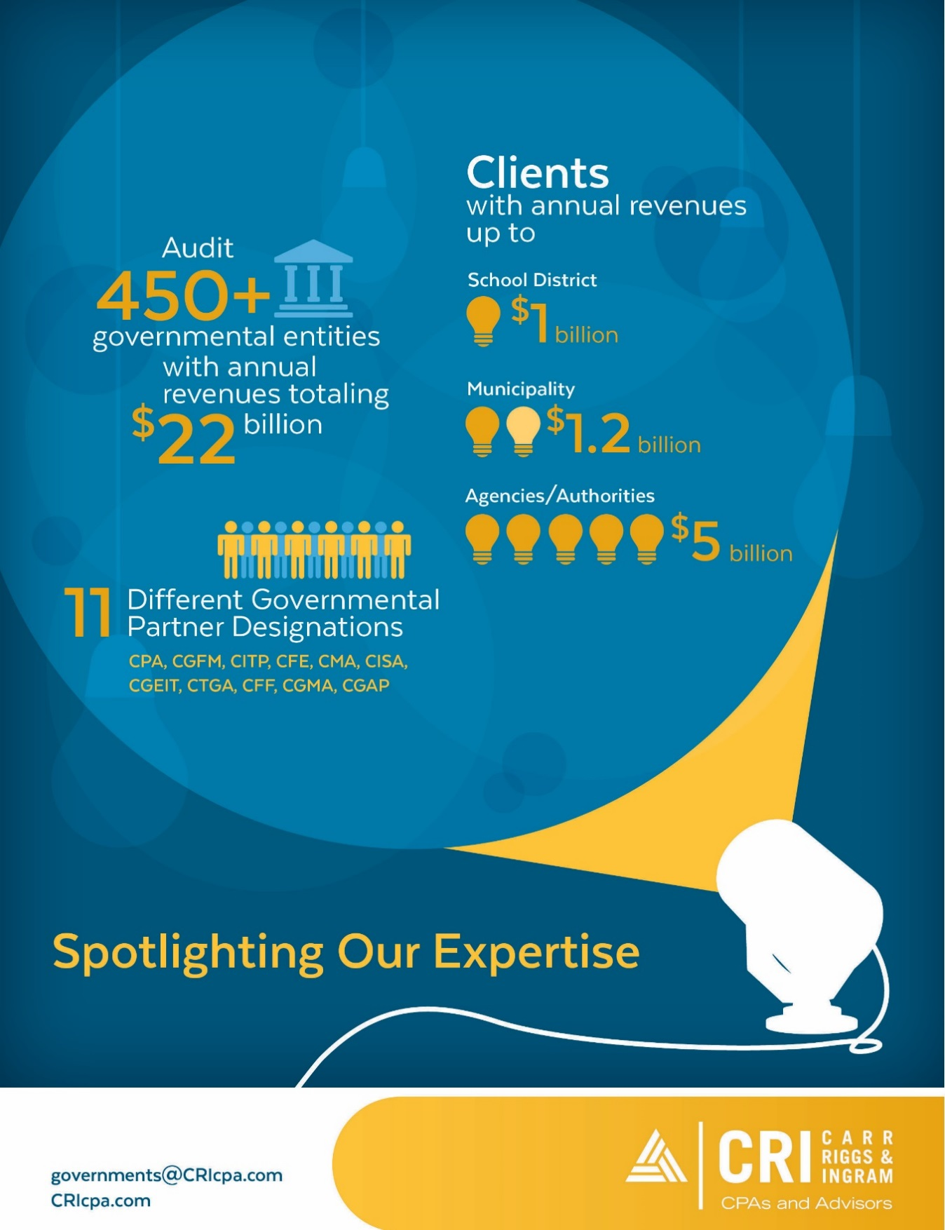
CRI: Government Industry Group

Slide 5
Presentation Overview
Pronouncements currently being implemented
What you need to be doing to prepare
Proposals currently being exposed for public comment and being deliberated by the Board

Slide 6
Pronouncements Currently Being Implemented

Slide 7
Effective Dates—June 30
2017
  Statement 73—pensions not within the scope of 67/68
  Statement 74—OPEB (plans)
  Statement 77—tax abatement disclosures
  Statement 78—certain multiple-employer pension plans
  Statement 79—certain investment pools and participants
  Statement 80—blending requirements
  Statement 82—pension issues
  Implementation Guide 2016-1
2018
  Statement 75—OPEB (employers)
  Statement 81—irrevocable split-interest agreements
  Statement 85—omnibus
  Statement 86—certain debt extinguishment issues
  Implementation Guide 2017-1
Notes:
*Paragraphs 18, 19, 23–26, and 40
+Except requirements related to the selection of assumptions in a circumstance in which an employer’s NPL is measured as of a date other than the employer’s most recent FYE. In that circumstance, those requirements are effective for that employer in the first reporting period in which the measurement date of the NPL is on or after June 15, 2017 or later
#May be implemented by topic

Slide 8
Effective Dates—June 30 (continued)
2019—Statement 83—certain asset retirement obligations
2020—Statement 84—fiduciary activities
2021—Statement 87—leases
Notes:
*Paragraphs 18, 19, 23–26, and 40
+Except requirements related to the selection of assumptions in a circumstance in which an employer’s NPL is measured as of a date other than the employer’s most recent FYE. In that circumstance, those requirements are effective for that employer in the first reporting period in which the measurement date of the NPL is on or after June 15, 2017 or later
#May be implemented by topic

Slide 9
Other Postemployment Benefits
Statements No. 74 and No. 75

Slide 10
Overview
What: The Board issued Statements 74 (plans) and 75 (employers), making OPEB accounting and financial reporting consistent with the pension standards in Statements 67 and 68
Why: Pension and OPEB standards were updated subsequent to a review of the effectiveness of the standards―objective was to establish a consistent set of standards for all postemployment benefits, providing more transparent reporting of the liability and more useful information about the liability and costs of benefits
When: Effective for periods beginning after June 15, 2016 (plans) and June 15, 2017 (employers)
Notes:
The Board exposed a proposed Implementation Guide to Statements 74 in November (final expected April 2017). IG for 75 is expected November 2017.

Slide 11
Plan and Asset Reporting
Scope includes defined benefit and defined contribution OPEB plans administered through trusts that meet specified criteria
Also addresses assets accumulated for purposes of providing OPEB through defined benefit OPEB plans that are not administered through trusts that meet the criteria
  Assets reported as assets in employer’s governmental/ proprietary funds
  Assets held for other government reported in an agency fund
Few changes from Statement 43 for financial statement recognition
Notes/RSI changes primarily to reflect changes in measurement of defined benefit liabilities of employers

Slide 12
Employer Scope and Applicability
Applies same definition of OPEB as used in Statement 45
  All postemployment healthcare benefits
  Other forms of postemployment benefits not provided through a pension plan
Addresses both defined benefit OPEB and defined contribution OPEB
Applies to employers and nonemployer contributing entities that have a legal obligation to make contributions directly to an OPEB plan or to make benefit payments as those payments come due

Slide 13
Liability to Employees for OPEB
Based on total OPEB liability—the portion of the actuarial present value of projected benefit payments that is attributed to past periods of employee service
Is OPEB administered through a trust that meets the specified criteria?
  Yes—recognize net OPEB liability (total OPEB liability, net of OPEB plan fiduciary net position)
  No—recognize total OPEB liability
Employer’s liability to employees for OPEB measured as of a date no earlier than the end of the employer’s prior fiscal year and no later than the employer’s current fiscal year
  Based on an actuarial valuation obtained at least biennially no more than 30 months and 1 day earlier than the employer’s most recent fiscal year-end

Slide 14
Measurement of the Total OPEB Liability—General Approach
Three broad steps
  Project benefit payments
  Discount projected benefit payments to actuarial present value
  Attribute actuarial present value to periods
Methods and assumptions
  Generally, assumptions in conformity with Actuarial Standards of Practice
  Single attribution method—entry age, level percentage of pay

Slide 15
Measurement of the Total OPEB Liability: Projections of OPEB Payments
Consider established pattern of practice with regard to sharing of benefit-related costs with inactive employees
Based on claims costs or age-adjusted premiums approximating claims costs, in accordance with Actuarial Standards of Practice
Includes taxes or other assessments expected to be imposed on benefit payments
Consider legal or contractual benefit caps if determined to be effective
Notes:
Discounting follows the same basic approach as the pension standards. It should be noted that relatively few OPEB plans have assets set aside in a trust that meets the specified criteria. Therefore, most plans will discount projected benefit payments using only the municipal bond rate and not the long-term expected rate of return.
Attribution method is the same as for the pension standards – entry age, as a level percentage of pay.

Slide 16
Measurement of the Total OPEB Liability: Alternative Measurement Method
Alternative measurement method may be applied if fewer than 100 employees (active and inactive) are provided benefits through plan as of the beginning of the measurement period
  Generally, same simplifications to assumptions can be used as were permitted by Statement 45
Notes:
Discounting follows the same basic approach as the pension standards. It should be noted that relatively few OPEB plans have assets set aside in a trust that meets the specified criteria. Therefore, most plans will discount projected benefit payments using only the municipal bond rate and not the long-term expected rate of return.
Attribution method is the same as for the pension standards – entry age, as a level percentage of pay.

Slide 17
Changes in Liability
Recognize most changes in liability for the current reporting period as OPEB expense immediately, except:
  Changes in total OPEB liability:
    Differences between expected and actual experience with regard to economic and demographic factors in the measurement of the total OPEB liability
    Changes of assumptions in the measurement of the total OPEB liability
    For OPEB not administered through a trust in which specified criteria are met, benefit payments
  For OPEB administered through trust in which specified criteria are met:
    Difference between projected and actual earnings on OPEB plan investments
    Employer contributions
Notes:
The changes in the total liability are reported as deferrals and introduced into OPEB expense over the average remaining service period of the plan members.
The change in the liability resulting from differences between projected and actual earnings are reported as deferrals and introduced into OPEB expense over a closed, 5-year period.
If not administered through a trust that meets the specified criteria, benefit payments are not recognized in expense. When made, those payments reduce the total OPEB liability.
If administered through a trust that meets the specified criteria, employer contributions are not recognized in expense. When made, those contributions reduce the net OPEB liability.

Slide 18
Cost-Sharing Employers
Relevant only for OPEB administered through trust in which specified criteria are met
Recognize proportionate shares of collective net OPEB liability, OPEB expense, and deferred outflows of resources/deferred inflows of resources related to OPEB
Proportion (%)
  Basis required to be consistent with contributions
  Use of relative long-term projected contribution effort encouraged
Collective measure × proportion = proportionate share of collective measure
Notes:
Drop this slide if not in a state with cost-sharing OPEB plans

Slide 19
Notes and RSI
Similar to those required for pensions
Disclosure of effect on net/total OPEB liability of a discount rate +/- 1 percent
Disclosure of effect on net/total OPEB liability of a healthcare cost trend rate +/- 1 percent
Single and agent employers: 10-year RSI schedules for changes in the net OPEB liability, ratios, and actuarially determined contributions (statutorily or contractually determined contributions, if no actuarially determined contribution is calculated)
Cost-sharing employers: 10-year RSI schedules for proportionate share/ratios, and statutorily or contractually determined contributions

Slide 20
Implementation Guide No. 2017-3, Accounting and Financial Reporting for Postemployment Benefits Other Than Pensions (and Certain Issues Related to OPEB Plan Reporting)

Slide 21
OPEB Implementation Guidance
What: An Implementation Guide for OPEB and certain issues related to OPEB plan reporting was published in December 2017.
Why: The effective date for Statement 75 is periods beginning after June 15, 2017. An Implementation Guide to Statement 74 on OPEB plan reporting was published in April 2017.
When: Generally effective for periods beginning after June 15, 2017, the same as for Statement 75.
Notes:
The requirements of Questions 4.85, 4.103, 4.108, 4.109, 4.225, 4.239, 4.244, 4.245, and 5.1– 5.4 are effective for actuarial valuations as of December 15, 2017, or later.
For circumstances in which OPEB is provided through an OPEB plan that is administered through a trust that meets the criteria in paragraph 4 of Statement 75, the requirements of Questions 4.484 and 4.491 are effective for an employer or nonemployer contributing entity in the first reporting period in which the measurement date of the (collective) net OPEB liability is on or after June 15, 2018.

Slide 22
Implementation Guidance
More than 500 questions and answers related to employer accounting and financial reporting for OPEB
Additional questions and answers related to OPEB plan reporting (Statement 74)
Notes:
-Approximately 235 “discrete” Q&As (i.e., approximately 265 Q&As are variations to address different reporting circumstances—for example, OPEB that is not administered through a trust that meets the specified criteria).

Slide 23
Illustrations
Determination of benefit payments if blended premium rates are stated
Determination of the discount rate in circumstances in which benefits are paid by the employer with its own resources as they come due and the OPEB plan is administered through a trust that meets the criteria in paragraph 4 of Statement 75
Determination of certain amounts to be presented in a single or agent employer’s required supplementary information (RSI) schedule of contribution-related information
Note disclosures, RSI, and calculation of certain recognized amounts for a cost-sharing employer

Slide 24
Effective Dates
In general, the same as Statement 75: periods beginning after June 15, 2017
Questions 4.85, 4.103, 4.108, 4.109, 4.225, 4.239, 4.244, 4.245, and 5.1–5.4 are effective for actuarial valuations as of December 15, 2017, or later
Questions 4.484 and 4.491 are effective for an employer or nonemployer contributing entity in the first reporting period in which the measurement date of the (collective) net OPEB liability is on or after June 15, 2018.

Slide 25
What Should You Be Doing to Prepare
Statements No. 74 and No. 75

Slide 26
Steps before year-end
Set up necessary accounts in the chart of accounts to record OPEB liability
Look into OPEB’s you provide your employees and determine what they are
Reach out to RHC and identify when their report will be issued as well as obtain plan documents used by actuary

Slide 27
Steps before year-end
Reach out to an actuary with proper qualifications and experience if you are not a participant of RHC (or have other OPEB’s)
Update the financial statements for all necessary note disclosures and RSI
Let governance know this is coming

Slide 28
Fiduciary Activities
Statement No. 84

Slide 29
Fiduciary Activities
What: The Board issued Statement 84 to clarify when a government has a fiduciary responsibility and is required to present fiduciary fund financial statements
Why: Existing standards require reporting of fiduciary responsibilities but do not define what they are; use of private-purpose trust funds and agency funds is inconsistent; business-type activities are uncertain about how to report fiduciary activities
When: Effective for fiscal years beginning after December 15, 2018. Earlier application is encouraged.

Slide 30
When Should a Government Report Assets in a Fiduciary Fund?
Four paths to making this determination:
Component units that are postemployment benefit arrangements
Component units that are not postemployment benefit arrangements
Postemployment benefit arrangements that are not component units
All other activities

Slide 31
When Should a Government Report Assets in a Fiduciary Fund?
Four paths to making this determination:
Are the assets held by a component unit?
Yes
No
Are the assets held for a pension or OPEB arrangement?
Yes
No
Yes
No
1
2
3
4

Slide 32
Component Units That Are Postemployment Benefit Arrangements Are Fiduciary if…
1
They are one of the following arrangements:
  A pension plan that is administered through a trust that meets the criteria in paragraph 3 of Statement 67
  An OPEB plan that is administered through a trust that meets the criteria in paragraph 3 of Statement 74
  A circumstance in which assets from entities that are not part of the reporting entity are accumulated for pensions as described in paragraph 116 of Statement 73
  A circumstance in which assets from entities that are not part of the reporting entity are accumulated for OPEB as described in paragraph 59 of Statement 74.

Slide 33
Other Component Units Are Fiduciary if…
2
They have one or more of the following characteristics:
  The assets are (1) administered through a trust agreement or equivalent arrangement in which the government itself is not a beneficiary, (2) dedicated to providing benefits to recipients in accordance with the benefit terms, and (3) legally protected from the creditors of the government.
  The assets are for the benefit of individuals and the government does not have administrative involvement with the assets or direct financial involvement with the assets. In addition, the assets are not derived from the government’s provision of goods or services to those individuals.
  The assets are for the benefit of organizations or other governments that are not part of the financial reporting entity. In addition, the assets are not derived from the government’s provision of goods or services to those organizations or other governments.

Slide 34
When Does a Government Have Administrative Involvement or Direct Financial Involvement?
Examples of administrative involvement
  If it monitors compliance with the requirements of the activity that are established by the government or by a resource provider that does not receive the direct benefits of the activity
  If it determines eligible expenditures that are established by the government or by a resource provider that does not receive the direct benefits of the activity
  If it has the ability to exercise discretion in how assets are allocated
Example of direct financial involvement
  If it provides matching resources for the activities

Slide 35
Postemployment Benefit Arrangements That Are Not Component Units Are Fiduciary if…
3
The government controls the assets of the arrangement and the arrangement is one of the following arrangements:
  A pension plan that is administered through a trust that meets the criteria in paragraph 3 of Statement 67
  An OPEB plan that is administered through a trust that meets the criteria in paragraph 3 of Statement 74
  A circumstance in which assets from entities that are not part of the reporting entity are accumulated for pensions as described in paragraph 116 of Statement 73
  A circumstance in which assets from entities that are not part of the reporting entity are accumulated for OPEB as described in paragraph 59 of Statement 74.

Slide 36
When Is a Government Controlling Assets?
A government controls the assets of an activity if:
  The government holds the assets.
  The government has the ability to direct the use, exchange, or employment of the assets in a manner that provides benefits to the specified or intended beneficiaries.

Slide 37
All Other Activities Are Fiduciary if…
4
All three of the following are met:
The government controls the assets
Those assets are not derived either:
  Solely from the government’s own-source revenues, or
  From government-mandated nonexchange transactions or voluntary nonexchange transactions with the exception of pass-through grants and for which the government does not have administrative or direct financial involvement
One of the criteria on the next slide is met

Slide 38
All Other Activities (continued)
4
  The assets are (1) administered through a trust agreement or equivalent arrangement in which the government itself is not a beneficiary, (2) dedicated to providing benefits to recipients in accordance with the benefit terms, and (3) legally protected from the creditors of the government.
  The assets are for the benefit of individuals and the government does not have administrative involvement with the assets or direct financial involvement with the assets. In addition, the assets are not derived from the government’s provision of goods or services to those individuals.
  The assets are for the benefit of organizations or other governments that are not part of the financial reporting entity. In addition, the assets are not derived from the government’s provision of goods or services to those organizations or other governments.

Slide 39
Fiduciary Fund Types
New definitions for pension trust funds, investment trust funds, and private-purpose trust funds that focus on the resources that should be reported within each.
  Trust agreement or equivalent arrangement should be present for an activity to be reported in a trust fund.
Custodial funds would report fiduciary activities for which there is no trust agreement or equivalent arrangement.
  External portions of investment pools that are not held in trust should be reported in a separate column under the custodial fund umbrella

Slide 40
Stand-Alone Business-Type Activities
A stand alone BTA’s fiduciary activities should be reported in separate fiduciary fund financial statements.
Resources expected to be held 3 months or less can be reported instead in the statement of net position, with inflows and outflows reported as operating cash flows in the statement of cash flows

Slide 41
What Should You be Doing to Prepare?
Statement No. 84

Slide 42
What do we do to Prepare?
Identify those funds that you have which meet the definition of fiduciary activities under GASB 84
Work with your auditor to determine if early implementation makes sense
Let governance know what changes are coming
Change your policies and procedures to reflect this change

Slide 43
Leases
Statement No. 87

Slide 44
Leases
What: The Board issued Statement 87 to improve lease accounting and financial reporting
Why: The existing standards had been in effect for decades without review to determine if they remain appropriate in light of GASB conceptual framework and continue to result in useful information; FASB and IASB conducted a joint project to update their lease standards; opportunity to increase comparability and usefulness of information and reduce complexity for preparers
When: Effective date is periods beginning after December 15, 2019

Slide 45
Scope and Approach
Applied to any contract that meets the definition of a lease: “A lease is a contract that conveys control of the right to use another entity’s nonfinancial asset (the underlying asset) for a period of time in an exchange or exchange-like transaction.”
  The right-to-use asset is that “specified in the contract”
  Control is manifested by (1) the right to obtain present service capacity from use of the underlying asset and (2) the right to determine the nature and manner of use of the underlying asset
Leases are financings of the right to use an underlying asset
  Therefore, single approach applied to accounting for leases with some exceptions, such as short-term leases
Notes:
Statement 87 does not include nonexchange transactions, such as $1/year leases, because the Statement 87 reporting model based on leases being financing transactions does not work well for nonexchange transactions. (Report a $1 lease liability and asset?)
In final deliberations, the Board decided to specifically note that the right to use a nonfinancial asset refers to the right to use another entity’s underlying asset. The Board also decided that the right-to-use asset should be what is “specified in the contract,” which would include the right to use the underlying asset for portions of time during a lease term, such as leases for certain days each week or for certain hours each day.
The Board also agreed to add guidance for determining when a lease contract conveys control of the right to use the underlying asset. The guidance is similar to the FASB guidance but is based on the notions of control found in Concepts Statement No. 4, Elements of Financial Statements, including (1) the right to obtain the present service capacity from use of the underlying asset and (2) the right to determine the nature and manner of use of the underlying asset. The control criteria would be applied to the right-to-use asset as specified in the contract. The Board agreed that, unlike FASB, the criteria would not limit a lease to contracts that convey “substantially all” of the present service capacity from use of the underlying asset.

Slide 46
Scope Exclusions
Intangible assets (mineral rights, patents, software, copyrights), except for the sublease of an intangible right-to-use asset
Biological assets (including timber, living plants, and living animals)
Inventory
Service concession arrangements (Statement 60)
Assets financed with outstanding conduit debt, unless both the asset and the debt are reported by the lessor
Supply contracts (such as power purchase agreements that do not convey control of the right to use the underlying power generating facility)

Slide 47
Short-Term Leases
At beginning of lease, maximum possible term under the contract is 12 months or less
Lessees recognize expenses/expenditures based on the terms of the contract
  Do not recognize assets or liabilities associated with the right to use the underlying asset for short-term leases
Lessors recognize lease payments as revenue based on the payment provisions of the contract
  Do not recognize receivables or deferred inflows associated with the lease
Notes:
The GASB chose maximum possible term rather than lease term because GASB was concerned about potential misapplication of lease term guidance to manufacture short-term leases, thus avoiding recording liabilities.

Slide 48
Initial Reporting
 | Assets | Liability | Deferred Inflow
Lessee | Intangible lease asset (right to use underlying asset)—value of lease liability plus prepayments and initial direct costs that are ancillary to place asset in use | Present value of future lease payments (incl. fixed payments, variable payments based on index or rate, reasonably certain residual guarantees, etc.) | NA
Lessor | Lease receivable (generally includes same items as lessee’s liability) Continue to report the leased asset | NA | Equal to lease receivable plus any cash received up front that relates to a future period
Notes:
FASB requires that lessors derecognize leased asset. GASB decided to not derecognize due to cost/benefit.
Lease incentives also affect measurement of the lessee’s lease asset and liability, and the lessor’s receivable.

Slide 49
Subsequent Reporting
 | Assets | Liability | Deferred Inflow
Lessee | Amortize the intangible lease asset over shorter of useful life or lease term | Reduce by lease payments (less amount for interest expense) | NA
Lessor | Depreciate leased asset (unless indefinite life or required to be returned in its original or enhanced condition) Reduce receivable by lease payments (less amount needed to cover accrued interest) | NA | Recognize revenue over the lease term in a systematic and rational manner
Notes:
Amortization of discount reported as interest revenue

Slide 50
General Lessee Disclosures
General description of leasing arrangements
Total amount of lease assets (by major classes of underlying assets), and the related accumulated amortization
Amount of outflows of resources recognized for the period for variable payments and other payments (such as residual value guarantees or penalties) not previously included in the measurement of the lease liability
Principal & interest requirements to maturity for each of the next 5 fiscal years and in 5-year increments thereafter
Commitments under leases that have not yet begun (other than short-term leases)
Components of any net impairment loss recognized on the lease asset during the period.
Notes:
General description includes (1) the basis, terms, and conditions on which variable payments not included in the measurement of the lease liability are determined and (2) the existence, terms, and conditions of residual value guarantees provided by the lessee not included in the measurement of the lease liability. Net impairment loss is gross impairment loss less change in lease liability. Specific disclosures also required for subleases, sale-leasebacks, and lease-leasebacks.
No disclosures for short-term leases.

Slide 51
General Lessor Disclosures
General description of leasing arrangements
Total amount of inflows of resources (such as lease revenue and interest revenue, if not otherwise displayed
Amount of inflows of resources recognized for the period for variable payments and other payments (such as residual value guarantees or penalties) not previously included in the measurement of the lease receivable
The existence, terms, and conditions of options by the lessee to terminate the lease or abate payments if the lessor government has issued debt for which the principal and interest payments are secured by the lease payments
Notes:
Disclosures for leases other than short-term leases. General description includes the basis, terms, and conditions on which any variable payments not included in the measurement of the lease receivable are determined. Specific disclosures also required for leases of assets that are investments, certain regulated leases, subleases, sale-leasebacks, and lease-leasebacks. Inflows disclosed if not determinable on the face of the statements.
If a lessor’s principal ongoing operations consist of leasing assets to other entities, the government should disclose a schedule of future payments that are included in the measurement of the lease receivable, showing principal and interest, for each of the five subsequent years and in five-year increments thereafter.

Slide 52
Other Topics Covered by Statement 87
Lease term
Contracts with multiple components
Contract combinations
Lease modifications & terminations
Lease incentives
Subleases
Sale-leasebacks
Lease-leasebacks
Notes:
This slide is meant to simply identify these topics – do not go through them item by item.

Slide 53
What you Should be Doing to Prepare?
Lease term
Contracts with multiple components
Contract combinations
Lease modifications & terminations
Lease incentives
Subleases
Sale-leasebacks
Lease-leasebacks
Notes:
This slide is meant to simply identify these topics – do not go through them item by item.

Slide 54
Other Topics Covered by Statement 87
Lease term
Contracts with multiple components
Contract combinations
Lease modifications & terminations
Lease incentives
Subleases
Sale-leasebacks
Lease-leasebacks
Notes:
This slide is meant to simply identify these topics – do not go through them item by item.

Slide 55
What Should You be Doing to Prepare?
Statement No. 87

Slide 56
What do we do to Prepare?
Let your departments know this is coming
Identify which policies and procedures will need updating
Determine the need for an IT solution to assist in the tracking of new leases

Slide 57
What do we do to Prepare?
Identify the leases you currently have, both operating and capital
Begin analyzing agreements to determine if they meet the GASB 87 definition of a lease
Consider if the need of an external consultant is needed for training, IT setup, and/or contract review

Slide 58
Current Proposals

Slide 59
Current Proposals
Accounting for Interest Cost during the Period of Construction: Proposed effective 12/15/18, earlier application encouraged
Implementation Guide 201Y-X, Implementation Guidance Update – 201Y:
Proposed effective 06/15/18, earlier implementation encouraged
Notes:
Would retain existing accounting requirements under modified accrual in the governmental funds.

Slide 60
Current Technical Agenda Projects

Slide 61
Current Technical Agenda Projects
Conduit Debt: Reexamination of Interpretation 2:
Added to Current Technical agenda August 2017, exposure draft expected July 2018.
Accounting and Financial Reporting for Majority Equity Interests:
Added to Current Technical agenda December 2016, final statement expected August 2018.
Financial Reporting Model—Reexamination of Statement 34:
Added to Current Technical agenda September 2015, preliminary views expected September 2015.
Revenue and Expense Recognition:
Added to Current Technical agenda April 2016, invitation to comment expected January 2018.

Slide 62
Pre-Agenda Research Activities

Slide 63
Pre-Agenda Research Activities
Going Concern Disclosures: Reexamination of Statement 56
Information Technology Arrangements, including Cloud Computing
Note Disclosures Reexamination
Public-Private Partnerships, including Reexamination of Statement 60

Slide 64

www.gasb.org

Slide 65
Website Resources
Free download of Statements, Implementation Guides, Concepts Statements and other pronouncements
Free access to the basic view of Governmental Accounting Research System (GARS)
Free copies of proposals
Up-to-date information on current projects
Articles and Fact Sheets about proposed and final pronouncements
Form for submitting technical questions
Educational materials, including podcasts

Slide 66
Plain-Language Materials
The GASB is committed to communicating in plain language with constituents about its standards and standards-setting activities.
Newly revised version of “Why Governmental Accounting Is—and Should Be—Different” (October 2017)
Fact Sheets are prepared for complex projects to answer commonly raised questions
  Series of 8 fact sheets on Statements 67 & 68 on pensions
Series of 7 brief videos developed regarding the Invitation to Comment on governmental fund financial statements

Slide 67
Alan Bowers, CPA
Partner
Carr, Riggs & Ingram, LLC
abowers@cricpa.com
Danny Martinez, CPA, CGFM
Partner
Carr, Riggs & Ingram, LLC
dmartinez@cricpa.com

