Slide 1
The new tax act and state and local governments
AGA New Mexico
Lealan Miller, CPA, CGFM, Partner
208.383.4756 lmiller@eidebailly.com

Slide 2
Agenda
Key Elements of the Tax Cuts and Jobs Act of 2017
Focus Areas for State and Local Governments
Questions
This presentation is presented with the understanding that the information contained does not constitute legal, accounting or other professional advice. It is not intended to be responsive to any individual situation or concerns, as the contents of this presentation are intended for general information purposes only. Viewers are urged not to act upon the information contained in this presentation without first consulting competent legal, accounting or other professional advice regarding implications of a particular factual situation. Questions and additional information can be submitted to your Eide Bailly representative, or to the presenter of this session.

Slide 3
Disclaimer
These materials, and the accompanying oral presentation, are for educational purposes only and are not intended to be “written advice concerning one or more Federal tax matters” subject to the requirements of section 10.37(a)(2) of Treasury Department Circular 230.
This information is of a general nature and based on authorities that are subject to change.
Notes:
The material in these slides is current as of January 10, 2018. Be sure to update before presenting. Remind audience that application of the information to specific situations should be determined through consultation with their own tax advisers.

Slide 4
Key elements of the tax cuts and jobs act (TCJA) of 2017.. In case you missed it..

Slide 5
Tax Cuts and Jobs Act
Largest Tax Reform in over 30 Years
Corporate Tax Reform
  Decreased corporate tax rate to 21%
  Net operating losses can only offset 80% of income
  Elimination of Corporate AMT
  Income computed separately for each unrelated trade or business activity
    Losses of one activity can not be used to offset income of another
    Can use losses in one year to offset income on same activity in the future
Excise tax on executive compensation
  20 percent excise tax on any remuneration in excess of $1 million paid to a covered employee
  Exception for compensation to qualified medical professionals for medical services
Notes:
20 percent excise tax on
Any remuneration in excess of $1 million paid to a covered employee and
Any excess parachute payment paid to a covered employee
Covered employee
One of five highest compensated employees for any taxable year beginning after 12/31/16 (including former employee)
Applicable tax exempt organization
Exempt from tax under 501(a)
Exempt farmers cooperative
Federal, State or local government entity with excludable income
Political Organization
Remuneration
All compensation (other than Roth contributions) by org and related orgs
Amounts included in income under Section 457(f)
Considered paid when no longer subject to a substantial risk of forfeiture
Does not include compensation attributable to medical services of certain qualified medical professionals

Slide 6
Tax Cuts and Jobs Act
Charitable Contribution Impacts
  Increase standard deduction
    Could impact charitable giving
  Increase percentage limit to 60% of AGI for cash contributions to a public charity
Advanced refunding of private activity bonds (and all other municipal bonds)
  Eliminates exclusion from gross income on interest received on advanced refunding of private activity bond (and all other municipal bonds)
  More later on this…
Notes:
Original provisions would have applied to all private activity bonds
Advance refunding of private activity bonds
Private activity bond
Bonds in which a government unit serves as a conduit providing financing to a nongovernmental person
Refunding bond
Any bond used to pay principal, interest, or redemption price on a prior bond issue
Advance refunding bond-issued more than 90 days before the redemption of a refunded bond

Slide 7
Tax Cuts and Jobs Act- colleges and universities
Excise tax on net investment income
  1.4% excise tax on net investment income of applicable educational institutions
  Assessed if fair market value of assets (excluding those used directly in carrying out exempt purposes) is at least $500,000 per student
  May include assets of related organizations
Eliminate deduction for college athletic event seating rights
  Under prior law 80% of the payment was treated as a charitable contribution if
    Paid to an institution of higher education
    Amount would have been charitable contribution but for the right to purchase tickets
Notes:
Applicable Educational Institutions
Had at least 500 tuition-paying students during the preceding year
More than 50% of the students are located in the United States
Not a State college or university
FMV of assets (excluding those used directly in carrying out exempt purposes) is at least $500,000 per student
Student based on full time equivalent
Assets of related organizations will be considered if
Entity is controlled by the institution
Entity is a 509(a)(3) supporting organization to the institution
Entity is not controlled or a supporting organization but the assets are intended and available for the use of the institution

Slide 8
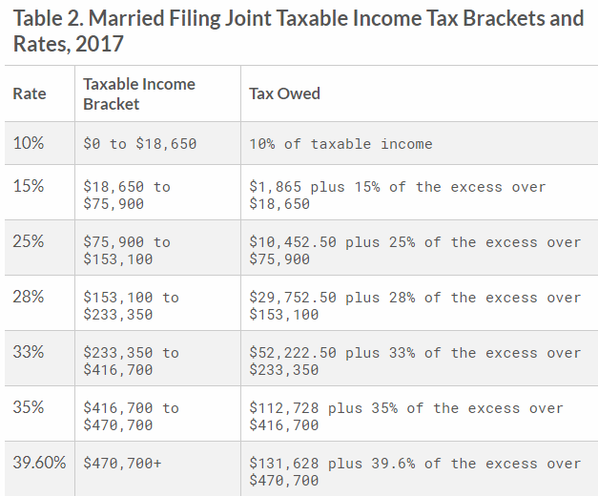
2017 Rates (joint filers)

Slide 9
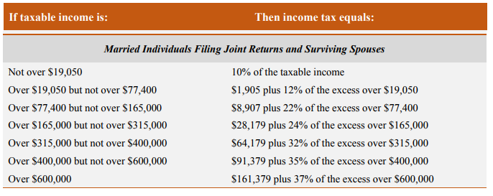
New (2018) Individual rates: joint filers

Slide 10
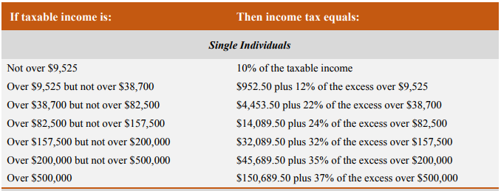
New (2018) Individual rates: single filers
For Governments – Make sure right withholding tables being used
For individuals – Make sure your W-4 is up to date!
Notes:
Note marriage penalty still exists for top bracket.

Slide 11
Focus areas for state and local governments

Slide 12
Local Lobbying
Expenses for lobbying before local government bodies eliminated for amounts paid or incurred after 12/22/17.
What does this mean?
  Could mean fewer visits from business representatives trying for economic development opportunities?

Slide 13
Government capital contributions taxable
Tax-free contributions to capital no longer include:
  A contribution in aid of construction or any other contribution as a customer or potential customer, and
  A contribution by any governmental entity or civic group (other than a contribution made by a shareholder as such)
  Contributions made after 12/22/2017
  Unclear how this will work with tax abatements, but they may be taxable
      New York State contemplating converting from tax abatements to grants
      Could they come back under infrastructure bill??
Notes:
https://www.bna.com/federal-tax-law-n73014474548/ - New York State contemplating switching from a tax abatement program to a grant program
https://businessfacilities.com/2018/01/tax-cuts-jobs-act-collateral-damage/
https://www.brookings.edu/research/localities-will-deliver-the-next-wave-of-transportation-investment/

Slide 14
State and local taxes
Repeals the itemized deduction for state and local taxes, including income and property taxes, effective after 2017, with the exception of a $10,000 annual allowance.
The allowance allows a maximum $10,000 deduction for state and local non-business property and income taxes, or, at the taxpayer’s option, property and sales taxes.
Same $10,000 limit for joint filers and single taxpayers.
What will this mean? Already seeing property tax rates weighing heavily on location decisions, but will states be able to adjust their tax laws to compensate?
  Also – could see a dip in property taxes next year as residents prepaid – budgeting could be harder

Slide 15
Other items in tax reform
Teacher expense deduction
Unchanged!

Slide 16
Advance refunding of municipal bonds
Eliminates exclusion from gross income on interest received on advanced refunding of private activity bond
Private activity bond
  Bonds in which a government unit serves as a conduit providing financing to a nongovernmental entity
Refunding bond
  Any bond used to pay principal, interest, or redemption price on a prior bond issue
  Advance refunding bond-proceeds of which are held more than 90 days prior to refunding a prior bond issue
Applies for refundings after 12/31/2017
Notes:
Original provision would have applied to all private activity bonds, not just advance refundings. It only applies to advance.
Only one time allowed for tax exempt for refundings - old

Slide 17
Advance refunding of municipal bonds
2017 Advanced Refundings was $91 billion – 22% of total debt issuances
Provide Federal Government approximately $17 billion over the next 10 years

Slide 18
Advance refunding of municipal bonds
What Will This Mean for Governments?
  Potentially issues with housing finance and volume cap (private activity bonds)
  Limitations on flexibility if interest rates become more favorable to refund debt
  Could mean more taxable deals – which means
    Higher interest rates to compensate for tax effect
    Potentially not a legal defeasance as the escrow may not be essentially risk free (potential loss of principal or substitution risk)
    Could result in a crossover refunding transaction [two liabilities outstanding at the same time until the crossover date(s)]
Talk to your bond counsel / municipal financial advisor prior to contemplating refunding transactions
Bill introduced in Congress to reverse these provisions
Notes:
Original provision would have applied to all private activity bonds, not just advance refundings
http://www.governing.com/week-in-finance/gov-finance-roundup-tax-reform-states-weighing-big-changes.html
This undo’s the refunding provision - Bill number H.R.5003, Introduced by Rep Hultgren (R-IL) and co-sponsored
by a bipartisan group of 2 Republicans and 3 Democrats. Latest action it
was referred to the House Ways and Means Committee on 2/13/2018.

Slide 19
Advance refunding
Options:
“forward delivery” bonds and so-called bond swaptions,
to capture the kind of savings that otherwise would have been available through the direct issuance of tax-exempt advance refunding bonds.

Slide 20
Other Issues
Many States (and Local Governments) start with Federal Taxable Income as a base to calculate their tax provisions
  Could result in governments revisiting their tax codes to break with Federal provisions?
  Could more states move toward a ‘millionaires tax?’
Iowa contemplating undoing a ‘reverse’ tax system
  Currently allows deduction of federal taxes paid (as federal taxes drop, Iowa taxes go up)
Notes:
https://taxfoundation.org/state-conformity-federal-tax-reform/
http://www.governing.com/week-in-finance/gov-finance-roundup-tax-reform-states-weighing-big-changes.html
Some states are telling taxpayers to extend their tax return
while the states review their position on implementing the federal tax
reform changes. Most of the states have the changes under review, but
will not have their decision to follow or not by the due date for filing
state returns.

Slide 21
STATE DEPENDENCE ON INCOME TAXES

Slide 22
CURRENT PROJECTIONS
As it stands today - it is being estimated that the states will lose revenue from the corporate income tax changes. This is primarily due to full expensing which will result in a timing issue and shift the revenues to a later year. The elimination of the deduction for net interest should offset some of this loss.
However, the individual income tax (voters?) will result in a base expansion should result in a large and rapid increase in tax revenue. The federal rate reductions have no impact on the states.
Notes:
The $10,000 cap on state and local tax deductions could make it challenging for state and local governments in high tax states to continue to deliver the current level of public services as their individual taxpayers will no longer be able to deduct the full amount of state and local taxes from their federal tax returns, which serves to increase the effective federal tax rate. Over time, state and local governments could face resistance to proposed increases in state and local taxes to fund public infrastructure projects and gain approval of general obligation and dedicated tax revenue bond ballot measures. This could pressure finances and have a detrimental impact on credit quality. This may be exacerbated, over the long run, by potential out migration from individuals in high tax states to lower or no tax states. The mortgage deduction caps (discussed below), can also contribute to negative credit forces through price degradation in high price, high tax states that now face SALT deduction limitations.

Slide 23
WHAT THE STATES ARE SAYING
Minnesota will see a tax windfall of $813 million for 2019 and
$1.49 billion in the following two years.
Iowa will see additional tax revenue of $106 million in 2019 and
$138 million in 2020.
Montana is looking at a loss of $67 million to $76 million. Missouri will see a loss of $120 million.

Slide 24
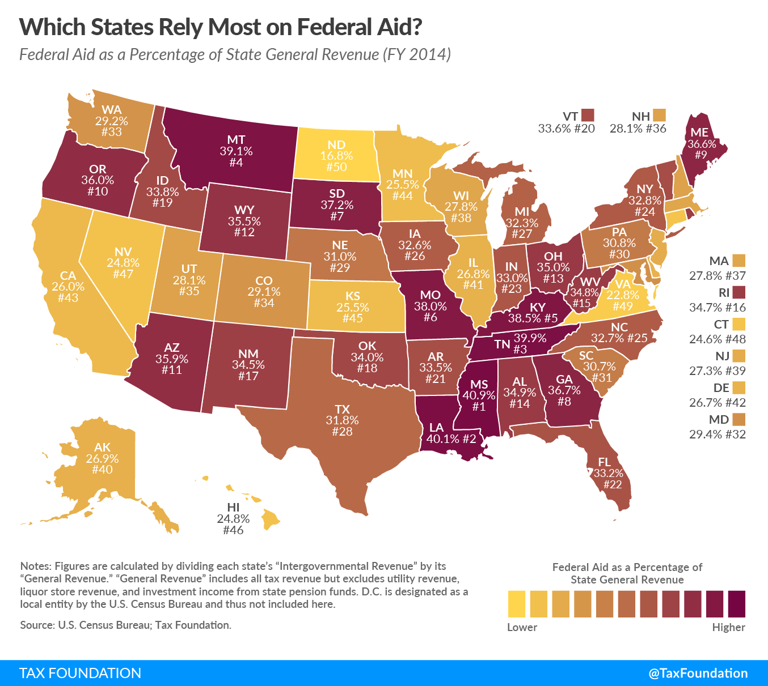
States reliance on Federal Aid

Slide 25
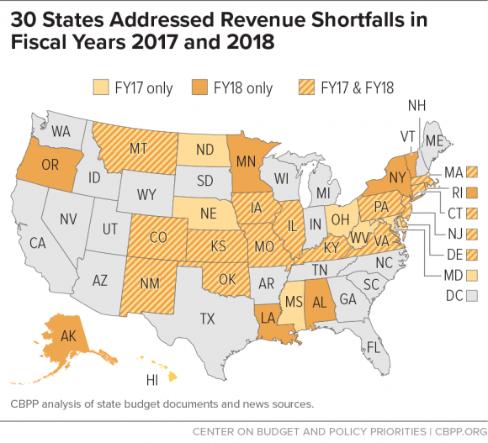
States with Revenue Shortfalls

Slide 26
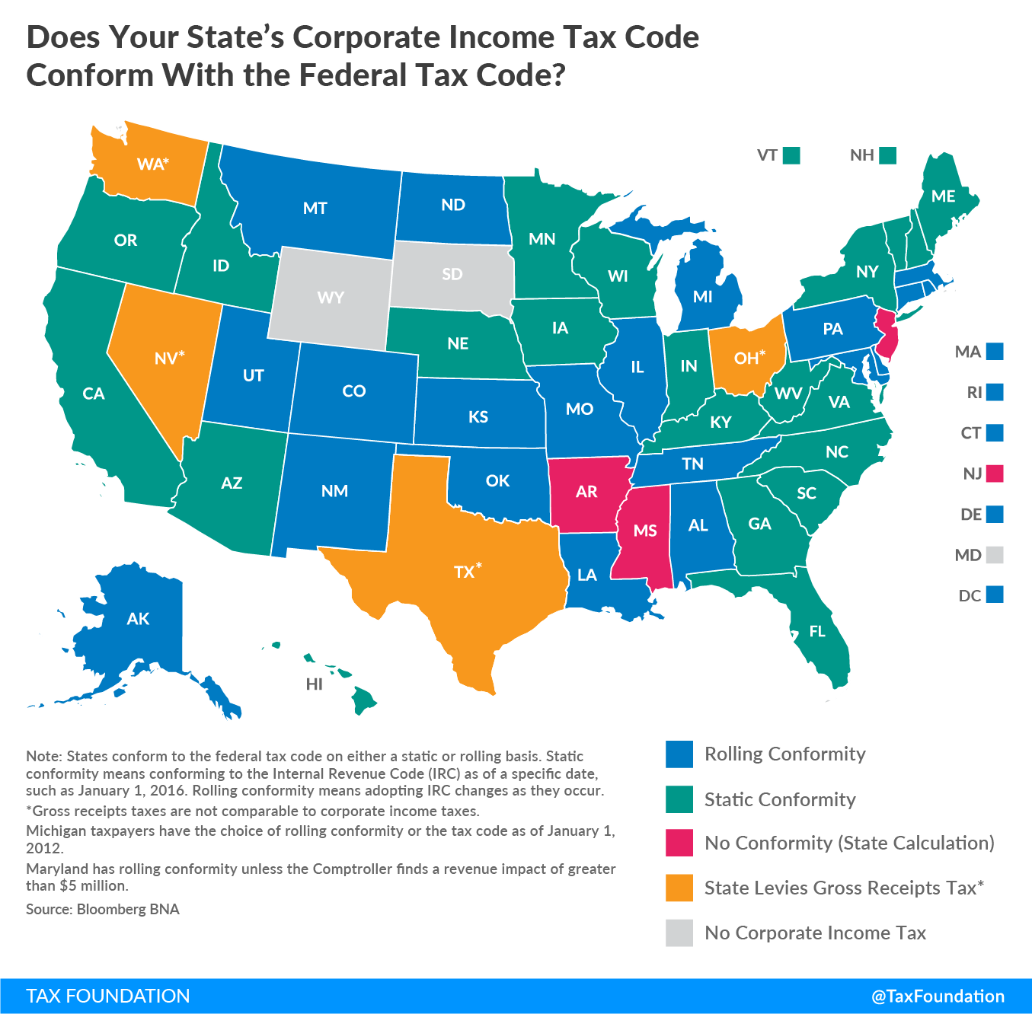
State Conformity for Corporate taxes

Slide 27
QUESTIONS?

Slide 28
THANK YOU
Lealan Miller, CPA, CGMA
Partner
lmiller@eidebailly.com
208.383.4756

