Slide 1
Missouri State Auditor’s Office
Recent Audits Involving Fraud
Pamela Allison, CPA, CFE
Supervising Manager of the Public Corruption and Fraud Division

Slide 2
Objectives
How to Report Fraud to the SAO and How Frauds are Investigated
Identify the Most Recent Common Fraud Schemes Noted During Audits
Discuss Recent Audits Involving Fraud
Identify Control Issues that Allowed Frauds to Occur

Slide 3
Public Corruption and Fraud Division
Reporting Fraud
Online Reporting Form - https://auditor.mo.gov/WhistleblowerHotline/Form
Whistleblower Hotline – 800-347-8597
Email - moaudit@auditor.mo.gov
Investigation Process

Slide 4
Recent Fraud Schemes
Payroll including benefits and leave payouts
Utilities

Slide 5
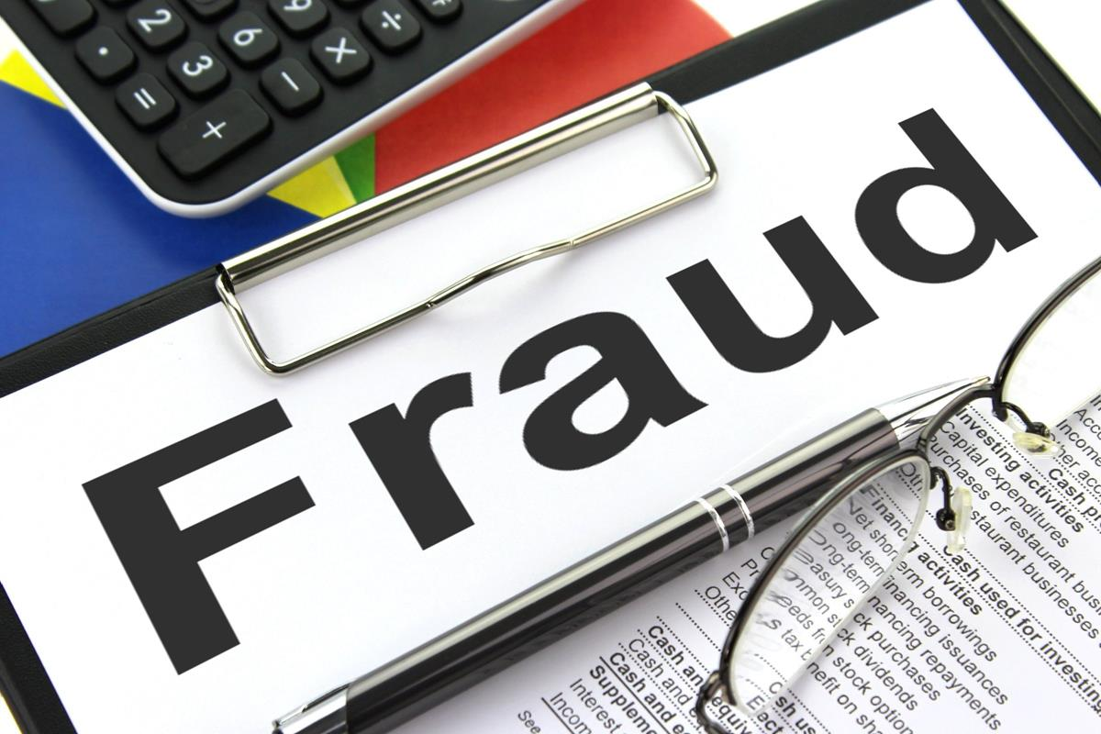
Recent Audits Involving Fraud
Carroll County Ambulance District
City of Purcell
City of Dixon

Slide 6
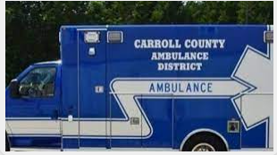
Carroll County Ambulance District
Report No. 2022-108
November 2022

Slide 7
Carroll County Ambulance District
Receipts for the year ended December 31, 2020, totaled approximately $1.3M
March 2021 – CCAD Board called the SAO Whistleblower hotline
April 2021 – Initial investigation determined further investigation was warranted
May 2021 – The Board requested an audit and the State Auditor accepted
Audit Period – June 1, 2020 – March 31, 2021 (Director hired June 16, 2020, and served to March 3, 2021)

Slide 8
Carroll County Ambulance District
Money totaling at least $91,794 was misappropriated from the district between June 2020 and March 2021
 | Description |  | Amount
 | Overtime pay (Appendix A) | $ | 35,150
 | Retention pay (Appendix A) |  | 15,000
 | Holiday pay (Appendix A) |  | 4,380
 | Payroll overpayments subtotal |  | 54,530
 | Questionable mileage reimbursements (Appendix A) |  | 1,945
 | Subtotal (Appendix A) |  | 56,475
 | Employee benefit reimbursement account |  | 4,021
 | Improper purchases |  | 108
 | Total | $ | 60,604

Slide 9
Carroll County Ambulance District
Director improperly added hours to other district employee time records that caused overpayments totaling $29,560
Director improperly approved a final payment to a district employee for $1,630
Total of the above is $91,794

Slide 10
Carroll County Ambulance District
The Director improperly claimed 642 overtime hours, resulting in $35,150 in overtime payments.
For those hours, the Director was not scheduled to work on an ambulance or did not make a run as the only driver on duty. It was only in these circumstances the Board had informally discussed overtime.

Slide 11
Carroll County Ambulance District
The Director improperly approved the issuance of a $15,000 payment to himself on December 30, 2020.
The Director informed the Business Manager the payment was for $10,000 retention pay and $5,000 for personal health insurance costs.

Slide 12
Carroll County Ambulance Board
Retention Incentive policy provides for an annual $200 incentive increased by $20 for each completed year of service.

Slide 13
Carroll County Ambulance District
The Director improperly approved payments to himself totaling $4,380, for 72 holiday hours at time and one-half.
The Director claimed 3,500 miles of travel and was reimbursed $1,945 for mileage between October 2020 and January 2021 that was questionable.
The Director paid for $108 in questionable shipping charges with the district’s credit card on March 2, 2021, the day before his termination. One package was to his mother in Florida.

Slide 14
Carroll County Ambulance District
The Director improperly authorized the creation of an employee benefit reimbursement account at a total cost of $11,385, and owes the CCAD $4,021 for reimbursements received.
Between November 2020 and May 2021, this resulted in $3,635 in administrative fees for the district and the Director also authorized $7,750 to advance fund his account. He used funds to purchase hearing aids.

Slide 15
Carroll County Ambulance District
The Director requested a final payment of $23,068 prior to his termination for final hours, accrued sick and vacation leave, and overtime for the period March 7 – 20, 2021.
Business manager denied the hours because they had not been worked and accrued leave payouts were not allowable.

Slide 16
Carroll County Ambulance District
The Director improperly authorized $31,190 in overpayments and final payments to other district staff.
Our review of the district's payroll system identified unusual increased payroll activity including time recorded as “other” during 4 bi-weekly pay periods between November 29, 2020, and January 23, 2021.

Slide 17
How did this happen?
Control Weaknesses:
Inadequate oversight
Inadequate time records and review
Board was not aware of or did not review policy changes
Poor controls over credit cards

Slide 18
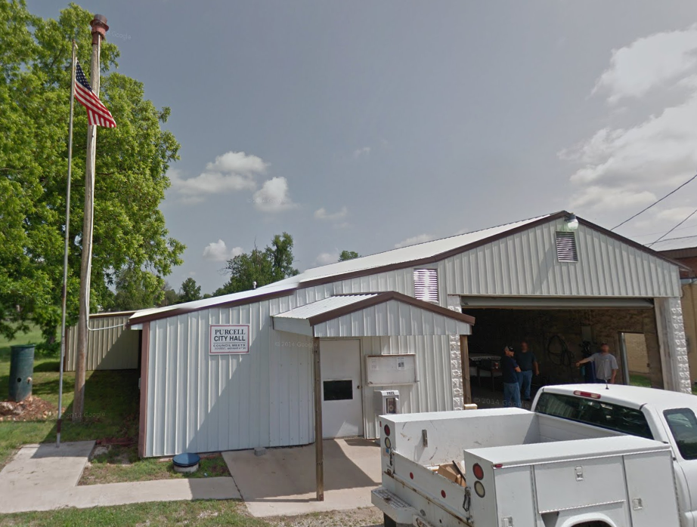
City of Purcell
Report No. 2022-033
June 2022

Slide 19
City of Purcell
4th-class city in Jasper County incorporated in 1903
Population of 318 at the 2020 census
Total area of .44 square miles
SAO was petitioned to audit the city in November 2020
The audit started in June 2021
Audit period – Year ended December 31, 2020

Slide 20
City of Purcell - Mayor Pro-Tem
October 2020
Mayor resigned
Mayor Pro Tem became responsible for providing a 2nd signature on city checks (Elected to Board in June 2020 and appointed Mayor Pro Tem August 2020)
February 2021
City Clerk and City Collector resign
Mayor Pro Tem gained access to other financial activities including:
Utility billing
Collecting, receipting, depositing city receipts
Preparing disbursements (including payroll checks)
Reviewing bank account activity

Slide 21
City of Purcell
SAO Secured Records in March 2021 due to allegations that records might be removed from City Hall and/or destroyed

Slide 22
City of Purcell
On March 1, 2021, the State Auditor's Office received 2 emails.
The first email accurately represents the correspondence sent from audit staff and acknowledged by Ms. Wilson at 8:53 a.m.
The second email was sent to audit staff at 10:17 p.m. It included the same acknowledgement, but also included inaccurate and false information related to the audit work, including false allegations related to potential charges that may be filed.
The SAO subsequently notified the city by letter on March 10, 2021, that the email was inaccurate, and clarified the purpose of the audit and authority of our office.

Slide 24
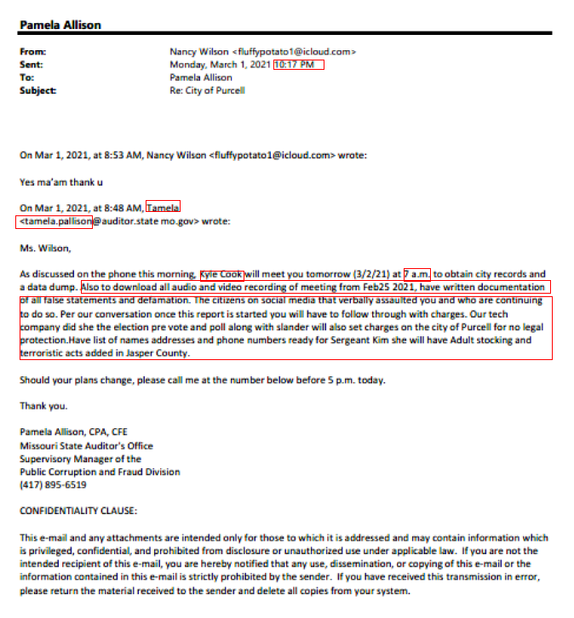

Slide 25
SAO Response to Email

Slide 26
City of Purcell - Change in Administration
On April 6, 2021, a new Mayor and new Board members were elected.
On April 12, 2021, Mayor Pro Tem Wilson was removed from office by vote of the Board.
On April 15, 2021, city officials provided documentation and filed a complaint with the Jasper County Sheriff's office of alleged fraudulent activity.

Slide 27
City of Purcell - Questioning and Arrest
Upon investigation by the Sheriff's office:
5 checks totaling $2,188 were endorsed by Ms. Wilson and deposited into her personal bank account.
Video evidence from the bank showed that on April 2, 2021, Ms. Wilson withdrew $400 from the city's General account.
May 27, 2021
Sheriff's office questioned former Mayor Pro Tem
Arrested former Mayor Pro Tem for class D felony of stealing of $2,588.

Slide 28
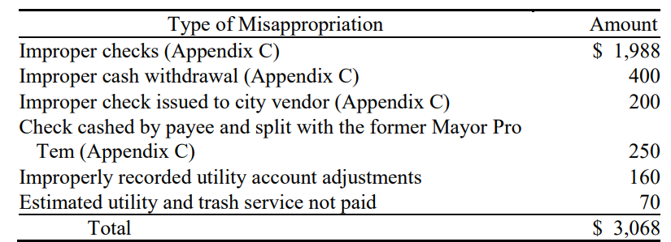
City of Purcell - Audit
Everything discussed prior to this point occurred before the audit even started in June 2021.
From February 2021 – April 2021 at least $3,233 was misappropriated or is missing

Slide 29
City of Purcell – Improper Checks
March 2021 – 4 checks totaling $1,988 to a payee and “or Nancy Wilson” as a joint payee
$500 – Mother plus “or Nancy Wilson” – memo said “city bills & cleaning”
$488 – Mother plus “or Nancy Wilson” - memo said “Invoice & Reimbursement CPA”
Mother said she was not an employee and never saw the checks

Slide 30
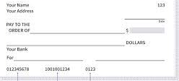
City of Purcell – Improper Checks
March 2021 – 4 checks totaling $1,988 to a payee and “or Nancy Wilson” as a joint payee
$500 – The third check was issued to "CPA or Nancy Wilson" for $500 with the memo line indicating "April Billing."
No work done and vendor did not receive payment
$500 - The fourth check was issued to an individual "and or Nancy Wilson" for $500 with the memo line partially unreadable with only "invoice 3-21" legible.
We were not able to locate the individual to discuss the details of this check.
CPA or Nancy Wilson
April Billing

Slide 31
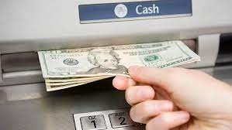
City of Purcell – Cash Withdrawal
$400 on April 2, 2021
When questioned by the Sheriff's office about this transaction, the former Mayor Pro Tem indicated the withdrawal was reimbursement for "gas mileage and everything that she has done for the last three months."
However, no documentation was available to support the withdrawal (e.g., mileage log, timesheets, etc.).

Slide 32
City of Purcell – Vendor Payment
$200 check on April 10, 2021 – Wrote check to a routine city vendor and then negotiated the check.
The check was signed solely by the former Mayor Pro Tem, and the memo line of the check indicated "Invoice For Dig.“
Endorsed by the Mayor Pro Tem

Slide 33
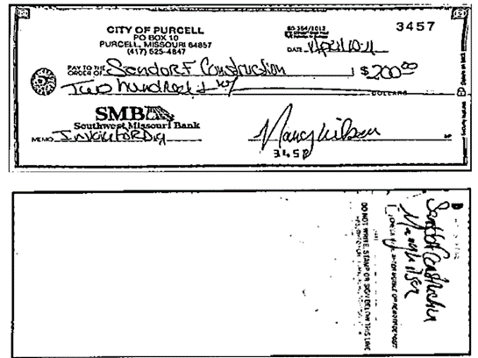
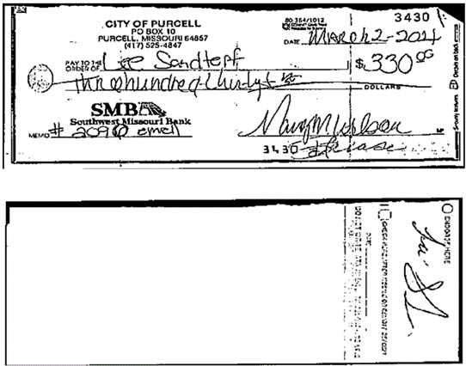

Slide 34
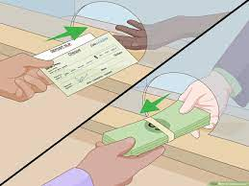
City of Purcell
On April 7, 2021 - $500 check to an individual for "Mowing & Cleaning City Hall."
The Sheriff's office obtained bank surveillance video from April 7, 2021, and determined that the former Mayor Pro Tem accompanied the payee to the bank and the check was cashed.
Confirmed the former Mayor Pro Tem took her to the bank to cash the check and the former Mayor Pro Tem gave her $250 cash and kept the remaining $250 cash.

Slide 35
City of Purcell – Utilities Not Paid
Adjustments totaling $160 ($80 each month) were improperly applied to the former Mayor Pro Tem's electronic utility account in January 2021 and February 2021.
The former Mayor Pro Tem did not pay for utility and trash services that were due in March 2021. Her monthly billings for the year ended December 31, 2020, averaged approximately $70; therefore, we estimated the utility and trash services not paid in March 2021 at $70.

Slide 36
City of Purcell – Missing Money
Utility receipts totaling $165 received by the Mayor Pro Tem in March 2021 were not deposited and are missing.
Additionally, 5 utility customers contacted city officials and indicated they made utility payments, totaling $670, during the time period the former Mayor Pro Tem was handling utility receipts, but the receipts were not deposited.

Slide 37
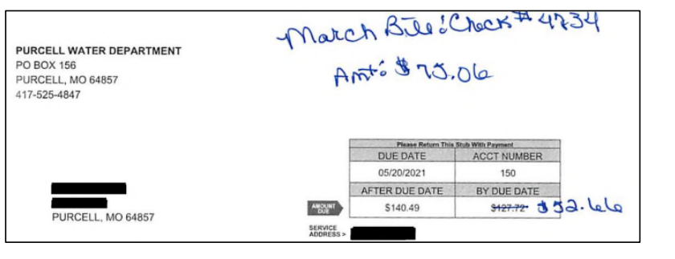

Slide 38
City of Purcell
THE RESULTS
In January 2022, Ms. Wilson pleaded guilty in circuit court to a class A misdemeanor of stealing
She was sentenced to one year in jail, with a suspended execution of the sentence, and 2 years unsupervised probation.
She was also ordered to pay court costs of $147 and restitution in the amount of $2,588.
The defendant's $2,600 cash bond was applied to restitution and court costs.

Slide 39
How did this happen?
Control Weaknesses:
Inadequate oversight
Inadequate controls over utility systems

Slide 40
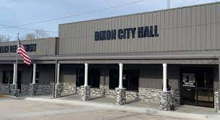
City of Dixon
Report No. 2022-134
December 2022

Slide 41
City of Dixon
4th-class city in Pulaski County incorporated in 1889
Population of 1,232 at the 2020 census

Slide 42
City of Dixon
In March 2022 - MSHP requested assistance with its investigation of overpayments made to the City Clerk.
April 2022 - City of Dixon Board of Aldermen passed an ordinance formally requesting and authorizing an audit by the SAO, and the SAO subsequently agreed to conduct the audit.
Audit period – November 2, 2013 – March 31, 2020 (City Clerk started November 6, 2013, and served until March 13, 2020, when he retired)

Slide 43
City of Dixon
From November 2013 through March 2020, money totaling at least $18,910 was misappropriated
Description |  | Amount
Vacation pay | $ | 9,345
Sick leave pay |  | 3,026
Severance pay |  | 2,639
Holiday pay |  | 2,695
Inaccurate rate of pay |  | 1,205
Total | $ | 18,910

Slide 44
City of Dixon – Vacation Pay
The City Clerk improperly paid himself $9,345 for 600 hours of vacation leave
Accrued vacation leave payouts at the end of the year - $8,686
Signed his own checks and Mayor signature stamp
Mayor stated he did not approve the transactions and did know the Clerk used his signature stamp
No payroll records were presented to the Board or Mayor for review or approval so they could determine what the checks were for.

Slide 45
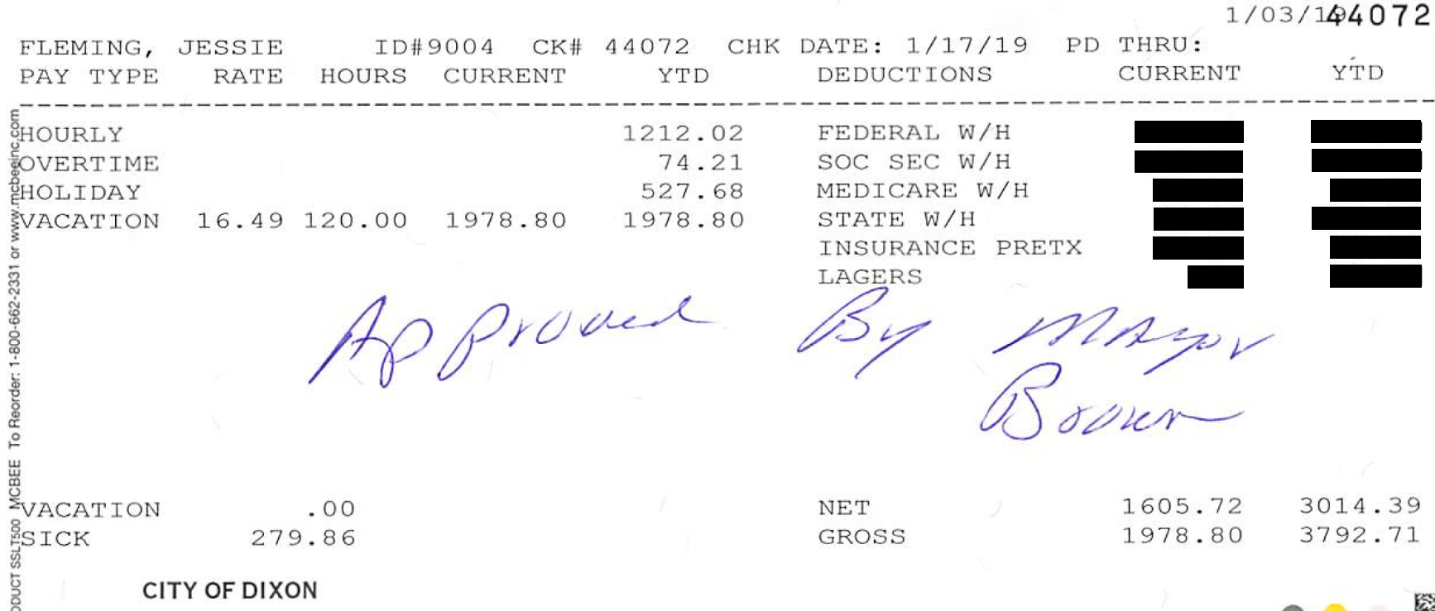

Slide 46
City of Dixon – Vacation Pay
The City Clerk overpaid himself $660 for 40 hours of accrued vacation upon separation.
During his last 2 months of employment, the City Clerk issued himself three checks totaling $1,980 ($660 each) for a total of 120 when only 80 hours was allowed
The City Clerk issued himself a $660 check for 40 hours of vacation on February 4, 2020, again on February 18, 2020, and then again on March 3, 2020.
The City Clerk and the then Mayor signed these 3 checks.
Mayor and City Clerk could not explain in recorded interviews.

Slide 47
City of Dixon – Sick Leave
The City Clerk overpaid himself $3,026 for accrued sick leave upon retirement.
The City Clerk issued himself a $3,179 check on March 13, 2020, for payment of 192.76 hours of accrued sick leave.
Our review and recalculation of the City Clerk's sick leave indicated his accrued sick leave balance was only 9.25 hours on March 13, 2020, and he should have only been paid $153 upon retirement for sick leave.

Slide 48
Sick Leave Recorded in Accounting System | Year Ended December 31, | Sick Leave Accrued (1) | Sick Leave Used | Cumulative Sick Leave Balance
 | 2013 | 16.00 | 5.84 | 10.16
 | 2014 | 108.00 | 62.11 | 56.05
 | 2015 | 112.00 | 72.99 | 95.06
 | 2016 | 112.00 | 77.20 | 129.86
 | 2017 | 132.00 | 40.00 | 221.86
 | 2018 | 118.00 | 72.00 | 267.86
 | 2019 | 144.00 | 154.10 | 257.76
 | 2020 | 28.00 | 93.00 | 192.76
 | Total | 770.00 | 577.24
 | (1) Sick leave accrued was determined based upon the sick leave balance recorded at the beginning and ending of each year, and the amount of recorded sick leave used.
Sick Leave per Audit | Year Ended December 31, | Sick Leave Allowed (1) | Sick Leave Used | Sick Leave Balance
 | 2013 | 0.00 | 5.84 | (5.84)
 | 2014 | 87.14 | 62.11 | 19.19
 | 2015 | 96.00 | 72.99 | 42.20
 | 2016 | 96.00 | 77.20 | 61.00
 | 2017 | 96.00 | 40.00 | 117.00
 | 2018 | 96.00 | 72.00 | 141.00
 | 2019 | 96.00 | 154.10 | 82.90
 | 2020 | 19.35 | 93.00 | 9.25
 | Total | 586.49 | 577.24
 | (1) The first and last month in which sick leave was allowed was prorated based on the days worked.

Slide 49
City of Dixon – Severance Payment
The City Clerk issued himself a $3,958 check for 240 regular hours of work on February 27, 2020.
City policy only provided for the payment of 80 hours of severance pay or $1,319 upon retirement, resulting in an overpayment of $2,639.
The City Clerk and then Mayor signed this check.
During recorded interviews, the City Clerk and the then Mayor indicated this check represented a severance payment; however, neither could explain why the check was issued prior to the City Clerk's date of separation on March 13, 2020, or why it was more than allowed by city policy.

Slide 50
City of Dixon – Holiday Pay
The City Clerk paid himself $2,695 for holidays in excess of those provided by ordinance.
Date of Check | Recognized Holidays During Pay Period | Number of Holiday Hours Paid | Number of Holiday Hours per Ordinance | Number of Holiday Hours Overpaid | Hourly Rate of Pay (1) | Amount of Overpayment
01/08/20 | Christmas Day, New Year's Day | 24 | 16 | 8 | $16.49 | $ 132
10/29/19 | Columbus Day | 8 | 0 | 8 | 16.49 | 132
01/08/19 | Christmas Day, New Year's Day | 32 | 16 | 16 | 16.49 | 264
10/17/18 | Columbus Day | 8 | 0 | 8 | 16.49 | 132
09/19/18 | Labor Day | 12 | 8 | 4 | 16.49 | 66
04/04/18 | None | 8 | 0 | 8 | 16.49 | 132
01/10/18 | Christmas, New Year's Day | 20 | 16 | 4 | 16.49 | 66
12/26/17 | None | 4 | 0 | 4 | 16.49 | 66
10/18/17 | Columbus Day | 8 | 0 | 8 | 16.49 | 132
09/20/17 | Labor Day | 24 | 8 | 16 | 15.49 | 248
07/12/17 | Independence Day | 16 | 8 | 8 | 15.49 | 124
01/23/17 | Martin Luther King, Jr. Day | 16 | 8 | 8 | 15.49 | 124
01/09/17 | Christmas Day, New Year's Day | 24 | 16 | 8 | 15.49 | 124
12/27/16 | None | 4 | 0 | 4 | 15.49 | 62
10/17/16 | Columbus Day | 8 | 0 | 8 | 15.49 | 124
09/20/16 | Labor Day | 16 | 8 | 8 | 14.75 | 118
01/12/16 (2) | New Year's Day | 16 | 8 | 8 | 12.25 | 98
09/23/15 | Labor Day | 16 | 8 | 8 | 12.25 | 98
01/14/15 | New Year's Day | 12 | 8 | 4 | 11.75 | 47
01/02/15 | Christmas | 24 | 8 | 16 | 11.75 | 188
10/23/14 | Columbus Day | 8 | 0 | 8 | 11.25 | 90
01/15/14 | New Year's Day | 12 | 8 | 4 | 10.75 | 43
01/03/14 | Christmas Day | 16 | 8 | 8 | 10.75 | 86
 | Total | 336 | 152 | 184 |  | $2,695

Slide 51
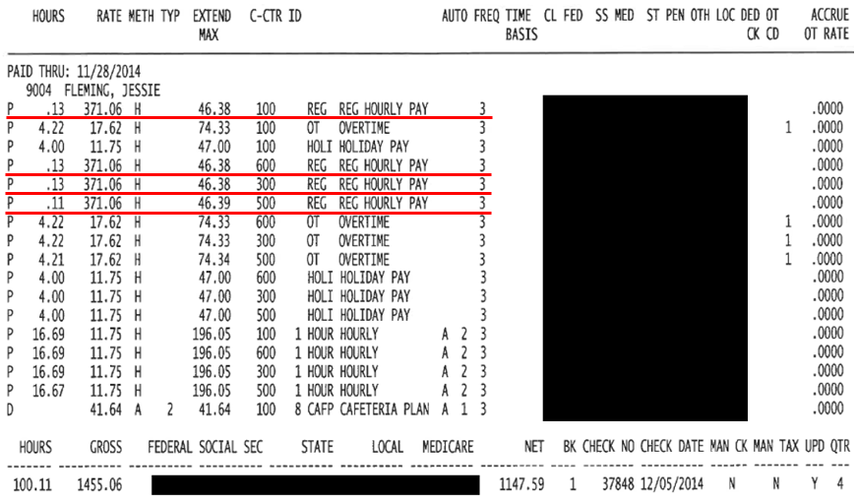
City of Dixon – Rate of Pay
The City Clerk inaccurately recorded his hourly rate in the payroll system, resulting in $1,205 in overpayments.
$14.25 instead of $12.25 from November 2015 to January 2016
$371.06 instead of $11.75 for a half hour in December 2014 ($180)

Slide 52
How did this happen?
Control Weaknesses:
Inadequate oversight
Inadequate time records and review
Inadequate oversight of the disbursement process
Prior Audits: 2015 Similar findings
SAO – Currently working on a petition audit of the city

Slide 53
Contact Information
Hearing from you is important!
Please let us know your questions, comments, or suggestions.
Email: moaudit@auditor.mo.gov
Website: auditor.mo.gov
301 West High Street
Office 880
P.O. Box 869
Jefferson City, Missouri 65102
Phone: 573-751-4213
Fax: 573-751-7984
Taxpayer Hotline: 800-347-8597

Slide 54
QUESTIONS

