Slide 1
A Tale of Two Cities
A Social Mood Failure of Internal Control
Professor Dennis Elam PhD CPA
Texas A & M University San Antonio

Slide 2
Your Presenter
Dennis Elam Phd CPA
  Texas A & M University San Antonio
  Teaches Ethics & Audit
  Three Degrees UT Austin
Texas CPA # 15,532
Numerous CE presentations
Multiple Teaching Awards

Slide 3
Overview
Rules of Internal Control
Rita Crundwell
Steals $53 M in Dixon, IL over decades
Gloria Padilla Henderson
Steals $291,000 from Centro in two years
Janet Mello
Steals $108 M over six years Fort Sam

Slide 4
Internal Control
Encourage adherence to policy & Procedure
Promote Operational Efficiency
Minimize Errors and Theft
Enhance Reliable and Accurate Data
Committee of Sponsoring Organizations COSO

Slide 5
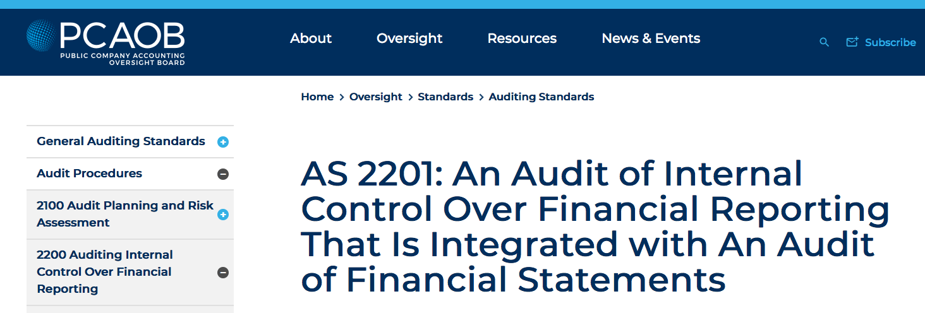
I C Regulations
Sec 404 SARBOX document, assess IC
PCAOB AS 2201
Examples
  Separation Duties
  Enforced vacation
  Reconciliations
  Existence?

Slide 6
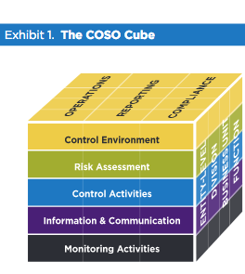
Committee Sponsoring Organizations
COSO
AICPA
Amer Acct Assoc
FEI
IMA
IIA

Slide 7
COSO IC Components
Control Environment
  Ethical Values
  Organization Structure
  Employ Competent Employees
  HR Policies
Risk Assessment
Control Activities – Policy, Procedure
Information & Communication
Monitoring

Slide 8
Rita Crundwell
Rita Born 1/120/53 near Dixon
Working Dixon City Hall 1970-High School
Began Quarter Horses 1978
1983 Became Treasurer & Comptroller
Married 1974, Divorced 1986, Part of Plan?
Do You See a Problem via COSO?

Slide 9
Why are they ‘Con Artists?’
Get your Confidence!
Three Decades as Comptroller / Treasurer
2011 City Commissioner Declared
She Looks After Every Tax Dollar is If It Were Her own
And in Fact Many Were Her Own!
Who Needs College to Succeed?

Slide 10
The Scheme
12/8/90 creates bank account RCSDA
  Reserve Sewer Capital Development Account
  Note all three ladies used similar scheme
  Looks Like City Account-only signatory
  Money Deposited Capital Dev Fund
  False Invoices to Treasurer and Money Transfer to RCSDA, and then to Rita
  Uncomplicated Scheme 22 Years stealing $53.7M
  RCSDA as same bank used by City of Dixon

Slide 11
The Scheme Grows
1991 – Stole $181,000
2008 stole $5.8 M in a budget of $8-9 M
Shortfalls – IL was late with Tax Rev Pmts
Horse Business very Successful
Horses eat money they don’t make money
IL not Kentucky or Texas where people know better

Slide 12
City of Dixon Suffers
Two Years without raises
Police - no radios
Laid off three street repair workers
Ten Years only 65 blocks of streets repaired
Heavily in debt to make ends meet

Slide 13

Rita Crundwell Benefits

Slide 14
Professional Skepticism
If anyone should have known, it was the American Quarter Horse Association
No one makes money with horses, it requires an outside fortune, the Game of Kings!
I require my students to read original Sherlock Holmes stories, observation and deduction
When you have eliminated the impossible, whatever remains, however improbable, must be the truth. – Sir Arthur Conan Doyle, stated by Sherlock Holmes

Slide 15

Barn & Tractor Trailer

Slide 16

Motor Home $800 K at Auction

Slide 17

Pop Culture, TV Movies

Slide 18
A Great Horse Breeder
RC Quarter Horses
52 World Championships
Named Leading Owner by American Quarter Horse Association 8 years in a row
300 Horses
Horse Farm
Three homes and Motorhome

Slide 19
How She Did It
Sole Signatory on all bank accounts
Both Comptroller and Treasurer, no separation duty
12/8/90 Created Reserve Sewer Capital Development Acct RSCDA – Fake Acct
Cash came to Capital Development Fund CDF
177 False State Invoices, to CDF
Cash transfer to RSCDA, check to Treasurer
She simply cashed the Treasurer check
No contact information on Fake Invoice

Slide 20
Clifton Larson Allen CLA CPAs violates I/C
CLA performs accounting work, payroll
CLA performs External Audit for Dixon
CLA prepares RC’s tax returns
2005 RC reports $304,000 to CLA, no 1099
2006 $461,000, no 1099
Audit Team Never Investigates Construction Expenditures at Dixon

Slide 21
CLA Lack Oversight
County Engineer Office down the hall
Never asked for other invoices supporting construction
Never examined existence of 177 projects
Never asked for RC’s supporting documents
2005 Got Mom and Pop Dixon CPA firm to sign audit which local firm did not prepare

Slide 22
Fifth Third Bank
No Oversight
Allowed RC to open accounts with no third party permission, City Commission
Had RSCDA, City Accounts and incredibly, RC’s bank accounts
Yet never asked where the money came from in her accounts
Cash W/Ds tens of thousands of dollars by RC
No questions asked

Slide 23
Scheme Ends Badly
Fall 2011 (recall like it was her own money) Rita oddly takes an extended vacation
City Clerk Kathey Swanson discovers RSCDA with 177 deposits
She contacts Mayor James Burke – FBI
Six-month FBI investigation
April 17, 2012 Arrest
May 2 2012 Indicted for $53 M

Slide 24
Sentencing
Nov 14, 2012 pleads guilty, otherwise life sentence
Forfeits $53.7 M in cash and assets
Dixon had lost $30 M last ten years
Prosecution asks 20 Y, Defense 13 Y
Judge Reinhard 19 Y 7 M, remanded to prison
7th Court of Appeals rejected Nov 2013
April 27 2020 asked for release, rejected

Slide 25
Fate Intervenes
Served 8.5 Year of 19 Y 7M sentence
43% of sentence
Released in mid 2021 to serve remainder in home confinement due to Covid
Returned to Brother’s farm in Dixon!
President Biden commutes her sentence Dec 12, 2014, reducing punishment for her crime
Dixon Mayor outraged

Slide 26
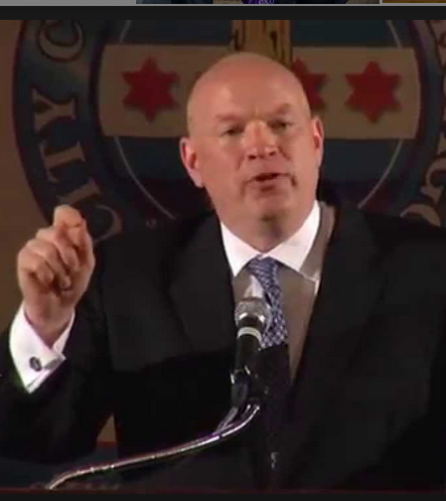
Recovery
Dixon Hires Power Rogers & Smith
Devon Bruce Partner pursues civil case
Recovers $40 M from CLA and Fifth Third Bank
Federal Marshalls horse auction $10-12 M
https://www.youtube.com/watch?v=EDjFX6AhwgQ

Slide 27

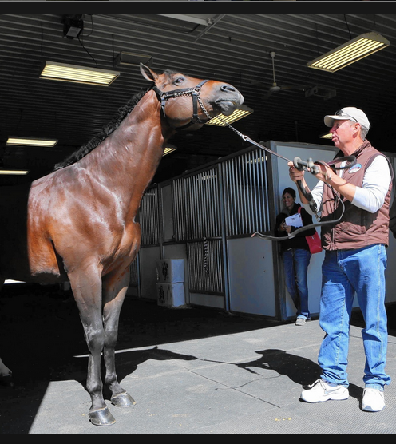
The Auction – Three Days

Slide 28
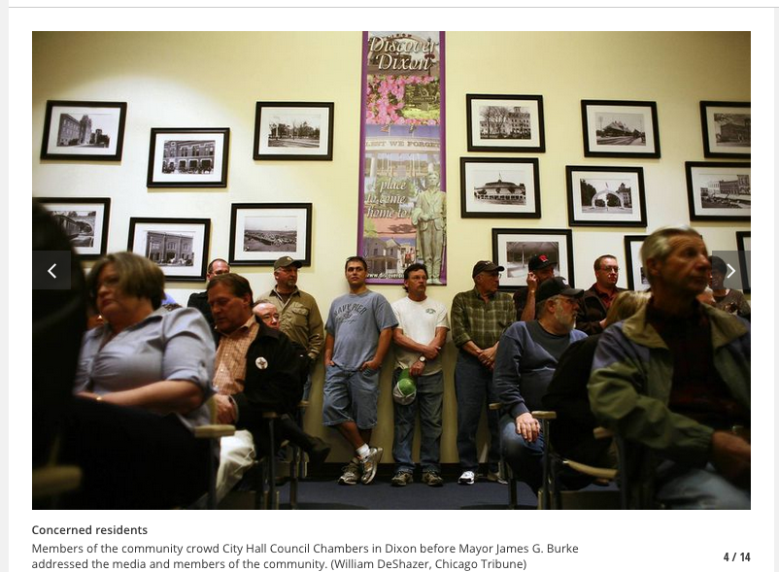
The Victims Gather at City Hall

Slide 29
Fraud Checklist, all the Boxes!
Separation of Duties – Comptroller & Treasurer
Bank Reconciliation – all accounts same bank!
Actually did leave for Horse Shows
No real audit
Played on CLA softball team
Living beyond one’s means Why stay City Accountant?

Slide 30
Multiple Fraud Dynamics
Fraud Triangle
  Opportunity, Rationalization, Urge
Fraud Diamond
  Ability to Pull off Scheme
Fraud Pentagon
  Belief they will not be caught
  Weinstein, Cosby, Crundwell
Why didn’t RC shut it down before vacation?
This was a fraud that could have been undone unlike Ponzi Scheme

Slide 31
Narcissistic Disorder
Mayo Clinic
a mental condition in which people have an inflated sense of their own importance, a deep need for excessive attention and admiration, troubled relationships, and a lack of empathy for others. But behind this mask of extreme confidence lies a fragile self-esteem that's vulnerable to the slightest criticism.

Slide 32
Sociopath
Mayo Clinic
a mental disorder in which a person consistently shows no regard for right and wrong and ignores the rights and feelings of others. People with antisocial personality disorder tend to antagonize, manipulate or treat others harshly or with callous indifference. They show no guilt or remorse for their behavior.
Professor, moral immoral amoral

Slide 33
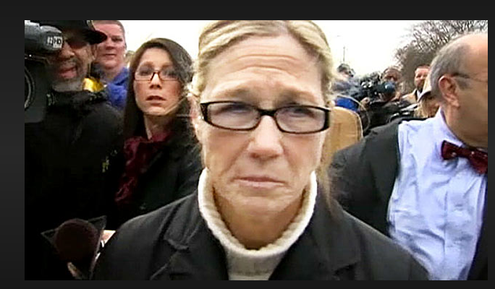
Then and Now

Slide 34
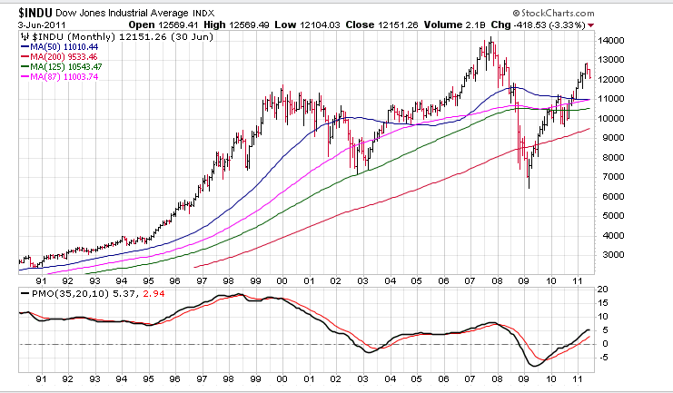
A Socionomic Perspective
1990-2011 / 2,500 – 13,000

Slide 35
Social Mood
Mood Motivates Actions
Mood Internally generated
  Rita played on the CLA’s softball team
People are not Skeptical Enough
  I was similar position similar sized County
  Someone would have noticed my lifestyle

Slide 36
Centro Case
Smaller Version of Dixon, IL
No background check
One Person Receives and Spends money
Where was the oversight?
A $291,000 fraud

Slide 37
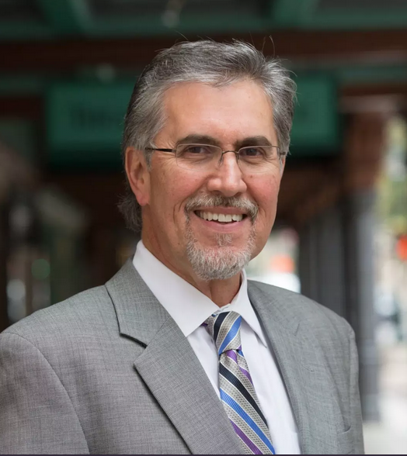
The Players
NW Univ Poli Sci
Univ Pittsburgh MPA
Deputy / City Mgr Kalamazoo, MI
Eco Development
Deputy City Mgr SA 6 Yr
President CEO Centro SA
Pat DiGiovanni

Slide 38
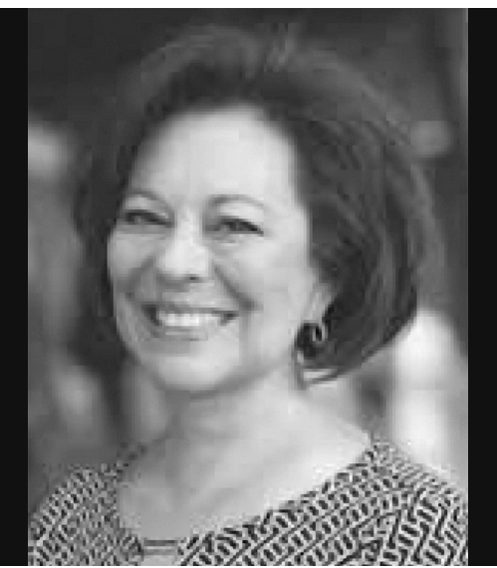
Gloria Padillo
1984 UTSA Grad
Former Alicia Henderson
Divorced 2018
Bankrupt, Previous fraud, not clear if jail time served

Slide 39
Centro
In January 2013, Pat DiGiovanni began leading Centro San Antonio’s efforts to foster a vibrant and prosperous downtown that benefits the entire San Antonio community, including focusing on guiding and leading development in the center city.

Slide 40
Centro
It also has a multimillion-dollar contract with the city to manage the downtown public improvement district, or PID, which collects property taxes to perform extra services such as street sweeping and graffiti removal.
Centro oversees two nonprofits: Centro Alliance, a lobbying wing for downtown developers and businesses, and another that oversees the PID, which the city pays the nonprofit to manage.

Slide 41
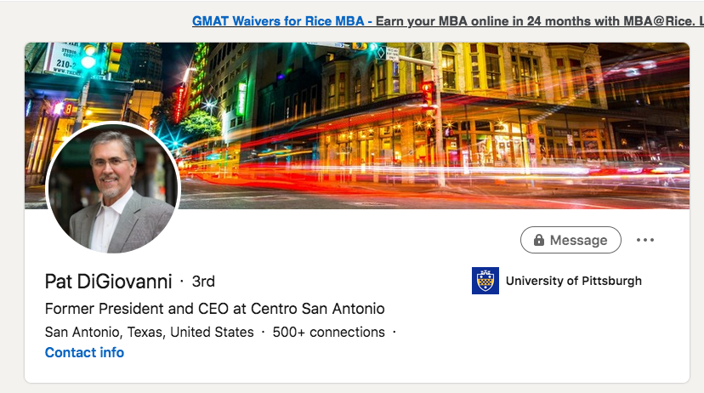
Pat’s Linked In Page
Contrition?

Slide 42
The Set Up
Hired as the bookkeeper for Centro late 2017
No background check by Emp Firm or Centro
At the time of her hire, Padilla already had been convicted of felony bank fraud in 1997 and charged with theft by check in 1989 and 1991. She was sentenced to one month in prison, five years of supervised release and $113,614 in restitution in the bank fraud case, federal court filings show. It’s unclear if she actually served time.
She also had financial trouble, filing for bankruptcy protection in 2013 and again in 2017, just months before the Centro scandal erupted.

Slide 43
No Lack Red Flags
E mails between Padilla and the City show she habitually turned in invoices months later than she was supposed to, and that her submissions often had errors and were missing the required backup documents.
She submitted the invoices late nearly every month in 2017, the emails show. City employees pointed out errors in her work on at least three occasions that year.

Slide 44
Lack of Oversight
During Padilla’s three years as Centro’s office manager and accountant, city employees emailed her supervisors on occasion to let them know she was late submitting invoices. But Ben Gorzell, the city’s chief financial officer, said he didn’t know of any instances of employees raising alarms about her work performance.

Slide 45
It Gets Better
The Fake Audit
She had recruited her ex-husband to pose as an auditor in front of the nonprofit’s board, the two lawyers told the Express-News.
In reality, no audit had been conducted. At the January meeting, Padilla admitted she fabricated one to fool Centro’s executives and board.
Husband claimed he was with CPA firm which had audited
Centro Board Member called the firm, What audit?
Sounds a lot like Dixon IL!

Slide 46
It Might Have Been Worse
The city has paid Centro $22.2 million since 2013 to manage the downtown district. City Manager Sheryl Sculley and two other city officials serve on its board.
Centro’s formation in 2010 was led by Sculley and other city officials, who envisioned an organization that would unite political and business leaders in a mission to transform downtown from a sleepy tourist district into a dynamic urban neighborhood.

Slide 47
I/C Failure
No Sep of Duties, Received and wrote checks
7/14-11/17 forged 118 checks $291,385 on Centro at Jefferson Bank
Disguised Payments to herself as for various vendors
Serving 33 Months in Prison and Restitution

Slide 48
Block by Block Complains
Contractor with Ambassador Amigos, Yellow shirted contractors
Not getting paid
Dgiovanni has signed the checks!
DiGiovanne talks to Don Frost, Centro Chair Asst City Mgr Lori Houston
The emails show Padilla and Centro’s then-chief financial officer, Tony Piazzi, met with employees of the Center City Development and Operations Department in mid-March to set up a timeline for submitting invoices.
“One crisis after another until we are back on track which is coming up,” Padilla emailed a city employee later that month.

Slide 49
The Admission
In 2018, Padilla admitted to the embezzlement and promised to pay back what she could. She met with Centro representatives and told them no PID money had been taken
The Good News
An audit commissioned by the city found no taxpayer dollars had been embezzled, but that the city failed to properly monitor Centro’s finances.

Slide 50
Reality Check
Centro’s board forced then-CEO Pat DiGiovanni, a former San Antonio deputy city manager, to resign after the embezzlement was uncovered.
Chief Financial Officer Tony Piazzi, who oversaw Padilla, departed in March 2018.

Slide 51
The Tone at the Top
Centro spent thousands
  Lobbying
  Meals and trips
  Fundraisers & Mixers
Centro board members say they are baffled that it would take so long for the SAPD and the district attorney’s office to press charges, especially after Padilla’s admission.
“I would like to think that long before now they would have arrested her and try to retrieve money out of her bank accounts,” Adelman said. “I’m angry, but what can I do about that?”
Trish DeBerry, Centro’s board chairwoman, called it “completely unacceptable that an arrest has not been made.” Frost, who served as Centro’s chair until the end of last year, called it “frustrating.”

Slide 52
Tone at the TOp
Controversial ascent
DiGiovanni’s ascent to president and CEO of Centro in January 2013 was also fraught with scandal. He was admonished by the city’s Ethics Review Board for “unknowingly” violating San Antonio’s code of ethics Negotiated his contract with the nonprofit. Zachry Corp. CEO David Zachry, who was vice chairman of Centro at the time, was vying for a $305 million contract to expand the Convention Center. DiGiovanni was on the city’s selection committee for that contract while negotiating his salary with Zachry and other Centro board members.

Slide 53


Suggested Centro Mascot

Slide 54
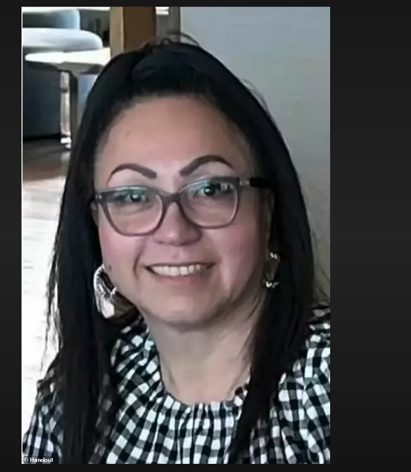
Meet Janet Mello
Finance Program Manager at Army Installation Management Command
Steals $108 M in six years
Fellow Employee letter to Judge, don’t send her to jail!
Darn but she is good
The New Face of Fraud!

Slide 55
Does this Sound Familiar?
2016 creates fake company Child Health and Youth Lifelong Development CHYLD
Submits fraudulent paperwork for CHLD to receive checks at UPS rented mail boxes
40 Instances
No services for Military 4 H program
Similarto Rita, no one asks for results

Slide 56
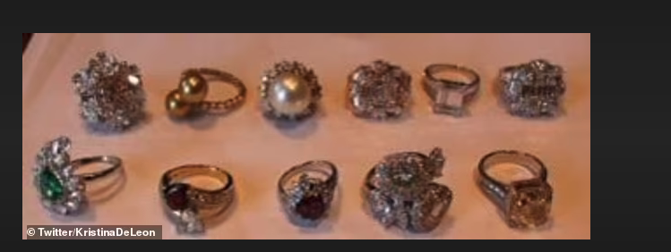
Gucci Queen
UPS and Fed Ex drivers delivered so may packages of Luis Vuitton , Coach, Gucci
Called her
Gucci Goddess

Slide 57

Maryland Estate, Maserati

Slide 58
The Scheme Unravels
CHYLD is on personal 1040
Under reports Income
IRS and Army Criminal Investigators raid her home in North SA
31 Real Estate, Condos, Homes, two large estates, Texas, New Mexico, Maryland, WA
Land Horse Shoe Bay and Canyon Lake
11 Acres Overlooking Puget Sound

Slide 59
But!
Base San Antonio Fort Sam Houston lets her retire with full benefits after the raid
Prosecutors say difficult to pursue retirement as she was not fired!
She was trusted, no review of CHYLD and Janet

Slide 60
The Sentence
Five counts mail fraud
Five counts false income tax return
Received $108,917,749
Oddly no one else charged
Fifteen Years Prison
Army apparently suppressing news and publicity

Slide 61
Lessons
All three female, the new trend
All three government employees
No internal audit
Vacations? No one steps in and recalculates
No inspection of results In Dixon, Centro, Mello
Lack of Professional Skepticism
Celebrity Board at Centro
Everyone’s Money is No One’s Money

Slide 62

Red Flags?

Slide 63
Compare Dixon and Centro
Rita was a clever fraudster, Gloria not so much
What could go wrong in a small town?
What could go wrong in a Big Town?
Ignored obvious red flags, lifestyle vs complaints
Apparently banks don’t investigate their account activity
Potential for larger loss in Centro, what if Centro had hired Rita?

