Slide 1

$718,000,000,000 of Hope and Hazard
Ken Dieffenbach, CFE
Department of Justice
Office of the Inspector General

Slide 2
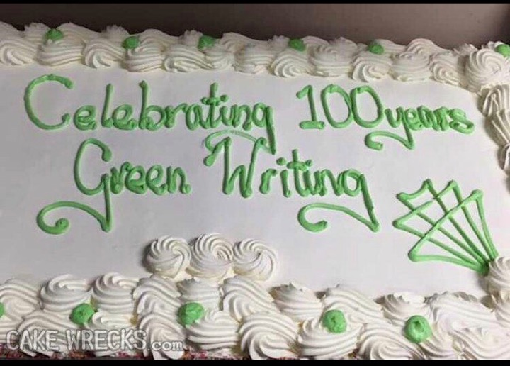

Slide 3
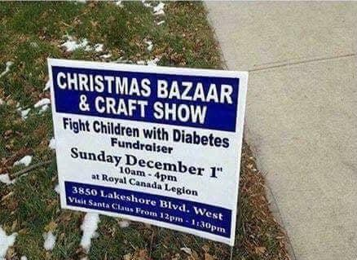

Slide 4

Office of the Inspector General
To detect and deter waste, fraud, abuse, and misconduct in DOJ programs and personnel, and to promote economy and efficiency in those programs.

Slide 5
Grants
Safeguards
UGG

Slide 6
Grants
Safeguards
UGG

Slide 7
Grants
Safeguards
UGG

Slide 8
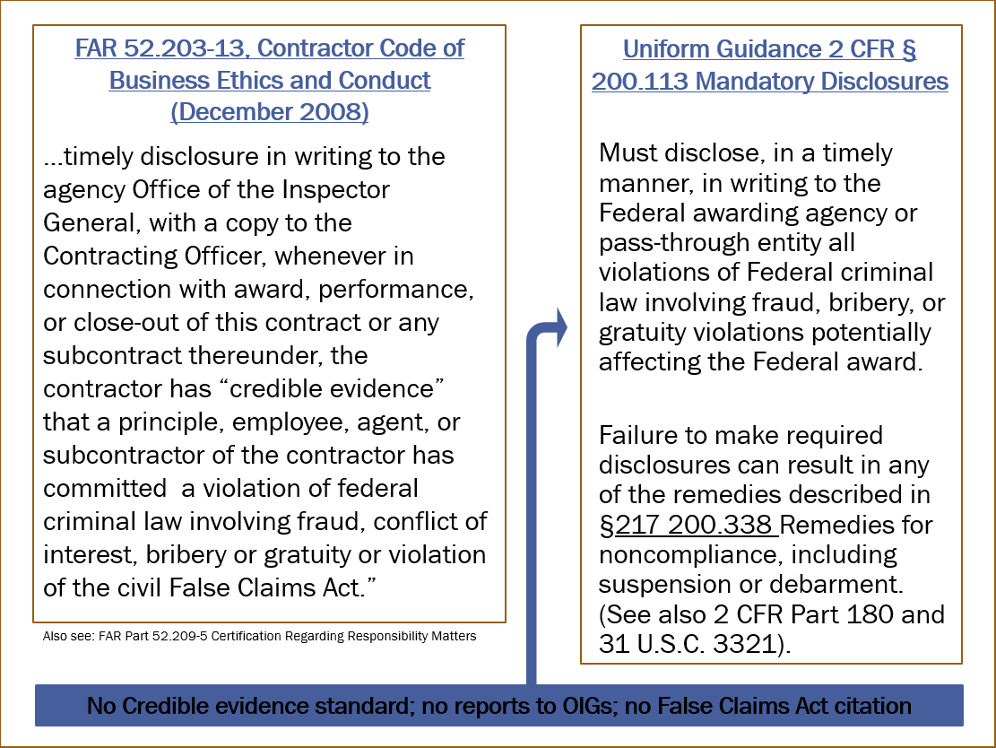

Slide 9
Risk

Slide 10
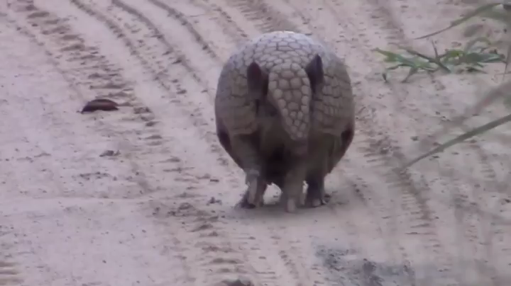

Slide 11
Lying, Cheating, and Stealing

Slide 12
Lying, Cheating, and Stealing

Slide 13
Inducement Fraud
Two individuals submitted grant proposals using the stolen identities of real people to create false endorsements and also lied about their facilities, costs, the principal investigator on some of the contracts, and certifications in the proposals.
(Source: Press Release, U.S. Attorney’s Office, Middle District of Florida, September 11, 2015)

Slide 14
Failure to Have Accounting Procedures
An grantee certified that it had written procedures in place to protect grant funds from misuse. A court later found that the organization did not have such policies and ordered payment of $844,985.
(Source: Court Order, Eastern District of California, December 2014)

Slide 15
Commingling
Big Brothers Big Sisters of America agreed to pay the United States $1.6 million to resolve allegations of false claims related to their commingling of over $10 million in grant funds with general operating funds.
(Source: Press Release, U.S. Attorney’s Office, Eastern District of Pennsylvania, January 21, 2016)

Slide 16
Background Checks
The Foster Grandparent Program required background checks for volunteers. A grantee failed to conduct or maintain adequate documents related to these background checks and employees “cut and pasted” forms in an effort to conceal this shortcoming. The grantee agreed to a $1.1 million civil settlement.
(Source: Press Release, U.S. Attorney’s Office, Eastern District of Pennsylvania, June 28, 2019)

Slide 17
Research Compliance
A university professor created false Institutional Review Board approvals and submitted them to the government in connection with multiple proposals. The case settled for $132,000.
(Source: Press Release, U.S. Attorney’s Office, Western District of Pennsylvania, March 21, 2018)

Slide 18
Research Misconduct
An individual knowingly made false statements about his research results, and these statements resulted in additional federal grant awards. The court ordered 57 months in prison and $7.2 million in restitution.
(Source: Press Release, U.S. Attorney’s Office, Southern District of Iowa, July 1, 2015)

Slide 19
Lying, Cheating, and Stealing

Slide 20
Grantee Ineligibility
The government awarded a grant to a nonprofit organization, which in essence turned over the award funds and program responsibilities to a related for-profit entity. The matter settled for $528,000.
(Source: Press Release, U.S. Attorney’s Office, Eastern District of Kentucky, September 19, 2018)

Slide 21
Organizational Self-Dealing
Several individuals sent federal grant funds intended for nonprofit public health services to for-profit entities controlled by the conspirators. One individual was sentenced to 18 years in prison and ordered to pay $13.5 million in restitution.
(Source: Press Release, U.S. Attorney’s Office, Northern District of Alabama, June 17, 2016)

Slide 22
Sub Award Self-Dealing
An elected state official helped direct a federal grant sub award to a university while also separately negotiating with the school to run the newly created program. The official was ordered to serve 9 ½ years in prison.
(Source: Press Release, U.S. Attorney’s Office, Eastern District of Virginia, August 12, 2011)

Slide 23
Lying, Cheating, and Stealing

Slide 24
Charter Schools Theft
An individual stole $3 million from several charter schools by creating fake companies and funneling school funds to those “businesses.”
(Source: Press Release, U.S. Attorney’s Office, District of New Mexico, October 12, 2018)

Slide 25
Emerging Issues
Alternative remedies; civil monetary penalties
Research misconduct
Technology transfer / foreign threats and influence
Spending transparency

Slide 26
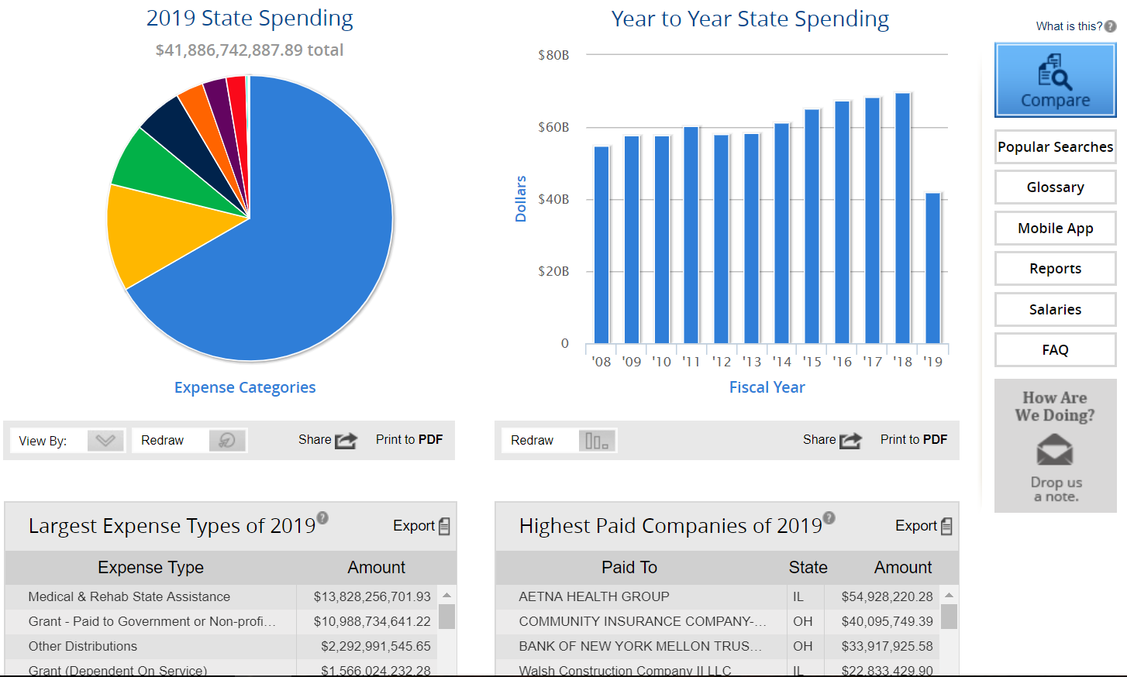
Ohio Checkbook
www.ohiocheckbook.com

Slide 27
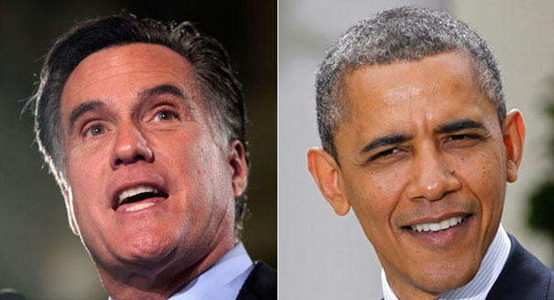
Campaign spending: Romney prefers Panera; Obama likes Cosi
Panera: $9,266.34
Cosi: $1,077.85
Source: www.politico.com/news/stories/1012/82349_Page3.html, Oct. 2012

Slide 28
FEC.gov
“Report to Taxpayers”

Slide 29
Grant Fraud Prevention
Internal Controls Matter
Read the Agreement
Due Diligence is an Ongoing Responsibility
  Consultants and other Procurements
  Time and Effort Reports
  Indirect Cost Rates
  Applications, Financial Certifications, Progress Reports, & Drawdowns
If in Doubt, Ask the Grantor or an Outside Expert
Facilitate an Internal Dialogue

Slide 30
$718,000,000,000 of Hope and Hazard
Ken Dieffenbach, CFE
Department of Justice
Office of the Inspector General

Slide 32
From 2006 to 2010, a woman embezzled $297,612 from a non-profit organization that provided funds to needy families, by falsifying beneficiary’s eligibility and then splitting the proceeds with the recipients. (Great Falls Tribune, June 12, 2014)
Pay You
Pay Me

Slide 33
A Navy Exchange employee created fake invoices from “Biscover” and “Tears National” to divert $750,000 to her Discover and Sears credit cards. (Virginia Pilot, December 8, 2009)
Pay Your Bills with Checks

Slide 34
A corporate finance executive wire transferred corporate funds to pay her personal credit card a total of $34 million. (Milwaukee Journal, December 13, 2014)
Pay Your Bills with ACH Payments

Slide 35
From 1995 to 2000, employees of a McDonald’s vendor stole winning monopoly game pieces and “won” virtually all the top prizes in the Monopoly game—a total of $24 million. 21 people were indicted. (Wikipedia)
Take an Asset

Slide 36
$718,000,000,000 of Hope and Hazard
Ken Dieffenbach, CFE
Department of Justice
Office of the Inspector General

