Slide 1
December 10th, 2020
Paul Ferwerda, CFA

Slide 2
Five Tips for Making Better Decisions in a Connected World

Slide 3
5
Beware
the expert.

Slide 6
Limit your body’s influence on decisions.
4

Slide 7
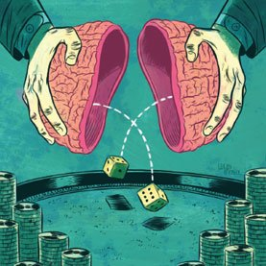

Slide 9
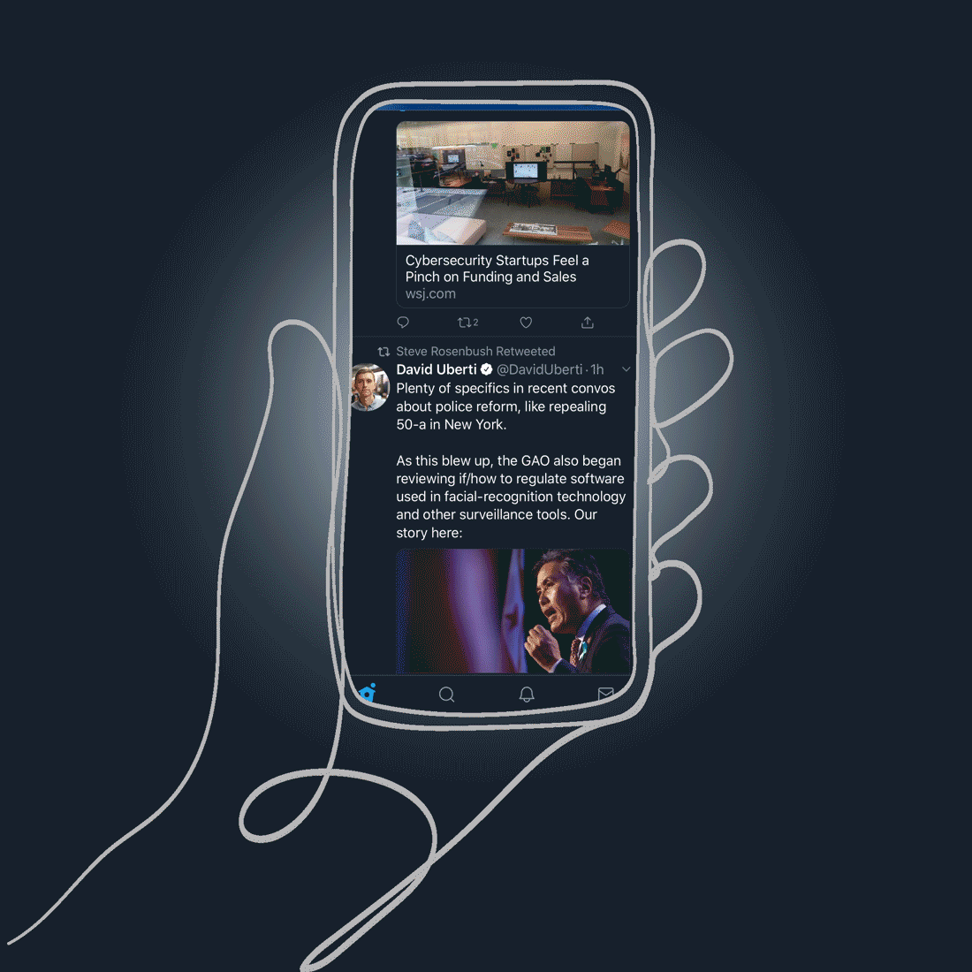
Doomscrolling – When we feel compelled to search for negative news.

Slide 10
Keep your future self in focus.
3

Slide 12
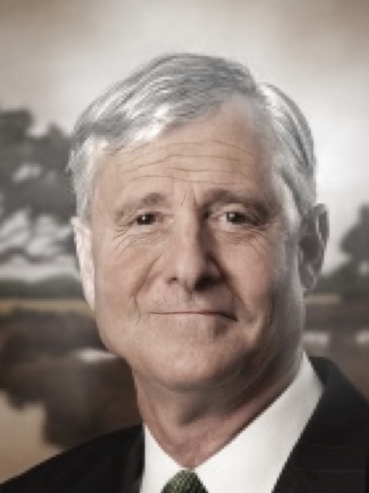

Slide 15
Know what you don’t know.
2

Slide 16
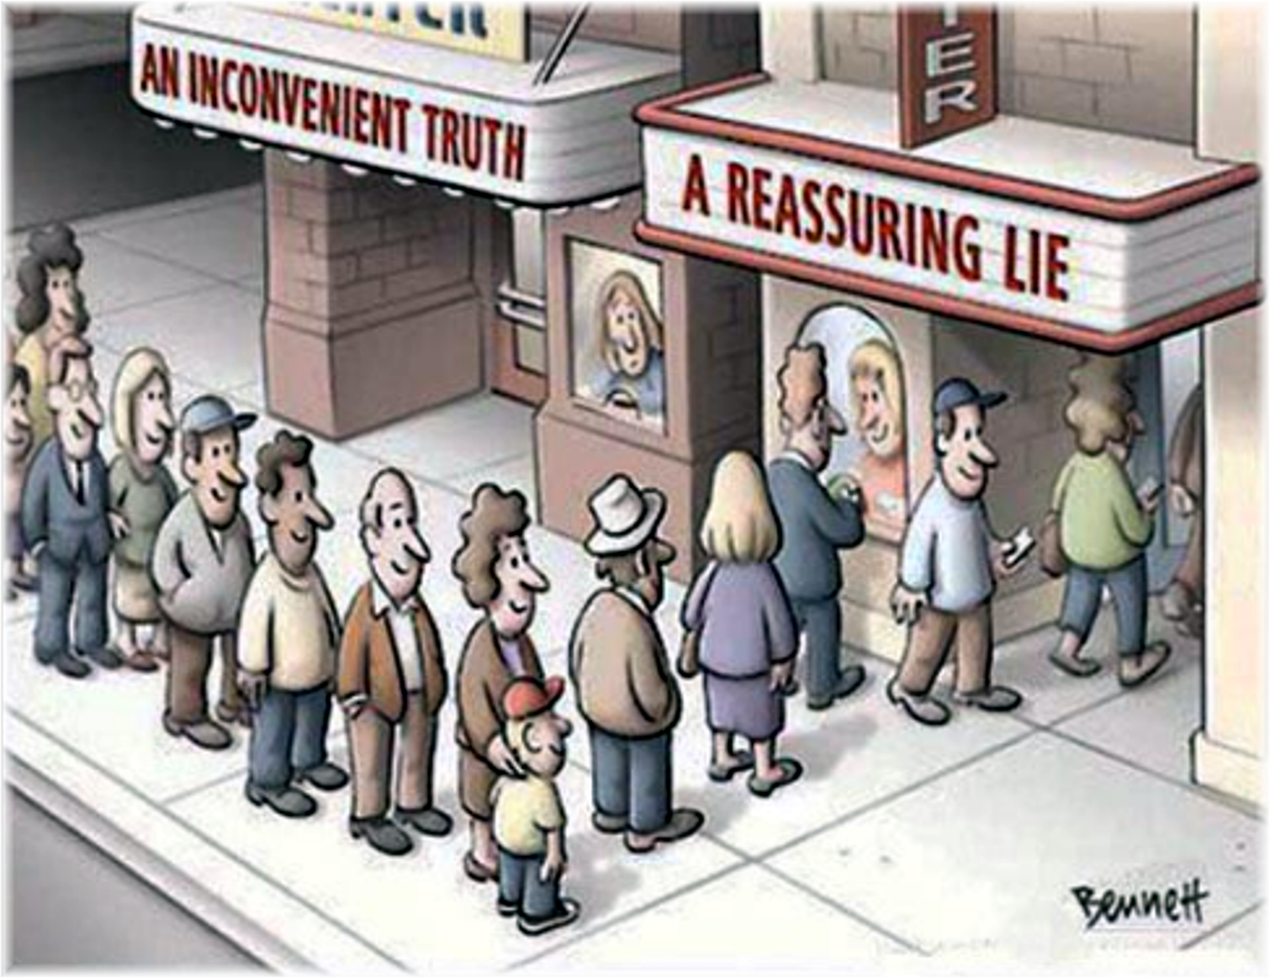
Cognitive Bias: A Systematic Error in Thinking

Slide 18
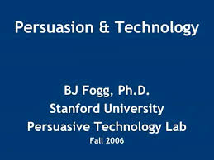
Captology: the study of how computer technology can be used to change people’s opinions or to persuade them to do something.
Cambridge Dictionary

Slide 19
Confirmation Bias: Seeking Information Matching your Beliefs

Slide 20
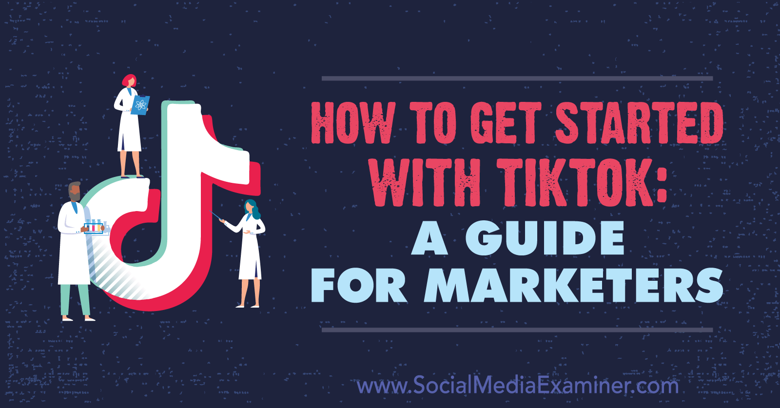

Slide 21
Confirmation Bias: Seeking Information Matching your Beliefs
36% Top link
12% Top 2 links
6% Top 5 links
2% Top 10 links

Slide 22
Recency Bias: Too much emphasis on recent information.

Slide 23
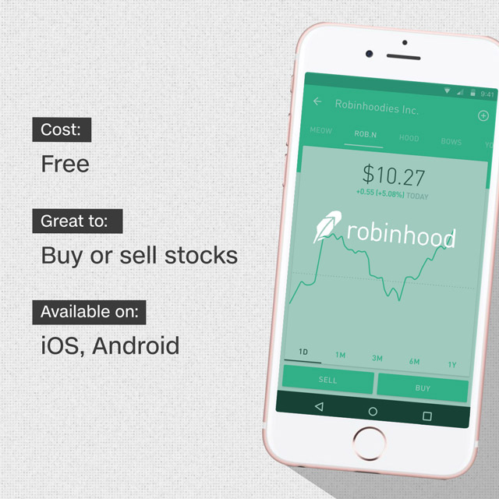

Slide 24
Outcome Bias: Judging the Quality of the Decision by the Outcome.

Slide 25
Stay curious and think deeply.
1

Slide 28
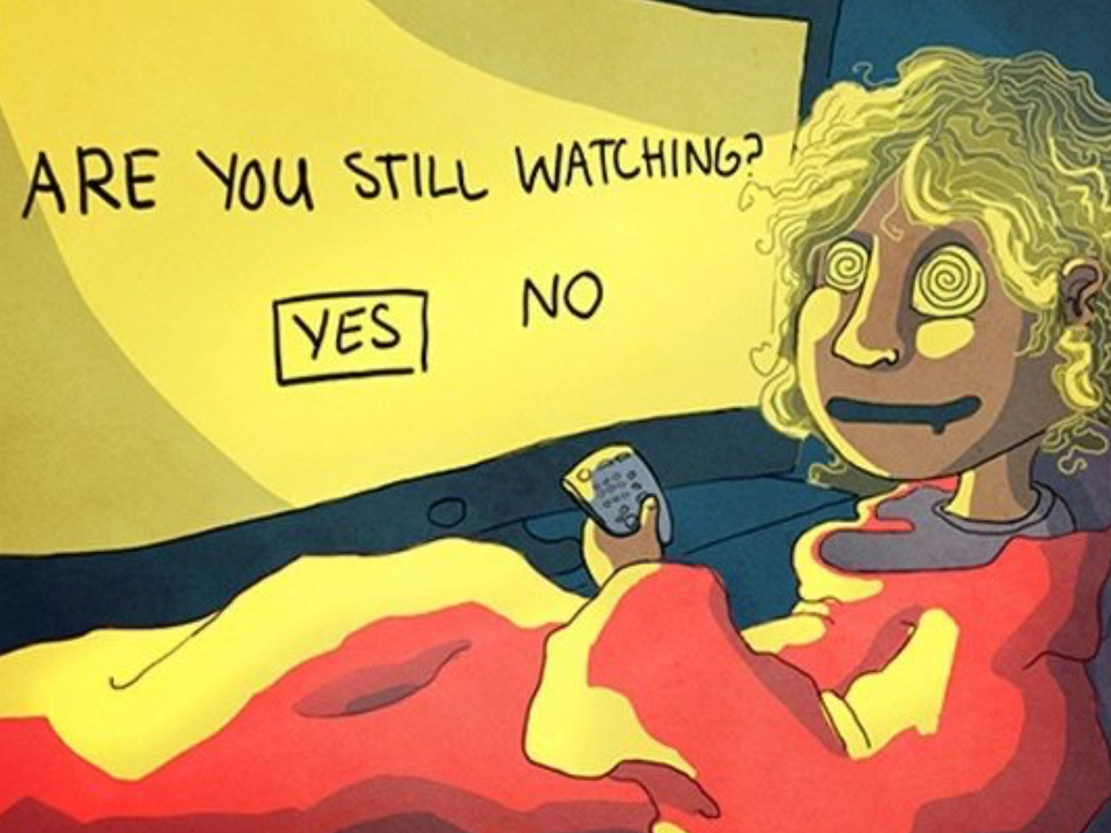

Slide 32
December 10th, 2020
Paul Ferwerda, CFA
paul.ferwerda@wstam.com

