Slide 1

Planning an Audit Based on Fraud Risk Indicators
Presented by: Richard A. Leach, CFE, CIA
Director and Senior Advisor, Government Advisory Practice
Date, 2019

Slide 2
Please read
This presentation has been prepared for information purposes and general guidance only and does not constitute professional advice. You should not act upon the information contained in this publication without obtaining specific professional advice.
No representation or warranty (express or implied) is made as to the accuracy or completeness of the information contained in this publication, and CohnReznick LLP, its members, employees and agents accept no liability, and disclaim all responsibility, for the consequences of you or anyone else acting, or refraining to act, in reliance on the information contained in this publication or for any decision based on it.
This presentation and its content are the property of CohnReznick LLP and are protected by applicable copyright laws. Any unauthorized use of the information herein will be considered a violation of CohnReznick LLP’s intellectual property rights. Unless stated otherwise herein, no part of this presentation may be copied, distributed, or published, in whole or in part, without the prior written agreement of CohnReznick LLP.

Slide 3
agenda

Slide 4

Today’s Topics
Number of Government Auditors is Declining
Federal Enterprise Risk Management (ERM) and Internal Control Policies
GAO Annual High Risk List
Criteria for Fraud Risk Assessments and Auditing
Define the types of fraud
Organizational cultures that increase fraud risk
Fraud and Cultural Triangles
Fraud Risk Assessments and Prevention Controls

Slide 5
presentation

Slide 6
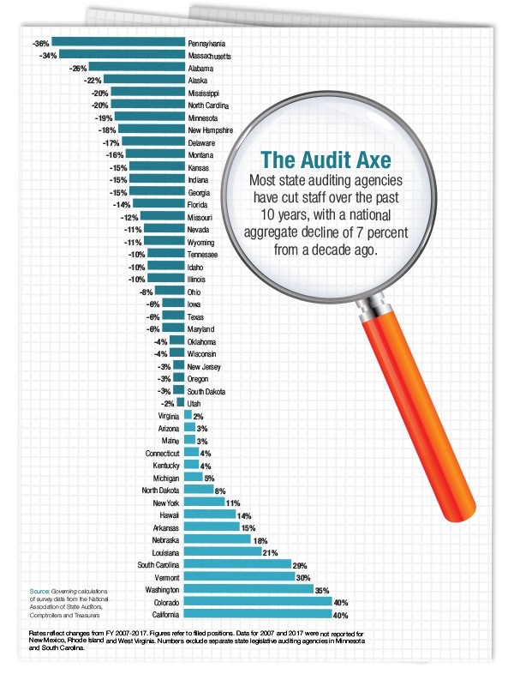

Growing Risk of Reduced Auditing

Slide 7
Federal Employee Responsibilities
OMB Circular A-123, “Management’s Responsibility for Enterprise Risk Management and Internal Control”
All Federal employees are responsible for:
  Safeguarding Federal assets and the efficient delivery of services to the public.
  Ensuring compliance with relevant laws and regulations, and managing both expected and unexpected or unanticipated events.
  Implementing management practices that identify, assess, respond, and report on risks.
All Federal managers are also responsible for establishing and maintaining internal controls to achieve specific internal control objectives related to operations, reporting, and compliance.

Slide 8
Standards for Internal Control
GAO Green Book
“Standards for Internal Control in the Federal Government”
“Risk Assessment” is a key component of internal control
Principle of Internal Control: “Fraud Risk Assessment” used in the identification and assessment of risks.”
“Management should consider the potential for fraud when identifying, analyzing, and responding to risks.”
Managing Fraud Risk through Training:
Effective internal controls require the right training, tools, structure, incentives, and responsibilities is operational success possible.
“There is no substitute for knowledge.” - W. Edwards Deming

Slide 9

Standards for Internal Control
2
Risk Assessment
1
Control Environment
3
Control Activities
5
Information and Communica-tion
4 Monitoring
GAO Green Book (contd.)
Five Components
of Internal Control
Incentive/
Pressure
Opportunity
Attitude/
Rationalization
Risk Factors
(Nearly Identical to the
Fraud Triangle)

Slide 10
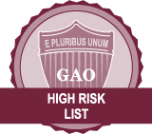

Where to Find High Risk Federal Programs
2019 High Risk List
GAO annually prepares “High Risk List” of programs and operations having vulnerabilities to fraud, waste, abuse, mismanagement, or need transformation.
2019 Risk Area Examples
Government-wide Personnel Security Clearance Process — NEW
VA Acquisition Management — NEW
2020 Decennial Census
Enforcement of Tax Laws
Ensuring the Cybersecurity of the Nation
Funding the Nation's Surface Transportation System
Improving Federal Oversight of Food Safety
Improving the Management of IT Acquisitions and Operations
Medicare Program & Improper Payments
Strengthening Medicaid Program Integrity

Slide 11

Types of Government Audits
Financial Audits (External Audits)
Performance Audits (Internal Audits)
Non-Audit Monitoring/Management Reviews
Independent assessment of financial condition, results, and use of resources
Includes reports on internal control having a material effect on the financial statements
Because the determination of abuse is subjective, auditors are not required to detect abuse in financial audits
Provide evaluations of either financial or non-financial topics
Audit objectives may include and assessment of:
Internal controls to provide reasonable assurance of achieving effective and efficient operations,
Reliable financial and performance reporting, or
Compliance with applicable laws and regulations
Involves either ongoing monitoring procedures or separate evaluations to gather and analyze the effectiveness of the internal control system

Slide 12
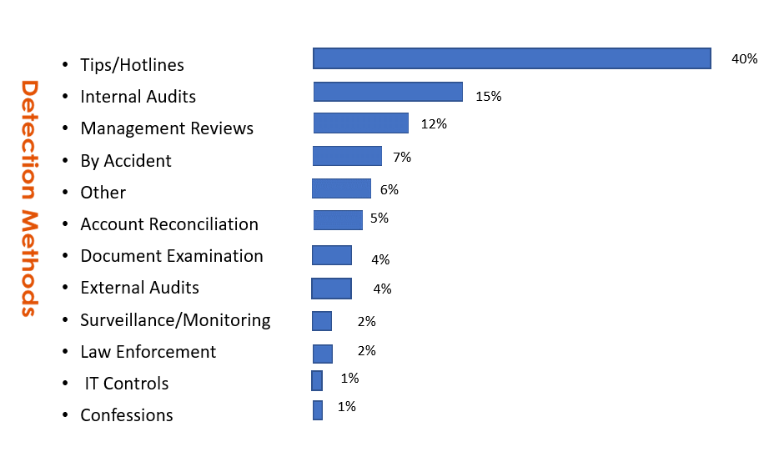
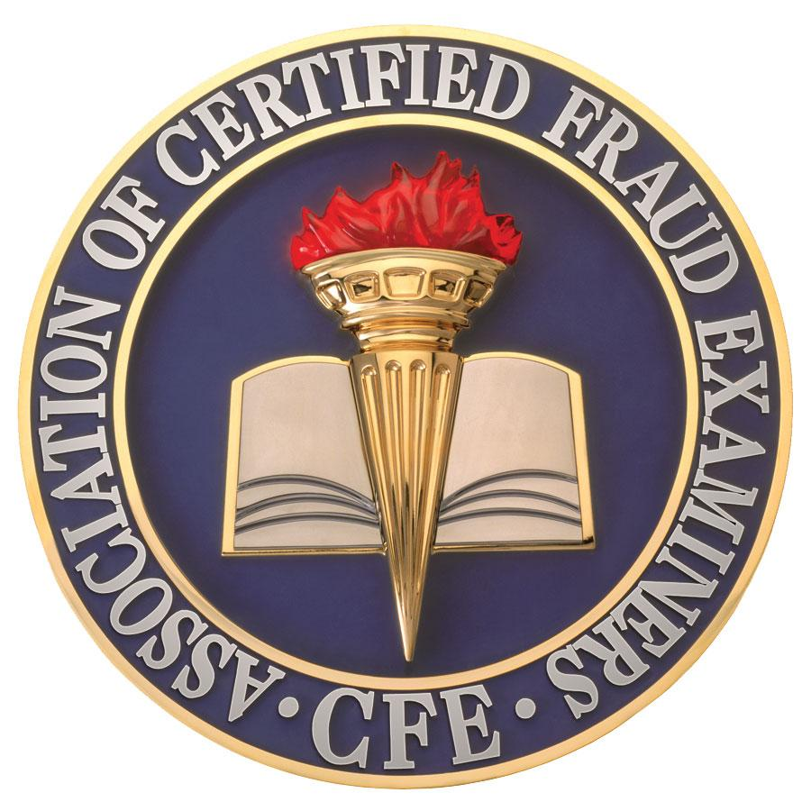
Sources for Fraud Detection
Source: “ACFE Report to the Nations”
2018 Global Study On Occupational Fraud and Abuse

Slide 13


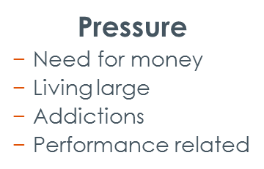


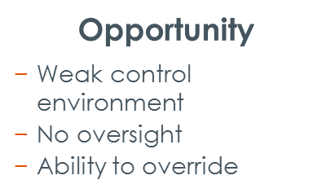
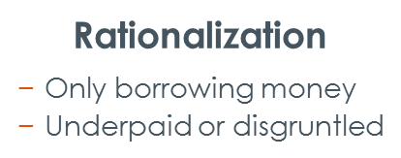
The Fraud Triangle

Slide 14


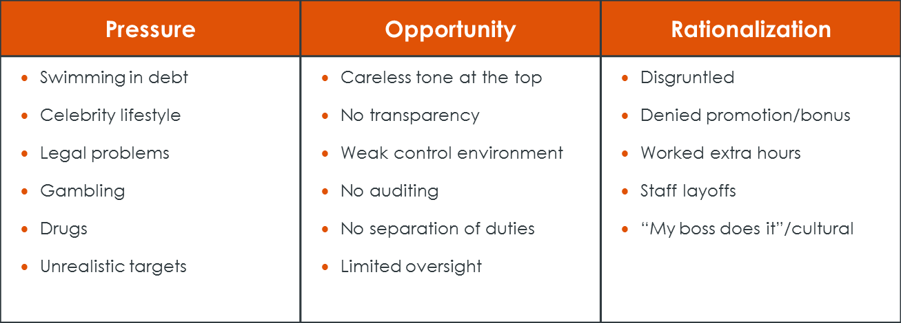




Red Flags

Slide 15


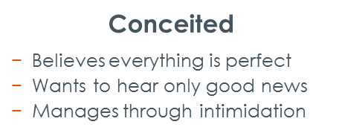
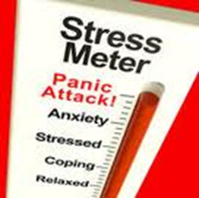

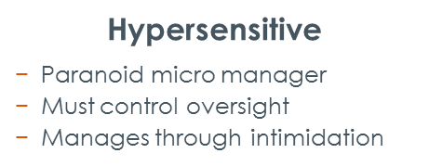
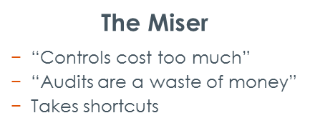

Culture and Attitude Triangle

Slide 16


Tone From the Top!
The Most Important Internal Control…..
Andy Fastow:
“I knew it was wrong, but I didn’t think it was illegal.”
Bernie Ebbers:
“I know what I don’t know. I don’t know technology, and I don’t know finance and accounting. No one will find me to have knowingly committed fraud.”
Bernie Madoff: “I was always able to rationalize [the fraud]. I tried to give moneys back to my clients…They wouldn’t take it back. Everyone said “No, you can’t do that. You can’t send me my money back. I have been a friend of yours, or a client for years.”
Ken Lay: “I take full responsibility for what happened at Enron. But saying that, I know in my mind I did nothing wrong. I can’t take responsibility for criminal conduct inside the company.”
“Any slots at the senior level including the CEO or other slots, will be filled internally.”

Slide 17



Judgment and Skepticism
Professional judgment: (Who Watches the Watchers?)
Application of knowledge, skills, and experience
Exercise reasonable care and professional skepticism
Professional skepticism: (Trust But Verify)
Attitude for questioning and assessing control environments and evidence.
Professional skepticism does not automatically assume management is honest or dishonest.
Beware of streamlining directives to eliminate internal controls

Slide 18

Fraud Risk Prevention Controls
Ethical Culture and Tone From the Top Code of Conduct Know Your Employees Mandatory Ethics Training Anti-Fraud policy Hotlines Surprise Audits | Job Rotation/Mandatory Vacation Employee Assistance Programs Protection and Rewards for Whistleblowers Fraud Awareness Training Internal Audit Program Management Reviews of Internal Controls Independent Audit Committee

Slide 19
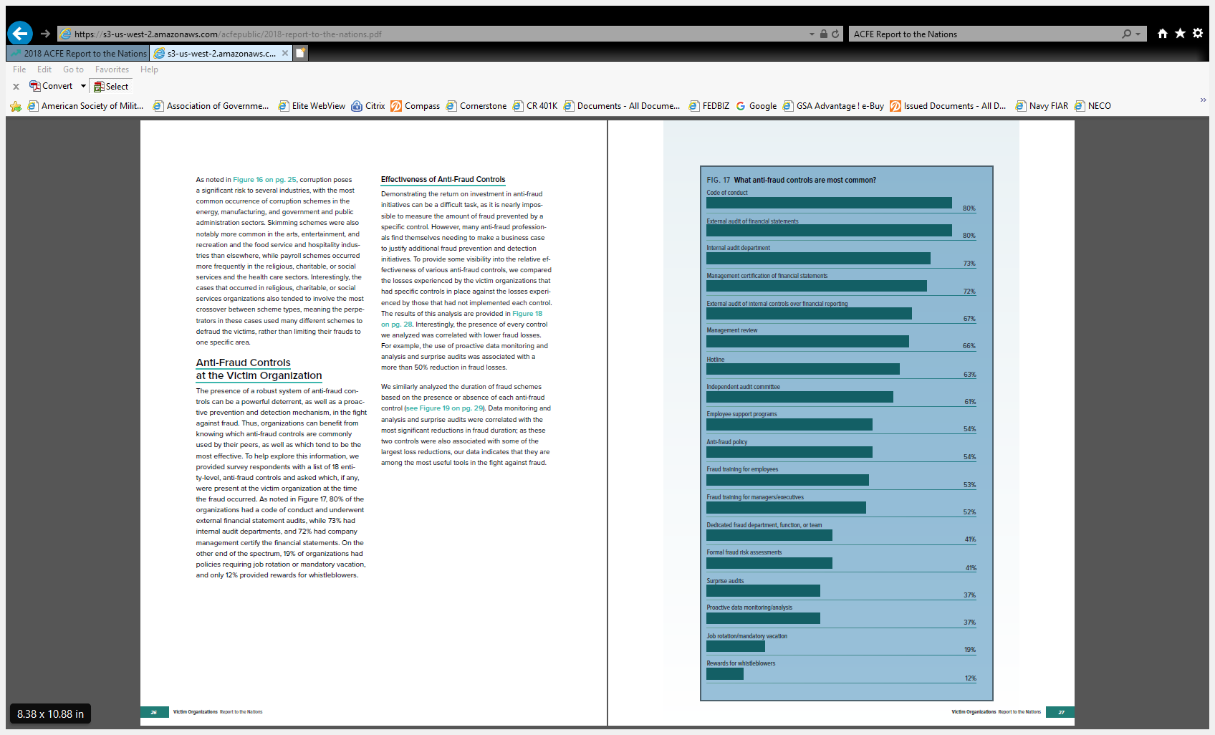
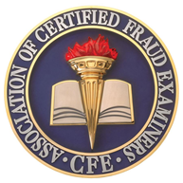

The Most Common Anti-Fraud Controls
Source: “ACFE Report to the Nations”
2018 Global Study on Occupational Fraud and Abuse”

Slide 20
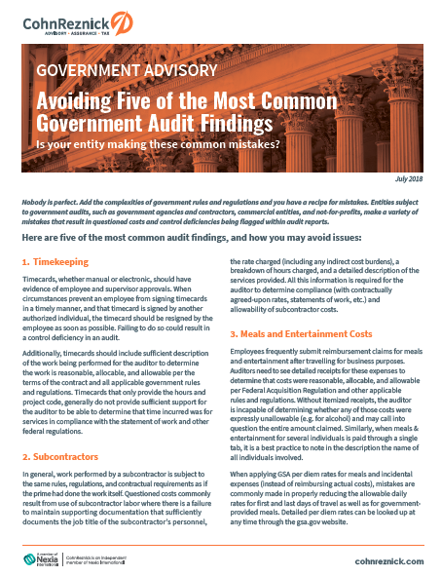
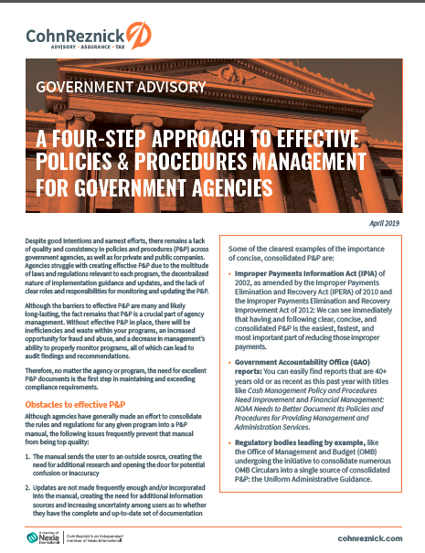
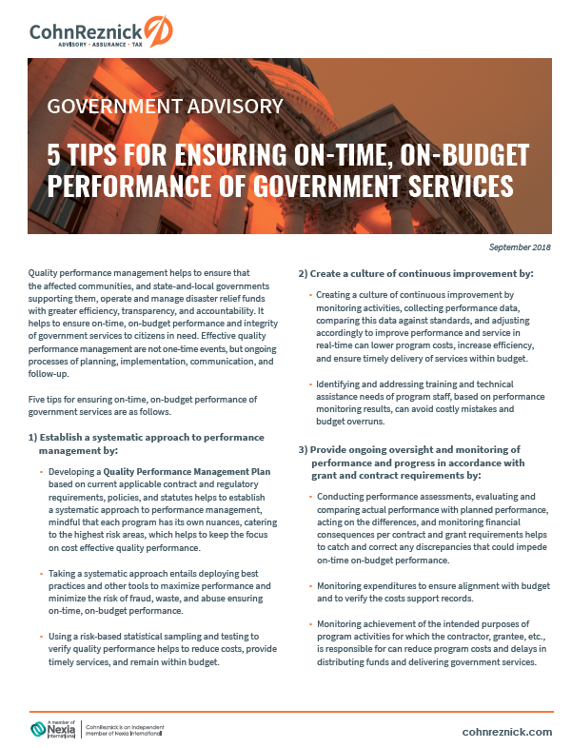
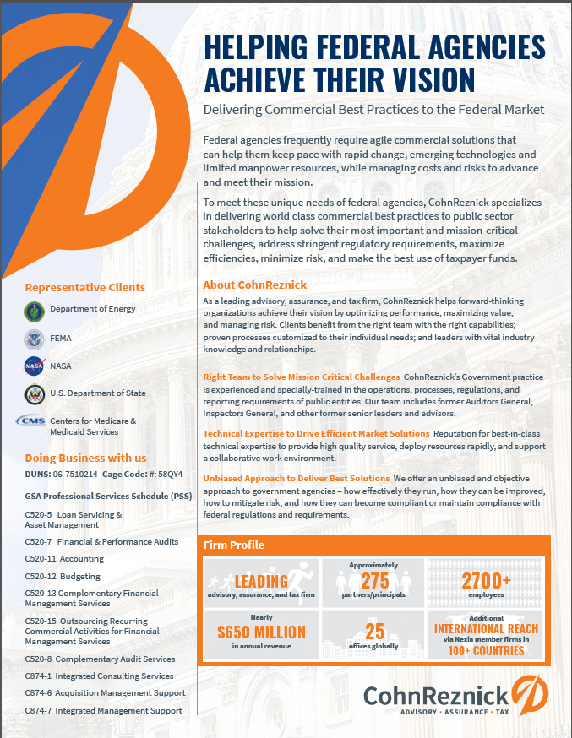


Slide 21
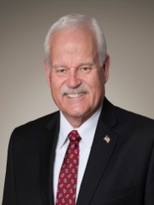

CONTACT US
Richard A. Leach, CFE, CIA
Director and Sr. Advisor
CohnReznick Government Advisory Practice
301-280-1919
Richard.Leach@cohnreznick.com
Richard Leach, CFE, CIA, a Director and Senior Advisor with the Government Advisory Practice of CohnReznick Advisory Group, has more than 35 years of government auditing experience. Richard enhances the Firm’s capabilities in providing government audit, accounting, and compliance services to the U.S. Department of Defense and key civilian agencies.

