Slide 1
Application of Emotional Intelligence
Kim Farington
CFO, FirstNet
December 13, 2019

Slide 2
Example #1
This face is expressing...
Pride
Contempt
Excitement
Anger
Notes:
Answer: Pride
Pride involves signs of dominance. The corners of the lips rise slightly, signaling that the person is happy. But what distinguishes this from happiness is that the head tilts back, with a slight jaw-thrust. Those are classic signs of power and dominance—they suggest that we’re feeling strong.
The expression of pride is also close to the expression of contempt. They both involve a backward head tilt, but contempt doesn’t involve a slight smile like pride does; instead, with contempt the lip movement is asymmetrical—only one side tightens.
https://greatergood.berkeley.edu/quizzes/ei_quiz/results/
https://icebreakerideas.com/emotional-intelligence-test/
https://www.emotionalintelligence.net/

Slide 3
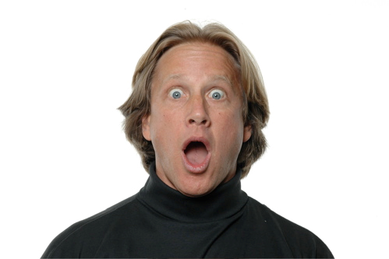
Example #2
This face is expressing...
Fear
Interest
Surprise
Compassion
Notes:
Answer: Surprise
Surprise is often confused with fear. But when we’re afraid, our lower eyelids tighten and our eyebrows look flat and tense; with surprise, our upper eyelids rise up and our eyebrows arch. Also, our jaws drop when we’re surprised, but our lip corners go sideways when we’re afraid, making the mouth look tighter.
Some experts believe our eyes open wide like this because when we’re confronted with something surprising—a long-lost friend, an unexpected award—we try to absorb as much of this new information as possible.

Slide 4
Example #3
This face is expressing...
Anger
Pain
Disgust
Sadness
Notes:
Answer: Disgust
When we feel disgust, the muscles above the upper lip pull up, raising the upper lip, wrinkling the nose, and narrowing the eyes.
People often confuse disgust and anger. But anger tightens the mouth and lowers the eyebrows more significantly, and raises the upper eyelid. With disgust, the mouth opens and the tongue comes out, just in case you need to throw up.

Slide 5
Session Objectives
Emotional Intelligence and Body Language
Assess Listening Skills
Understand Non-verbal Communication
Traits of Leaders with High Emotional Quotient
Responding to Emotionally Charged Situations
Tips for More Successful Emotional Intelligence

Slide 6
Emotional Intelligence and Body Language
Body language communicates up to 60% of what you want to say
Anger: Hands on hips or arms folded, eyes staring
Happy: Relaxed body, smiling, open arms and legs
Anxious: Restlessness, rapid breathing
Interest: Leaning forward
Sadness: Drooping body, mouth turned down
Surprise: Eyebrows up, wide eyes, mouth open
Notes:
60% - Burleson Greene – Handbook of communication and social interaction skills (2003)

Slide 7
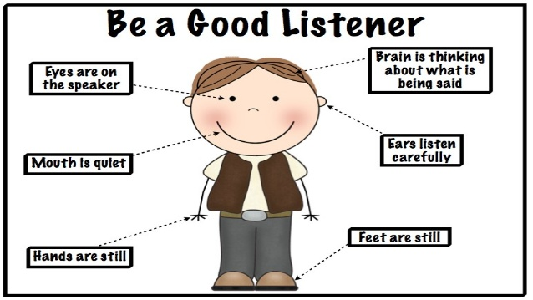
Listening Skills
Listening takes practice
Be attentive
Ask open ended questions
Follow-up questions
Request clarification
Paraphrase and summarize
Watch body language

Slide 8
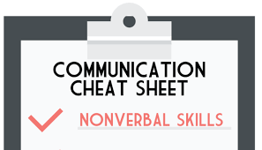
Non-Verbal Communication
Gestures
Eye Contact
Body Posture
Appearance
Head Movements
Hand Movements
Fascial Expressions
Body Contact
Sounds

Slide 9
Traits of Leaders with High Emotional Quotient (EQ):
Remain Calm and Composed
Find the “Rainbow”
Smart Hiring and Nurturing
Set and Maintain Clear Boundaries

Slide 10
1) Remain Calm and Composed
You should:
Calm down
Survey the emotional landscape
Share calm with your team
Create a positive outcome
Empathize
You should not:
Lose your temper
Berate your team publicly
Send impulsive abusive emails
Hold a grudge

Slide 11
2) Find the “Rainbow”
You should:
Support failure
Help your team learn from failures
See the bright side of bad news
Continue moving your team toward its goals
Incorporate the insights learned
You should not:
Shy away from conflicts
Make it personal or negative

Slide 12
3) Smart Hiring and Nurturing
You should:
Look beyond the resume
Hire staff with the appropriate level of soft skills for their role
Help them learn
Allow staff to share new ideas
Listen and provide undivided attention
Provide honest feedback
Be patient
You should not:
Pile work on an overwhelmed team member
Be biased in new ideas shared
Disregard other’s point of view
Interrupt when staff express themselves

Slide 13
4) Set and Maintain Clear Boundaries
You should:
Understand your strengths and weaknesses
Own your “no”
Hold your ground in debates
Build trust with others
You should not:
Think you know everything
Just be a “yes” person or people pleaser

Slide 14
Responding to Emotionally Charged Situations
Neutrality
Less is more
Respect and Professionalism
Keep Calm
Pause
Think before you speak
Confidence

Slide 15
Tips for Improved and More Successful Emotional Intelligence
Learn more about the nonverbal communications and understand how to read them
Be conscious of your own non-verbals:
To boost your confidence stand with your arms stretched open
To increase participation, make sure you reflect that you are listening
Don’t be checking your watch or text messages
Instead, turn your head and torso to face the person who is speaking to you and make eye contact
Touch is the most powerful nonverbal cue
To connect instantly with someone, shake hands
One study showed that people are 2 ties more likely to remember you if you shake hands with them (Income Center for Trade Shows)

