Slide 1
Cybersecurity: Low-Cost Solutions and Best Practices
AGA Professional Development Training
December 10, 2020
Tyler Gall, CPA, CISA, CFE

Slide 2
Learning Objectives
Cybersecurity organizational risk considerations
Cyber statistics
When cybersecurity efforts really matter
Common threats
Low-cost solutions and best practices

Slide 3
Cybersecurity Organizational Risk Consideration
Virtually no such thing as absolute Cybersecurity
One size does not fit all
Organizational culture considerations (current and preferred)
Regulatory, legal, and industry considerations
Resource limitations
Diverse user risk profiles within same organization
In commercial businesses, the term commercially reasonable cybersecurity is used to help determine levels. What does your organization call this level and is it discussed in this manner?

Slide 4
Cybersecurity Organizational Risk Consideration
Starting the process
Is there agreement in the organization on what the organizational culture will allow to be restricted?
Have current regulatory, legal and industry considerations been agreed to and mapped out in considering the framework to be used?
If user risk profiles are diverse, can different security be applied to these different segments differently?
With resource limitations, all organizations are “buying” at least some level of risk
The acceptable levels of risk and resource limitations should be balanced.

Slide 5
Statistics
43% of all cyber attacks are aimed at small businesses*
91% of attacks launch with a phishing email*
85% of all attachments emailed daily are harmful for intended recipients*
95% of data breaches have cause attributed to human error*
49% of CIO’s and CISO’s who responded feared their business could be wiped out by ransomware***
* - according to Cyber Defense Magazine
** - according to EdTechmagazine.com K-12 – October 2019 – The Cybersecurity Threats
that keep K-12 CIOs up at night
*** WSJ survey

Slide 6
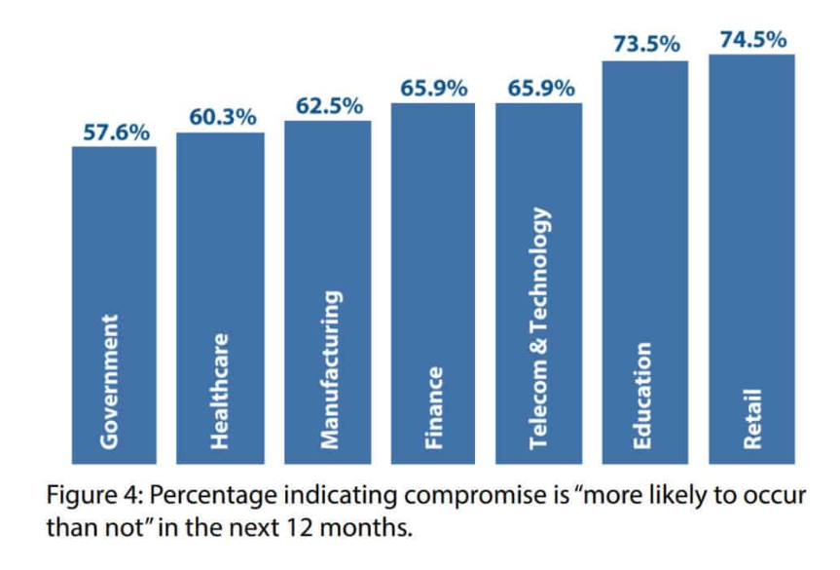
Statistics*
* Imperva 2019 Cyberthreat Defense Report issued in March 2019

Slide 7
When Cybersecurity Really Matters
Does your organization:
Have a small IT staff, with significant outsourcing/online portal use?
Have aging infrastructure?
Conduct e-commerce on a website?
Store and transfer “personally identifiable information,” about anyone (including sending data to the cloud)?
Collect information on preferences and habits of customers/external users?
Provide users with devices that aren’t just used onsite?
Allow users to install “rogue” applications that aren’t specifically installed by the organization
Understand that for almost all organizations, the question isn’t if there will be a breach, but when will there be a breach?
Have a Cybersecurity insurance policy?

Slide 8
Common Threats
Data can reside in many places and is difficult to manage.
Aging infrastructure may make systems less secure, especially on systems that are no longer supported by the maker.
Organizations are highly dependent on technology
As technology, security, and global internet connectivity continue to grow in complexity and scope, there is no way to avoid cybersecurity risk.
Organizations increasingly outsourcing key functions and transitioning data to third parties or cloud vendors.
Outsourcing does not equate to no risk. You are accepting the risk level of the organization you do business with, assuming it properly manages its operations to its desired risk level and performing monitoring on the service.

Slide 9
Common Threats
Common cyber threats that face organizations include:
An inside attacker. A malicious or disgruntled employee can change, delete or destroy data, damage systems, and steal or sell sensitive information.
An outside attacker. These attackers can hack into systems, develop social engineering attacks, and perform email hacking or extortion.
A virus or malware. An organization can become infected or infiltrated by a virus or malware that can originate with a phishing email or infected file.

Slide 10
Common Threats
An employee accident where an employee causes a breach through an innocent error.
Non-malicious system or coding errors implemented by IT personnel through inadvertent creation of vulnerabilities in software or applications.
When it comes to trusted third-parties, such as cloud providers or other vendors that control your organization’s data or systems, can suffer a breach that exposes critical information.

Slide 11
Low-Cost, High-Priority Solutions Entity Level
1. Assess your risk.
Perform risk assessments - can be conducted within the organization or by an outside specialist.
Risk assessments help identify vulnerabilities related to sensitive data.
Assessments should be updated at least annually or whenever a significant change occurs.

Slide 12
Low-Cost, High-Priority Solutions Entity Level
2. Upgrade computers and software.
Older operating systems, computers, and networks are more susceptible to data breaches.
3. Train and inform employees.
Don’t assume that employees understand terms like spear-phishing and how to recognize malicious links in emails and website pop-ups.
Get professional training on how to protect against viruses, malware, spyware and other items.
Develop strict policies on what employees can download and install on computers.

Slide 13
Low-Cost, High-Priority Solutions Entity Level
4. Invest in reputable technology.
Are company newsletters sent through Outlook or is a customer database kept in an Excel Spreadsheet on a desktop? Consider using an email provider like Constant Contact or MailChimp to send email blasts. Explore purchasing a CRM system to keep information on customers.
Cloud-based products allow companies to outsource a big part of their security needs to leaders in the market.

Slide 14
Low-Cost, High-Priority Solutions Entity Level
However, there are important data security risks to consider when storing data in the cloud.
If you don't take the time to understand your data, then you are setting yourself up for failure in a public cloud environment. Securing data has to begin with data classification.
Some data classification steps to follow are to:
Identify the data that will be processed or stored in the cloud.
Classify the information in regards to sensitivity. This would include identifying regulatory requirements for the data.
Define the rules by which particular data classes must be stored, transmitted, archived, transported and destroyed. Many data handling requirements result from contractual or regulatory requirements.

Slide 15
Low-Cost, High-Priority Solutions Entity Level
If there are restrictions on the physical location of data, you'll need to find a provider that can handle them. Amazon Web Services uses regions, and many of the other cloud providers offer similar structures.
Also use one of these methods to meet your data protection requirements:
File system access control lists: This means using the access control mechanisms inherent in the cloud offering to ensure appropriate restrictions on the data. Access control lists should be used in all cases, but it would not protect from malicious acts by staff within your organization.
Using encryption with a mixture of public and private key solutions would most likely be used to protect against malicious staff.
In addition, using transport level encryption whenever sensitive information is being passed or transmitted.
Using a “Zero Trust” architecture.

Slide 16
Low-Cost, High-Priority Solutions Entity Level
5. Institute a cybersecurity breach response plan.
Should a cyber attack occur, having a plan ready to go will ensure that all appropriate members are able to react instantly, work together faster, and be strategic. When dealing with an attack, it is important to note that timing is critical. The more time that passes the more hackers can cover their tracks or steal more data from your systems.

Slide 17
Low-Cost, High-Priority Solutions Entity Level
To ensure your plan is effective, it should include at least these four elements.
It’s Tested Consistently
Unless the plan has been tested, you really have no idea if it is effective. Routinely testing an incident response plan gives your organization the practice it needs to identify weak spots and make improvements.
It’s Detailed but Flexible
Flexibility is crucial to being able to apply the plan to different kinds of attacks and incidents. Flexibility and variety in a plan also ensures it can be updated regularly — so it can evolve as cyberattacks change over time.

Slide 18
Low-Cost, High-Priority Solutions Entity Level
It’s Clear About Communication
Clear communication plans are essential for incident response. Many incident response plans are too informal and assume communication across a network that may have been compromised.
It’s Inclusive When It Comes to Stakeholders
A concise list of stakeholders and how each should be involved in incident response is imperative. Also think through who your external partners will be that are going to help in a time of crisis.
An incident response plan should also include the intention to get your legal department involved as early on in the process as possible. Your legal department can often advise if it’s necessary to involve law enforcement or other external partners. This action may also provide protection to the organization via attorney-client privilege.

Slide 19
Low-Cost, High-Priority Solutions Individual Level
At the individual level you can do some of the following things:
1. Focus on your passwords.
Do not have the same password for every social network and website you access! Change it slightly and make sure to keep that information in a secure location. Consider using a password manager to store your logins to systems.
What makes a great password? Mix up the types of characters you use (numbers, letters, symbols) and don’t use words you can find in the dictionary.

Slide 20
Low-Cost, High-Priority Solutions Individual Level
2. Government organizations are the stewards of information for their stakeholder and need to ensure that only individuals with the right authorization can access the information required, and nothing more. You, as an individual, are part of this stewardship responsibility.
As an authorized user, you are responsible for contributing to the security of computer systems. A secure information system maintains the principles of confidentiality, integrity, availability, authentication, and non-repudiation. You must abide by these principles in your daily work routine to protect information and information systems.

Slide 21
Low-Cost, High-Priority Solutions Individual Level
When storing sensitive information, including PII, you can help prevent breaches by following these security tips:
Store data on the network in accordance with your organization’s data classification policies
Keep in mind, some systems are strictly non-sensitive—never transmit, store, or process sensitive data on a non-sensitive system (i.e., unsecured fax machine, unencrypted thumb drive)
Label paperwork containing personally identifiable information (PII) appropriately and ensure it is not left lying around
Use secure bins to dispose of paperwork containing PII
Keep only what you need
If you suspect a breach, notify the appropriate individuals in accordance with your organization’s incident response plan.

Slide 22
Low-Cost, High-Priority Solutions Individual Level
3. Social Engineering best practices (social engineering includes activities such as phishing, spear phishing, vishing, and smishing):
If you receive a suspicious call: document the situation and attempt to verify the caller identity; if caller ID is available, write down the caller’s number; take detailed notes of your conversation
Don’t share personal information
Don’t give out computer system or network information
Listen to your gut – When something feels off, it probably is. You should be generally reluctant to download attachments and click links.
Scrutinize the address an email says it came from and the text of any URLs it contains. If the source is legitimate, the text may still seem out of character for that sender. In this case, reach out to the person outside of email to confirm.

Slide 23
Low-Cost, High-Priority Solutions Individual Level
Protect your facility by:
Always using your own badge to enter secure operational areas
Never granting access for someone else using your badge
Challenge people who do not display badges or passes
Report any suspicious activity that you see in accordance with the incident response plan
Avoid discussing sensitive operations outside work premises, whether you are talking face to face or on the phone
Be discreet when retrieving messages from smart phones or other media

Slide 24
Low-Cost, High-Priority Solutions Individual Level
4. If your system begins to act unusual, maybe running more slowly, or exhibits an increase in CPU utilization, you need to consider that you might have a virus on your system. This should be reported immediately in accordance with your incident response plan or procedures. Methods to prevent viruses are:
Removing software you don’t use
Keeping internet activity relevant (IT can use webcontent filtering to help reduce irrelevant activity)
Logging out at the end of the day
Updating your operating system, browsers, and plugins as soon as updates are available
Only accessing SSL protected websites (how can you tell if a website is SSL protected?) – Look for the padlock symbol in the upper left corner of the web browser

Slide 25
Low-Cost, High-Priority Solutions Individual Level
5. When it comes to social media
Be aware of what you post online. Even information you might consider inconsequential, such as a spouse’s name, employer, or birthday, could be used by someone to steal your identity or gather information for other purposes.
Ensure you monitor privacy settings carefully as these can change from time-to-time.
Refrain from discussing any work-related matters on such sites.

Slide 26
Low-Cost, High-Priority Solutions Individual Level
6. When it comes to Mobile computing.
Always maintain physical control of mobile devices
Disable wireless functionality when you are not using it
As much as possible, have separate devices and email accounts for personal and business use. This is especially important if other people, such as children, use personal devices. Do not conduct any sensitive business activities (like online business banking) on a personal computer or device, and do not engage in activities such as web surfing, gaming, or downloading videos on business devices. Do not send sensitive business information to personal email addresses.
Lastly - Do not leave devices unattended.

Slide 27
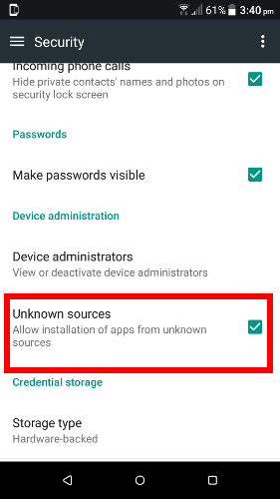
Mobile Phone Security
Android
Android has built its reputation on its relative openness compared to iOS.
You can download apps from anywhere and you can root your device.
If you’re downloading from unknown sites or rooting your devices, you should consider an antivirus app.
If always downloading apps from the Google Play and following good security practices, then you might be ok without one.

Slide 28
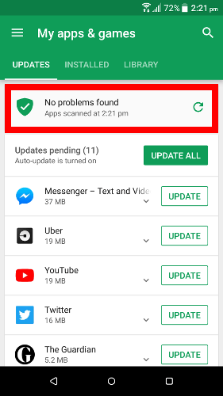
Mobile Phone Security
Android
Google provides a tool called Play Protect to scan your device for malicious apps and purges them.
Go to Play Store app, select “My apps & games”, then under “updates” tap the “refresh” icon near the top of the screen to scan.

Slide 29
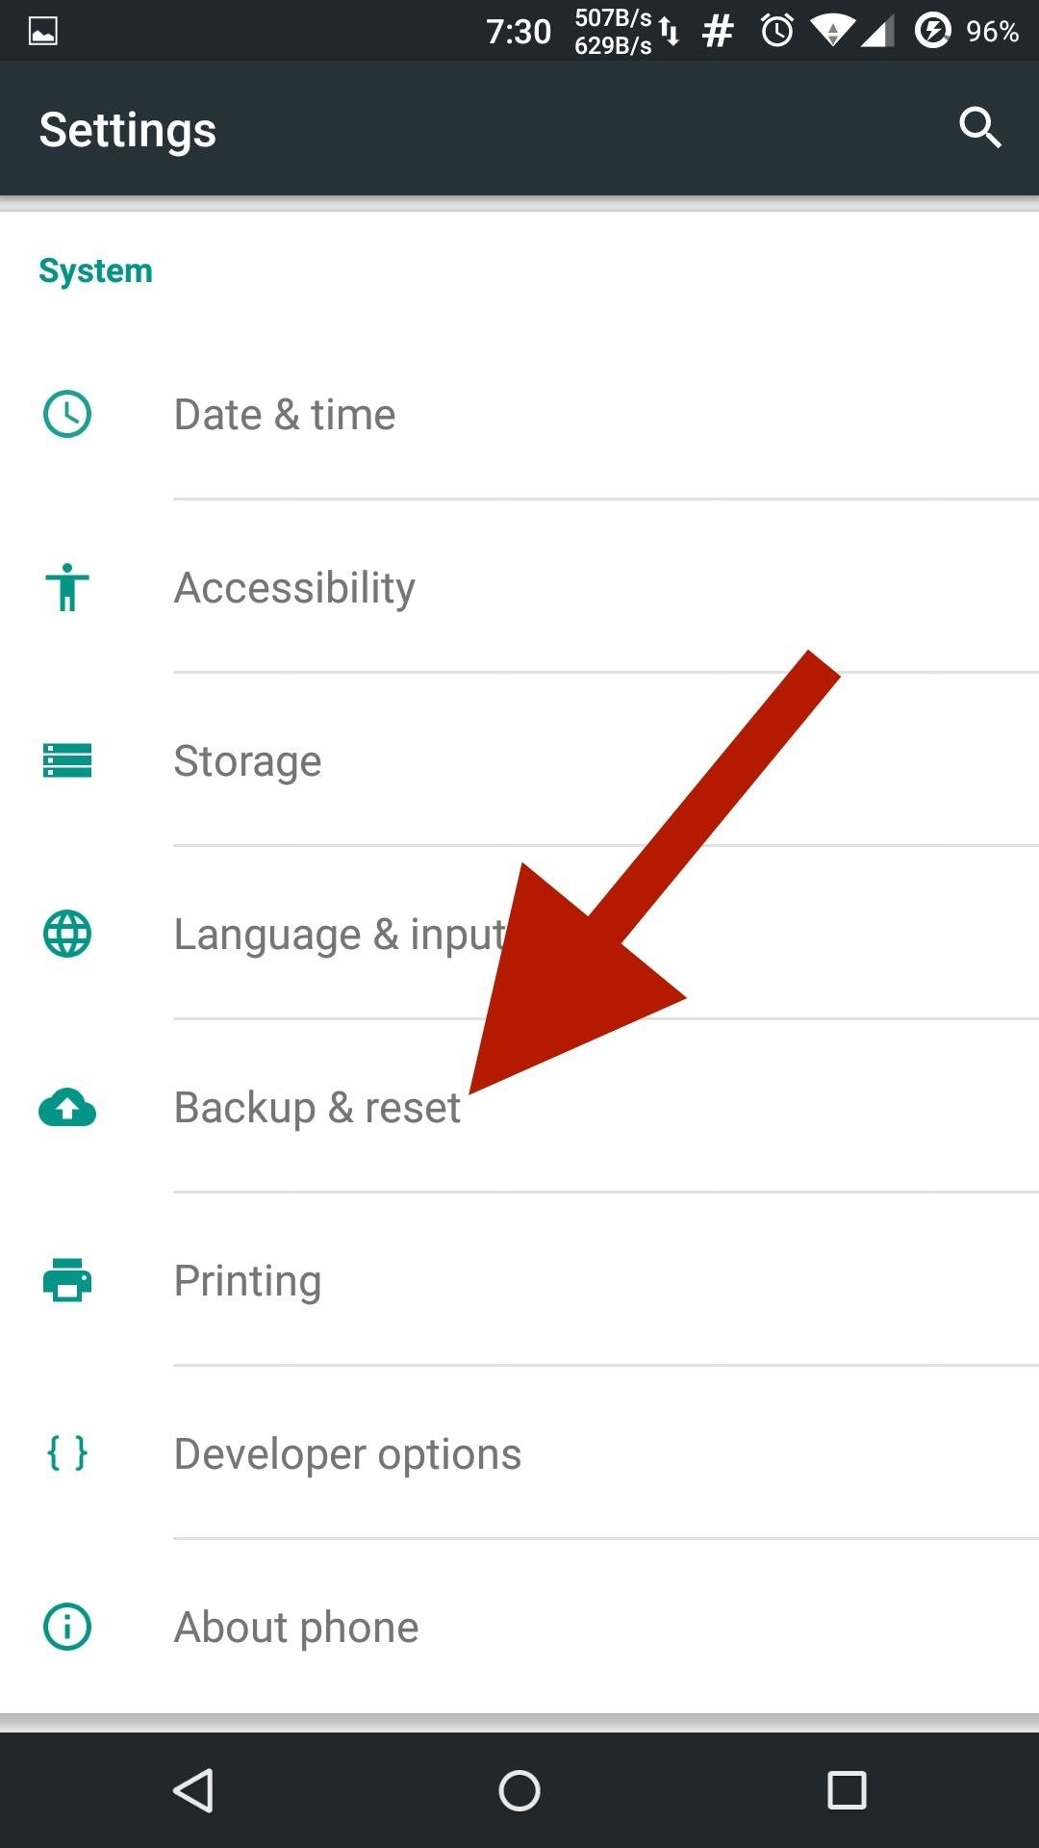
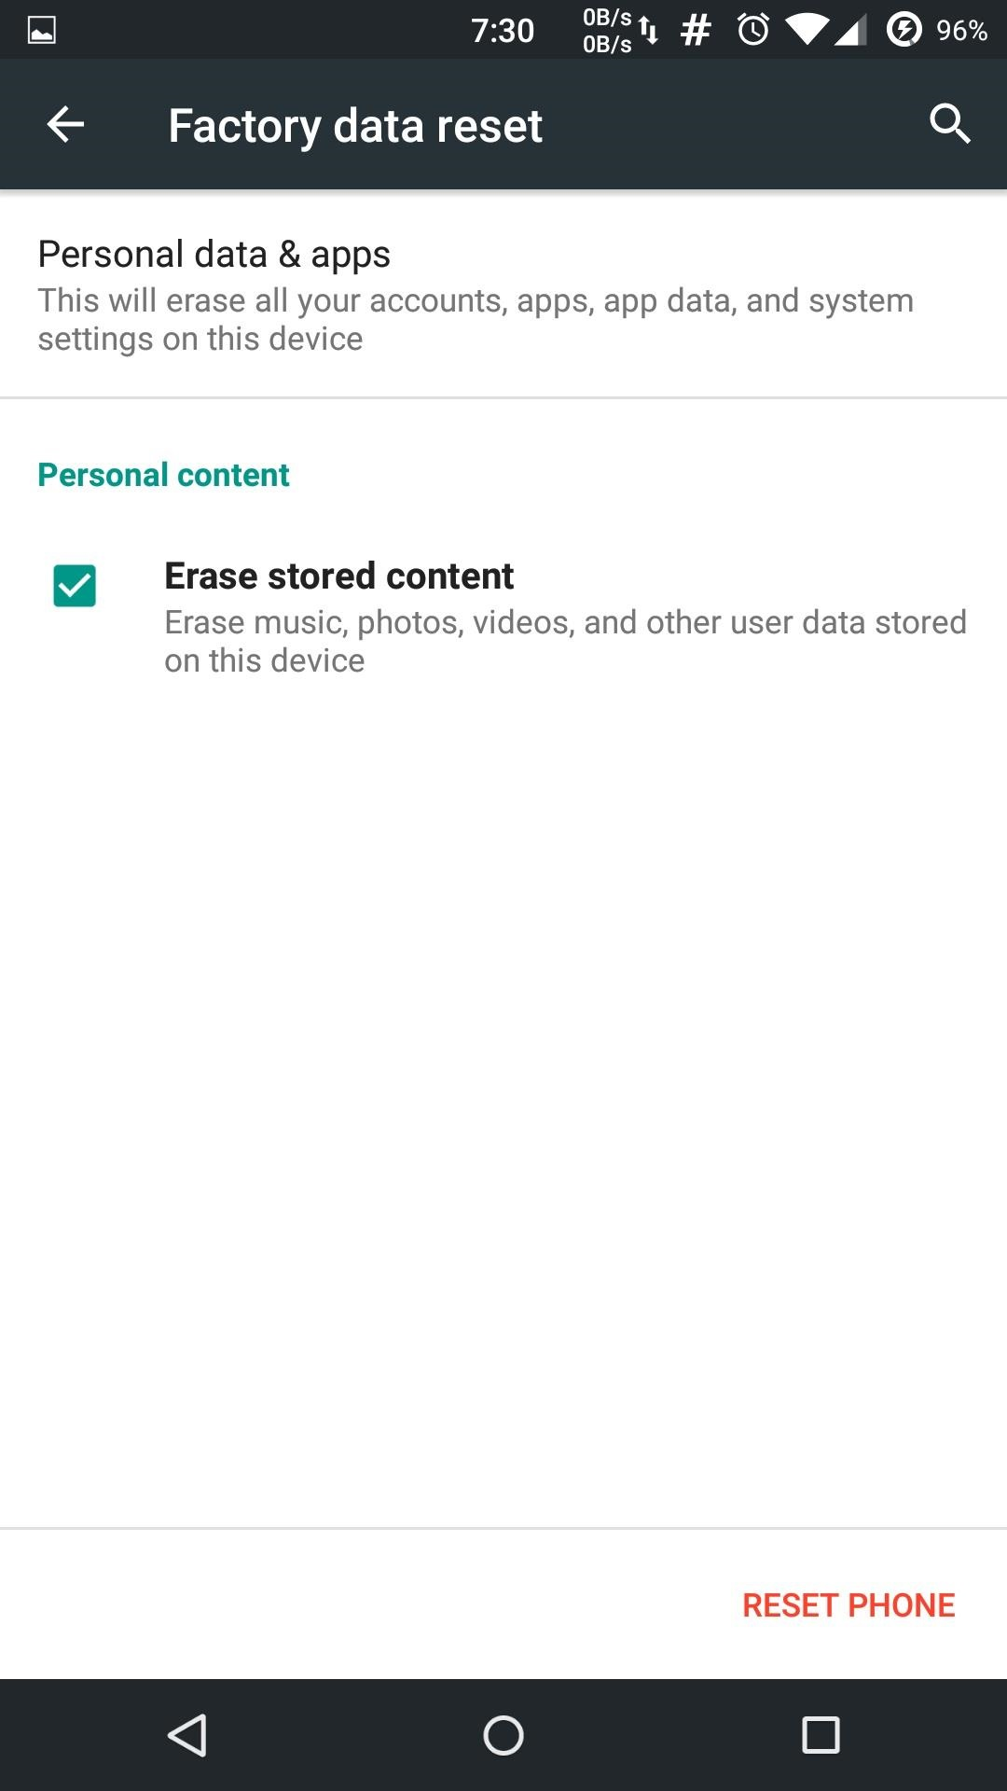
Mobile Phone Security
Android
If, after following all of this advice, your device still gets a virus, a factory reset should solve the problem. However, you can lose data and settings if you use this method.

Slide 30
Mobile Phone Security
iPhone
Any apps you install on your iPhone run in a sandbox that limits what they can do.
Any “security” apps you install are forced to run in the same sandbox as all other apps.
These “security” apps can’t see a list of apps you’ve installed and can’t scan anything on your device for malware.

Slide 31
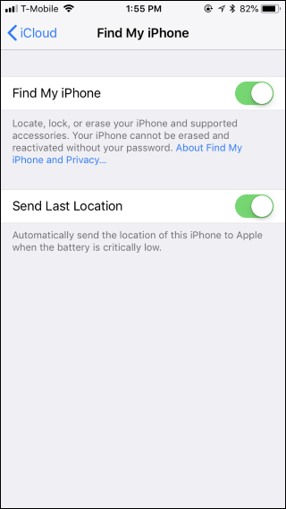
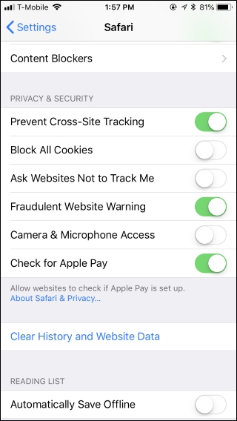
Mobile Phone Security
How your iPhone already protects you

Slide 32
Mobile Phone Security
iPhone
Additionally, your iPhone device can only install apps from Apple’s App Store. If malware is found in an app later, Apple can remove it from the Store and have your iPhone immediately delete the app.
“Find My iPhone” functionality lets you remotely locate, lock, or erase a lost or stolen iPhone.
“Fraudulent website warning” will present you with a warning if you end up on a malicious website.
DON’T JAILBREAK YOUR IPHONE!! This allows your device to run outside of the normal security sandbox. It also lets you install apps from outside the App Store.

Slide 33
Examples
Catawba Valley Medical Center (Individual Hack)
Hack originated by an employee mistakenly opening an email that turned out to be a phising scam. This led to three employee emails being hacked.
Potential to impact 20,000 patients – included names, birthdates, social security numbers.
Atrium Health (Hack of a third party provider)
Their billing provider (AccuDoc) was hacked potentially affected more than 2.5 million patients where patient data could be viewed. This was due to a Database hack.
Potentially compromised all those accounts for a week.
Included data of guarantors and patients, names, addresses, dates of birth, insurance policy details, medical record numbers, account balances, and dates of service. Approximately ¼ of the total also had social security numbers.

Slide 34
Takeaways
Discussion - Takeaways
Entity Level – Goals, risk assess, mitigate issues based on assessed risk, have a cybersecurity response plan, encourage employee communication about anything “unusual” as relates to their systems/communications.
Entity Level – organizations may consider other reports such as 2019 data breach information across industries, and other resources such at www.idtheftcenter.org
Entity Level – Discuss with those in your organization, peers, and other resources to ensure that actions that can be taken align with goals, and what risks are to be accepted.

Slide 35
Takeaways
Discussion - Takeaways
Entity Level – with smaller IT staff sizes, determine what the most vital areas are to be covered with that staff, including monitoring outsourced items, and work downward until out of staff time/resources.
Individual Level - Training, training, training!!
Don’t just depend on any software/hardware/security setup to protect you from unusual items that come up.
Listen to your gut.
Scrutinize the email addresses of unknown senders, or requests that appear unusual.
Use technology tools such as Mimecast to filter email messages.

Slide 36
Tyler Gall, CPA, CFE, CISA tgall@becpas.com
540 345-0936

