Slide 1

Collaborative grants management:
$
A working guide to relationships between grant managers & accountants

Slide 2

Amanda Day, GPC
20 years working in local government & grant field
Grant prospect research, writing, and management experience
Trainer for Grant Writing USA
Cohost of Fundraising HayDay, a podcast about grants & such
Grant consultant
President, Grant Professionals Association
Book nerd & tea connoisseur

Slide 3





What we’ll cover today
Importance of Grant Management
Role of the Grant Manager
Role of the Accountant
Improving Communication
True Collaboration
25th Annual Commonwealth Professional Development Training

Slide 4



IMPORTANCE OF GRANT MANAGEMENT
Must follow Office of Management and Budget (OMB) guidelines when managing federal funds

Slide 5
2 CFR 200
OMB Uniform Guidance
The Uniform Guidance (UG) took effect 26 December 2014 as the standard rules for federal and flow-through grants
The UG is also sometimes called the Super Circular or the Omni Circular or simply “Part 200”
The full name is “Uniform Administrative Requirements, Cost Principles, and Audit Requirements for Federal Awards,” which is a combination of the names of three previous categories of circulars

Slide 6
Uniform Guidance
Organized by Subparts:
Subpart A 200.000 Acronyms & definitions
Subpart B 200.100 General
Subpart C 200.200 Pre-Award (Federal)
Subpart D 200.300 Post-Award (Recipient)
Subpart E 200.400 Cost Principles
Subpart F 200.500 Audit Rules
Appendices I – XI

Slide 7

IMPORTANCE OF GRANT MANAGEMENT
Must follow Office of Management and Budget (OMB) guidelines when managing federal funds
Funders focus on risk assessment

Slide 8
Awarding and Subawarding
Focus on Risk Assessment
Both federal agencies and flow-through entities must review the merit and risk associated with a potential grantee prior to making an award including:
  Financial stability
  Quality of management systems
  History of performance
  Reports and findings from audits

Slide 9

IMPORTANCE OF GRANT MANAGEMENT
Must follow Office of Management and Budget (OMB) guidelines when managing federal funds
Funders focus on risk assessment
Penalties for non-compliance
This Photo by Unknown Author is licensed under CC BY-NC

Slide 10
Failure to Comply
Temporarily withhold cash payments
Disallow all or part of the cost
Suspend or terminate the award
Recommend suspension or debarment
Withhold further federal awards
Take other remedies that may be legally available
Issue a “high risk” designation (federal agencies)
PS: This is not an exhaustive list…

Slide 11

IMPORTANCE OF GRANT MANAGEMENT
Must follow Office of Management and Budget (OMB) guidelines when managing federal funds
Funders focus on risk assessment
Penalties for non-compliance
SIMPLY PUT: IF YOU WANT MORE GRANT FUNDING FOR YOUR ORGANIZATION, MANAGE WHAT YOU HAVE WELL

Slide 12

ROLE OF THE GRANT MANAGER, PART 1
Know and follow the federal OMB rules
Document and retain required program and financial information for each award and subaward (develop a system of record keeping)
Exercise good internal controls and
organization management
Comply with grant agreements, communicate with the funder, and seek necessary approvals in writing

Slide 13
ROLE OF THE GRANT MANAGER, PART 2
Understand and follow grant terms and conditions
Work with project directors to ensure program is implemented as spelled out in the approved work plan
Provide leadership for the project, in conjunction with project directors
Understand allowable and unallowable costs
Monitor grant expenditures
Be hones, ethical, and law-abiding (can’t stress this enough)

Slide 14

ROLE OF THE ACCOUNTANT
Work with grants team to ensure compliance with grant rules and regulations
This Photo by Unknown Author is licensed under CC BY-SA

Slide 15
Five Levels of Non-Compliance
Fraud
Intentional non-compliance – Ignoring the rules because they don’t apply to us
Substandard performance
Unintentional non-compliance – Ignorance of regulations & obligations
Detrimental reliance

Slide 16
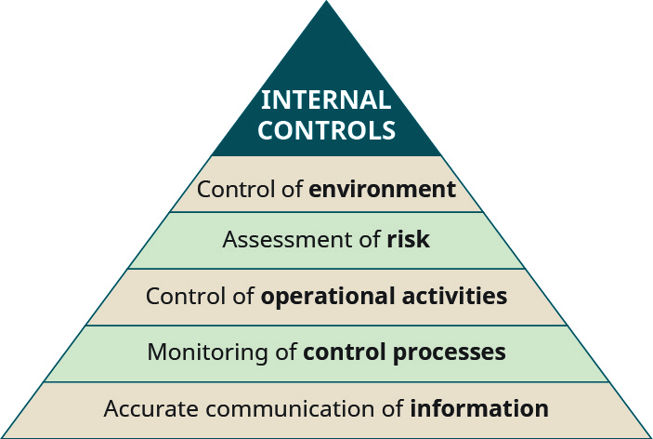
ROLE OF THE ACCOUNTANT
Work with grants team to ensure compliance with grant rules and regulations
Assist with internal controls

Slide 17
Good Internal Controls
Protects resources against waste and fraud
Minimizes risk of poor management
Ensures accuracy and reliability
Evaluates the level of performance in all organizational units
Provides management peace of mind
Establishes consistent business practice

Slide 18
1) Control environment
Management staff and employees should establish and maintain an environment throughout the organization that sets a positive and supportive attitude toward internal control and conscientious management
2) Risk assessment
Internal controls should provide for an assessment of the risks the agency faces from both external and internal sources

Slide 19
3) Control activities
Internal control activities help ensure management's directives are carried out. The control activities should be effective and efficient in accomplishing the agency's control objectives
4) Information and communications
Information should be recorded and communicated to management and others within the entity who need it and in a way that enables them to carry out their responsibilities

Slide 20
5) Monitoring
Internal control monitoring should assess the quality of performance over time and ensure the findings of audits and other reviews are promptly resolved

Slide 21

ROLE OF THE ACCOUNTANT
Work with grants team to ensure compliance with grant rules and regulations
Assist with internal controls
Oversee annual audit and Single Audit (if warranted)
Ensure grant funds are not commingled
Ensure grant funds are not used to supplant local funds
Follow accounting rules & regulations

Slide 22

IMPROVING COMMUNICATION
Bridge the communication barrier, because we often speak different languages
Remember, grant professionals typically have a writing background; rarely do they have finance or accounting backgrounds
Communicate regularly and share information freely

Slide 23
TRUE COLLABORATION, PART 1
Shared access to information – grant applications, award agreements, reports, financial documents, audits, etc.
Provide grant manager with access (can be view only) of financial software system
Work together to ensure procurement and contract rules are followed
Communicate regularly, including asking questions when you don’t understand

Slide 24
TRUE COLLABORATION, PART 2
Present unified front to colleagues
Show up together when funders arrive for site visits
Meet regularly, both in person and through email communication
Back up the grant manager when he/she is working to follow the rules – everyone else thinks grant money is their money to do with what they will
Remember, no one looks good in orange, so collaboration means we stay out of jail

Slide 25

GWUSA DISCOUNT CODE
2-day grant management or grant writing course
Register by selecting any zoom online class on the schedule here: http://grantwritingusa.com/events.html
Discount code: AGA
Instantly takes $100 off tuition (no stacking with other offers)
Must register between today and December 31, 2020
Unlimited number of users

Slide 26

Thank You
GRANT WRITING USA
www.grantwritingusa.com
1.800.814.8191
cs@grantwritingusa.com
amandadaygpc@gmail.com
Grant Consultant &
Grant Writing USA Trainer &
Fundraising HayDay Cohost
www.fundraisinghayday.com

