Slide 1
Changing the Conversation from Risk Management to Value Management
Dr. Doug Webster

Slide 2
What Do You Value?
What is important to you in your life?
…in your organization?
What exactly do we mean by value?

Slide 3
Words—and how we interpret them—do matter
“What we have here is a failure to communicate”

Slide 4
Defining Value
Which provides greater value to you (or a customer)?
VS.
OR
VS.
Notes:
7

Slide 5
Understanding Value
Value is the relationship between the benefits provided to the cost of gaining those benefits:
Value is “in the eye of the beholder.” Different stakeholders view cost/benefit tradeoffs differently
Understanding stakeholder perception of “value” is critical
V=
Benefits provided to a customer or other stakeholder
Cost of providing those benefits (resources consumed)
Notes:
8

Slide 6
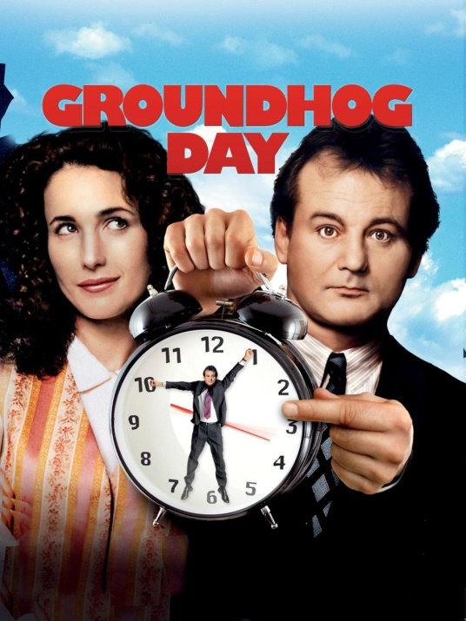
Change in a world of … certainty
Life would be simple if only the world around us did not change moment by moment.

Slide 7
Which environment best reflects your world?
Life would be simple if only it were not for… Change

Slide 8
The Challenge of Change
External Change
External Environment
Today’s
Environment
The Future
Environment
Reactive
Internal Change
Proactive
Internal Change
Internal Environment
Organization
Actions
© Douglas W. Webster
Many organizations act as if in Groundhog Day, focused only on improving today’s organization.
“A good hockey player plays where the puck is. A great hockey player plays where the puck is going to be."
~ Wayne Gretzky

Slide 9
Types of change
We manage Internal change in response to External change
Proactive
Change
Reactive
Change
Reactive
Change in
Crisis
The proverbial
“Burning Platform”

Slide 10
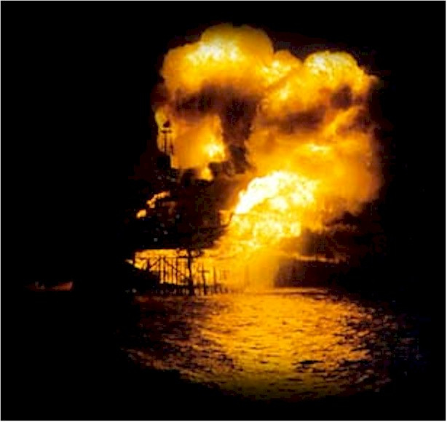
July 6, 1988
Piper Alpha, a North Sea oil production platform
The actual “burning platform”
167 men perished—only 59 survivors
Not a goal for motivating change
10

Slide 11
Responding to Change
The impact of different internal change responses to external change
Proactive
Change
Reactive
Change
Reactive
Change in
Crisis
Options
The proverbial “Burning Platform”
Urgency
and Risk
Do you React to Crises Or Manage Risks?

Slide 12
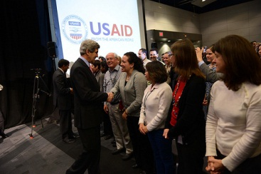
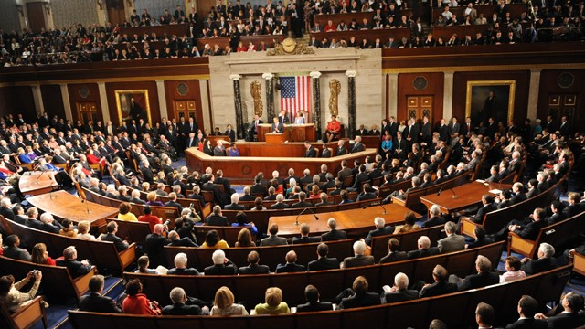
Value: An issue of balance
Results Sought
Stakeholder
Satisfaction
…and others

Slide 13
Value: An issue of balance
Resources Allocated
Resource Consumption
Results Sought
Stakeholder
Satisfaction

Slide 14
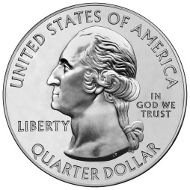
Value Maximization
Results (Gross Return)
Resources Allocated
Resource Consumption
Results Sought
Stakeholder
Satisfaction
- Cost
Value Maximization
Reward (Net Return)
ROI
Possible Return
( )
Return
Cost
Risk Accepted
Opportunity/
Loss Balance
Most Likely Return
Risk Adjusted ROI

Slide 15
Value Maximization
Every decision—individual and corporate—should seek to balance:
Results
Resources and
Risks
Results
Performance
Resources
Costs
Value Maximization
“Life, business, everything you do, every decision you make – it’s all about risk and reward!”
Risk
Opportunity/
Loss Balance
~ Bill Kaplan, founder /leader of the MIT Blackjack Team that won millions in Vegas; inspired the movie 21 and the national bestseller, Bringing Down the House.

Slide 16
Linking Strategy to Value: Current-State Assessment
Non-value-added functions;
May require staff, functional, process realignment
What we actually do
Internal Environment
(Under management control)
Mandated but not
Value-Added
Value-Added;
Not mandated
Value-Added
and
Mandated
Value-Based strategy/capability Gap
Compliance Gap
External Environment
(No control; limited influence)
What we are required to do
What
Stakeholders want
Mission Gap
No stakeholder value; may pose reputation and other risks
Unmet Customer Expectations
Regulatory Misalignment
© Douglas Webster

Slide 17
Integration across the enterprise: A Portfolio perspective
But value is not optimized by simple aggregation of independent decisions
Maximizing organizational value requires an integrated, enterprise-wide portfolio view of organizational goals and tradeoffs
Strategic
Functions, Programs, SBUs
Tactical
Operational
Value management requires breaking through the “titanium silos of excellence”,
and applies at all organizational levels.

Slide 18
Strategy, Objectives, Results, Resources and Risk Must all Interconnect
Risks
Risks
Risks
External Demands/
Internal Capabilities
= V
Risks
Risks
R/R/R
Enterprise
Objectives
Enterprise
Objectives
R
R
R
R
= V
R
R
= V
R/R/R
Requirements
Capabilities
Requirements/Capabilities
R/R/R
Program
Objectives
Program
Objectives
Program
Objectives
Program
Objectives
R
R
R
R
R
R
= V
R
R
R
R
R
R
R
R/R/R
= V
R/R/R

Slide 19
The “House” of Value Based Management
Value Creation
in the face of change
The Goal
Governance
Setting Direction
(Doing the Right Thing)
Mission
Stakeholders/
Customers
Products/
Services
Objectives
Powering Forward
(Doing Things Right)
Requirements
Resources
Allocated
Capabilities
Constraints
Constraints
Results
Sought
Risks Accepted
Technology Enablers
IT: Transaction and Decision-Support
The Foundation
Aware, Supportive & Capable Organizational Culture
(Organizational Change Management)
© Douglas W Webster
19

Slide 20
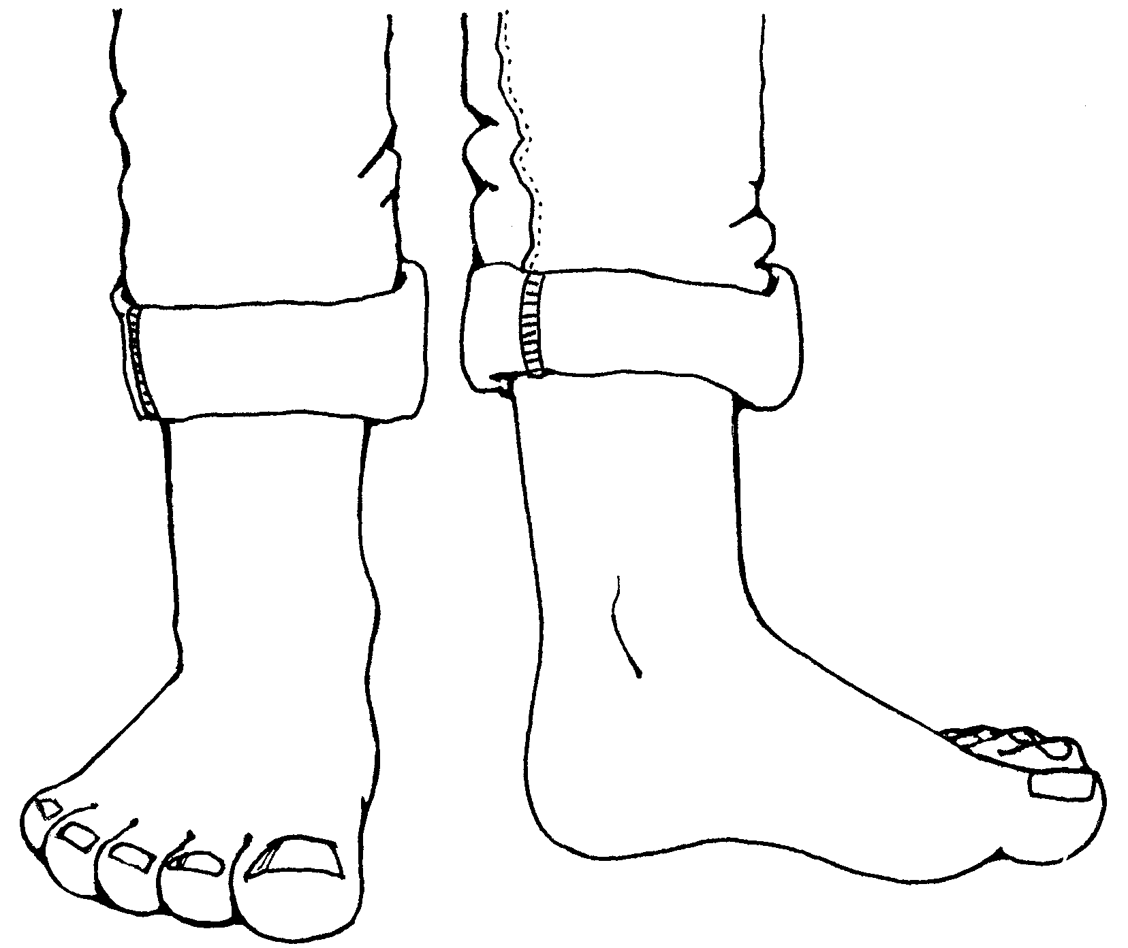
An Effective Change Management Model
Managing behavioral change is frequently a key challenge
Similar to:
Awareness
Desire
Knowledge
Abilities
Reinforcement
Understanding
Incentives
Motivation
“Tools”
© Douglas Webster

Slide 21
Meaningful ERM
“ERM is a discipline that addresses the full spectrum of an organization’s risks, including challenges and opportunities, and integrates them into an enterprise-wide, strategically aligned portfolio view. ERM contributes to improved decision-making and supports the achievement of an organization’s mission, goals and objectives.”
~ Association for Federal Enterprise Risk Management
Numerous organizations have adopted practices claimed to be ERM, but are simply practices of internal control or traditional risk management.
Risk management is broader in scope than internal control.
ERM is the integration of all risks across organizational, functional and programmatic silos to develop a strategically aligned, portfolio view of risk.

Slide 22
ERM and VBM
Organizations should strive to maximize the overall value delivered
This requires maximizing the portfolio of value opportunities across the organization.
ERM applies a portfolio approach to managing risk.
While ERM integrates risk management across silos, risk is but a part of what must be considered in maximizing value.
VBM builds on ERM by adding considerations of resources sought and resources allocated.
VBM should be a fundamental element of strategic planning, and cascading strategic objectives into successfully defining and achieving operating plans and project objectives.

Slide 23
Closing Thoughts on Challenges
ERM and VBM face similar challenges:
Recognition that risk and value impacts every decision
Risk and Value Management are everyone’s responsibility
ERM and VBM cannot be properly managed without meaningful transparency and communication
Organizational culture must be aligned with needs for transparency and accountability vertically and horizontally across the organization
Organizational change management may be more important than improved risk policies…culture is often a greater impediment than policy.

Slide 24
A vision without a strategy remains an illusion.
~ Lee Bolman
Strategy without tactics is the slowest route to victory. Tactics without strategy is the noise before defeat.
~ Sun Tzu

Slide 25
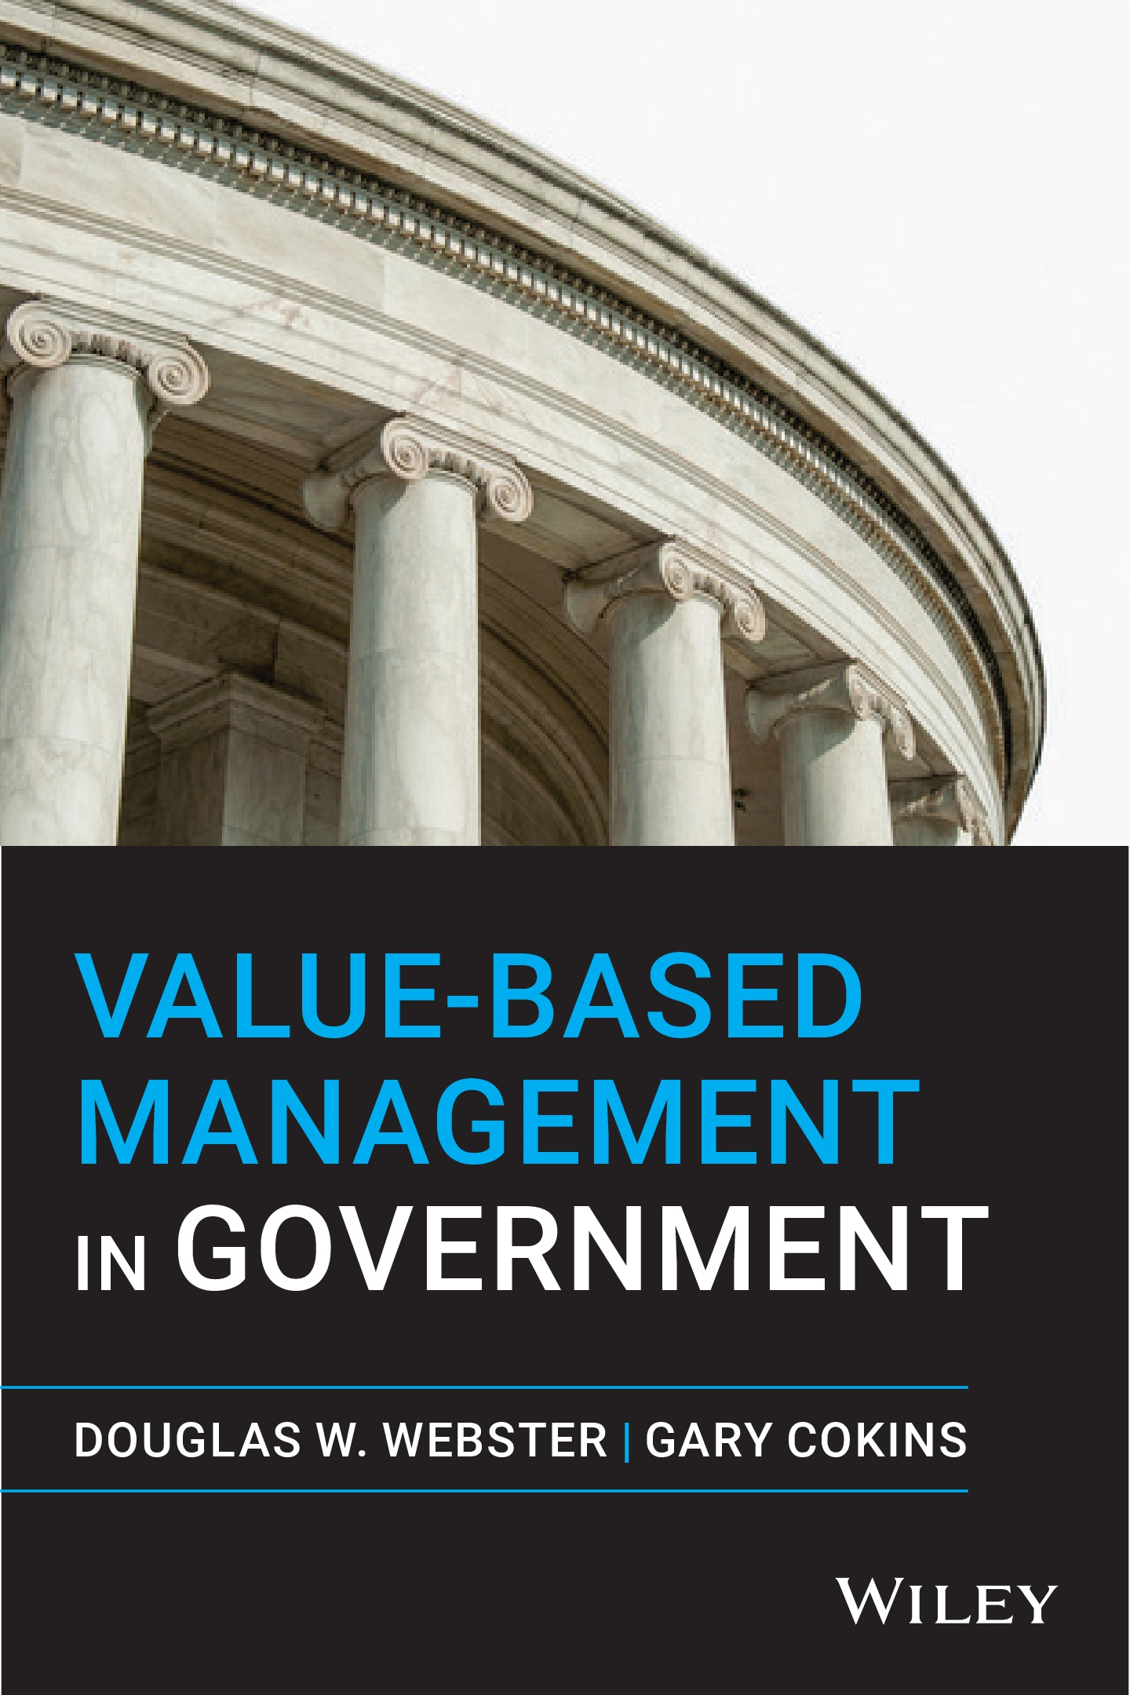
Contact information: dwebster@tfcci.net 703-625-7619
Available January 2020

