Slide 1

How is My Performance?
Frank Jones, CIA
Management Analyst
25th Annual AGA Commonwealth of Virginia
Professional Development Training
(December 17, 2020)
“The biggest problem with communication is the illusion that it has taken place.”
George Bernard Shaw
Notes:
“The biggest problem with communication is the illusion that it has taken place.”
George Bernard Shaw

Slide 2
Session Objectives
Overall objective: To gain a better understanding and importance of effective interpersonal skills to provide feedback. This includes recognizing the benefits from building positive rapport with your boss, peers, employees, and your auditee can have on the audit cycle and audit results. Specifically, during this training session we will discuss:
Understanding workload measures and their relationship to performance.
Coaching vs. Mentoring.
Techniques for Providing Feedback and Dealing with Resistance.

Slide 3
Setting Time Frames
Notes:
Each audit plan contains an Audit Milestone section. This section reflects the timeframes resources, and costs for completing the audit work. It consists of anticipated completion (contract) dates for each audit phase. Let’s review each section.

Slide 4
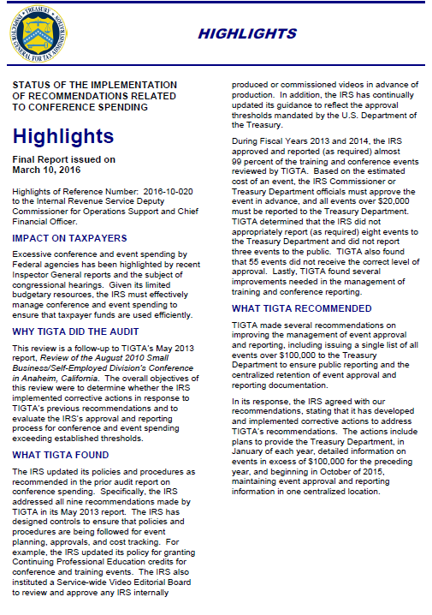
Steps in the Audit Cycle
1. Entrance Letter / Engagement Letter
2. Planning / Opening Conference
  3. Fieldwork / Agreement to the Facts
    4. Referencing
    5. Discussion Draft Report
    6. Quality Assurance
    7. Exit Conference
      8. Formal Draft Report
      9. Agency Response
      10. Final Report
Notes:
Explain that this is the TIGTA process and participants should become familiar with their agency audit cycle.

Slide 5
What are the Standards and
How are we Measured at TIGTA?
Planning Days:
Staff Days:
Calendar Days:
Percentage Meeting
  Staff Day Requirement:
  Draft Report Date:
Draft Report Date:
Final Report Date:
Generally 30 calendar days.
350. (Actual FY20 = 384)
365. (Actual FY20 = 421)
70 percent (Actual FY20 = 83%)
70 percent (Actual FY20 = 79%)
End of the Month Scheduled for Issuance.
Generally 7-10 days after receipt of IRS management response.
Notes:
Source: TIGTA OA Performance Report (September 2020).

Slide 6

Frustrated Worker
Frustrated Leader
Is your time and energy being drained by putting out fires and supporting your staff that seem unable to solve problems on their own?
Do you feel like you’re being micro-managed and that your great ideas go unheard?

Slide 7
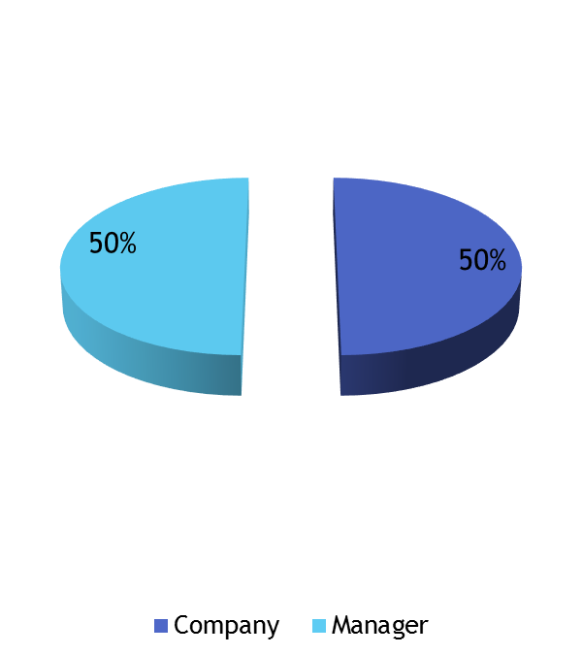
When an employee leaves are they leaving the company or the manager?
Polling Question: 1
Company
Manager

Slide 8
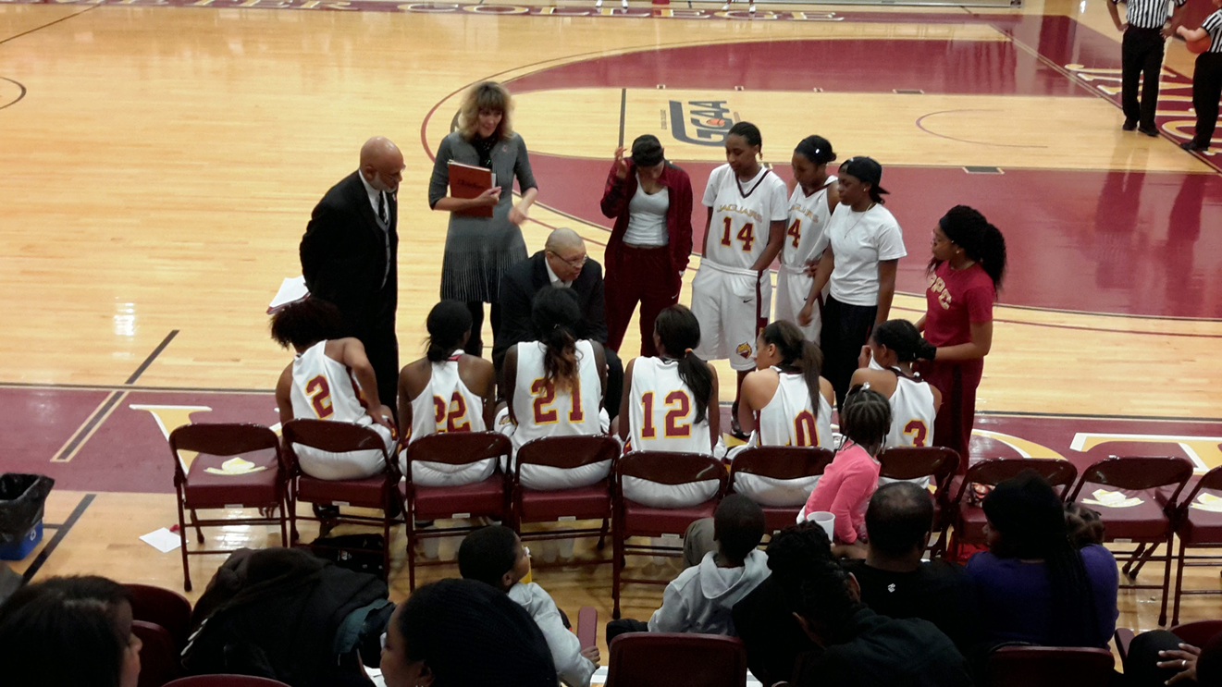
PUT ME IN COACH!
“Champions are Made When No One is Watching!”

Slide 9
THE POWER OF A MENTOR!

Slide 10
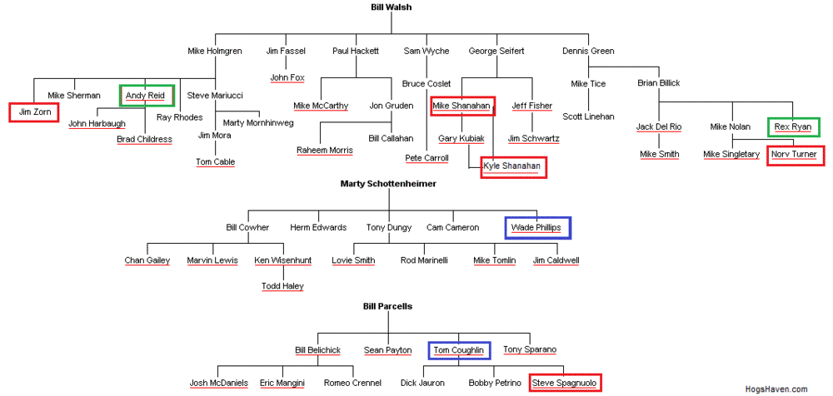
“Most Decisions Made About You Happen When You Are Not in the Room!”
Notes:
15 of 37 coaches under Bill Walsh’s coaching tree have coached a team to the Super Bowl.
8 of 15 coaches who coached a team to the Super Bowl….won the game!

Slide 11
Do You Understand the Process?
Is it clear about your role as a Coach or Mentor?
Coach
Progress Feedback | Individual Tasks |  |  |  |  |  | Progress Feedback | Individual Tasks
Mentor
Guidance/Dialog |  |  |  | Overall Performance and Goals
Notes:
Knowledge of the Process
What is the employee doing and should continue?
What is the employee doing, but should stop?
What is the employee not doing, but should start?
Coaching is typically a relationship of finite duration where the focus is on strengthening or eliminating specific behaviors in the here and now. Coaches are engaged to help professionals correct behaviors that detract from their performance or, to strengthen those that support stronger performance around a set of activities. Helps you improve immediately.
Mentoring is a long term relationship where the focus is on supporting the long term growth of the mentoree. The mentor is a source of wisdom, teaching and support, but not someone who observes and advises on specific actions or behavioral changes in daily work. High level guidance for long-term development.

Slide 12
Meeting Performance measures

Slide 13
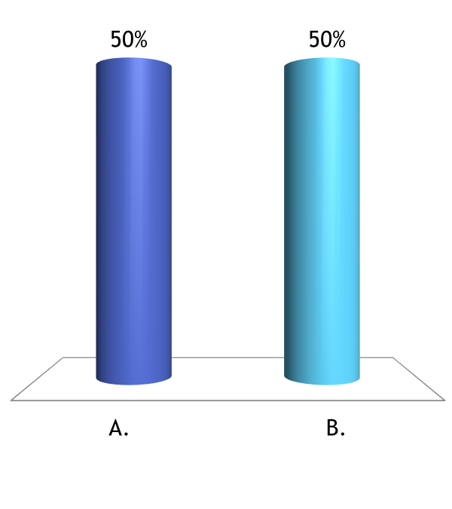
When an organization does worse immediately after the departure of a leader; what does that say about the person’s leadership?
Polling Question: 2
The leader was a good leader and very effective.
The leader was not a good leader and did not train people well.
Notes:
What are your view’s about this situation?

Slide 14
Supervision
A cycle of observing performance, giving feedback, and observing changes made is necessary to accomplish employee development.

Slide 15
Supervision
The supervisor should:
  Direct efforts of the staff to ensure objectives are accomplished.
  Provide sufficient guidance.
  Stay informed about problems encountered.
  Review work performed.
  Provide effective on-the-job training.
  Maintain independence.
  Ensure applicable standards are followed in planning and conducting audits and reporting results.

Slide 16
Delegation
Delegate – entrust a task or responsibility to another person, typically one who is less senior than oneself.
    Oxford Dictionary online
Do not do it for them, rather provide ideas to follow-up on or sources for further information.

Slide 17
Accountability
Equates to clear commitments that in the eyes of others have been kept.
Front load accountability by providing specifics.

Slide 18

Communicate Desired Outcomes
Follow
Up and Provide Feedback
Delegate and Hold Accountable
Notes:
Communicate Desired Outcome – Clearly define the desired outcome (i.e., what does a good job, product or deliverable look like)?
Delegate and Hold Accountable – Empower, set realistic or mutually agreeable timelines and expect results.
Follow-Up and Provide Feedback – make sure staff is on track, listen versus speak for them or “dump and run.” Make sure they can get it done and enable staff to deliver.

Slide 19
Providing Feedback without Accountability is a Waste of Time!!!!
The point is NOT the meeting, it is the action or the results.
Collect Information
Prepare Feedback
Deliver Feedback
Clear
Concise
Consistent
Notes:
Recognize areas for improvement and end the discussion with proposed solutions (develop a plan of action) to change performance.

Slide 20
Follow-Up
Supervisory review of audit evidence must be documented in work papers – Yellow Book.
Use coaching notes to provide feedback on individual work papers.
Careful review of work papers ensures quality audits and appropriately documented results.

Slide 21
Provide Feedback
When conducting team or individual meetings:
  Do not dominate the conversation.
  Allow yourself to obtain the insights of others in attendance.
  Provide feedback to encourage: good performance, correct poor performance and keep assignments on track.
  Empower others to think/act.

Slide 22
Providing Feedback
Feedback is an essential part of routine coaching and effective performance management.
Feedback has only two purposes:
  Improve/make better behavior.
  Reinforce or maintain current behavior.
To be constructive, feedback must be FAST:
    Frequent (remember the cycle of observing)
    Accurate
    Specific
    Timely
Notes:
In most workplaces, there is too little feedback rather than too much. This is especially true when the feedback is of a negative nature, and this risk is especially evident in the performance appraisal process. Employees and managers often dread this ritual (the performance appraisal process) because we have institutionalized the giving and receiving of feedback. We often save up our comments and document all the things we noted about a person’s performance. And then, like a big cat ready to pounce, the manager brings a hapless employee into the office and springs a year’s work of “constructive criticism” onto him or her. This makes the process unnerving and fear provoking.
When done the right way and with the right intentions, feedback communication can lead to performance greatness. Employees have to know what they are doing well and not so well. Feedback contributes to clarity. When employees receive feedback that is timely, frequent, accurate, and specific, they are more likely to understand what is expected from them and to repeat successful performance.

Slide 23
CANNOT DO!
Vs.
WILL NOT DO!
“You May or May not Know When People Change Their Mind About You!”

Slide 24


Key questions to address
Just Because You are in the Same Place Does Not Mean You See the Same Thing

Slide 25

Understand Yourself
Notes:
“Warren Bennis identifies that great leaders begin with a profound understanding of themselves. Bennis calls it ‘a positive self-regard.’ Good leaders understand themselves so well that they can leverage their strengths, mitigate their weaknesses, and manage themselves effectively to make sure that they’re not held up by one of their limitations.”
Regularly ask yourself these two questions:
How am I doing?
How do others see me?

Slide 26
Providing Feedback
“You May Make the Right Point; but Use the Wrong Method!”
Notes:
I grouped praise, reinforcement, and congratulatory comments together as positive feedback. I chose to call suggestions for improvement, explorations of new and better ways to do things, or pointing out something that was done in a less that optimal way as negative feedback.

Slide 27
What Must I
SAY?
What Can I Say?
What Should I Say?
How Can I Say It?
What is the Employee’s Likely Reaction

Slide 28
Auditor Feedback Key Questions to Address:
What must I say? Is the issue a cannot or will not do?
  What is the employee doing and should continue?
  What is the employee doing, but should stop?
  What is the employee not doing, but should start?
What can I say? Do I have adequate evidence/examples to support my conclusion/opinion regarding performance?
What should I say? What’s the significance of the feedback? Have I tied employee performance into the goals / objectives of the Office of Audit auditor performance measures as a whole?
How can I say it? What sequence / logic / tone of presentation will facilitate understanding of my message?
What is the employee’s likely reaction? If the employee disagrees, what is my planned response?

Slide 29
CARE Technique for Providing Feedback
Context | Action | Results Affected (Me – Person Delivering Feedback) | Results Affected (Others) | Empathetic Exploration
C – State the specific context/situation/issue observed. During the weekly team meeting.
A – State the specific action or behavior observed without judgment. Talked over coworkers during the team meeting.
R – State how the action affected you and/or other individuals. Team members felt disrespected and that their ideas did not matter.
E – Explore and ask questions to get clarification of what happened. What was going on to cause you to behave in this manner. . .this is unlike you?
Notes:
Source: IRS Senior Management Development Class
Avoids surprises at mid-year and annual performance evaluations.
Creates opportunities for immediate improvement.
Provides a written record or evidence to support performance ratings.
Increases engagement, trust, and communication (i.e., improved rapport and risk of conflict).

Slide 30
Techniques for Improving Performance When Delivering Feedback
What to do:
Maintain professionalism.
Emphasize ideas/suggestions are welcome.
Focus on the issue/behavior and not the attendees.
Prepare your comments.
Make it a positive process and experience (i.e., use encouraging terms).
Avoid surprises.
Be prepared.
Stay on track.
Listen and suspend judgment.
Minimize making assumptions.
Push back “with kid gloves.” – Be professional and ask clarifying questions.
Align priorities.…know why you are there.
Address the content of the discussion - not the tone.
Notes:
Emphasize point that this list applies to both the leader and participants.
Always remember that how you respond to any questions is completely in your control. Take that control to improve the quality of your conversations.
Ask yourself or the team:
What went well?
Identify what could we have done better?
What might be done to prevent the issues/problems from happening again?

Slide 31
Techniques for Improving Performance When Delivering Feedback
What to do:
Ensure accuracy.
Maintain documentation of facts to support opinions or conclusions to justify feedback and ratings.
Ensure that expectations are clear and reasonable.
Use “I” statements instead of YOU. (i.e., “ I am concerned vs. “You did not.”)
Look for opportunities to coach or mentor.
Use AND instead of BUT.
Promptly address issues instead of waiting until the next performance evaluation.
Allow time for employee to talk.
Listen and work on solutions together.
Start and end the discussion on a positive note.
Notes:
Describe how you expect efforts to improve, new responsibilities to be implemented, and how future performance will be measured.
Good managers know that turnover costs are high. They know that to retain employees, development and training are essential for long term success.
Use “I” to give feedback from your perspective. This way you avoid labeling the person. Say, “I was concerned with how you handled our discussion with the auditee yesterday” rather than “You were insensitive yesterday.”

Slide 32
Say Hello To
SARA
SUPRISE
ANGER
REJECTION
ACCEPTANCE
Notes:
Realize that auditees may go through SARA when discussing audit results. When you anticipate this reaction, you can manage steps to mitigate r anger (or at least control your response, empathize with their perspective, and most importantly……STAY CALM)!!!!!
Often people are defensive from the start or get that way as soon as they hear something negative. Even if comments are presented as facts based on audit results supported by sufficient and appropriate evidence, the barrier caused by defensiveness is often tough to overcome.
Keep an open mind when evaluating responses to negative feedback, informal or formal. This is true even if the response is delivered poorly or makes you angry. (Remain CALM and do not react; no response is better than an overreaction). We should stick to the facts/processes and not dwell on the personnel issues which eventually elevate and make it more of a competition as opposed to providing opportunity for improvement. They need to remember that auditees have a vested interest in their programs and might not like criticism. Seek to understand before being understood (7 Habits of Highly Effective People). This can help you process the feedback, and it will bolster your relationship with the other person as well.
Our feedback is often given about past performance. The IRS cannot change the past, but can change the future (e.g., implementation of our recommendations). At some point during the conversation, ask questions like, “What could you have done differently?” or “What can you do moving forward?” Often, just answering these questions can help the IRS better understand where the feedback itself is coming from.
Four conditions needed to change behavior:
Agreement that there is a problem and that change is needed.
Agreement that it’s the IRS’s responsibility to fix (with the appropriate support).
Belief that corrective actions will facilitate change.
An understanding of the consequence of not changing.

Slide 33
Techniques for Providing Feedback
What not to do:
Raise issues you cannot back up with examples.
Discuss personality traits -- especially negative ones.
Use categorical words like “always” and “never.”
Make promises or commitments you cannot keep.
Compare to other employees.
Over-rate to "motivate."
Using the same examples over and over (i.e., going through the motions).
Use feedback as a way to retaliate, control, or manipulate.
Unload frustration by being “honest” at the expense of another.
Notes:
Make a general statement about poor performance and almost every employee will, quite rightly, ask for specific examples. Without concrete instances your point is lost. Never refer in general terms to any problem or area for improvement without examples that back up your conclusion. Facts and figures are a necessity.
The longer the evaluation period the more likely this is to occur. Sometimes evaluation focus on performance over the previous couple of months, even if great things had been accomplished over the course of the entire year. Focus on the near-term and employees naturally catch the “Oh yeah, my evaluation is coming up soon so it's time to buckle down" disease. Keep records, take notes, and make sure the evaluation reflects performance over the entire period.
Over-rate to “motivate” - some people feel employees will live up to an evaluation. ("If I tell her she's doing a great job, maybe that will give her the boost she needs to actually start doing a great job.") Evaluations should accurately reflect performance. Find other ways to motivate besides puffing up an evaluation.

Slide 34

Transform Your Reaction!!!
Consider your employeeeeeeeeeeempathetically!
Stay CALM:
Clarify the Issue
Address the problem
Listen to the Other Side
Manage Your Way to Resolution
Notes:
The first step toward clarifying the issues is to avoid quick, unplanned reactions. Instead focus on understanding the issue to develop a response.
Address the problem; not the person(s)/program/system/function or office. Present conclusions, evidence to support what you found, what happened, and the effect. Present the cause and the recommendations to improve performance. The goal is to reach agreement/not to win the argument.
Listening is the only way to consider other points of view. Tips for listening:
Give others total attention.
Never interrupt.
Ask questions for clarification.
Paraphrase/practice active listening to what you have heard.
Use positive body language.
Manage your way to resolution by:
Gaining an agreement that a problem exits.
Identify/recognize the concerns of others.
Discuss win-win resolutions/course of actions/recommendations.
Determine/Discuss how disagreements will be handled and close on a positive note.

Slide 35
Polling Question: 3
Put the following steps in order when preparing to deliver feedback
CALM, CARE, FAST, SARA
FAST, CARE, SARA, CALM
SARA, CALM, FAST, CARE
CARE, CALM, CARE, FAST

Slide 36
Questions

Slide 37
Presenter Contact Information:
Frank W. Jones, CIA
Management Analyst
(770) 617-6433
Frank.Jones@tigta.treas.gov

