Slide 1
Government Excellence in an Evolving Landscape 24th Annual AGA Commonwealth of Virginia PDT December 12 – 13, 2019

Slide 2
Objectives
Understand the evolution of Federal Financial Management since the passage of the CFO Act of 1990
Describe current/potential key disruptors within Federal Financial Management
IT Challenges and Opportunities
IT Government Excellence

Slide 3
Federal Financial Management Landscape
CFO Act of 1990 / FASAB
Government Performance Act and Results Act (GPRA) of 1993
Government Management Reform Act (GMRA) of 1994
Federal Financial Management Improvement Act (FFMIA) of 1996
Notes:
Before discussing how the landscape is evolving, let’s first talk about where the landscape is and how we got here. Next year will mark 30 years since the passage of the CFO Act, kick-starting federal financial management reform. There are many laws prior to 1990, but we’ll start with the CFO Act.
CFO Act –
Most comprehensive and far-reaching legislation since the Budget and Accounting Procedures Act of 1950.
Established the Office of Federal Financial Management (OFFM) with OMB and designated a CFO in each executive department and major executive agency (i.e., CFO Act agencies).
Requires each CFO agency to prepare and audit annual financial statements for each revolving fund and trust fund for accounts that perform substantial commercial functions.
Directed 10 agencies to prepare audited financial statements.
Requires director of OMB to produce annual financial management status report and government-wide, 5-year financial management plan.
comprehensive federal financial management reform enacted to address issues with fraud, waste and abuse and to provide a framework for agencies to manage their programs, protect its assets, and provide accountability to taxpayers. The CFO Act established the Controller position at the government-wide level and CFO positions at each of the 24 CFO act agencies, began the process for auditing federal financial statements, and called for integrating accounting and financial management systems, performance measurement and cost information. The CFO Act initially required audited statements of only revolving funds, trust funds and other commercial type activities.
GPRA – built upon the CFO Act - emphasizes managing for results – measures program accomplishments and well those accomplishments match the program’s purpose and objectives. Requires agencies to prepare strategic plans, annual performance plans and reports. These are combined with the financial reporting and reported via Performance and Accountability Reports (PARs).
GMRA – continues to built upon the CFO Act - focuses on performance but required full scope audited statements.
FFMIA – focus on improvement on systems – requires CFO Act agencies to maintain systems that substantially comply with 1) federal financial system requirements, 2) federal accounting standards, and 3) the USSGL at the transaction level.

Slide 4
Federal Financial Management Landscape
Improper Payments Information Act (IPIA) and Recovery Audit Act of 2002
Accountability of Tax Dollars Act (ATDA) of 2002
Improper Payments Elimination and Recovery Act (IPERA) of 2010
Digital Accountability and Transparency Act (DATA) of 2014
Notes:
IPIA – The major objective of the legislation was to enhance the accuracy and integrity of federal payments.
ATDA – expanded requirement of annual audited financial statements to every executive agency.
IPERA – Replaced IPIA and consolidated Recovery Audit Act. Retained core provisions of IPIA while requiring improvements in agency improper estimation methodologies and improper payment reduction plans. Also significantly expanded the scope and reporting requirements of recovery audit programs.
DATA –

Slide 5
Federal Financial Management Landscape
CFO Act of 1990
Government Performance Act and Results Act (GPRA) of 1993
Federal Financial Management
Improper Payments Information Act (IPIA) of 2002
Government Management Reform Act (GMRA) of 1994
Federal Financial Management Improvement Act (FFMIA) of 1996
Accountability of Tax Dollars Act (ATDA) of 2002
Improper Payments Elimination and Recovery Act (IPERA) of 2010
Digital Accountability and Transparency Act (DATA) of 2014
Notes:
Various laws have been passed since the CFO Act of 1990 which either built upon, supplemented, or increased the federal financial reporting requirements.

Slide 6
Federal Financial Management Landscape
FASAB
Concepts
Statements
Interpretations
Bulletins
Technical Releases
Guidance
GAO
Audits
Budget and Accounting Act of 1921
Government Corporation Control Act of 1945
Federal Property and Administrative Services Act of 1949
Budget and Accounting Procedures Act of 1950
Federal Grant and Cooperative Agreement Act of 1977
Inspector General Act of 1978
Prompt Payment Act of 1982
Federal Managers Financial Integrity Act of 1982 (FMFIA)
Single Audit Act of 1984
Chief Financial Officers Act of 1990 (CFO Act)
Government Performance and Results Act of 1993 (GPRA)
Government Management Reform Act of 1994 (GMRA)
Information Technology Management Reform Act of 1996
Debt Collection Improvement Act of 1996 (DCIA)
Single Audit Act Amendments of 1996
Federal Financial Management Improvement Act of 1996 (FFMIA)
Federal Financial Assistance Management Improvement Act of 1999
Recovery Auditing Act Reports Consolidation Act of 2000
Accountability of Tax Dollars Act of 2002 (ATDA)
Improper Payments Information Act of 2002 (IPIA)
Federal Information Security Management Act of 2002 (FISMA)
Consolidated Appropriations Act of 2004
OMB
A-123
A-129
A-133
A-136

Slide 7
Federal Financial Management Landscape
U.S. GAAP
OCBOA*
FASB
GASB
Before FASAB GAAP Designation (<1999)
*Other Comprehensive Basis of Accounting
Notes:
Prior to 1999, federal entities were preparing their statements using OCBOA.
Commercial entities using FASB
State and Local governments using GASB

Slide 8
Federal Financial Management Landscape
GAO
OMB
Treasury
SFFAC 1 Objectives of Federal Financial Reporting
SFFAC 2 Entity and Display
SFFAS 1 Accounting for Selected Assets and Liabilities
SFFAS 2 Accounting for Direct Loans and Loan Guarantees
SFFAS 3 Accounting for Inventory and Related Property
SFFAS 4 Managerial Cost Accounting Standards and Concepts
SFFAS 5 Accounting for Liabilities of the Federal Government
SFFAS 6 Accounting for Property, Plant and Equipment
SFFAS 7 Accounting for Revenue and Other Financing Sources and Concepts for Reconciling Budgetary and Financial Accounting
SFFAS 8 Supplementary Stewardship Reporting
Notes:
In 1990, an MOU between GAO, OMB, and Treasury created the Federal Financial Accounting Advisory Board (FASAB) to develop formal Federal accounting standards and concepts.
From 1991 through 1996, FASAB developed two concept statements and the first 8 standards

Slide 9
Federal Financial Management Landscape
U.S. GAAP
FASB
GASB
FASAB
After FASAB GAAP Designation (≥1999)
Notes:
Since 1999, FASAB is recognized as GAAP by the AICPA.

Slide 10
Evolving Federal Financial Management Landscape
8 Concepts
57 Standards
9 Interpretations
10 Technical Bulletins
19 Technical Releases
3 Implementation Guidance
Notes:
Since the original 2 concepts and 8 core statements, FASAB has issued and continues to update existing and add new accounting standards

Slide 11
Evolving Federal Financial Management Landscape
Notes:
Since 1990, we can see the clear upward trend of the number of unmodified opinions for both CFO Act and

Slide 12
Evolving Federal Financial Management Landscape
“computer systems able to perform tasks that normally require human
intelligence, such as visual perception, speech recognition,
decision-making, and translation
between languages.
DATA Act
Signed into law 2014, expanding on previous federal transparency legislation
Required a variety of data to be disclosed, including budget and financial, and spending information to be linked to program activities
Gave OMB and Treasury responsibility for establishing government-wide financial data standards (57)
* Image from SurveyCTO – April 13, 2018
5
Notes:
Signed into law 2014, expanding on previous federal transparency legislation
Required a variety of data to be disclosed, including budget and financial, and spending information to be linked to program activities
Gave OMB and Treasury responsibility for establishing government-wide financial data standards (57)

Slide 13
Evolving Federal Financial Management Landscape
Source: GAO-20-75
Notes:
Hard to see but the green is good, and the red is bad. We can see the difference that one year makes with 2018 showing marked improvement from the prior year. Here, the green is “significantly consistent”, which GAO defines as having an estimated consistency rate of at least 90% based on their sampling. The grey represents neither significantly consistent nor significantly inconsistent data elements as GAO did not include these in their testing frames.

Slide 14
Evolving Federal Financial Management Landscape
Improper Payments
Significant = improper payments in preceding year exceeding either;
1.5% of outlays and $10 million or,
$100 million
OMB stopped reporting a government-wide improper payment estimate in 2017, however, Treasury is reporting compliance with IPERA as determine by OIG for all 24 CFO Act agencies
Notes:
Improper Payments – discuss slides

Slide 15
Evolving Federal Financial Management Landscape
Source: Paymentaccuracy.gov
Notes:
The term “improper payment” are payments made by the government to the wrong person, in the wrong amount, or for the wrong reason.
Not all improper payments are fraud, and not all improper payments represent a loss to the government
All improper payments do degrade the integrity of government programs and compromise citizens’ trust in government.
This chart show IPERA compliance, which has bounced with over the years with 2018 having exactly half the 24 CFO Act Agencies compliant and the other half non-compliant.

Slide 16
Information Technology

Slide 17
IT Evolution: AI
“computer systems able to perform tasks that normally require human
intelligence, such as visual perception, speech recognition,
decision-making, and translation
between languages.
Initially, enables quicker information gathering for prompt, non-critical, low impact, simple logic decisions. For e.g. AI can facilitate:
Analysis of relevant information to make benefit adjudication decisions (financial impact)
Used to analyze large populations to identify outliers and anomalies to be tested; classifying and recording accounting entries/transactions. (Financial/Accounting)
Analysis of electronic health record data and public
social activity to identify potential candidates for
counseling. VA is using this data to predict and
prevent veteran suicides (personal impact)
From 2016 to 2018 contract obligations and AI-related investments grew ~75% to ~$700 million. Spending on AI expected to grow to $1 billion in 2019 – per the Professional Services Council.
* Image from SurveyCTO – April 13, 2018
5

Slide 18
IT Evolution
RPA systems develop the action list by watching the user perform that task in the application's graphical user interface (GUI), and then perform the automation by repeating those tasks directly in the GUI.
For e.g. RPA can execute the process of receiving email containing an invoice, extracting the data, and entering the data into a bookkeeping system.
RPA provides cost savings and accuracy especially for tedious activities.
Robotic process automation (or RPA) is an emerging form of business process automation technology based on metaphorical software robots (bots) or artificial intelligence (AI) workers.
* Image from Invisible - October 10, 2019
5

Slide 19
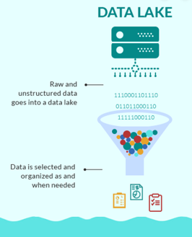
IT Evolution
“…is a system or repository of data stored in its natural or raw format, usually object blobs or files.”
“Total worldwide data will swell to 163 zettabytes by 2025, 10 times the amount today. Nearly 20% of the data in the global data sphere in 2025 will be critical to people’s daily lives and nearly 10% of that will be hypercritical.”
A Data Lake takes unstructured data and labels, categorizes, and organizes it to be useful.
E.g. A data lake can take audio, image and other unstructured data together with structured data for given purpose – such as processing insurance claims.
5

Slide 20
Opportunities
More Effective Delivery of the mission
Improved Cost Effectiveness
Less Resource Intensive
Simplicity in the solution & in the customer experience
Increased Speed
Greater Value
5

Slide 21
Challenges
Increasing public expectations of the government
Limited investment
- new technology
- Equipping/training government personnel
More stringent regulation and transparency
Competing in a dynamic environment with new technology, more data, evolving requirements…
Greater external threats
5

Slide 22
Government Excellence
“…helped design an algorithm that uses game theory to prevent hackers from gaining access to a cloud environment by penetrating insecure virtual machines used by another cloud client.”
“… seeking standards that will render brute-force attacks by quantum machines ineffective… calling for algorithms that can resist both quantum and conventional attacks” – to ensure strong cryptographic security controls.
“… developing the Federal Cloud Computing Strategy, known as “cloud smart.” … put engagement and collaboration between agencies and vendors at the forefront and helped identify the barriers the government faces in modernizing its legacy IT. The resulting strategy — the government’s first major cloud policy update in seven years — addresses many of the concerns identified by stakeholders and embraces iterative improvement. … creating greater savings while enhancing security and delivering faster services.”
“… established a service-wide incident response team to quickly resolve system outages affecting Air Force financial and business operations.
… within 24 hours of identifying what was blocking $2 billion of financial transactions from processing, the quick response team had properly configured the server in question and processed 80,000 transactions.
“… created 110 enterprise dashboards for all the agency’s administrative functions and, in the process, provided unprecedented access to data for agency leaders who make strategic decisions in the areas of IT, human resources, finance, property and fleet, procurement, operations and homeland security”
5

Slide 23
Government Excellence: US Digital Service
United States Digital Service 18F
A GSA Office work with government.
We support your mission
“… Federal, state, and local governments can partner with 18F to deliver projects that fulfill their mission, stay within budget, and use leading technology practices.”
“What they do:
Modernize software development processes while introducing good agile and human-centered design practices to your agency
Improve public-facing services like websites or applications
Digitize and streamline internal systems to save time and increase accuracy”

Slide 24
Government Excellence: US Digital Service
The U.S. federal government spends $3.8 trillion every year, managed by Treasury.
Where does it all go?
The Digital Accountability and Transparency Act (DATA Act) of 2014, requires that federal agencies adopt a common data standard so that we can answer that question…
Results:
One of the largest government-wide agile projects ever undertaken.
Made powerful tools to analyze government spending accessible to the public (USASpending.gov)
So 18F:
Assisted in developing a prototype for the implementation of the DATA Act
Used an agile approach: reducing risk, using real data for decision making and streamline implementation of a complex law.
Provided development expertise, procurement strategy, and product management.

Slide 25
Government Excellence: Data Center Optimization
The BIG ask!
OMB (since 2010) via the Data Center Optimization Initiative (DCOI):
Phase 1: Reduce data center Duplication & Costs
Phase 2: Optimization.
✗
$
=
=
$
✗
✗
OMB’s current DCOI – Target savings goal: $2.7 billion
5

Slide 26
Government Excellence: Data Center Optimization
$ Per DoE, average government data center has 100 to 200 times the energy consumption of a commercial building.
$ While reported server utilization rates as low as 5 percent across the federal government’s servers.
$ Government paid $450m for electricity costs on 1000 Data Centers.

Slide 27
Government Excellence: Data Center Optimization
As of August 2018 - 16 agencies met or planned to meet, their cost savings targets of $2.36 billion for fiscal years 2016 through 2018.
Most notable was:
DOJ and USDA for closing outmoded data centers; GSA and Commerce demonstrated impressive cost savings.
SSA and EPA for optimization efforts.

Slide 28
Government Excellence: Data Center Optimization
Communication Channels w/ Sub-Organizations
$128m in Cost Savings (August 18)
✗
Closed 101 of 110 Data Centers
Reskilled/Retooled Employees
Shift to Commercial
Cloud
(36 Providers)
Private Cloud (Sensitive Data)
5

Slide 29
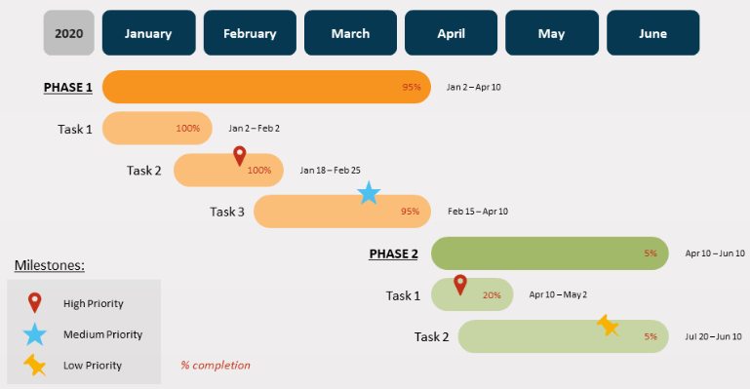
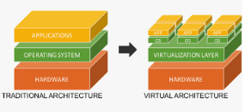
Government Excellence: Data Center Optimization
2
3
4
5
1
Comprehensive Repeatable
Planning Process
✗
Scaling Virtualization Infrastructure
Closed 2233 of 2237 Non-Tiered Data Centers
✗
1 - 4
Closed 29 of 35 Tiered Data Centers
Shift to Commercial
Cloud
5

Slide 30
Government Excellence: Data Center Optimization
Leadership
Backing
Consolidation, Virtualization Standardization in Large Decentralized Organization
✗
Closed ~50% of 74 Non-Tiered Data Centers (66 buildings/48 cities)
✗
1 - 4
Closing 1 of 4 Tiered Data Centers
Shift to Commercial
Cloud
5

Slide 31
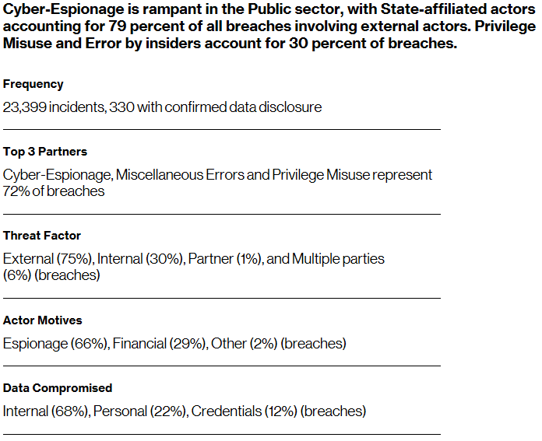
Government Excellence: Cybersecurity Collaboration
“Given the sheer number of incidents in this sector, you would think that the government incident responders must either be cape and tights wearing super heroes, or so stressed they’re barely hanging on by their fingernails.”
From Verizon 2019 Data Breach Investigations Report
5

Slide 32
Government Excellence: Cybersecurity Collaboration
“In March, a Utah-based renewable energy company became the target of a first-of-its-kind cyberattack on a U.S. utility, sporadically losing track of its generation sites over a 12-hour period….”
Per the Department of Energy the attack “is the first confirmed to have caused interruptions of electrical system operations…”
Attackers responsible numerous attacks resulting in outages in other countries were discovered probing the defenses of our energy grid in June
“The increasingly interconnected nature of vital systems means an ever-expanding landscape of threats, and energy infrastructure is emerging as one of the most critical intersections of vulnerability and risk.”
5

Slide 33
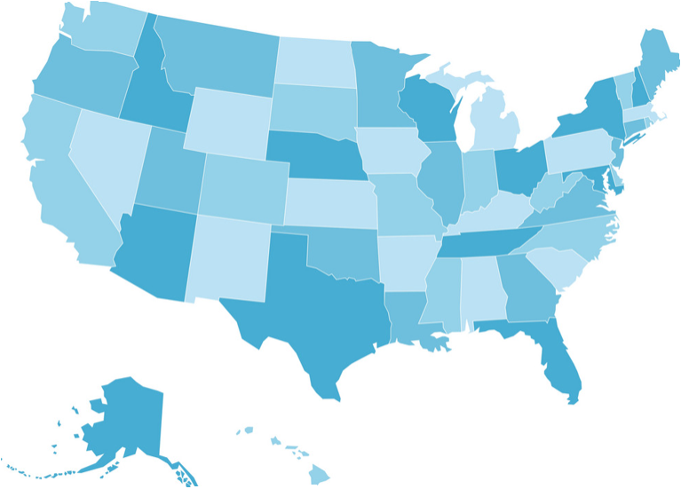
Government Excellence: Cybersecurity Collaboration
Sharing resources with states
In 2018, DOE formed the Office of Cybersecurity, Energy Security, and Emergency Response (CESER) to address cybersecurity, energy security and the emergency response function.
Collaborating with state-level stakeholders and private sector
+
Building relationships via public-private professional exchanges
Emphasizing information sharing, analysis centers, communications, preparedness exercises
Leveraging NIST Cyber Security Framework: Reprioritize, more focus on “detect-and-protect”
5

Slide 34
The Building Blocks of IT Success
Be a Catalyst
Adopt a Forward-Looking Mindset
Develop Agility in adopting new technology
Cultivate Adaptability
Collaborate & Partner
Garner Executive Leadership Support
Employ organization/stakeholder Communications
Consider Experience and Lessons Learned
5

Slide 35
Questions?

Slide 36
Jason Wagoner
Principal
Jason.Wagoner@claconnect.com
(301) 902-8568
Jason Gordon
IT Director
Jason.Gordon@claconnect.com
(703) 825-2142

