Slide 1
Grant Management
Best Practices
Blended Federal and State/University Perspective
Speaker: Justin Poll
Senior Accountant – National Science Foundation
Grantee Cash Management Section

Slide 2

What happens when grants go wrong?
Auditor: Baltimore hasn’t’ kept track of millions in grant money. (Again)
“Top elected officials expressed frustration that city government agencies have failed – yet again – to properly account for how they spent grant dollars.”
Source: https://www.baltimoresun.com/maryland/baltimore-city/bs-md-ci-grants-audit-20180321-story.html
Notes:
March 2018: A new audit of how the city manages millions of dollars in state and federal grants has come to the same conclusion that previous examinations have: Grant money coming into government coffers is not balancing out with what city agencies are spending.
“The city is not able to establish accurate balances of grant accounts,” city Auditor told Baltimore’s spending panel Wednesday.
One possible result: “The city could lose its much-needed [grant] funding.”
And that’s a lot of money. The city receives nearly $448 million in grants, or about 16 percent of its $2.8 billion budget.
City Council President expressed outrage over the findings, arguing that grant management problems should have been fixed by now.
“I don’t understand how we can have a problem with grants. That has to really stop. If the grants don’t add up … the federal government is going to come and they’re going to want their money. We’re going to owe thousands, maybe millions of dollars.”
Baltimore’s problem with tracking grant money has existed for years. Several previous examinations have found that city officials have failed to properly account for millions of dollars in grant funds. Each time finance officials have pledged to fix the issues, as they did on Wednesday.

Slide 3


Audit: ASU misspent more than $1 million in federal research funds
“ASU did not always comply with all Federal, NSF, and ASU regulations and policies when allocating expenses to NSF awards,” the auditors wrote. “It needs improved oversight of the allocation of expenses to NSF awards to ensure costs claimed are reasonable, allocable, and allowable in accordance with those regulations and policies.”
Source: https://www.azcentral.com/story/news/local/arizona-education/2019/04/17/national-science-foundation-audit-finds-asu-misspent-more-than-1-million-nsf-tamara-deuser/3491508002/
Notes:
April 2019: Arizona State University inappropriately spent more than $1 million in research grant funds on things like scholarships, equipment and travel, a federal audit published Tuesday found.
In some instances, the auditors said the university lacked the proper oversight and controls for its expenses and how they are submitted to the NSF. The university has agreed to review its processes in some areas to see what may need improvement.
The biggest piece of spending in question was nearly $900,000 in unapproved transfers to other entities, which resulted when ASU gave NSF funds to follow researchers who left the university for other institutions.
Auditors also said they were concerned about nearly $130,000 in “inappropriately allocated expenses,” more than $50,000 in other expense problems, and more than $5,000 in “unreasonable” travel expenses.

Slide 4

Audit: Nevada mishandled millions in US crime victim grants
RENO – Nevada’s Department of Health and Human Services misappropriated or failed to adequately justify the use of millions of dollars in federal crime victim assistance grants from 2012-16.
Source: https://www.rgj.com/story/news/2018/03/27/audit-nevada-mishandled-millions-us-crime-victim-grants/465002002/
Notes:
March 2018: RENO – Nevada’s Department of Health and Human Services misappropriated or failed to adequately justify the use of millions of dollars in federal crime victim assistance grants from 2012-16, a U.S. Justice Department audit said.
The flawed process the state used to distribute funds to individual groups resulted in the approval of approximately $4 million in excess awards.
The audit found that the state agency “cannot sufficiently explain why one application was denied and another application was accepted.” It said an agency official told the auditors the department “has had significant turnover of staff and does not know how or where the prior staff documented the selection process.”

Slide 5
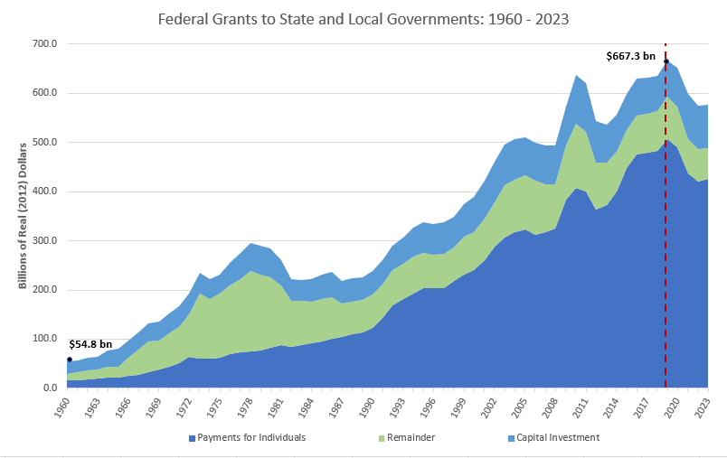
Scope of Government Grants
Source: OMB, Historical Tables, Table 12.1. Data estimates after 2018 are projected outlays (FY 2020 Budget Support)
Notes:
Updated with FY 2020 budget support data:
Let’s talk about Government Grants! This presentation has a lot of information and grant resources. I apologize upfront if you know about grants as this is pretty basic but this can be a conversation so feel free to jump in anytime with your input.
Chart Shows -- Over $660B in Federal grant assistance going to state and local governments.
Q* Who in the room receives, provides or is touched by a Government grant??? How are you involved in Grants?
Grants are the #1 employer around the Country.
When you take into account the amount of people whose jobs are supported by federal, state, local grants.
Then you factor in all of the jobs of the federal, state, and local government staff’s administering the grants
along with contractors supporting those agencies and #’s really explode.
91,000 U.S govt entities.

Slide 6
Types of Grants
Small Business
Block
Types of Grants
Formula
Student
Home Improvement
Project/ Research
Disaster Prevention & Relief
Notes:
Categorical grants may be spent only for narrowly defined purposes and recipients often must match a portion of the federal funds. 33% of categorical grants are considered to be formula grants. About 90% of federal aid dollars are spent for categorical grants.
Project grants are grants given by the government to fund research projects, such as a research project for medical purposes. An individual must acquire certain qualifications before applying for such a grant and the normal duration for project grants is three years.
Formula grants provide funds as dictated by a law. (Aid to Families with Dependent Children, Head Start Program or Job Training Partnership Act)
Block grants are large grants provided from the federal government to state or local governments for use in a general purpose.
(i.e. Local Law Enforcement Support or Community Development)

Slide 7
FY 2019 Actual: Total Research Grants by Agency
Budget Authority in Billions of Dollars
Data Source: Federal Budget Analytical Perspectives: Research and Development FY 2019 Estimate Column
Notes:
Updated as of FY 2019:
Research Grants by Agency
Total Research Grants are approximately $140B
The top research grant agencies are: DOD, NIH, NASA & Energy Dept
NSF Receives over $6 Billion in grant funds

Slide 8
Grants vs Cooperative Agreements
Grants
Financial Assistance to carry out a public purpose of support
Federal assistance to individuals or organizations
Covers benefits or entitlements
Substantial involvement is not expected between agency and recipient
Cooperative Agreements
Similar objectives of a grant
Main difference = significant involvement by the federal government
Notes:
Definitions:
In the United States, federal grants are economic aid issued by the United States government out of the general federal revenue. A federal grant is an award of financial assistance from a federal agency to a recipient to carry out a public purpose of support or stimulation authorized by a law of the United States. Assistance with few restrictions.
Grants are federal assistance to individuals, benefits or entitlements. A grant is not used to acquire property or services for the federal government's direct benefit.
Grants may also be issued by private non-profit organizations such as foundations, not-for-profit corporations or charitable trusts which are all collectively referred to as charities.
Substantial involvement (beyond routine monitoring and technical assistance) is not expected between the executive agency and the State, local government, or other recipient when carrying out the activity contemplated in the agreement.
When an awarding agency expects to be substantially involved in a project, the law requires use of a cooperative agreement instead. When the government is procuring goods or services for its own direct benefit, and not for a broader public purpose, the law requires use of a federal contract.

Slide 9
Grants vs Contracts
Grants
Not used to acquire property or services for the federal government’s direct benefit
Contracts
A binding agreement between a buyer and a seller to provide goods or services in return for consideration (usually monetary).
Notes:
Like a grant or cooperative agreement a Federal Contract can an instrument used by the Federal Government to provide funding for research and development projects.
However, unlike a grant or cooperative agreement, the Federal Government uses contracts as a procurement mechanism. The primary purpose of the Federal Contract mechanism is to purchase services for the direct benefit or use of the United States Government. Federal Contracts are subject to a strict set of terms and conditions, including clauses from the Federal Acquisition Regulation (FAR) and usually require frequent reporting and a high level of responsibility to the sponsor. A failure to accomplish the agreed upon results or deliver the product on time and on budget could result in criminal and/or civil actions and/or financial consequences to the University, administrators, or others involved.

Slide 10
Difference in Expectations
Grants
Diligent efforts are used in completing research and the delivery of results with little to no sponsor involvement
Cooperative Agreements
Diligent efforts are used in completing research and the delivery of results with substantial sponsor involvement
Contracts
Significant emphasis placed on delivery of results, product or performance with sponsor routinely approving activities and high expectation of stated results
Notes:
https://www.purdue.edu/business/sps/pdf/Grant_vs_Contract.pdf

Slide 11
Flexibility
Grants
Flexible
Principal Investigator has more freedom to adapt the project and less responsibility to produce results
Cooperative Agreements
Usually Flexible
Substantial involvement is expected between the executive agency and the State, local government, or other recipient when carrying out the activity contemplated in the agreement.
Contracts
More restrictive
High level of responsibility to the sponsor for the conduct of the project and production of results
Notes:
https://www.purdue.edu/business/sps/pdf/Grant_vs_Contract.pdf

Slide 12
Which Policy Applies?
Grants
Uniform Guidance
Terms and Conditions of the grant agreement
General Research Terms and Conditions (if applicable)*
Agency Specific Terms and Conditions
Cooperative Agreements
Uniform Guidance
Terms and Conditions of the cooperative agreement
General Research Terms and Conditions (if applicable)*
Agency Specific Terms and Conditions
Contracts
Governed by Federal Acquisition Regulations (FAR)
*The RTCs apply if the federal agency is a RTC participant

Slide 13
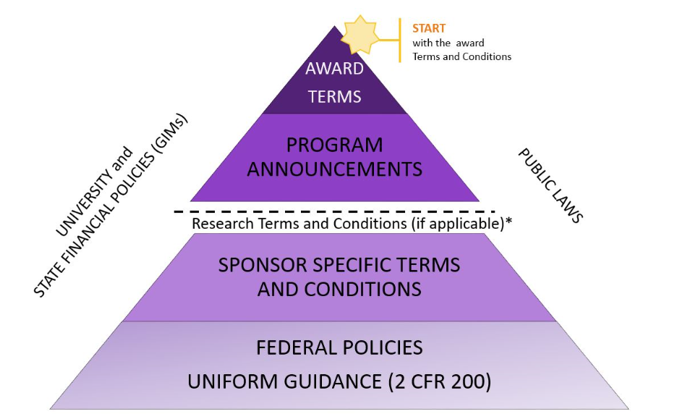
Policy Hierarchy Pyramid
Source: https://finance.uw.edu/pafc/federal-regulation-hierarchy-pyramid
*The RTCs apply if the federal agency is a RTC participant
Notes:
This pyramid represents the order of precedence of the federal regulations for awards. The order starts from the top of the pyramid – the Federal Award itself – and flows down to the Code of Federal Regulations which is at the base of the pyramid. Also, if your organization is a component of a state agency, the University and State Financial Policies and State public laws apply.
To determine the applicable regulation, review the Award first to determine if there is anything written into the Award that provides guidance or direction on the topic. If the Award is silent, then move down level by level as needed until the information is located.

Slide 14
Grant Policy – Uniform Guidance
In December 2014, OMB together with Federal awarding agencies issued final rule to implement the “Uniform Administrative Requirements, Cost Principles, and Audit Requirements for Federal Awards” (Uniform Guidance or UG), 2 CFR 200 https://cfo.gov/grants/uniform-guidance/
  Strengthens oversight of Federal awards to reduce the risk of waste, fraud, and abuse.
  Streamlines regulations to ease administrative burden
A comprehensive consolidation of OMB Circulars:
  Cost Principles: A-21, A-87, A-122,
  Administrative Requirements: A-110 & A-102
  Audit Requirements: A-133 & A-50
  CFDA: A-89

Slide 15
Training - Uniform Guidance
Grants 101 Training provides an introduction to the general provisions, pre- and post-award administrative requirements outlined in Subparts A through D of the Uniform Guidance (2 CFR 200) for Federal awarding agencies and award recipients. It has 5 Modules:
  Module 1 – Laws, Regulations and Guidance
  Module 2 – Financial Assistance Mechanisms
  Module 3 - Uniform Guidance Administrative Requirements
  Module 4 – Cost Principles
  Module 5 – Risk Management and Single Audit
Visit https://cfo.gov/grants/training/ to access the training.
Notes:
People always ask “is there training on the Uniform Guidance” or is there “cliff notes” or a summary UG version.
There are some summary version’s out there put out by accounting firms. Just search UG Summary. I can’t mention them as don’t want to be seen as endorsing a version or firm.
I did want to endorse the grants 101 training module on CFO website. It is pretty comprehensive and you can skip around to topics you want. It has different lesson’s in the each module. It provides examples of how federal awarding agencies apply these requirements into their daily grants management practices and what is required by the award recipient during the award.
5 modules:
Module 1 – Laws, Regulations and Guidance - Presents the underlying laws, regs, practices and guidance, including their order of preference
Module 2 – Financial Assistance Mechanisms – Presents the types of federal assistance awards and the appropriate use of each.
Module 3 - Uniform Guidance Administrative Requirements – presents general provisions and pre and post award requirements. Has examples
Module 4 – Cost Principles – Outlines the general principles governing cost, indirect cost, Examples of how agencies apply cost principles
Module 5 – Risk Management and Single Audit – provides common techniques to manage risk/strengthen compliance and single audit requirements

Slide 16
How Does Uniform Guidance Impact Grantee Audits?
Audit Requirements
Grantee recipients (other than Federal institutions) are subject to the audit requirements of OMB 2 CFR 200, Subpart F—Audit Requirements.
  Any state or local government or non-profit organization (including IHEs) that expends $750,000 or more per year under Federal grants, cooperative agreements, and/or procurement contracts must have an annual audit.
Notes:
The Uniform Guidance did impact Grantee Audits. It changed the threshold to $750,000 of federal funds

Slide 17
Latest Grant Policies
Digital Accountability and Transparency Act of 2014 (Data Act)
Grants Oversight and New Efficiency Act of 2016 (GONE Act)
American Innovation and Competitiveness Act of 2017
Notes:
Latest Grant Policies
Digital Accountability and Transparency Act of 2014 (Data Act)
- Improve the quality and transparency of agency grants
- Required starting in April 2017 the reporting of extensive data elements on agency grants – 57 data elements
Grants Oversight and New Efficiency Act of 2016 (GONE) Act
-Goal is to improve close out of expired grants. Requires reporting of grants expired for more than 2 years.
American Innovation and Competitiveness Act of 2017
- Key items is it raised Purchase Card threshold for grantees to $10,000 from $3,500

Slide 18
Effectively Communicating Your Request
Don’t be intimidated, however be respectful
Do your homework
  Defensible
  Supportable
Avoid assumptions/ambiguity
If someone else has prepared the submission, pre-screen for concerns
Notes:
Don’t be intimidated
It may surprise you, but most federal agency employees are not directly involved in the creation of the regulations/terms and conditions and must learn the correct interpretation just like you
It is ok to disagree with an interpretation
Be respectful and have support for your stance/preferably with citations
Keep in mind that not all federal agencies interpret a regulation the same way – be familiar with agency specific policy documents
Do your homework
Do your own review of regulations/terms and conditions, be familiar with the specifics that apply to the particular award
It is also a good idea to read the funding announcement – most post-award employees don’t appreciate the funding announcement. The FA often will provide context for why certain decisions were made during proposal preparation that won’t be apparent if you only rely on the NOA
Prepare a defensible request
Based on supportable logic or estimations
Avoid assumptions/ambiguity
Each institution has slight variations on how they refer to topics, don’t assume the person on the other side of your request understands your lingo or looks at it the way your institutional culture does
The way the request is worded matters – wording the request without ambiguity
Don’t jump to conclusions – if it doesn’t make sense, ask for it to be clarified as it probably won’t make sense to the federal sponsor reviewer
Pre-screen your institution’s requests
Common Red Flag areas (If it sounds funny to you, it will probably sound funny to the federal agency)
Late re-budget requests for CAS items – Cost Accounting Standard (CAS) Items are items normally charged as F&A and an exception scenario exists which gives you the ability to direct charge them. They are usually included in the proposal, but when they are not and identified late in the project, it can be a red-flag for improper spending. Examples: admin expenses, computers, general supplies, memberships and subscriptions, other electronics, phones, postage.
High burn rate in certain categories in the final months of the award (supplies; equipment)
give the appearance of “spending out an award”
Re-budgeting restricted categories (Restricted categories such as participant costs, capital equipment (DOE), etc.) Will it change the SOW, why wasn’t it budgeted, why do you need it now?
Spending first, asking second (using Pcards or seeking reimbursements) Concern with purchasing items not budgeted. If you repeatedly go to the sponsor for this approval, it will raise questions on whether you are managing the award properly.
Reduction in effort of key personnel that falls under the threshold. Also, too much effort (NSF 2-month policy). Issue of effort could impact a go/no-go decision as schedules may be impacted.
Help the PI strengthen the justification if needed
Writing a good justification makes a world of difference in the outcome
Asking the right kinds of questions. Include information on - What are we requesting, why, how does the project benefit/is it improved, will the scope be impacted?
Does the information provided by the PI answer the above questions? Does it make sense based on the type of request? If not, push back to PI for more information – depending on the request, a stronger justification might be needed (e.g. equipment & CAS)
Avoid including the kitchen sink
Trim down support documentation to only include what is necessary. It is easy to simply pass on whatever the PI/project staff has provided which may complicate the review

Slide 19

Grantee Responsibilities
Keys to Success
  Comply with Federal rules.
  Adhere to award terms and conditions.
  Read your award notice carefully! It may include project or award-specific requirements, such as:
    Funding restrictions, Special reporting requirements.
    Special terms and conditions or other instructions.
  Be consistent with Grant Providers policies and your policies.
  Manage funds prudently.
    Allowable. Allocable. Reasonable. Necessary.
Notes:
General Grantee Responsibilities – Keys to success. Of course there is the Uniform Guidance just mentioned to follow for compliance
Know your award terms and conditions and this may sound simple but “read you award notice carefully” as there may be special project requirements, restrictions (like buy America) or special reporting or terms. {Disaster relief}
Be consistent with all your grants and with you own agency policy. Don’t do one thing for one grant and something different for another.
Manage the funds like they are yours. Follow the cost principles to make sure all expenses are:
allowable, allocable, reasonable, and necessary
These are the keys to success in administering a grant

Slide 20
Value of the Funding Opportunity Announcement (FOA)
An FOA is a publicly available document by which a U.S. Federal agency makes known its intentions to award discretionary grants or cooperative agreements, usually as a result of competition for funds.
Contains all the official information about a grant program and provides instructions on how to apply
For post-award staff: the FOA may explain why certain actions were taken in a grant proposal (i.e. why expenses may have been budgeted in a particular category)
Notes:
An FOA is a publicly available document by which a U.S. Federal agency makes known its intentions to award discretionary grants or cooperative agreements, usually as a result of competition for funds. Funding opportunity announcements may be known as program announcements, requests for applications, notices of funding availability, solicitations, or other names depending on the agency and type of program.

Slide 21
Understanding Appropriation Life Cycle
Appropriation | 2014 | 2015 | 2016 | 2017 | 2018 | 2019 | 2020 | 2021 | 2022 | 2023
FY14/15 Research | 1 | 2 | 1 | 2 | 3 | 4 | 5
FY17/18 Research |  |  |  | 1 | 2 | 1 | 2 | 3 | 4 | 5
Budget Authority AVAILABLE (allowed to make new obligations)
Budget Authority EXPIRED (allowed to adjust or liquidate existing obligations – NO NEW OBLIGATIONS)
Budget Authority CANCELLED (NO OBLIGATIONS OR OUTLAYS/EXPENSES)
Notes:
Each year grantees lose millions and millions because the period of availability cancels. Don’t let that happen on your grants.
Most grant funds have a limited period of availability for expenditure (usually 5 years from the appropriation year). When requesting no cost grant extensions be aware of extended the grant beyond the period of availability (canceling appropriation)
NSF Example of How long are appropriations available?? - The slide here provides you some legal language, but to put this in simpler language:
- NSF grant appropriations are generally available for 2 years to make new obligations.
- After the initials 2-year open period, we are permitted to make payments on existing grants for an additional 5 years.
- After this total of 7 years (2+5) the appropriations will close or it is often referred to as canceling.
In general, award periods of performance don’t last long enough for this to be an issue, however when an awardee experiences delays or grant problems they can bump into this canceling period.

Slide 22
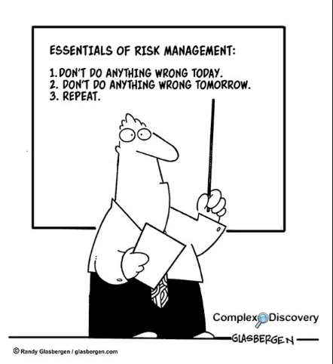
Grantee Risk Posture
Allowability of expenses
Internal Controls
Notes:
It is important for Grantees to understand their Risk Posture/Culture as an important element in making decisions on grant financial management.
Federal & State Agencies monitor for unallowable expenses. Audit’s check for Allowability of Expenses.
Judgement calls come up frequently with purchases and allowability. Grantees have key focus areas when evaluating the risk of an expense that is not cut and dry.
Has the agency providing the grant relayed some high risk areas they are monitoring? Business meals, taxes, equipment purchases
Stories??? Equipment purchases at end of grant

Slide 23
Spending Review Case Example
Which of these scenarios would you approve?
  Request to spend $12,000 for two computers and graphics card that would be used to conduct specialized work on a four-year grant.
  Request to spend $3,500 to repair a centrifuge the team was using to conduct grant-related research funded by the sponsored award.
  Request to spend $27,000 for “wearable eye-tracking units” that had been part of the award’s budget.

Slide 24
Spending Review Case (Additional Context)
Would you still have approved them?
  Request to spend $12,000 for two computers and graphics card that would be used to conduct specialized work on a four-year grant that would have only been used for a maximum of six days during the four-year grant period.
  Request to spend $3,500 to repair a centrifuge the team was using to conduct grant-related research funded by the sponsored award. However, the repairs took place one day before the award’s four-year term ended. Plus, the repair was for a general piece of laboratory equipment the University had used, and would continue to use, to benefit multiple projects.
  Request to spend $27,000 for “wearable eye-tracking units” that had been part of the award’s budget that weren’t received until after the grant ended.

Slide 25



Grant Oversight Pyramid
OIG Audit
Local Govt
Audit
Agency Site Visits
Agency Reviews and Remote Testing
Grantee Internal Control Reviews
UG(Single Audit) or State Grantee Audits
Notes:
Wanted to show you this so you can see where baseline monitoring fits in overall Grant Oversight Pyramid.
Explain bottom up
Bottom is UG single audit or State Audit almost all grantees undergo in one fashion
Middle – is Grantee Internal Control program – self reviews
Middle – is also where agencies do grant monitoring and remote testing just discussed
Top – in blue you have Agency Site Visits and desk reviews,
Top – Audit level. Inspector General or City/State Audits. These vary by year.
Grantees don’t want to be in the top blue level

Slide 26
Using Data Analytics
Use of data analytics in our baseline monitoring.
  Examples:
    Excess Cash
    Spending patterns by grant -- Zero activity, 80/20, expiration
    Risk Based Testing
Agencies are always looking at our data for additional baseline monitoring metrics that may assist the grantees identify issues before a problem exists.
Notes:
Agencies try to use all the data at their disposal to provide business assistance to grantees.
Some examples of Data Analytics used in grant monitoring:
Excess Cash – grantees are drawing down funds in excess of expenses being reported
Spending patterns though the grant lifecycle
No activity after award inception – could mean problems with grant
80/20 monitoring. 80% of grant funds spent in 20% of time/ & reverse 20/80
Awards approaching Expiration, send out notices if have substantial balances
Risk Based testing
Categorize grants into H _ M _ L Risk Buckets, grants not grantee
Use risk factors to categorize with different levels of testing
testing to identify if unallowable, unsupported or erroneous. Different from audit testing for allowability
Results can lead to Good outcomes – less monitoring and Bad outcomes – audits

Slide 27
Troubled Grantee Indicators
Signs of a Troubled Grantee
  Staff Turnover
  Late or can not provide expenditure reports
  Can not provide quickly expenditure reports requested
  Changing #’s or high # of adjustments
  Late program reports
  Do not return repeated phone calls
Notes:
Some universal signs of troubled grantees to watch out for. You can see these in normal monitoring activities.
Staff Turnover
Late or can not provide expenditure reports or program reports
Can not provide quickly expenditure reports requested through sampling
Changing #’s or high # of adjustments
Do not return repeated phone calls
There are other indicators like reading about in audits or the papers which we won’t cover.

Slide 28

Support Documentation Case Example
University received an equipment expense audit request from the sponsor. The auditor has requested detailed documentation to support the reimbursed expense.
As the audit liaison, you contacted the PI and department staff to request this support documentation and they have provided a 122-page PDF file filled with internal email correspondence, equipment quotes, equipment invoice and internal approval documents.
True or False:
Forward the provided support document as-is to the auditor for review to satisfy the request for support documentation.

Slide 29
Support Documentation Case Example
University received an equipment expense audit request from the sponsor. The auditor has requested detailed documentation to support the reimbursed expense.
As the audit liaison, you contacted the PI and department staff to request this support documentation and they have provided a 122-page PDF file filled with internal email correspondence, equipment quotes, equipment invoice and internal approval documents.
True or False:
Forward the provided support document as-is to the auditor for review to satisfy the request for support documentation.

Slide 30
Support Documentation Case Example
This is an example of what we like to refer to as the “kitchen-sink” of support documentation
Please trim-down the support documentation to only include what is necessary to support the expense.
“Kitchen-sink” support documents complicate the review/approval process.
Notes:
In real example, less than 10 pages of the 122 page PDF document was required to support the expenditure.

Slide 31
Useful Reminders
Know the Requirements. Read your award letter carefully!
Review your own institutional policies and procedures, as these may be more restrictive than Federal regulations.
Document organizational policies and procedures clearly in writing.
Train staff in their roles and responsibilities.
Maintain timely and effective lines of communication with your researchers.

Slide 32
Free, online toolkits and guides to help financial professionals working at all levels of government do their jobs better | www.agacgfm.org/tools
Blended and Braided Funding: A Guide for Policy Makers and Practitioners
Making Better Decisions: Leveraging Government Resources in Challenging Financial Times
Risk Assessment Monitoring Toolkit
Sub recipient vs. Contractor Checklist
Cooperative Audit Resolution and Oversight Initiative (CAROI) Guide
Fraud Prevention Toolkit
Candidate Assessment Toolkit for Grants Managers
Partnerships Matter: How
a Federal, State and Non-Profit Collaboration Improved Efficiencies in Delinquent Debt Collection
Visit https://www.agacgfm.org/Resources/Online-Library/Intergovernmental-Reports.aspx
Notes:
Managed and overseen by our Intergovernmental Partnership, AGA’s work groups include our members, industry colleagues, corporate partners, several non-profit associations and academia.
Leverage these while you’re in school! Our research reports are 100% free for you to use. So take advantage of all AGA offers now!

