Slide 1
Transforming federal Financial MANAGEMENT
Exploring Distributed Ledger Technology for Multi-Tier Grant Payments
December 10, 2020

Slide 2
Poll Question:
On a scale of 1 – 10, what is your level of blockchain expertise?
(1 = no experience; 10 = expert)

Slide 3
What is Blockchain?
Blockchain is to VALUE, what the Internet is to INFORMATION. Hence, the Internet of Value.
[
]
No single ownership, Multiple contributors, No 3rd party
A distributed ledger which allows
digital assets / tokens to be transacted in a
real-time, immutable manner
dig·i·tal ass·et: something represented in a digital form that has an intrinsic or acquired value (e.g., land, house, currency, vote, identity, rewards) and can be transferred and tracked across the network. In the DLT for Multi-Tiered Payments project, digital assets are referred to as “tokens”.
Transparent, Secure, Irreversible
Verifiable record of every transaction
Low Friction
Near real-time settlement of recorded transactions
Cryptography
(Public & Private Keys)

Slide 4
Representative Blockchain Examples
Blockchain technology can add value to a variety of use cases.
Connected Supply Chain | Know Your Supplier | Locate Lost/Stolen Products | Connected Services
End-to-end supply chain solution connected to IoT sensors and the blockchain | The ability to verify and endorse any stakeholder an entity wishes to conduct or continue to do business | Product tracking in order to identify authenticity and activate product shipping / damage insurance | After-care service can be based on predefined contracts and agreements stored and executed on blockchain
Authenticity and provenance | Fraudulent Transactions | Smart Loyalty Programs | Targeted Recall
Proof of authenticity which would eliminate the risk of counter products and resale markets | Create an escrow system via smart contracts, protecting buyer and seller funds until both parties have confirmed they are satisfied | Capture, store, and verify customer details and behaviors through smart contract logic | Enables manufacturers and retailers to identify products that are unsafe or defective
Delivery | Consumer Participation | Connected store | Sharing Economy
Tracking manufacturing and consumer deliveries to specific locations through the supply chain | Transparent consumer surveying and research, via a secure, transparent blockchain ledger | Store and analyze supply chain related data on chain in order to improve fulfilment capabilities | Utilize the blockchain network to safely and quickly verify, monitor, change ownership of a product
Consumer Payments | B2B Payments | Digital Advertising | Consumer Protection
Save time and money on payments by use of cryptocurrencies, credit payments, etc. by eliminating cost of banks and CC companies | Smart contracts to replace traditional letters of credit; blockchain based transaction process between intermediaries | Improve transparency around real-time bidding for digital advertising by providing a full audit trail | Keeping an up-to-date and easily transferable digital record of consumer purchases of product warranties

Slide 5
Fiscal Service’s Blockchain Journey
2017 - 2018
2018 - 2019
Physical Asset Tracking
Software License Tracking
Grant Payments
Gave us a foundational understanding of DLT by exploring a low-risk use case.
Expanded our understanding of what does, and does not make a good use case for blockchain
Explored how blockchain could be used to tokenize (digitally represent), transfer, and redeem a Federal payment.

Slide 6
Reporting Burden Associated with Grants
Researchers spend 44% of their research time performing mandated administrative tasks*
* Reducing Administrative Burden in Federal Research Grants to Universities, IBM Center for the Business of Government, January 29th, 2020.

Slide 7
More Payment Visibility = Less Reporting Burden
Current State
Federal
Agencies
Multiple Grant Payment Platforms
Prime
Recipient
Unknown
Sub-Recipients
Future State
Federal
Agencies
One Grant
Payment Platform
Prime
Recipient
Known
Sub-Recipients

Slide 8
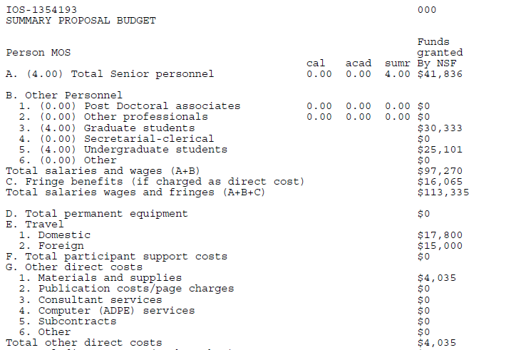
“Tokenizing” a Grant Letter
A Grant Letter becomes “tokenized” by extracting, digitizing, and storing specific data elements onto a blockchain token where those data elements are permanently stored and can be transferred
Grant Letter Information and Payment Data are Digitized and Stored on the Token
Blockchain Token
Grant Info
Key Dates
Awardee Information
Award Amount

Slide 9
Proof of Concept User Flow
The prototype demonstrates how Federal Agencies can convert a grant award into a digital representation with unique properties and business rules for the transfer and redemption of the award, all which can be stored and tracked digitally.
FEDERAL AGENCY USER
GRANT RECIPIENT USER
ALL USERS
DLT SYSTEM
0. Award a grant to a recipient
1. Convert grant award into a digital asset
2. Set internal controls (e.g. thresholds)
3. Request payment / receive token
4. Redeem token / initiate payment
5. Streamline reporting
NEAR REAL TIME DATA VISIBILITY

Slide 10
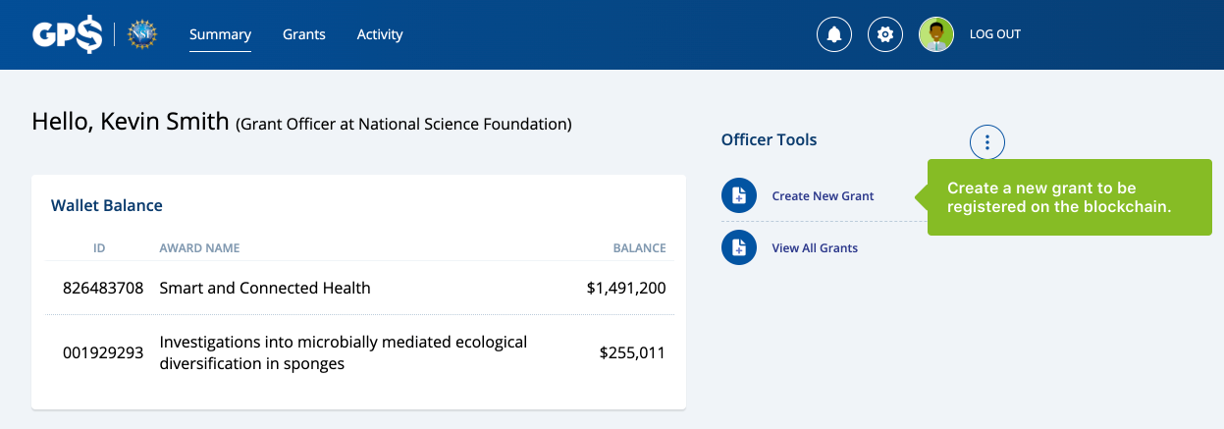
Clickable Prototype
This clickable prototype allows us to share the process flow and concepts of the prototype with greater audiences to receive their input.
Clickable Prototype
Users sign in as an Agency grant officer, prime recipient, or agency viewer to observe the blockchain process flow of the tokenized grant award
Copy and Paste the following link into your browser: https://projects.invisionapp.com/share/FRYG7MWQ7GV
Password: fit_gps

Slide 11
Findings and Lessons Learned
What We Found
How We Go Forward
REGULATORY CHALLENGE
The Uniform Guidance that governs grant payments does not include a declarative statement that authorizes the Agency to pay sub-recipients directly
INTEGRATION WITH THE AGENCY FINANCIAL SYSTEM
How tokens will flow through the Agency systems has not yet been determined
ACCOUNTING/AUDIT TREATMENT OF TOKENS
Tokens aren’t recognized as cash, making their treatment unclear in existing audit guidance
DLT COMPLIANCE WITH NIST STANDARDS
Ethereum does not meet NIST standards for blockchain hashing
FINANCIAL SYSTEM CONNECTIVITY
Connecting the blockchain application to agency financial systems to reconcile token transfers
CONTINUE GROWING THE ECOSYSTEM OF PUBLIC AND PRIVATE SECTOR STAKEHOLDERS
Ecosystem governance will determine how blockchain can be deployed with multiple agencies, including co-funding models, inter-agency IT security, change control, and standards of use.
EXPLORE BLOCKCHAIN SERVICE DELIVERY MODELS
The service model for blockchain, whether building on our own or through an “as-a-service” approach will determine how legacy business processes and roles will change moving forward.
CONVENE POLICY AND TECHNICAL EXPERTS TO ASSESS BLOCKCHAIN TECHNOLOGY AGAINST FEDERAL STANDARDS
Aligning on resolutions for key regulatory and IT standards to take blockchain into production requires additional analysis with relevant stakeholders across the Federal government.
Key Generation
Key Storage
Transaction Signing: Digital Signatures
Blockchain Hashing
Ethereum uses hashing algorithm keccack256 that is inconsistent with NIST best practices. However, it is believed that keccack256 is no less secure than the NIST standard.
Notes:
SMEs:

Slide 12
Poll Question:
Given what you learned today, what ideas do you have for potential use cases?

Slide 13
Fiscal Service Contact
Tammie Johnson
Management and Program Analyst
tammie.johnson@fiscal.treasury.gov
National Science Foundation
Justin Poll
Senior Accountant
jpoll@nsf.gov

Slide 14
Appendix

Slide 15
When is Blockchain the Right Fit?
There are several requirements that, when met in part or in full, indicate that blockchain may be a good possible solution.
Blockchain may be a good solution
if it involves…
Blockchain may not be the best solution
if it involves…
Shared Data | Need for a structured repository of information in an immutable format
Single Entity | Transaction is confined to only one entity and impacts only internal stakeholders
Multiple Writers | Multiple organizations generating transactions, or components of transactions, that modify the database
Big Data | High-volume, high-density data required to be stored with transaction information (videos, images, etc.)
Intermediaries | Organizations require a third-party to authenticate/facilitate transactions (e.g. a clearing house or central gatekeeper)
Centralized Control | Few participants in the ecosystem or need for one entity to maintain sole discretion over transaction validation
Accountability & Auditability | Transaction contains sensitive data to be encrypted and secured to only those with permissioned access; auditability is paramount

Slide 16
How to Spot a Blockchain ‘Moment’
Evaluate the actions, struggles, and aspirations of a program to determine if blockchain may be a good fit.
Are you doing any of the following?
Are you struggling with any of the following?
Are you aspiring to any of the following?
Operational cost reduction
Disintermediating third parties
Working to improve multi-party relationships within industry
Simplifying your supply chain
Paying third parties for settlement / reconciliation of your data
Shared data across multiple entities / parties
Absence of trust and intermediaries
Tracking flow transfer of physical assets
Economic inefficiencies
Managing settlement reconciliation processes
Understanding the potential
Overcoming the hype
Envision and roll out new business models
Drive emergent industry / vertical dynamics
Achieve dramatically improved efficiencies
Raise transparency standards through regulatory compliance

Slide 17
Blockchain Checklist
After addressing the need for blockchain, identifying ecosystem partners, and evaluating technical challenges, it is important to determine if other technologies are a better fit than blockchain.
Value identification
Do you often share information, credentials or value with other?
Are you managing contractual relationships?
Is trust a critical requirement / challenge?
Is there a presence of intermediaries to help enable trust today?
Do you currently need to prove to others you are transacting/reporting accurately?
Do you want / need to enable transparency of transactions?
Do you need transaction privacy?
Do you need transaction anonymity?
Is there potential to monetise the data or digital assets in your value chain in future?
Do you own the problem? (Is this your own value chain, or a wider industry challenge)
Participant buy-in
Do you have a network of stakeholders (i.e. more than 2) ?
Are you dependent on other stakeholders for information?
Does more than one participant need to be able to update the data?
Is there a need for a central, controlling authority among the participants?
Is there scope to open the ecosystem to ancillary parties in the future?
Are you working with other industry players on any activities?
3. Technical challenges
Is it complicated to digitise assets in your value chain that are not digital today?
Do you need to store a particularly rich or complex data structure?
Is there an ongoing need for high data throughput?
Do you need to rely on public data sources to inform activities or decisions? (e.g. markets data, prices)
Showstopper!!
Can it be done better with another technology or technologies?

