Slide 1
Developing your Inner Leader for Success!
Prepared for:
\
AGA 24th Annual Commonwealth of VA PDT
Theme: “The Changing Landscape of Accountability”
Prepared By:
Kevin M. Coleman
KMC Empowerment, LLC
Date: Friday, December 13, 2019
www.KMCEmpowerment.com
Notes:
I AM statements, I AM a Transformational Leader, I AM a Next Generation Leader, I AM Passionate about My Success! Focus on Leaders vs. Managers

Slide 2
Developing your Inner Leader for Success!
Ten (10) Transformational Principles for Today’s
Next Generation Leaders! Today we will only touch on Five (5)
www.KMCEmpowerment.com
Notes:
The Biggest difference between Training and Development? How many of you go to Trainings and Remember everything about it? Most don’t it goes in one ear and right out the other. That is why I am giving each of you an opportunity to get in a Development Program after this training by going to my website to learn more.

Slide 3
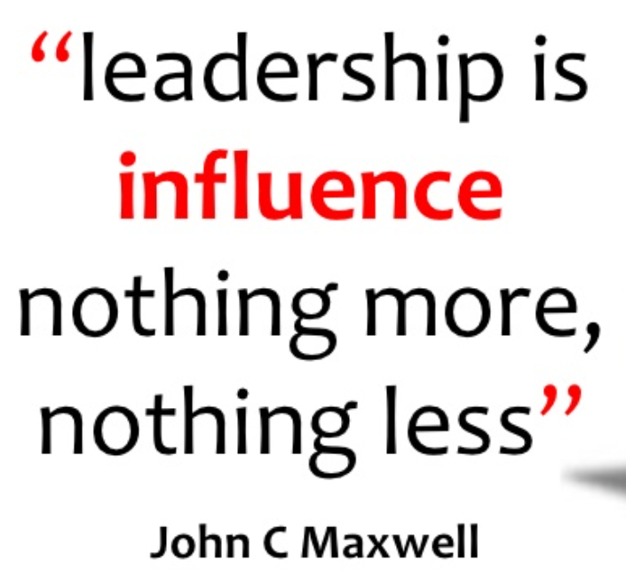
1. The Definition of Leadership: Influence
www.KMCEmpowerment.com
Notes:
Coaching Client CEO for a Multi Million Dollar IT Company…

Slide 4
AGA Emerging Leader “Interactive” Question # 1
Who are the 3 people you influence the most in your personal life or professional life? What do you think is the reason you have influence with them?
www.KMCEmpowerment.com

Slide 5
1. The Definition of Leadership: Influence
5 Levels of Leadership: John C. Maxwell
www.KMCEmpowerment.com
Notes:
Level 1 POSITION: Rights – People follow you because they have to
Level 2 PERMISSION: Relationships – People follow you because they want to
Level 3 PRODUCTION: Results – People follow you because of what you have done for the organization
Level 4 PEOPLE DEVELOPMENT: Reproduction – People follow you because of what you have done for them
Levin 5 PINNACLE: Respect – People follow you because of who you are and what you represent

Slide 6
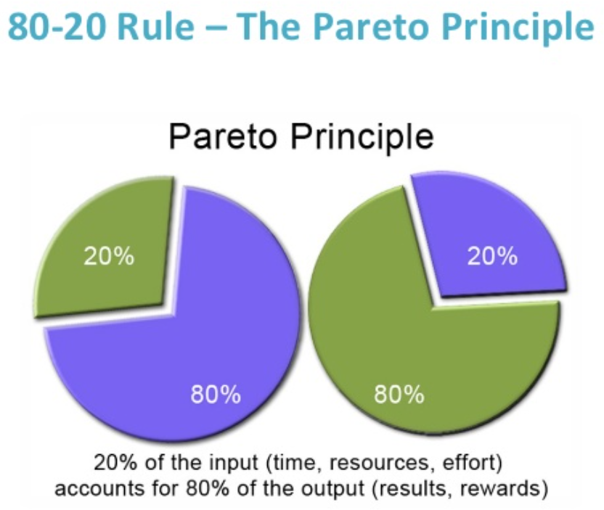
2. The Key to Leadership: Priorities
FOCUS
SIMPLIFICATION
CLARITY
www.KMCEmpowerment.com
Notes:
In 1906, the economist Vilfredo Pareto noticed the 80% of the land in Italy was owned by 20% of the population. (NOTE: 20% of cause to improve 80% of the results)
= FOCUS / SIMPLIFICATION / CLARITY

Slide 7
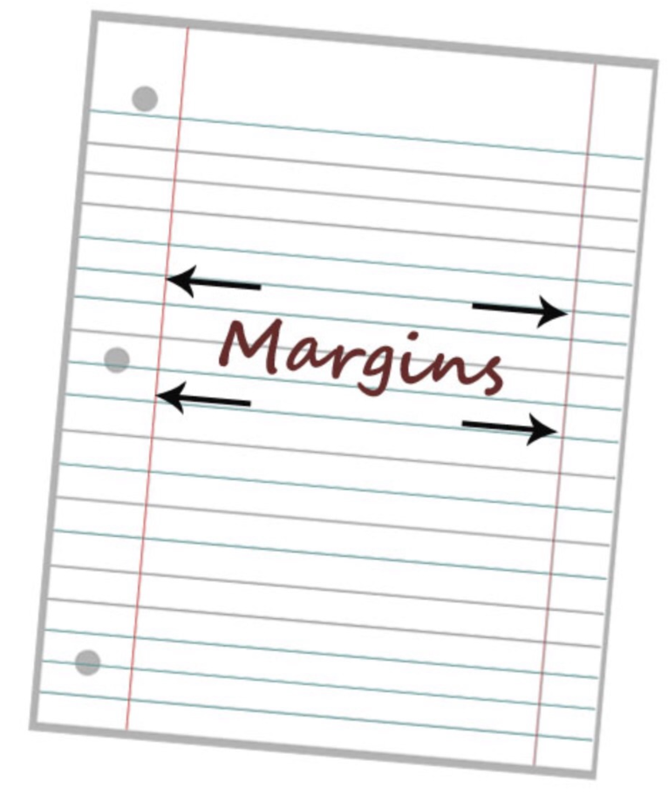
2. The Key to Leadership: Priorities
Margins Improve Self-Awareness
Make room (time) for:
Margins Give You Needed Think Time
Margins Provide You With Energy Renewal
www.KMCEmpowerment.com

Slide 8
AGA Emerging Leader “Interactive” Question # 2
On a scale of 1-10 with 10 being very organized, how would you rate yourself in the ability to get through your daily tasks and still be able to meet the demands of emergencies that may arise throughout the day?
What could you do tomorrow to raise that number by 1?
www.KMCEmpowerment.com

Slide 9
AGA Emerging Leader “Interactive” Question # 3
What does the below Zig Ziglar’s quote mean to you?
“If you help people get what they want, they will help you get what you want.” - Zig Ziglar
www.KMCEmpowerment.com

Slide 10
7. The Heart of Leadership: Serving People
“The true leader serves. Serves people. Serves their best interests, and in so doing will not always be popular, may not impress. But because true leaders are motivated by loving concern rather than a desire for personal glory, they are willing to pay the price.” - Eugene Habecker’s The Other Side of Leadership.
www.KMCEmpowerment.com

Slide 11
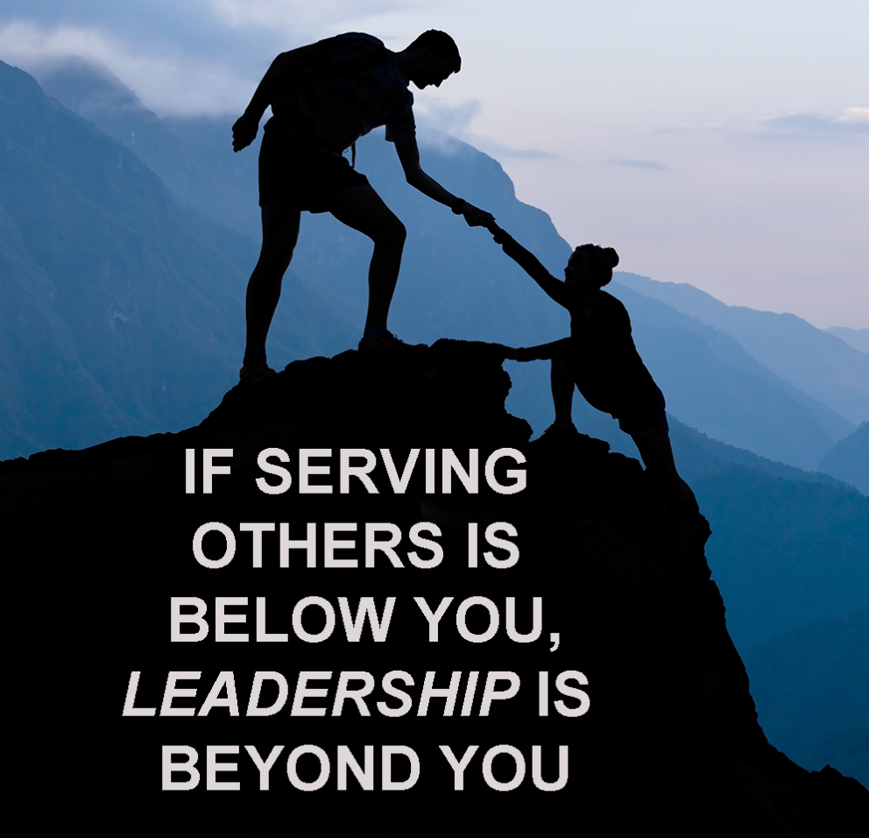
7. The Heart of Leadership: Serving People
How to Be a Better Servant Leader:
1. Don’t Rely on Your Position or
Title
2. Believe in People and Their
Potential
3. See Things from the Perspective of
Others
4. Create an Environment of
Encouragement
5. Measure Your Success by How
Much Value You Add to Others
www.KMCEmpowerment.com
Notes:
Shaking Hands and Kissing Babies

Slide 12
AGA Emerging Leader “Interactive” Question # 4
What is the hardest thing you have done to improve yourself or your circumstances?
www.KMCEmpowerment.com

Slide 13
9. The Price Tag of Leadership: Self-Discipline
www.KMCEmpowerment.com
Notes:
Do you want to control of Lead!

Slide 14
9. The Price Tag of Leadership: Self-Discipline
1. Self -Discipline Enables You to Go Uphill.
DESTINY
2. Self -Discipline Makes the Difference Between
Temporary Success and Sustained Success.
3. Self -Discipline Makes Habit Your Inspiration
Instead of Your Downfall.
OWN
4. Self -Discipline is Developed – Not Given.
5. Self-Discipline is Most Easily Developed
in Areas of Strength and Passion.
YOUR
6. Self-Discipline and Respect Are
Connected.
CONTROL
7. Self-Discipline Makes Consistency
Possible and Consistency Compounds.
YOU
www.KMCEmpowerment.com
Notes:
Story about BIG Leading Chapter

Slide 15
AGA Emerging Leader “Interactive” Question # 5
What do you spend the most time thinking about – Yesterday, Today or Tomorrow? Why is that?
www.KMCEmpowerment.com

Slide 16
10. The Expansion of Leadership: Personal Growth
GROWTH MATTERS
1. Growth is the Only Guarantee That Tomorrow
Will Get Better.
2. Growth Means Change.
3. Growth is the Great Separator Between Those
Who Succeed and Those Who Don’t.
4. For Growth to Be Maximized, It Must Be
Strategic.
5. Growth is Joy!
www.KMCEmpowerment.com
Notes:
Take ownership of your Personal Growth….INVEST IN YOURSELF

Slide 17
10. The Expansion of Leadership: Personal Growth
Adopt a Learner’s Mind-Set:
What is your mind-set about growth?
What must you change in your attitude to become a better learner?
Develop a Specific Growth Strategy:
Big Picture: Where do I need to focus my growth?
Measurement: How can I measure and affect my growth?
Consistency: How can I grow daily?
Application: Can I act on it?
www.KMCEmpowerment.com
Notes:
INVEST IN YOURSELF you Deserve it! Get a Coach find a Mentor

Slide 18
AGA Emerging Leader “Interactive” Question # 6
How will you Develop the Leader Within You?
www.KMCEmpowerment.com

Slide 19
Complimentary Offers
Go to: https://www.KMCEmpowerment.com :
Sign up for Complimentary 30-minute Coaching Intake session
Virtual – Five (5) Week, One (1) Hour Leadership Development Training
Request Copies of This Presentation
www.KMCEmpowerment.com

Slide 20
Developing your Inner Leader for Success - Key Points:
1. The Definition of Leadership: Influence
2. The Key to Leadership: Priorities
3. The Foundation of Leadership: Character
4. The Ultimate Test of Leadership: Creating Positive Change
5. The Quickest Way to Gain Leadership: Problem Solving
6. The Extra Plus in Leadership: Attitude
7. The Heart of Leadership: Serving People
8. The Indispensable Quality of Leadership: Vision
9. The Price Tag of Leadership: Self-Discipline
10. The Expansion of Leadership: Personal Growth
www.KMCEmpowerment.com

Slide 21
Remember M.O.R.E. is required of you!
Maximize
Opportunities
Relentless
Enthusiasm
www.KMCEmpowerment.com

Slide 22
?
QUESTIONS
www.KMCEmpowerment.com

Slide 23
Thank You!
Kevin M. Coleman
KMC Empowerment, LLC
Contact me: www.KMCEmpowerment.com
Phone: 703.597.1897
www.KMCEmpowerment.com

Slide 24
Complimentary Offers
Go to: https://www.KMCEmpowerment.com :
Sign up for Complimentary 30-minute Coaching Intake session
Virtual – Five (5) Week, One (1) Hour Leadership Development Training
Request Copies of This Presentation
www.KMCEmpowerment.com

