Slide 1
Economic Update
Alice Louise Kassens
Roanoke College

Slide 2
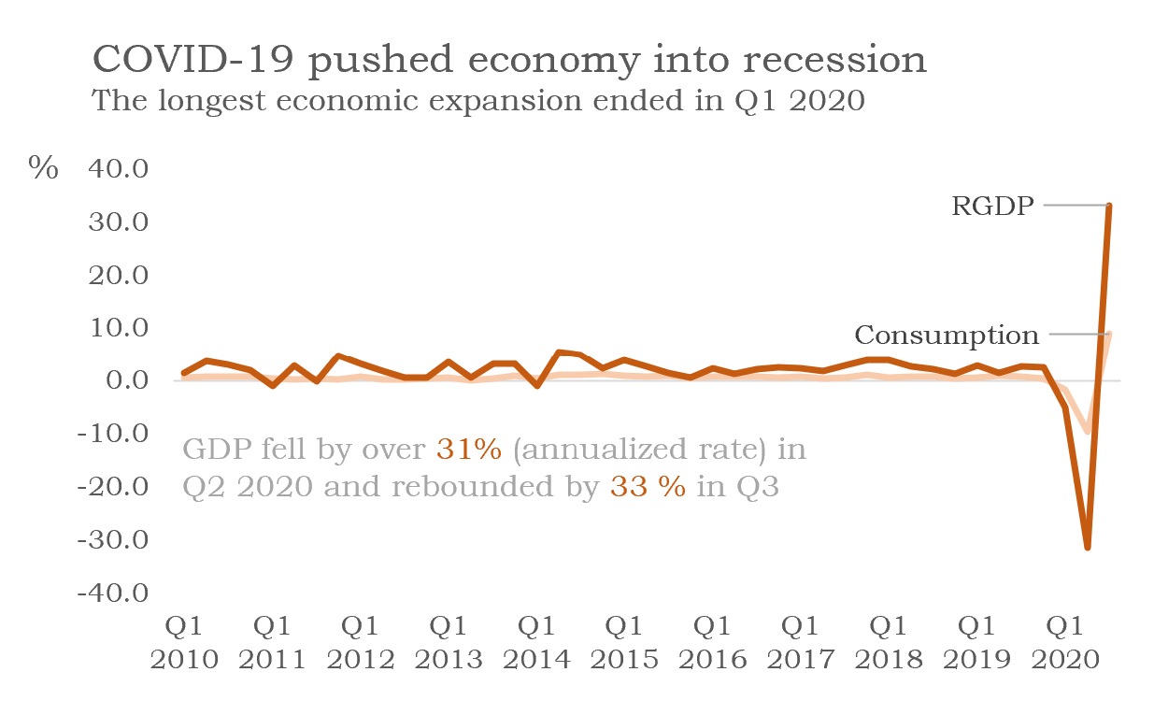

Slide 3
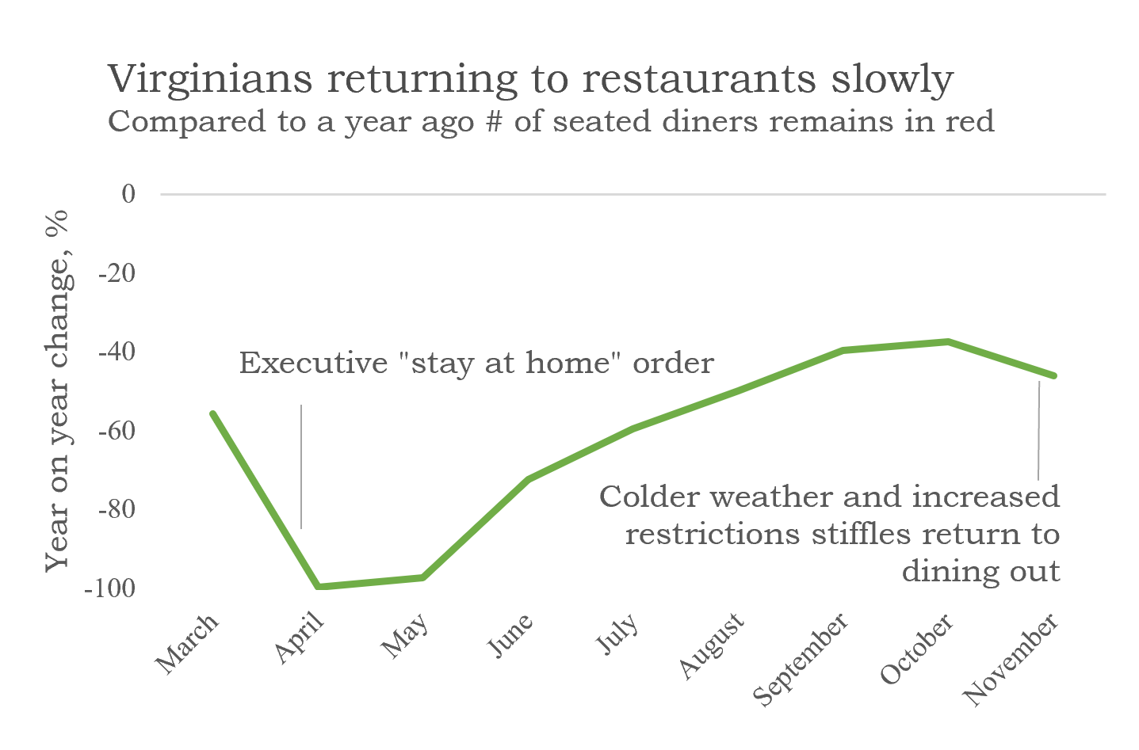

Slide 4
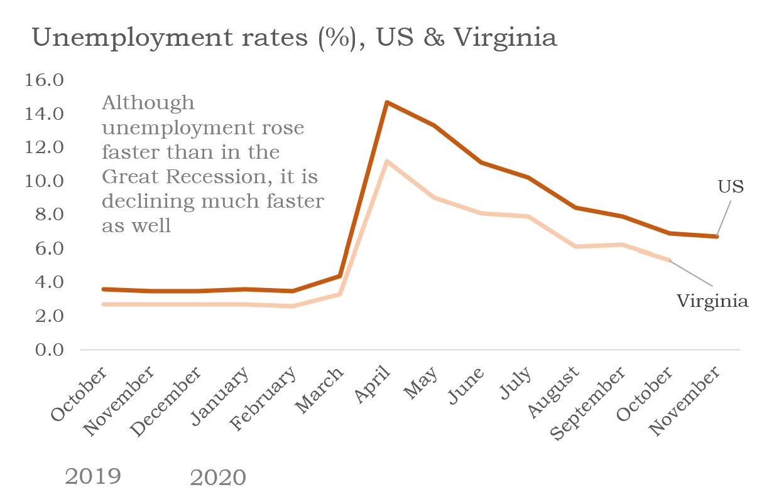

Slide 5
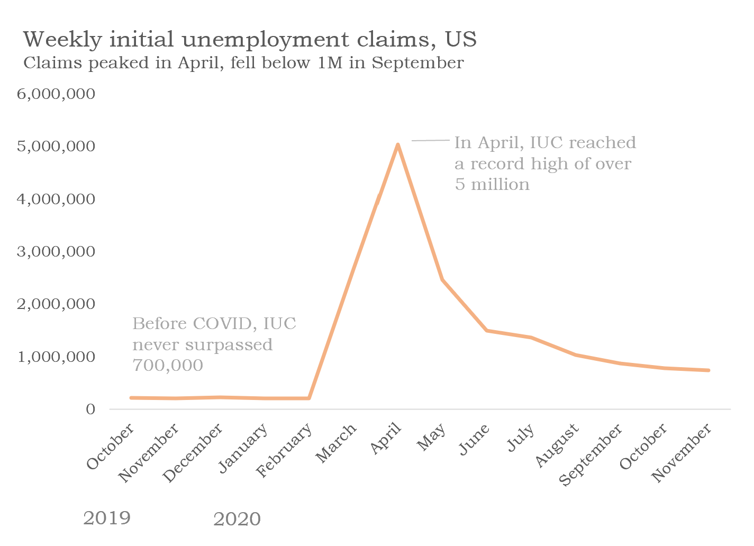

Slide 6
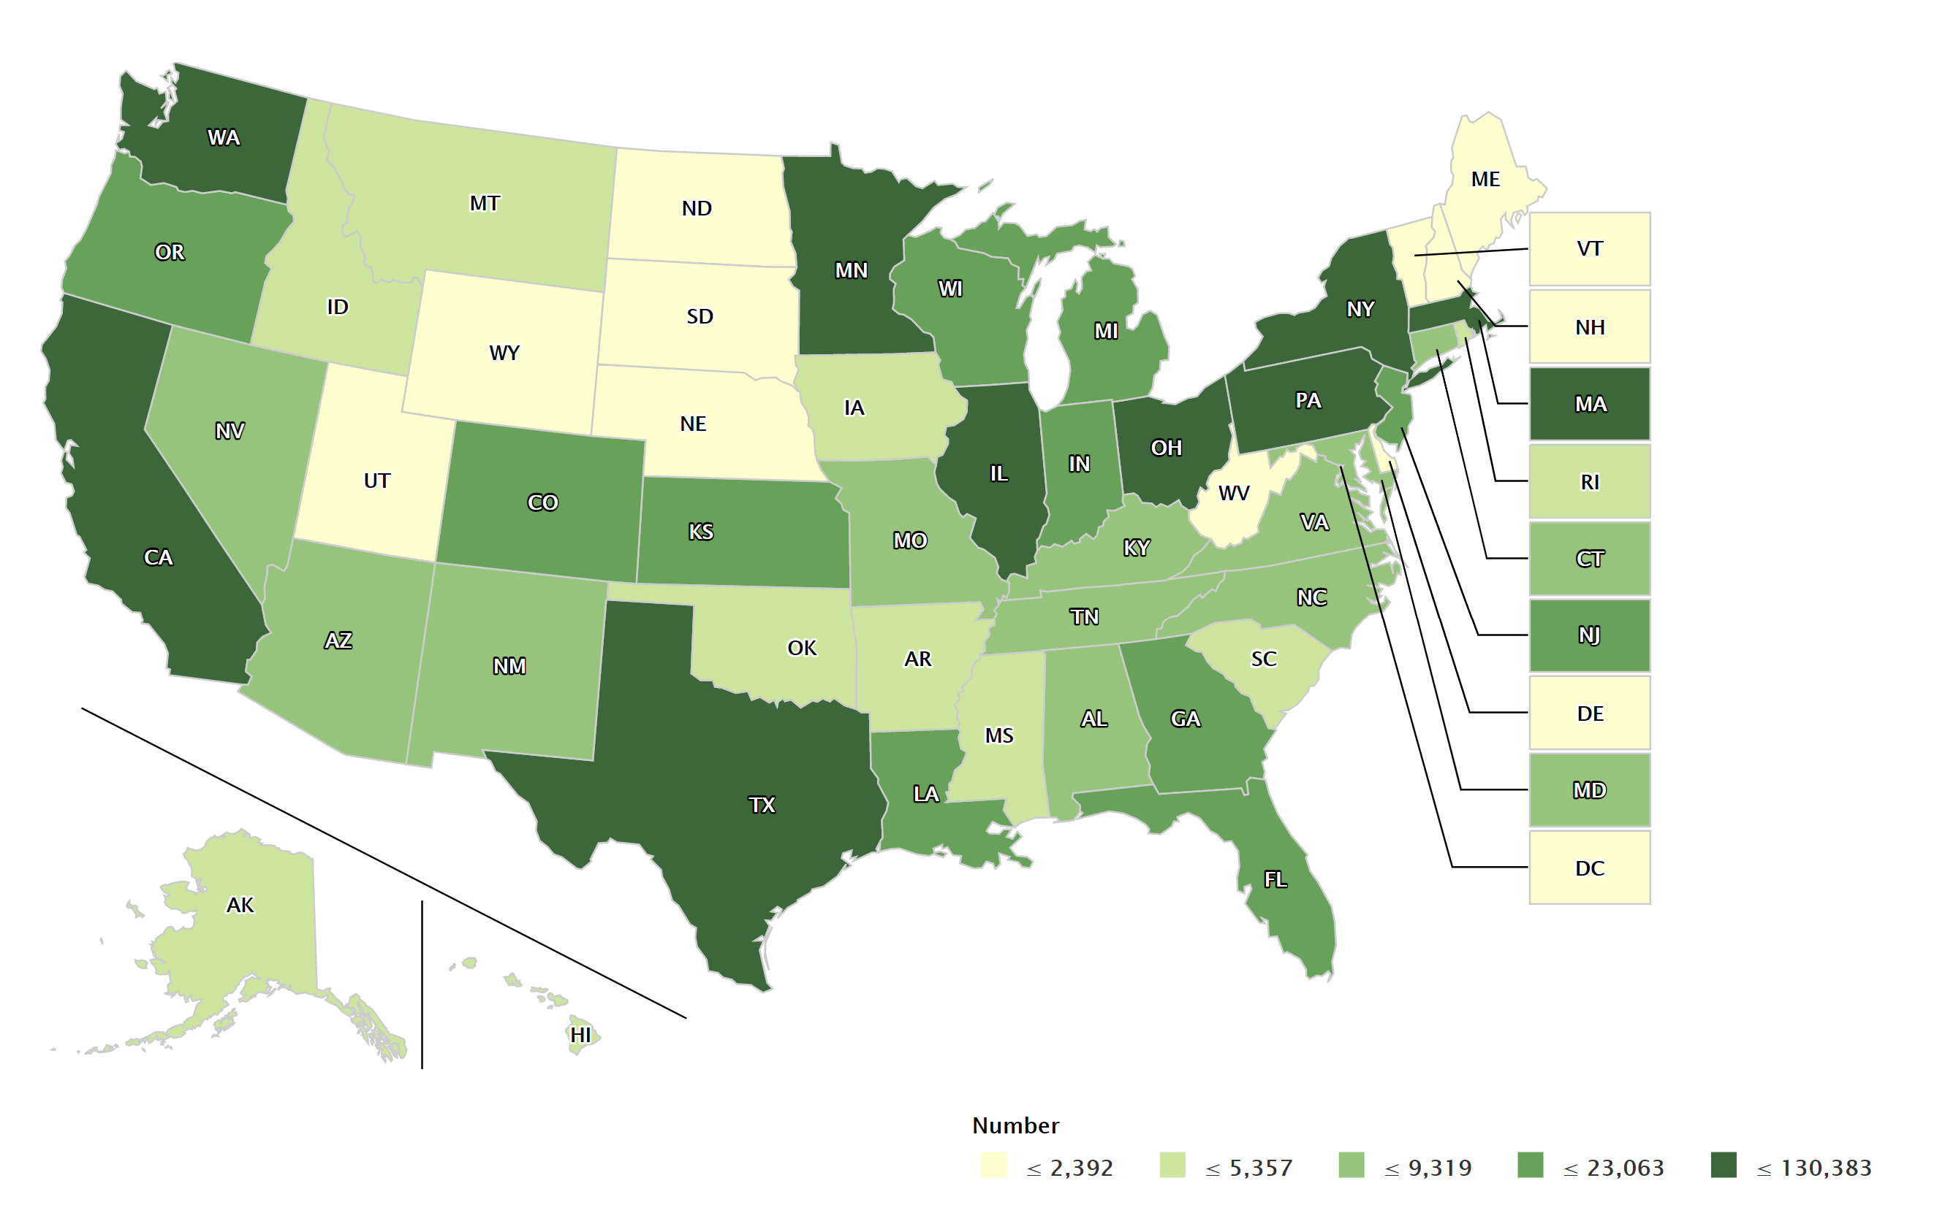
Initial unemployment claims, Week of 11-28-20

Slide 7
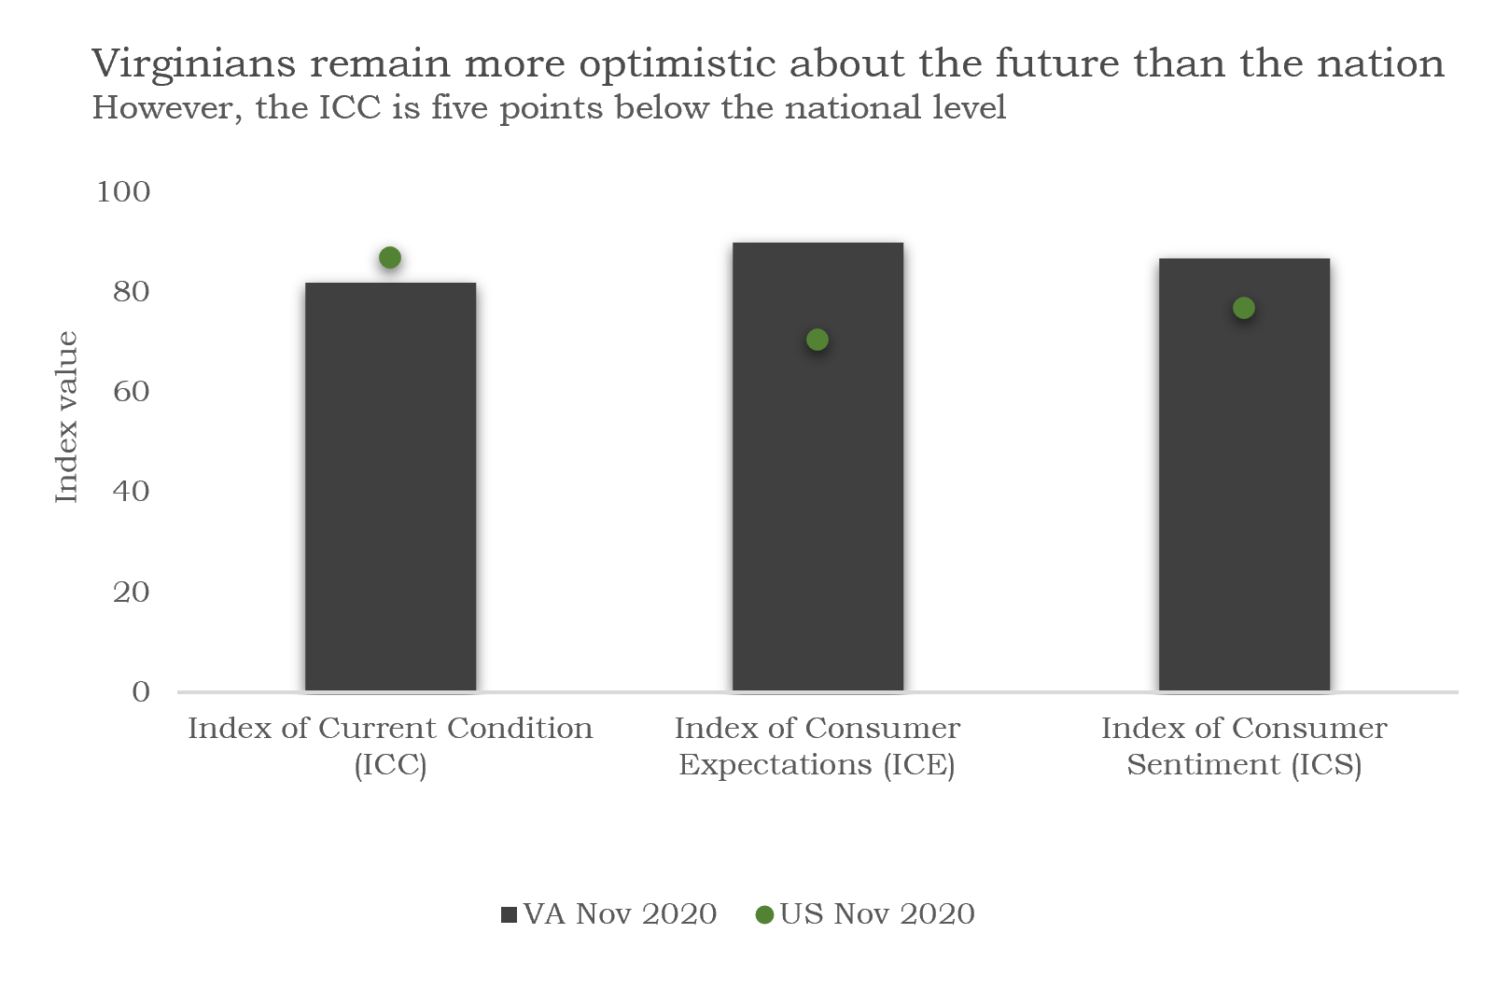

Slide 8
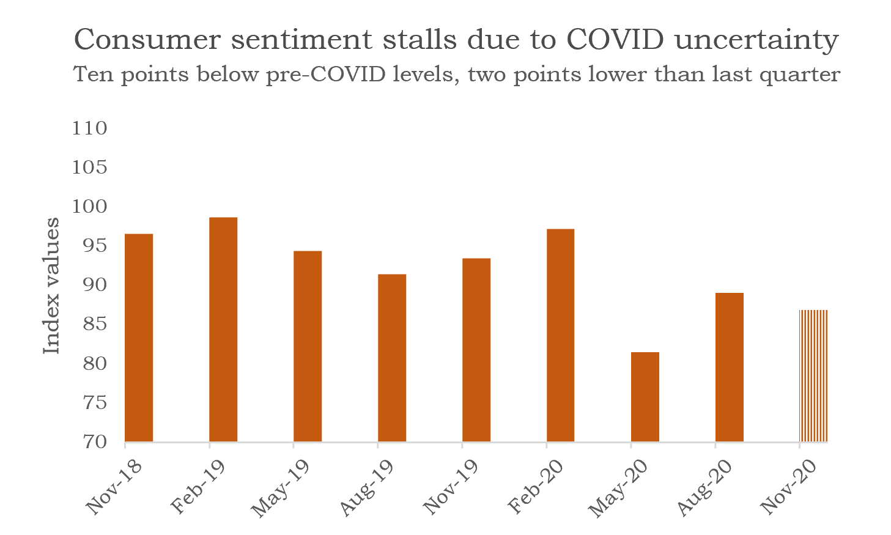

Slide 9
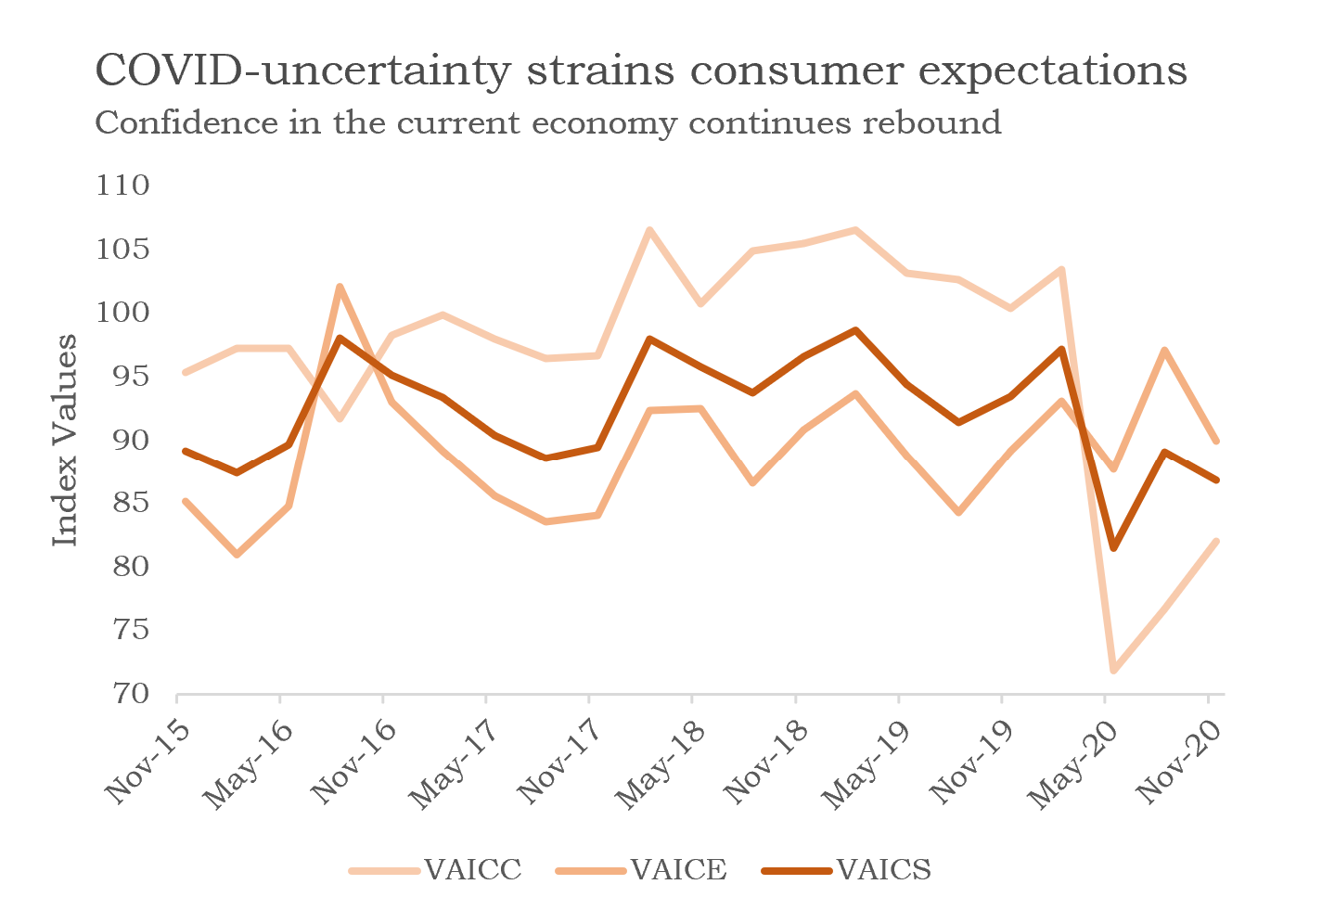

Slide 10
Thank you
Questions?
Email: kassens@roanoke.edu

