Slide 1
Government Accountability in a Virtual World
25th Annual AGA Commonwealth of Virginia Professional Development Training (PDT)
Panel Discussion: Professionalizing Grants Management

Slide 2
Professionalizing Grants Management
December 10—2:05 to 2:55. This panel discussion brings together three panelists who have been working in different roles to help professionalize grants management as a job function that is within Federal Financial Management but demands its own separate and unique skill set to ensure successful stewardship of $800B+ in public funding.
Agenda
Components of professionalizing any career skillset
The need for Grants Management career professionalization
Current Federal Government professionalization activities
Notes:
Jim reads the Agenda

Slide 3
Panelists
Theresa Falance, MBA, PMP, SPHR
ManTech Research and Economic Division, Senior Principal Subject Matter Expert, Grants Workforce Development
Mike Peckham, ICAgile Certified Professional
ReInvent Grants Management Lead for the Department– wide ReImagine Health and Human Services (HHS) initiative and currently the Acting CFO of. HHS's Program Support Center (PSC).
Andrea Brandon, MA Public Administration, Masters in Legal Studies
Deputy Assistant Secretary (DAS) for Budget, Finance, Grants and Acquisition within the Department of the Interior)
Moderator: James McKay, MBA, CICA, CGMS
ManTech Research and Economic Division, Senior Principal Subject Matter Expert, Grants Management
Notes:
James McKay: I have had 40 years of federal financial management experience. Having served as former Inspector General and later as Deputy CFO, I was overseeing a $30B Grant portfolio. Currently, I lead the Grants Management Advisory Services for ManTech’s Research and Economic Division. Over the years, we have had the pleasure of working with both Mike and Andrea in advancing Grants Management as a profession.
Theresa Falance: Theresa Falance has served as a consultant to the Federal Government for more than 20 years of her 35-year career in Human Capital Management. She brings together various tool sets including instructional design, project management, human performance, lean six sigma, and human resource management to design Workforce Development Programs. Her work in Acquisitions and Grants Management has been the focus of nearly half of her career. She developed a total Acquisition Workforce Development framework and curriculum for NAVSEA and has participated with HHS in preparing a plan for a Human Capital Framework and Curriculum Design for the HHS Grants Workforce.
Mike Peckham Bio: Michael Peckham is the Acting CFO of the HHS Program Support Center. Most recently he led the ReInvent Grants Management transformation initiative under the HHS ReImagine program. Mike also led the HHS DATA Act initiatives in successfully meeting the implementation goals as well as the grants pilot required under section 5 of the statute. He brings over 30 years of broad experience leading HHS in meeting its administrative modernization and shared services goals. He is a champion for positive change, creating new approaches to old problems through Human Center Design, Agile methodologies, microservices architecture, and applying emerging technology to promote data driven business decisions.
Andrea Brandon: Ms. Andrea Brandon is currently the Deputy Assistant Secretary (DAS) for Budget, Finance, Grants and Acquisition within the Department of Interior (DOI). As the DAS she has executive responsibility for the leadership and strategic direction of all budget, finance, financial assistance, acquisitions, property, and related business IT systems for the DOI. This portfolio comprises of more than $5.3 B. Ms. Brandon has held similar positions in DHS and HHS. She has had broad experience in risk management, audits, internal controls, information technology innovation, acquisition management, and financial operations in her federal career of 30 years.

Slide 4
Polling Question 1.
Which role do you play in Grant Management?
(A) GS 1109 Grants Manager
(B) GS 500 Series Financial Manager
(C) GS 511 Auditor
(D) GS 0340 Program Manager
(E) Private Sector Advisory Services
(F) Private Sector Audit Services
(G) Recipient Grant Administrator
(H) Other (Scientist, Researcher, Educator, etc.)
Notes:
Jim introduces the demographic question

Slide 5
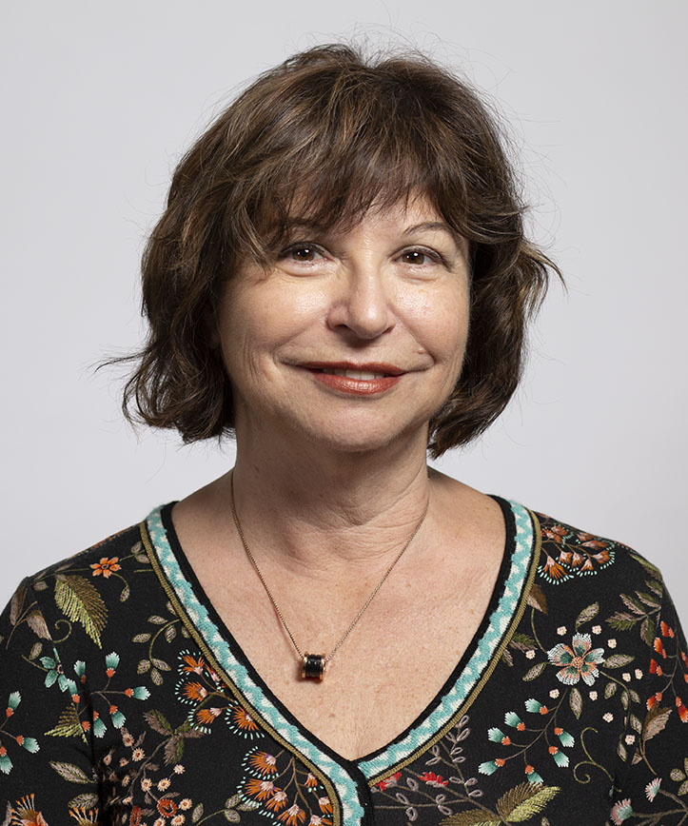
Grants Management Professionalization
Components of professionalizing any career skillset
Define the skillset
Specify a competency model
Develop a curriculum
Certify professionals
Polling question
Theresa Falance
Notes:
Theresa: Any new profession goes through a series of infrastructure development tasks on its way to recognition as a distinct career. Often the new profession breaks away from an existing discipline as it gets more specialized. Grants Management has evolved from Financial Management.
To build a new career path, the skills needed to perform the job at various levels needs to be defined. That information evolves to a recognized competency model separate with more specificity that that of its parent occupation.
To support this competency model, a curriculum needs to be developed that addresses as the individual skills at the at least three levels. Each skill needs to be defined in a progressively more complex mastery at each level.
Once all of this is in place, an authority can chose among available training and mandate a body of information that defines a professional in the field so that a certificate, then certification credentials, then accreditation can be achieved meeting a standard like ANSI ICE Standard 1100

Slide 6
Polling Question 2.
Question
Whose responsibility is it to define and build the infrastructure for Grants Management?
(A) Federal Government for all practitioners
(B) Professional Association for all practitioners
(C) Federal Government for public servants and Associations for grantees
Notes:
Theresa: So given this information…read the polling question

Slide 7
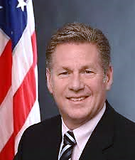
Targeting a Multidisciplinary Future Workforce
Mandating Workforce Development
Deficit in existing Federal Grants Manager Training today
HHS Initiative on modeling the Federal Grants Manager competencies
Consider accountability in demonstrating skills
Building the foundation for Accreditation
Mike Peckham
Notes:
Mike responds to the polling question using the points on the slide

Slide 8
Polling Question 3.
Question
How important is it to require a base skill set to have an effective career in federal government grants management
(A) Yes, because the importance speaks to accountability
(B) Yes, we because need to be able to measure performance
(C) Both A&B
(D) No, audit results takes care of it
(E) No, just get the money out quickly
Notes:
Mike reads the Polling Question

Slide 9
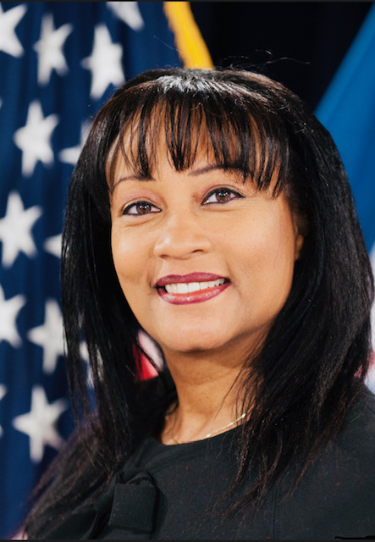
Defining the Federal Grants Manager
Defining the Position
Beyond Financial Management, the Grants Manager’s universe of skills
Grants Management Workforce Development Federal Government history
Quick comparison between Acquisitions and Grants-making Workforces
The current state of industry training
The importance defining training competencies to Federal Government so that the skill sets ensure reciprocity across multiple agencies
Andrea Brandon
Notes:
Andrea provides a history of Grants Workforce Development and gives a summary of its current state

Slide 10
Polling Question 4.
Which of the following skill development tools does your organization use to develop Grants Managers?
(A) Grants.gov and other Federal Resources
(B) Customized Training Programs designed in-house
(C) Customized Training Programs developed by a vendor
(D) Private sector training programs such as Management Concepts or USA Graduate School
(E) Professional Associations like AGA, AICPA, NGMA
(F) None currently
Notes:
Andrea reads the polling question

Slide 11
Ask the Experts
Polling Summary
Questions for the Panel?
Notes:
Jim summarizes the polling questions and fields questions directing questions to panel members for discussion

