Slide 1
Put On Your Auditor Hat: What are the Audit Considerations for Fin-Bots?
kpmg.com/us/federal
#kpmgfed
Presentation at the 24th Annual Commonwealth of Virginia PDT
December 12, 2019
The information contained herein is of a general nature and is not intended to address the circumstances of
any particular individual or entity. This presentation represents the views of the author only, and not necessarily
the views or professional advice of KPMG LLP.

Slide 2
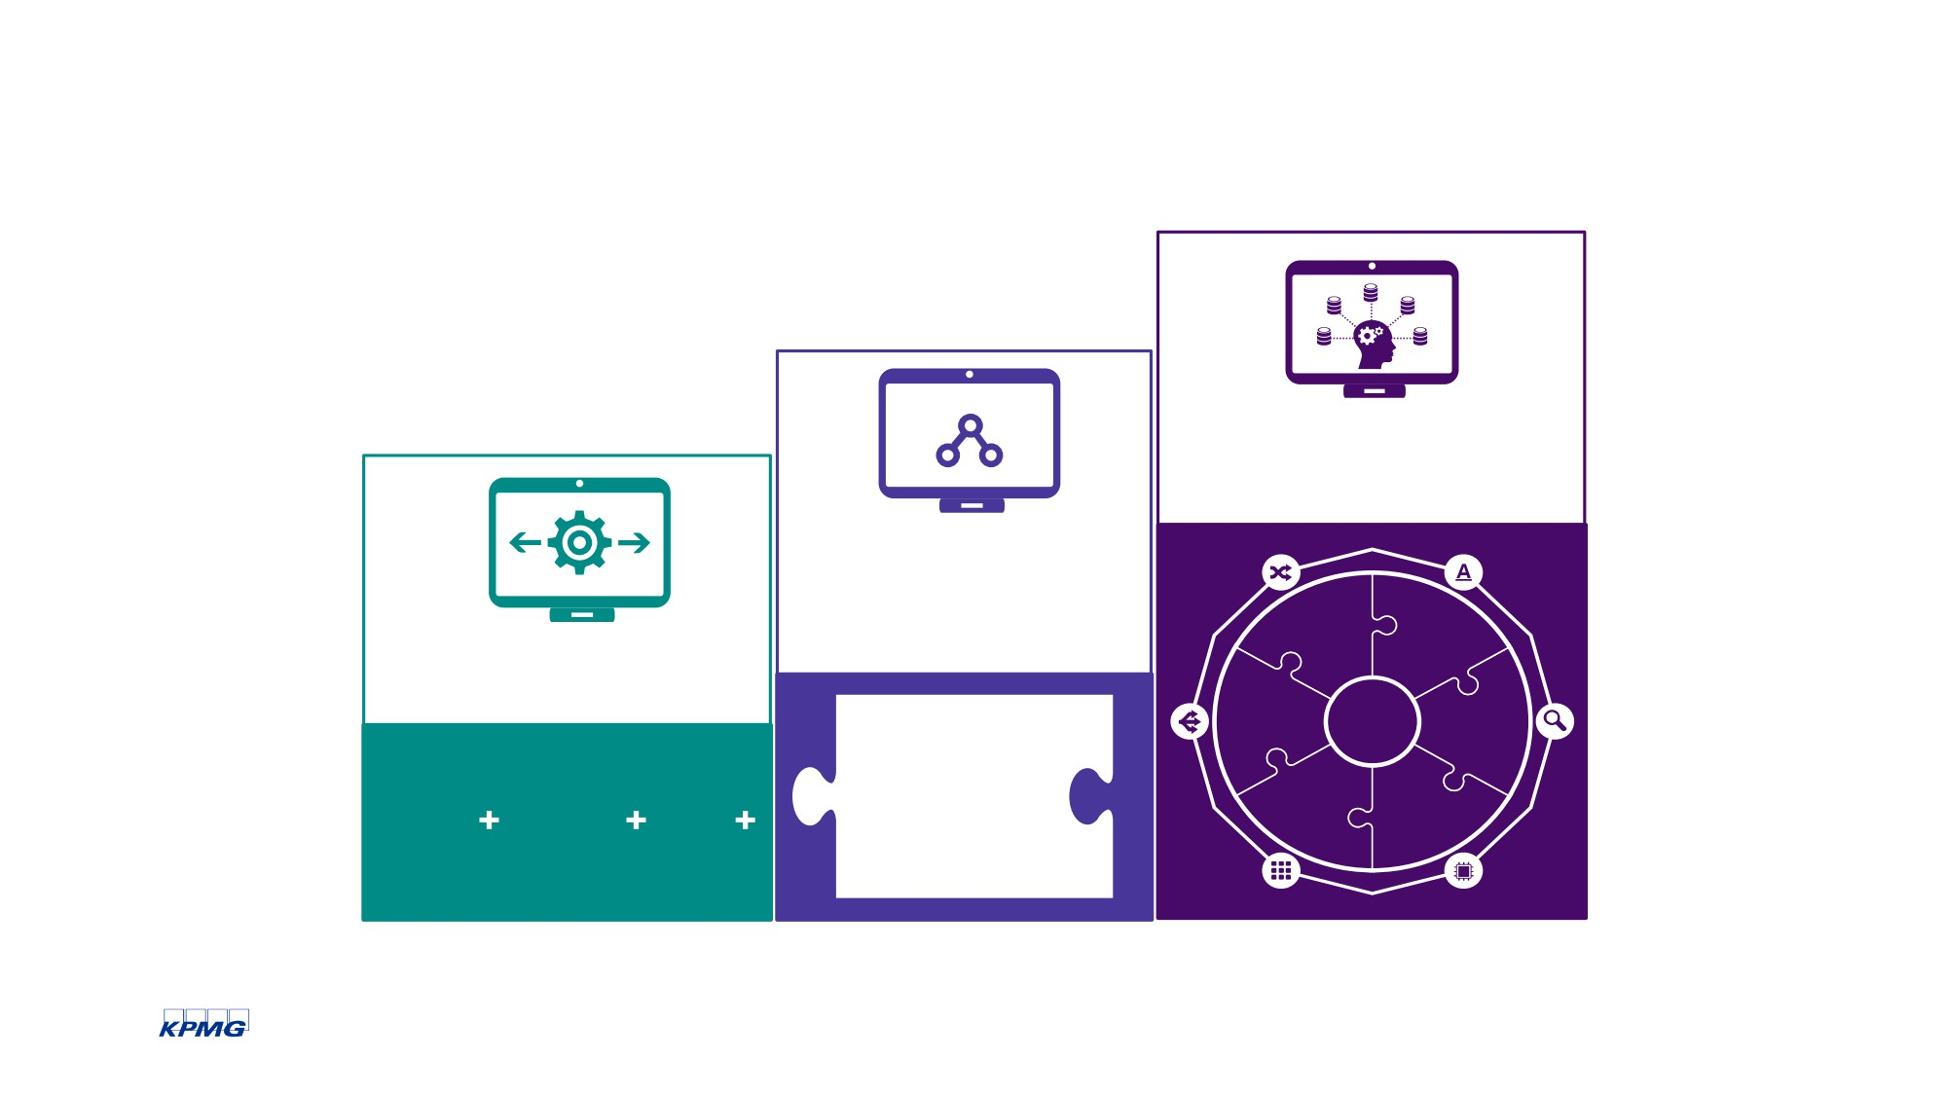
What are the initial stages of Intelligence Automation?
Cognitive
Automation
Enhanced
Process
Automation
Adaptive alteration
Natural
Basic Process Automation
language processing
Processing of unstructured data and base knowledge
Large-scale processing
Big data
analytics
Supervised or unsupervised
rules-based processing
Machine
Artificial intelligence
Learning
© 2019 KPMG LLP, a Delaware limited liability partnership and the U.S. member firm of the KPMG network of independent member firms affiliated with KPMG International Cooperative (“KPMG International”), a Swiss entity. All rights reserved.
3

Slide 3
Common Questions
How do I go about a large scale transformation?
Which emerging technologies should I make investments in?
How and when should we modernize our finance technology platform?
What are we doing today that we could transform tomorrow through technology?
How does our finance and technology strategy fit our mission objectives?
What are the benefits of a technology transformation?
How and when do we take advantage of disruptive technologies?
What have other organizations done in the technology space that are similar to my situation?

Slide 4
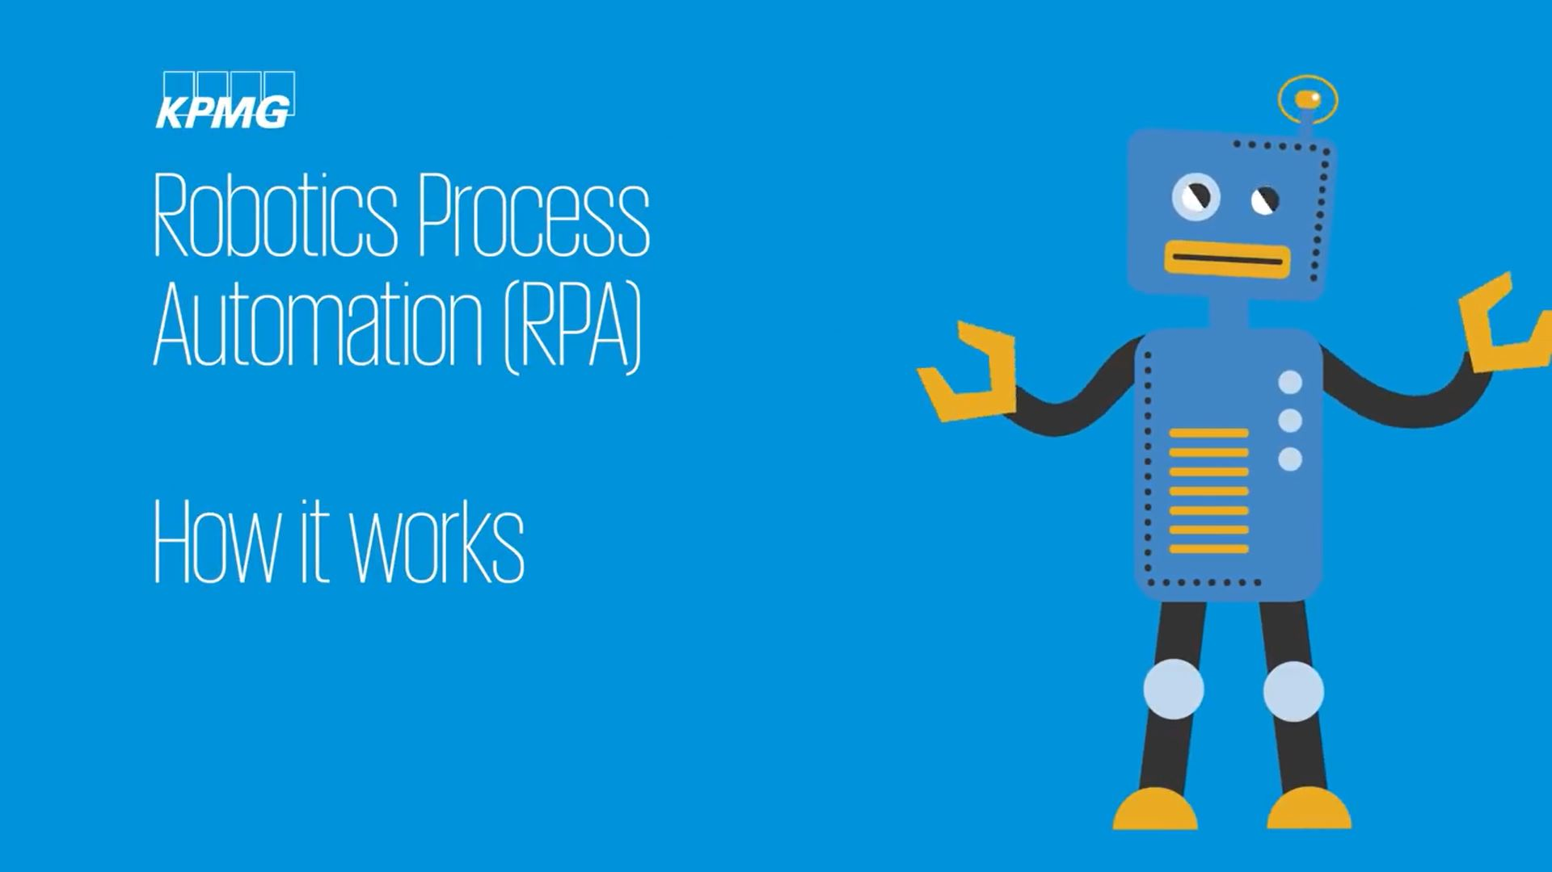
What does a fin-bot look like?
https://www.youtube.com/watch?v=xW95yb6J1eU

Slide 5
Where are fin-bots in use?
Department of Housing and Urban Development:
Identified 50,000 to 60,000 work hours that will be converted to RPA
Centers for Medicare and Medicaid Services:
Bot: One record in one minute with 95% accuracy
Legacy Process: One record in 65 minutes and less accurate
General Services Administration:
Used bots to reduce more than 13,000 hours of unnecessary or duplicative work
National Aeronautics and Space Administration:
Four bots deployed over funds distribution, invoicing, procurement requests, and human resources
Bureau of the Fiscal Service:
One bot eliminated the need to process 300-plus reports in Excel
Defense Logistics Agency:
Plans to have deployed 75 bots by the end of FY 2019

Slide 6
When adopting a fin-bot, it pays to get an auditor’s input, and to understand the rationale of any auditor recommendations.

Slide 7
Fin-Bots: Risks, Impacts, and Steps to Consider
Risk: Badly Configured Bot
Risk: Bot Not Monitored Adequately
Potential Impacts:
Risk: Poorly Designed Bot
Risk: Documentation Not Available
Process and input errors
Erroneous calculations
Unauthorized transactions
Data loss
Non-compliance with laws and regulations
Business disruption
Security breaches
Reputational harm
Loss of public confidence
Negative impact on mission execution
Risk: Lack of Adequate Governance
Risk: Full IA Lifecycle Not Considered
Address risk and governance upfront
Prioritze sound program development
Adopt a change management process
4. Control access to programs and data
5. Supervise and review bots
6. Reperformance by auditors and end-of-life for a bot

Slide 8
Address risk and governance up front:
Are clear roles and responsibilities present?
How strong is management’s oversight?
What automation policies and procedures are in place?
Are the right stakeholders involved in the automation lifecycle?
What risk assessment activities are in place?
What key performance or risk indicators are used to monitor the fin-bots?

Slide 9
Prioritize sound program development:
Is the platform subject to standard IT processes and policies?
Does management have a formal system development lifecycle for the creation of fin-bots?
How does the entity verify secure development and testing?
Who has access to develop, build, and migrate bots into production?
Who is responsible for evaluating and approving bots before they go live?
Is there an official “authorization to operate” for each bot?

Slide 10
Adopt a change management process:
Are script changes properly approved?
Is access to the control room or orchestrator function restricted?
Are changes in application production appropriately restricted and segregated from the development process?
Are post-implementation reviews performed to verify if the fin-bot is operating as intended?

Slide 11
Control access to programs and data:
Is access to shared accounts appropriately restricted?
How is user access to the automation platform reviewed and approved?
Is access of terminated or transferred users removed or modified in a timely manner?
Is user access continually reviewed for the timely detection of misuse?

Slide 12
Supervise and review bots:
Are all system application jobs (interfaces, batches, automated processing and data loads) monitored for exceptions?
How are exceptions resolved?
How is overall performance accuracy monitored?
How does the organization respond to performance shortfalls?
Are jobs not completed successfully communicated to stakeholders for follow up and resolution?
Is logging enabled on the system?
Is critical information backed up regularly and stored securely?
Are business continuity plans in place?

Slide 13
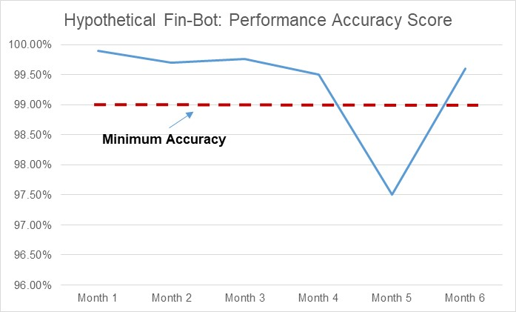

Slide 14
Re-performance by auditors and end-of-life of a bot:
Are data management and documentation warehousing for bots available for re-performance by the auditor?
What is the expected lifecycle of bot development and deployment?
What are end-of-life considerations for a bot?

Slide 15
Thank you!
www.kpmg.com/us/federal
#KPMGFed
Andrew C. Lewis
aclewis@kpmg.com
202-533-4886
Please follow me on social media:
linkedin.com/in/andrew-c-lewis
@andrew_c_lewis

Slide 16
Some or all of the services described herein may not be permissible for KPMG audit clients and their affiliates.
kpmg.com/socialmedia
The information contained herein is of a general nature and is not intended to address the circumstances of any particular individual or entity. Although we endeavor to provide accurate and timely information, there can be no guarantee that such information is accurate as of the date it is received or that it will continue to be accurate in the future. No one should act on such information without appropriate professional advice after a thorough examination of the particular situation.
© 2019 KPMG LLP, a Delaware limited liability partnership and the U.S. member firm of the KPMG network of independent member firms affiliated with KPMG International Cooperative (“KPMG International”), a Swiss entity. All rights reserved.
The KPMG name and logo are registered trademarks or trademarks of KPMG International.

