Slide 1
Legacy, Leadership and Transformation
Wendy Morton-Huddleston, CGFM, PMP
AGA 2019-2020 President-Elect December 12, 2019

Slide 2
Overview
1 Celebrate Legacy
2 Practice Servant Leadership
3 Promote a Diverse and Inclusive Culture
4 Demonstrate Sound Business Acumen
Embrace Transformation & Innovation
Concluding Thoughts

Slide 3
Celebrate Legacy

Slide 4
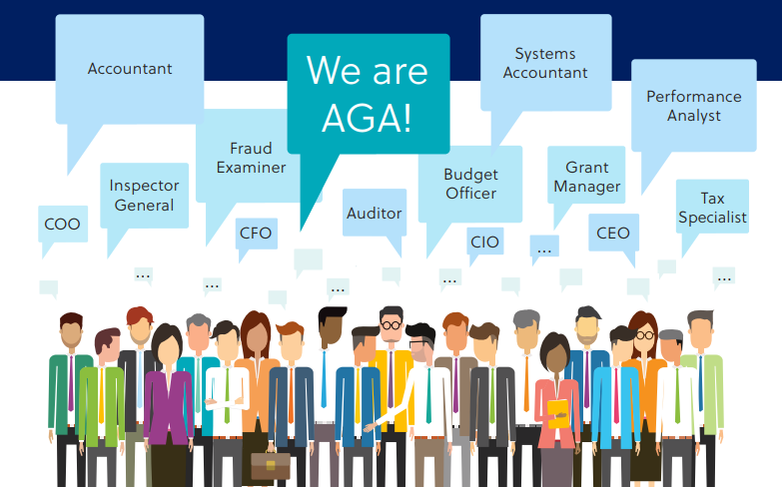
Celebrate Legacy – Decades of Service
AGA will celebrate its 70-year milestone in 2020 “Vision to Reality”

Slide 5
Mission and Vision
Mission: AGA is a professional association advancing accountability, transparency and leadership by promoting education, certification, innovation and collaboration across all levels of government and to stakeholders
Vision: To be the premiere association for advancing government accountability
www.agacgfm.org

Slide 6
Transformational Demographics
AGA is the only association supporting government financial professionals working at all levels of government - federal, state & local, as well as the private sector, nonprofits and the academic community

Slide 7
AGA Strategic Goal - Certification
Each certification/license logo is owned by its sponsoring organization.
AGA - CGFM Certification

Slide 8
Practice Servant Leadership

Slide 9
Practice Servant Leadership
"Servant leadership is a philosophy and set of practices that enriches the lives of individuals, builds better organizations, and ultimately creates a more just and caring world" – Robert Greenleaf
Principles:
Stewardship
Empathy
Awareness
Foresight
Development
Community
Persuasion

Slide 10
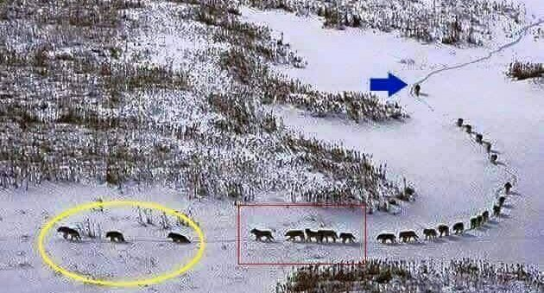
Leadership Dynamics
Diverse Traits
Leader
Status quo
Follower
Blind spots
Motivated
Alpha

Slide 11
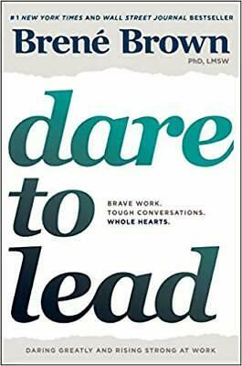
Servant Leaders

Slide 12
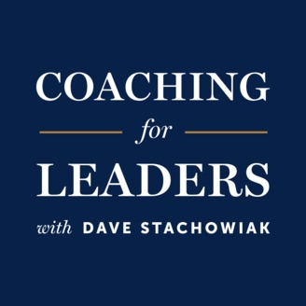
Podcast Insights

Slide 13
Promote a Diverse and Inclusive Culture

Slide 14
Promote a Diverse and Inclusive Culture
"A diverse workforce in an inclusive environment will improve individual and organizational performance and result in better value to customers, clients, taxpayers, and other stakeholders" – OPM
www.OPM.gov

Slide 15
Promote a Diverse and Inclusive Culture
Promote a foundation of diversity:
Develop a diversity strategy and plan
Assess the impact of a diverse culture using quantitative/qualitative measures
Consider a succession planning process
Promote a diverse recruitment process
Engage employees through unconscious bias training programs

Slide 16
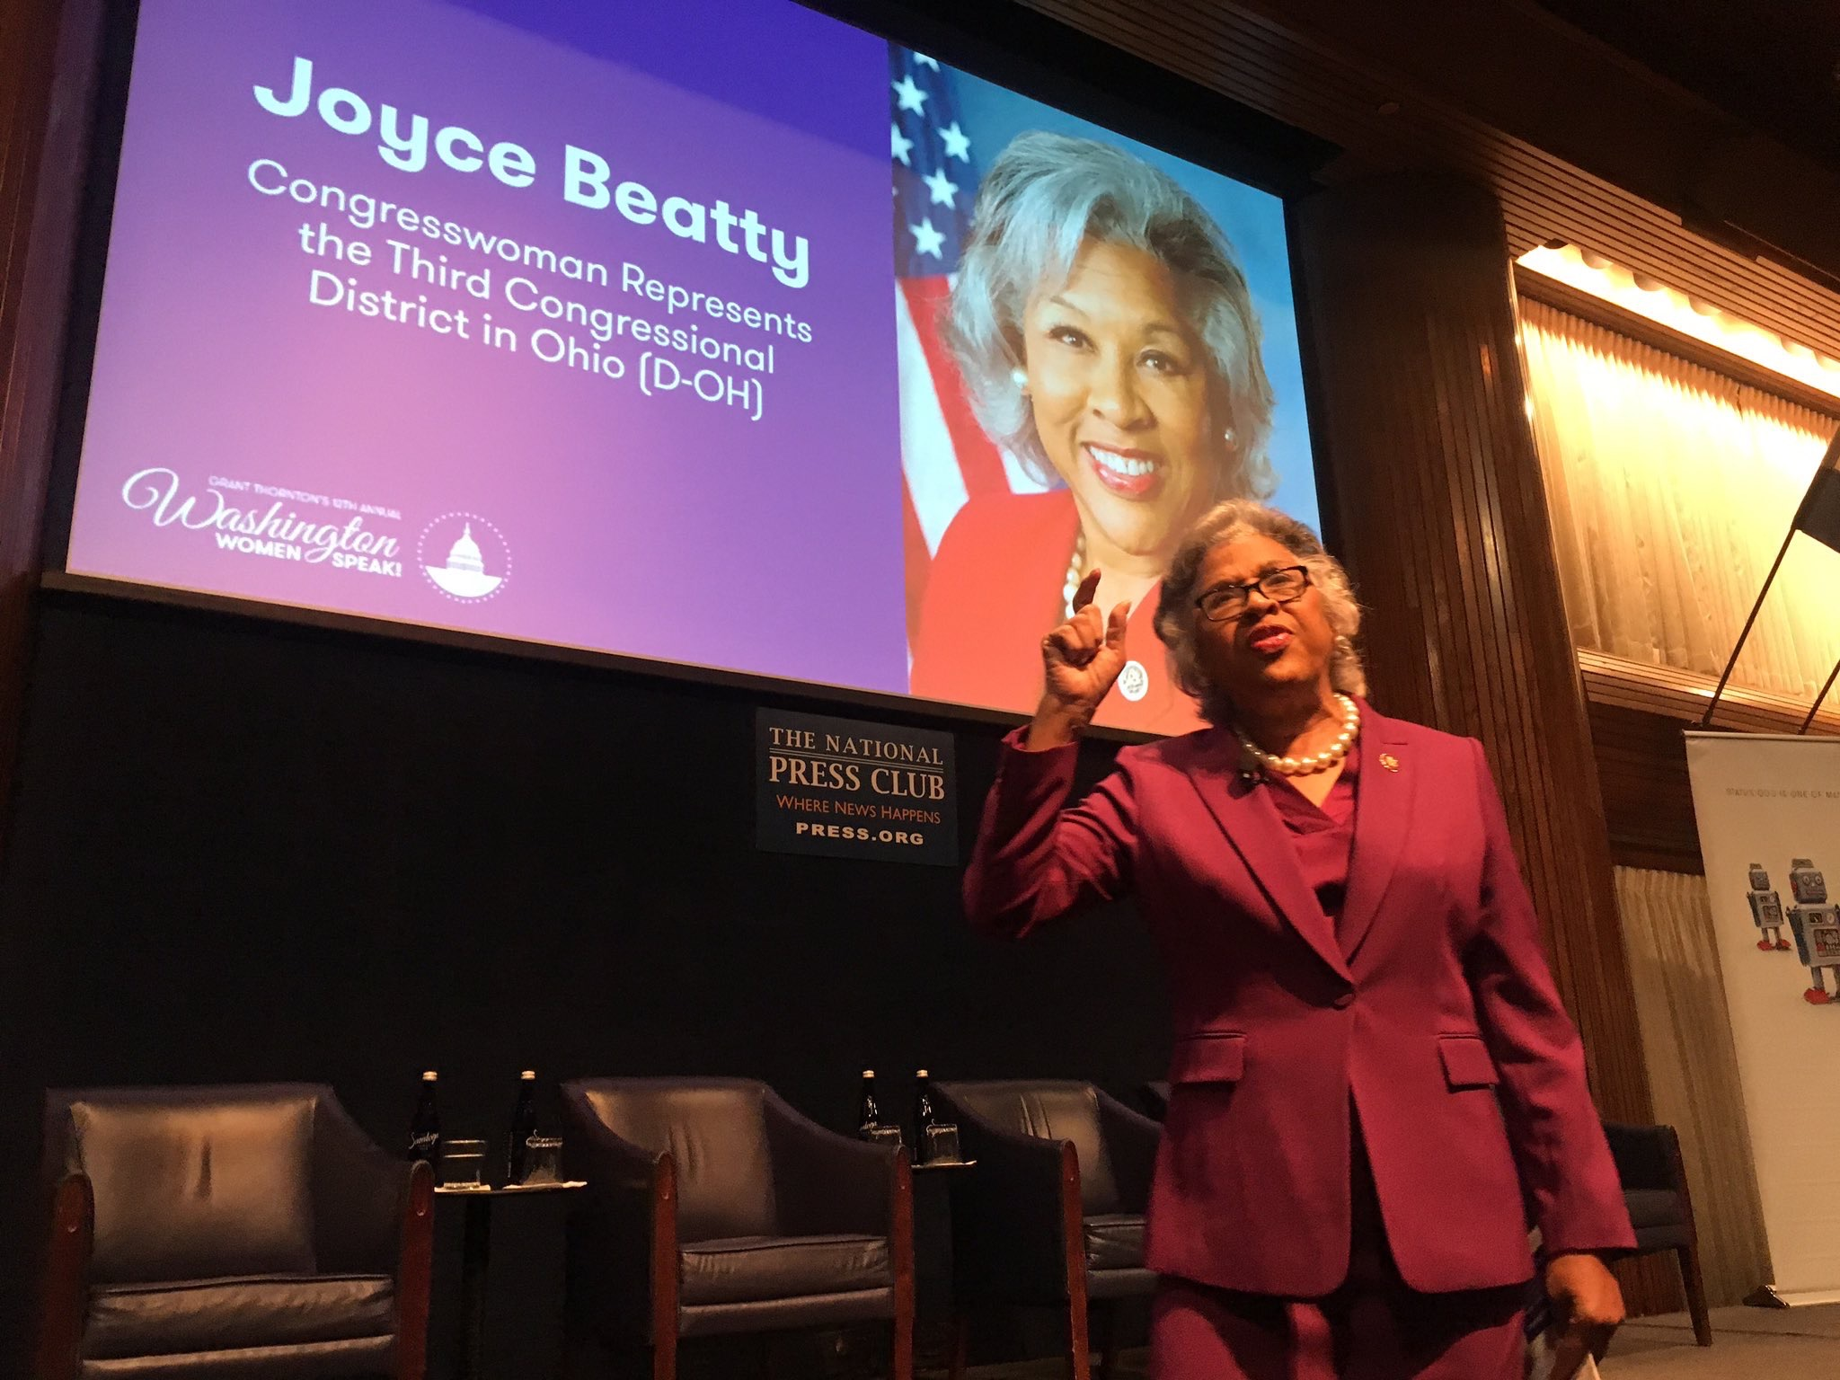
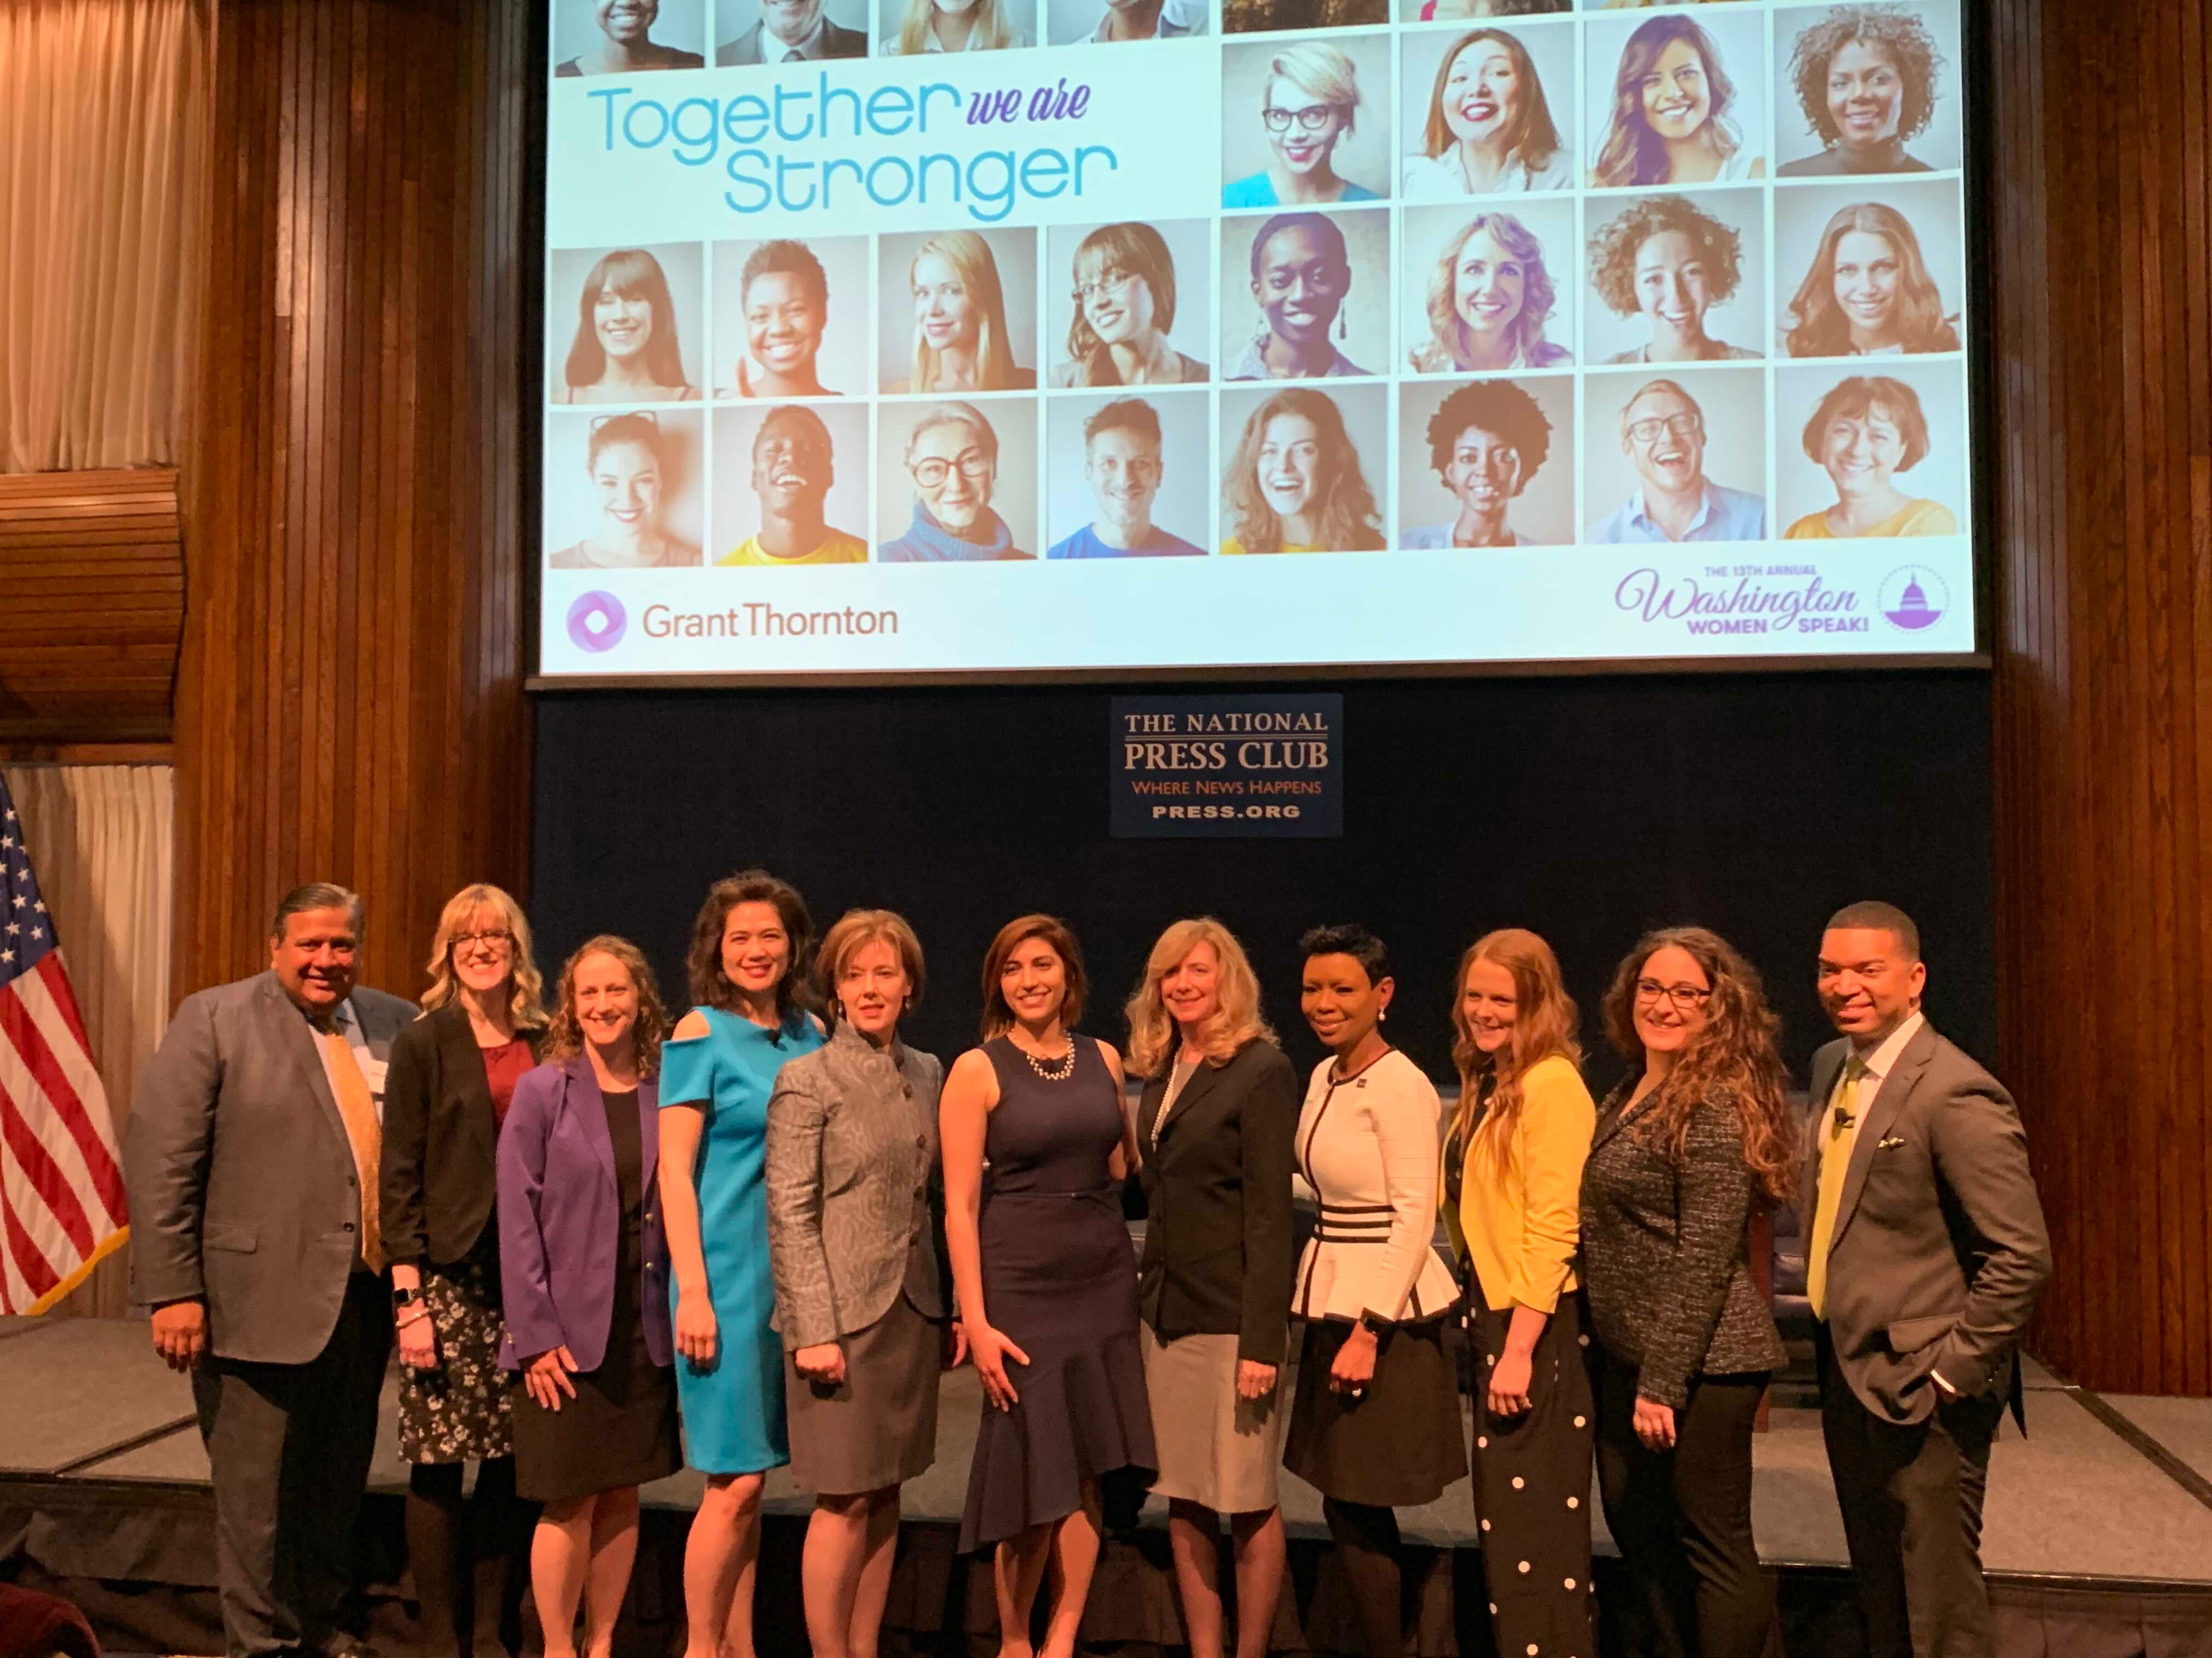
Washington Women Speak 2019

Slide 17
Demonstrate Sound Business Acumen

Slide 18
Demonstrate Sound Business Acumen
Management
Business
Strategic Thinker
Discernment
Analytical
Creative

Slide 19
Demonstrate Sound Business Acumen
Partnership for Public Service's Excellence in Government Fellows Program
GS-14 and GS-15 professionals
Prepares leaders to cultivate sound decision making, critical thinking and judicious business acumen

Slide 20
Embrace Transformation and Innovation

Slide 21
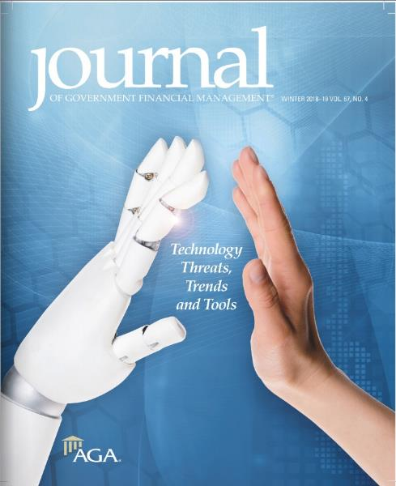
Embrace Transformation & Innovation
"Becoming innovative and adaptive is an ongoing journey of modernization" – Harvard Business Review
www.AICPA.org

Slide 22
2020 Digital Trends & Strategic Predictions
"Technology priorities must be established in the context of business trends such as ethics and privacy” - Rick Howard, Gartner
Agent interfaces
Facial recognition payment
AI oversight & ethics
www.gartner.com

Slide 23
Concluding Thoughts
Your legacy is every life that you touch – Oprah Winfrey
AGA service has no expiration date – Wendy Morton-Huddleston
Inclusive workplace = different people, cultures and perspectives – AICPA
Ideas, questions, acumen = viewed as a valuable contributor – Kevin Cope
Create legacies that will take the next generation to another level – Jim Rohn

Slide 24
Questions?

Slide 25
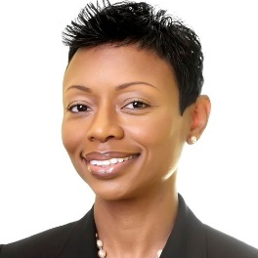
Contact Information
Wendy Morton-Huddleston
E: Wendy.Morton-Huddleston@us.gt.com
@WMHUDDLES
Wendy Morton-Huddleston, CGFM, PMP

