Slide 1



U.S. Department of Justice
Antitrust Division
COVID-19: Safeguarding the Procurement System from Increased Collusion & Criminal Antitrust Risks
Danielle Garten, Trial Attorney, WAS1
Jason D. Jones, Trial Attorney, WAS1

Slide 2

Disclaimer
The views expressed herein do not necessarily reflect those of the Department of Justice.
This presentation is for informational purposes only and does not constitute legal advice. For legal advice on any issue, you should consult with an attorney.

Slide 3
Learning Objectives
To understand the nuts and bolts of criminal antitrust violations in procurement.
To better identify red flags of potential procurement collusion and fraud.
To learn “best practices” for maximizing cooperation and safeguarding your procurement system during COVID-19.
To apply this knowledge to mitigate new risks, detect potential suspicious activity, and protect against new bad actors in your supply chains.

Slide 4
Roadmap
  Antitrust 101
  Detecting Antitrust Violations
  What Can You Do?

Slide 5
Criminal Antitrust Violations (Antitrust 101)
The Antitrust Division
Our mission is the promotion and maintenance of competition in the American economy.

Slide 6
The Sherman Act: 15 U.S.C. § 1
“Every contract, combination in the form of trust or otherwise, or conspiracy, in restraint of trade or commerce among the several States, or with foreign nations, is declared to be illegal.”

Slide 7
Elements of a Sherman Act Violation
Unreasonable restraint of trade/conspiracy
Price Fixing
Customer/Market Allocation
Bid Rigging
Knowingly joined—intended to agree
Interstate or foreign commerce
Statute of limitations: Generally 5 years

Slide 8
Criminal Antitrust Violations
  Price Fixing Agreements
  Bid Rigging Agreements
  Allocation Agreements

Slide 9
Price Fixing Agreements
Competitors agree to fix or otherwise determine the prices at which their products or services are sold.
Include agreements to:
Charge the same price or raise prices together
Add fees or other surcharges
Eliminate discounts or have uniform discounts
Establish minimum or floor prices
Establish a standard pricing formula
Coordinate and not compete on other commercial terms (i.e., credit terms, warranties, etc.)

Slide 10
Price Fixing Example
Justin@competitor1 – Rachel, do you want to come up to our prices or should we come down to yours?
Billy@competitor2 – Yeah, we stopped undercutting each other last year and agreed on prices. We got tired of the customer winning.
Justin@competitor1 – Since we started our “friendly” competition, we’ve only just been increasing prices.
Billy@competitor2 – Let’s get past this competition stuff.
Rachel@competitor3 – Alright, I’m in.

Slide 11
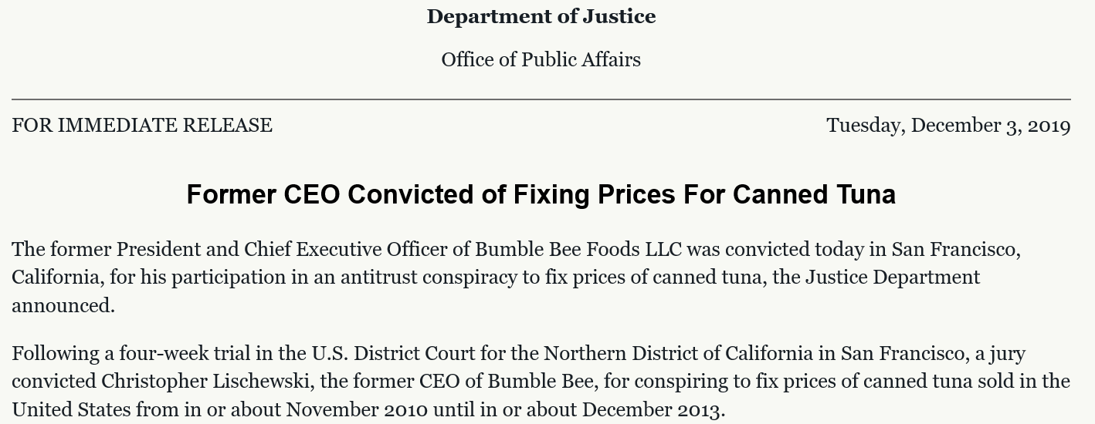
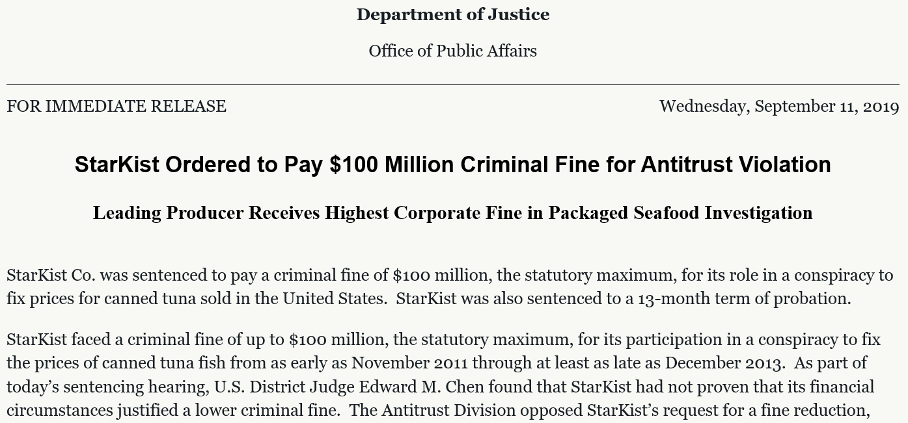
Case Study
Packaged Seafood Investigation
Price-fixing conspiracy involving three largest canned seafood suppliers in the United States
Charged 2 corporations
  $125 million in fines
Charged 4 high-level executives
  3 pleaded guilty
  Former CEO of Bumble Bee Foods convicted after four-week trial
  Defendants are awaiting sentencing

Slide 12
Bid Rigging Agreements
Competitors agree in advance who will win the bid.
Types of Bid Rigging:
  Bid Rotation or Allocation—competitors agree to take turns winning bids
  “Complementary” or “Cover” Bids—competitors agree to submit intentionally high bids, or otherwise unacceptable bids
  Bid Suppression or Limitation—competitors agree to refrain from bidding

Slide 13
Bid Rigging Example
From: Justin@govtcontractor.com
To: Sallyprocurementofficer@mail.mil
Subject: Quotes
Sally:
Here are the 4 quotes to use. If these are ok with you, let me know. Then I’ll send you the other quotes.
Thanks for your business.
Justin

Slide 14
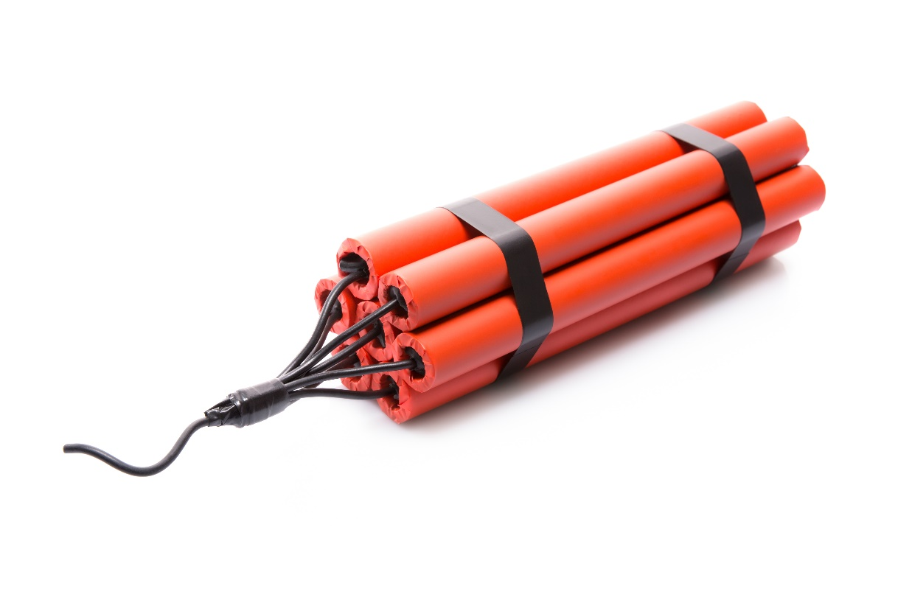
Cover Bid Example
Bidder 1: “I’d like to win the bid to demolish the Water Street Bridge. If I get the job for $850,000, I can make some good money. Can you submit a bid above mine?”
Bidder 2: “Sure. I’ll come in at $900,000 if you’ll let me have the next one.”
Bidder 1: “Okay. I’ll plan on it.”
Photo credit: Nomadsoul1/iStock/Getty Images Plus

Slide 15


Bid Rigging: Real Example
Real Estate Auctions
100+ Individuals

Slide 16
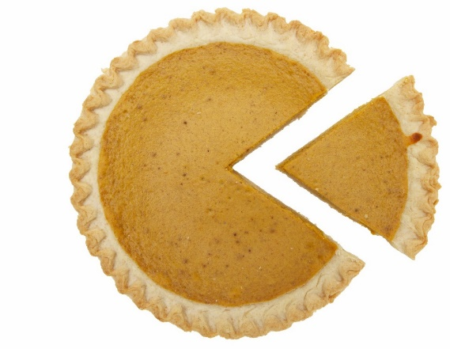
Allocation Agreements
Competitors agree to divide up a market, usually by:
  Geographic area (north of Hwy 1/ south of Hwy 1)
  Customer (big customers / small customers)
  Product (men’s uniforms / women’s uniforms)
May also include a bid rigging component to implement the allocation scheme.

Slide 17
What Market Allocation Sounds Like
“We can’t sell to you”
“You aren’t in our area”
“We don’t sell in that area – you will need to call Company X”
“Company Y should not be calling you for that product”

Slide 18
Geographic Allocation Example
Existing
Customers
New
Customers
Company A
Company B
Company C

Slide 19
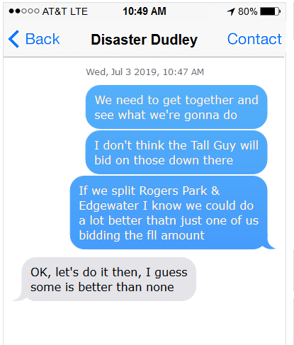
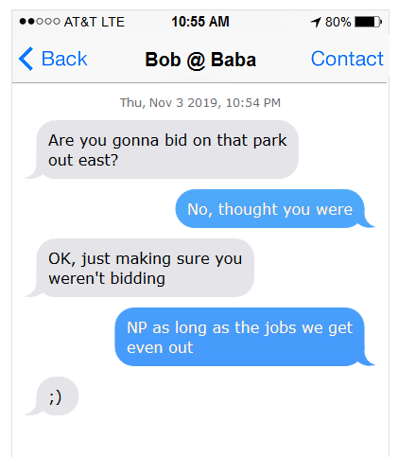
Allocation in the Digital Age

Slide 20
Per Se Violations – Don’t Have to Prove
That the agreement was successful
Loss or harm as a result of the agreement
That conduct was unreasonable or lacked economic justification

Slide 21
The Costs of Collusion: Why Do We Care?
Victims: overcharged & defrauded
Victims: aggregate harm in $$$ and number of victims
Conspiracies: lengthy in time and effect
Conspiracies: often spread to other related goods/services

Slide 22
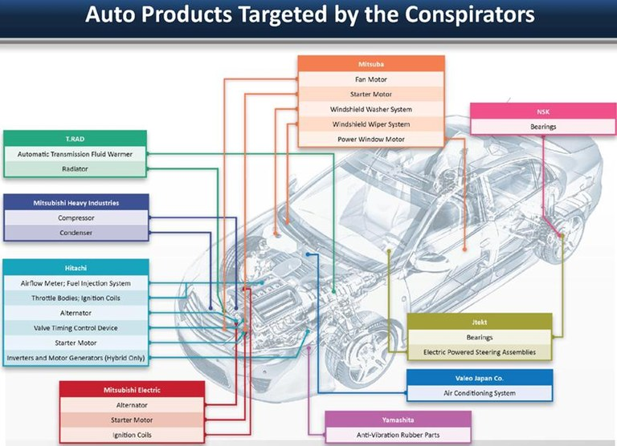

Slide 23
The Outcome of Collusion: Penalties Are Significant
Criminal Penalties
Individuals: Incarceration up to 10 years
Corporations: Fines up to $100 million or twice gain/loss
Volume of commerce drives the sentence for both individuals and corporations
Other Penalties
Restitution paid to identified victims
Civil lawsuits for three times the damages
Because plea or conviction is based on beyond a reasonable doubt standard, debarment from federal and other contracts is often a foregone conclusion

Slide 24
Other Relevant Statutes
Kickbacks
Mail/Wire
Fraud
Public Procurement Statutes
Obstruction Statutes
*Antitrust Crimes
Money
Laundering
Tax Fraud
* If antitrust activity is part of a larger white-collar conspiracy,
Antitrust Division may prosecute all related conspiratorial conduct.

Slide 25
Roadmap
  Antitrust 101
  Detecting Antitrust Violations
  What Can You Do?

Slide 26

Detecting Antitrust Violations
Favorable Conditions for Collusion
Suspicious Bid Patterns
Warning Signs in Pricing
Suspicious Statements and Conduct

Slide 27
Favorable Conditions for Collusion
Few sellers
Limited number of qualified bidders
Difficult for new competitors to enter the market
Few substitute products
Standardized products
Repetitive or regularly scheduled purchases
Rush or emergency work
Competitors meet at conventions, trade association meetings, etc.
Competitors have joint ventures, teaming arrangements, prime/sub-contractor relationships, etc.
Revolving door for employees

Slide 28
What to Watch For: Suspicious Bid Patterns
Same company always wins or loses
Certain companies only submit bids in certain geographical areas
Companies appear to take “turns” winning
Winning company subcontracts to losing company
Regular suppliers/vendors fail to bid for work they typically perform, but continue to bid for other work
Bids are much higher than estimates or previous bids
Large differences between price of winning bid and other bids
All companies end up winning same amount of work over a series of bids
No-chance, Betting, or Loud-Mouth Bidders

Slide 29
What to Watch For: Warning Signs in Pricing
Sudden and identical increases in price or price ranges that cannot be explained by cost increases
Anticipated discounts or rebates disappear unexpectedly
Similar transportation costs specified by local and non-local companies
Attempts to “shop around” stonewalled

Slide 30
What to Watch For: Suspicious Statements
A customer or territory “belongs” to a supplier
References to “respecting” the customers or territories of competitors
References to “courtesy” bids or “throwing in a number”
Use of same terminology or rationales by companies when explaining price increases
Statements indicating advance knowledge of competitor’s pricing

Slide 31
Other Suspicious Conduct and Behavior
Companies meet privately before bids
Procurement official regularly exempts competitive bidding because of “emergency” work
Invoicing for work awarded contains charges for “consulting” work (when not reasonably within scope of work)
Procurement officials associated with “consulting” vendors

Slide 32
The Not-So-Clever Criminal
Similar applications – handwriting; typeface; stationery; typos; mathematical errors
Last-minute changes – white-outs or physical alterations to prices
Vendor picks up an extra bid package for another vendor OR submits a competing vendor’s bid

Slide 33


All American Gloves, Inc.
1234 Fifth Avenue
Philadelphia, PA 19112
DOD Defense Logistics Agency
P.O. Box 1543-11
Philadelphia, PA 19111
Gloves For All Co.
6789 Tenth Street
Philadelphia, PA 19113
DOD Defense Logistics Agency
P.O. Box 1543-11
Philadelphia, PA 19111

Slide 34
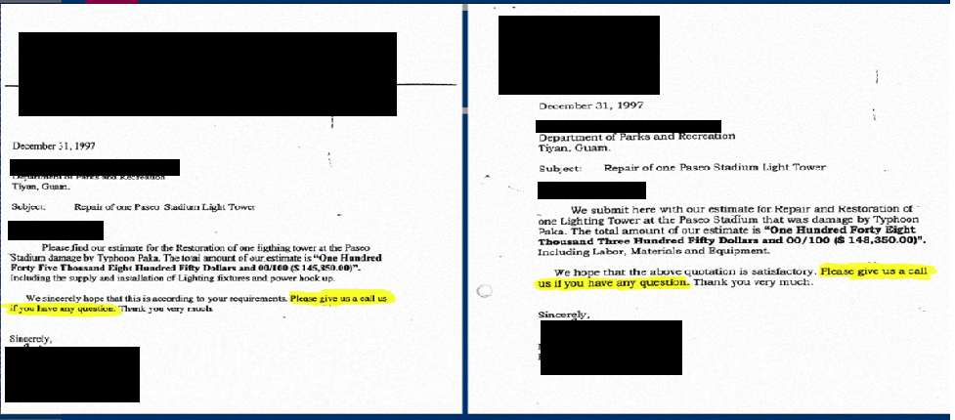
Bid: $145,350.00
Bid: $145,850.00
“Please give us a call us if you have any questions.”
“Please give us a call us if you have any questions.”

Slide 35
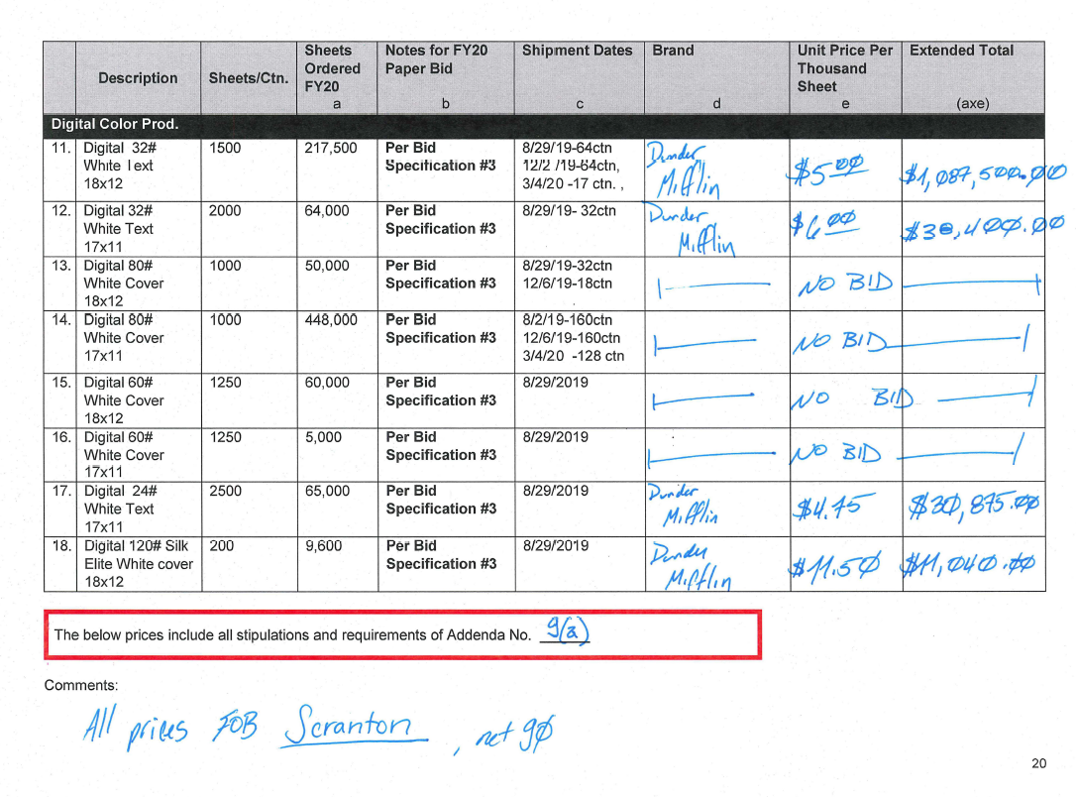
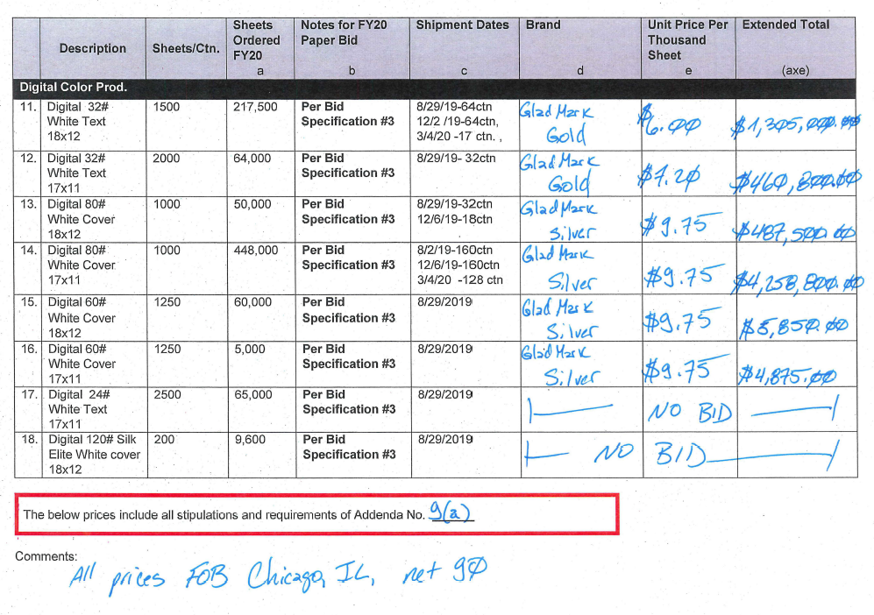
Dunder Mifflin Paper Company
Gladco Paper & More

Slide 36


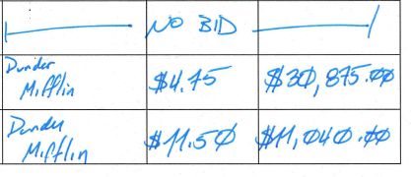
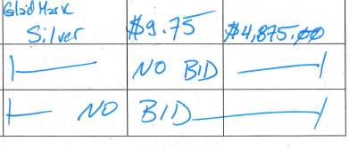
Dunder Mifflin Paper Company
Gladco Paper & More

Slide 37
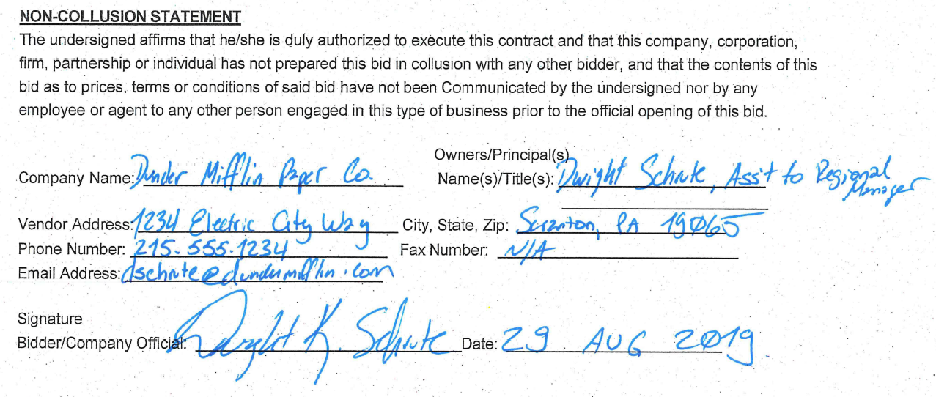
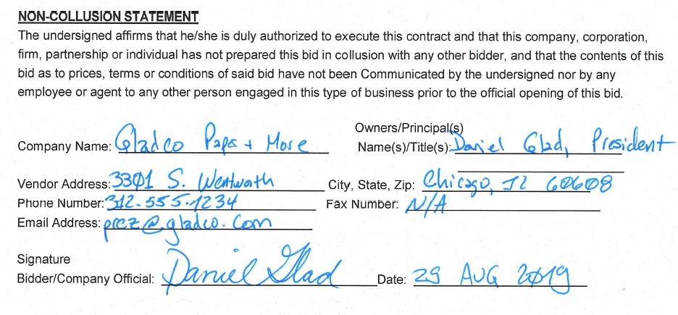
Dunder Mifflin Paper Company
Gladco Paper & More

Slide 38
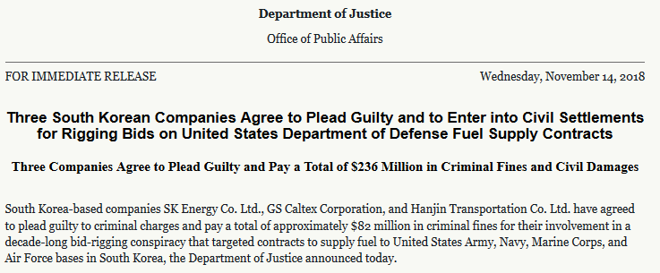
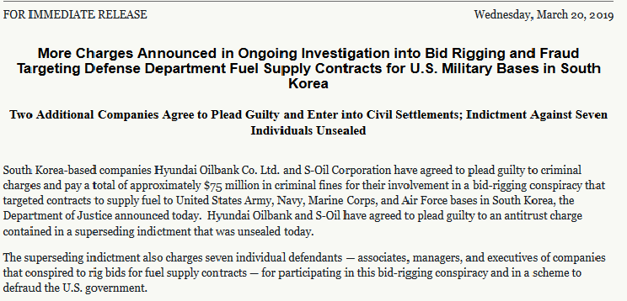
Case Study
Korea Fuel Supply Case
Price-fixing, bid-rigging and allocation conspiracy
Indictment alleged conspiracy caused over $100,000,000 in losses
Brought charges against:
  4 oil refineries
  1 logistics company
  7 individuals
Over $150 million in criminal fines

Slide 39
Roadmap
  Antitrust 101
  Detecting Antitrust Violations
  What Can You Do?

Slide 40
What Can You Do?
Require “no collusion,” “independent price,” “independent bid” or “no contact” certifications

Slide 41
Federal Acquisition Regulation
(FAR 48 C.F.R. § 52.203-2)
Bid offeror must certify that:
Prices in the offer have been arrived at independently without consultation, communication, or agreement with any other competitor;
Prices in the offer have not been and will not be knowingly disclosed by the offeror, directly or indirectly, to any other competitor before bid opening or contract award unless otherwise required by law; and
No attempt has been made or will be made by the offeror to induce any other competitor to/not to submit an offer for the purpose of restricting competition.

Slide 42
What Can You Do?
Maximize size of bidding pool – actively seek out new bidders
Be familiar with suppliers and their typical pricing – not just list prices
Awareness of industry developments and changes in price and supply
Know what prices are being paid by purchasers similar to you
Keep bids (and identity of other bidders) confidential until opened

Slide 43
What Can You Do?
Don’t allow vendors to pick up extra bid packages for another vendor OR submit a competing vendor’s bid
Don’t allow subcontracting to losing bidders
Write specifications with an eye towards inclusion
Examine bid files
  Same phrasing
  Same return address
  Same price calculations or errors
Maintain procurement records

Slide 44
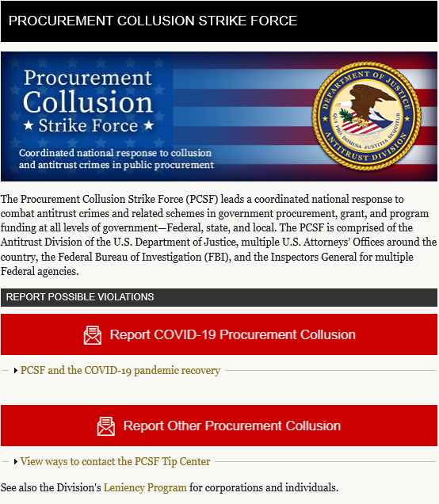
What Can You Do?
Listen and Report!!!
https://www.justice.gov/
procurement-collusion-strike-force

Slide 45
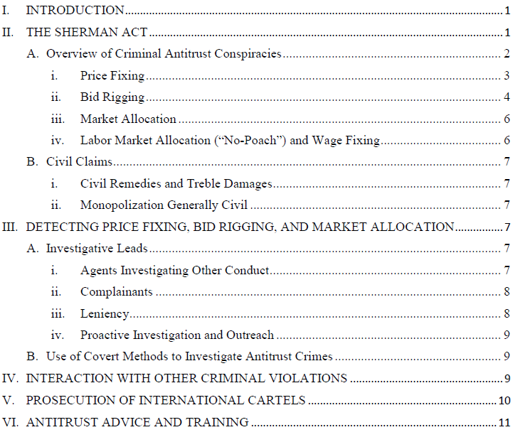
Other Resources
Antitrust Primer for
Federal Law Enforcement Personnel:
www.justice.gov/atr/criminal-enforcement

Slide 46
Reporting Suspected Antitrust Violations
Suspected Antitrust Violations against the Government?
To report suspected violations affecting government procurement, grant
and/or program funding contact the
Procurement Collusion Strike Force at pcsf@usdoj.gov
Danielle Garten Jason D. Jones
Danielle.Garten@usdoj.gov Jason.Jones3@usdoj.gov
202-514-4687 202-203-0040

Slide 47
Questions?

