Slide 1
Presentation for the Tallahassee Chapter of the AGA March 17, 2021
Disaster Preparedness and Planning

Slide 2
Ben A. (Steve) Stevens III, CPA Director, Assurance Services Thomas Howell Ferguson P.A. CPAs 2615 Centennial Blvd., Ste. 200 Tallahassee, FL 32308 sstevens@thf-cpa.com Office: 850.668.8100 Cell: 850.554.1034

Slide 3
Presentation Outline
Goal: Be Prepared
I. Overview
II. Four Phases of Emergency Management
III. Emergency Planning Process
IV. Emergency Planning Process Steps
V. Questions and Answers

Slide 4
I. Overview
The National Preparedness Goal (the Goal) is “[a] secure and resilient Nation with the capabilities required across the whole community to prevent, protect against, mitigate, respond to, and recover from the threats and hazards that pose the greatest risk.”
See Department of Homeland Security, National Preparedness Goal, Second Edition, 1 (Sept. 2015).
The Goal essentially defines what it means for all communities to be prepared collectively for the threats and hazards that pose the greatest risk to the nation.

Slide 5
II. Four Phases of emergency management
Mitigation
Preparedness
Response
Recovery

Slide 6
Mitigation Preventing future emergencies or minimizing their effects
Includes any activities that prevent an emergency, reduce the chance of an emergency happening, or reduce the damaging effects of unavoidable emergencies.
Buying flood and fire insurance for your home is a mitigation activity.
Mitigation activities take place before and after emergencies.

Slide 7
Preparedness Preparing to handle an emergency
Includes plans or preparations made to save lives and to help response and rescue operations.
Evacuation plans and stocking food and water are both examples of preparedness.
Preparedness activities take place before an emergency occurs.

Slide 8
Response Responding safely to an emergency
Includes actions taken to save lives and prevent further property damage in an emergency situation. Response is putting your preparedness plans into action.
Seeking shelter from a tornado or turning off gas valves in an earthquake are both response activities.
Response activities take place during an emergency.

Slide 9
Recovery Recovering from an emergency
Includes actions taken to return to a normal or an even safer situation following an emergency.
Recovery includes getting financial assistance to help pay for the repairs.
Recovery activities take place after an emergency.

Slide 10
Iii. Emergency planning process
The emergency planning process is successful when all parties involved understand their responsibilities.
Federal
State
Local

Slide 11
Iii. Emergency planning process
Federal Responsibilities
At the Federal level of government, the Federal Emergency Management Agency (FEMA) is involved in mitigation, preparedness, response, and recovery activities. FEMA helps the states in several ways.
FEMA provides the following programs:
Training programs and research information on the latest mitigation measures;
Review and coordination of State emergency plans;
Financial assistance;
Flood insurance to individuals and businesses in communities that join the National Flood Insurance Program (NFIP);
Subsidies to State and local offices of emergency management for maintaining emergency management programs;
Guidance and coordination for plans to warn and protect the nation in national security emergencies; and
Coordination of services for disaster response and recovery activities.

Slide 12
Iii. Emergency planning process
State Responsibilities
The State emergency management office is responsible for protecting communities and citizens within the state. The State office carries out statewide emergency management activities and:
Helps coordinate emergency management activities involving more than one community.
Assists individual communities when they need help.
Helps with money, personnel, or other resources.

Slide 13
Iii. Emergency planning process
State Responsibilities (continued)
The Governor reviews the local government’s application, studies the damage estimates and, if appropriate, declares the area a State disaster.
This official declaration makes State resources available. However, if damages are so extensive that the combined local and State resources are not sufficient, the Governor applies to the President for Federal disaster assistance.
If the need for Federal assistance funds is justified, the President issues a major disaster declaration and Federal resources are made available.

Slide 14
Iii. Emergency planning process
Local Government Responsibilities
Identifying hazards and assessing their potential risk to the community.
Determining the community’s capability to mitigate against, prepare for, respond to, and recover from major emergencies.
Identifying and employing methods to improve the community’s emergency management capability through efficient use of resources, improved coordination, and cooperation with other communities and with the State and Federal governments.
Establishing mitigation measures such as building codes, zoning ordinances, or land-use management programs.

Slide 15
Iii. Emergency planning process
Local Government Responsibilities (continued)
Developing and coordinating preparedness plans.
Establishing warning systems.
Stocking emergency supplies and equipment.
Educating the public and training emergency personnel.
Assessing damage caused by the emergency.
Activating response plans and rescue operations.
Ensuring that shelter and medical assistance are provided.
Recovering from the emergency and helping citizens return to normal life as soon as possible.

Slide 16
Iv. Emergency planning process steps
STEP 1.
Form a Collaborative Planning Team
Step 2.
Situational Awareness
Step 3.
Determine Goals and Objectives
Step 4.
Plan Development
Step 5.
Plan Preparation, Review, and Approval
Step 6.
Plan Implementation and Maintenance

Slide 17
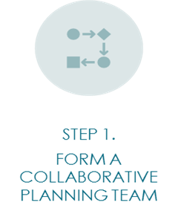
IV. Emergency planning process steps
Form
Form a Collaborative Planning Team
Identify
Identify the Core Planning Team: Emergency Management, Finance, Legal, Law Enforcement, Utilities, Infrastructure, etc.
Engage
Engage the Community: Business Chambers, Volunteer Organizations like the Red Cross, Municipality Leaders, etc.

Slide 18
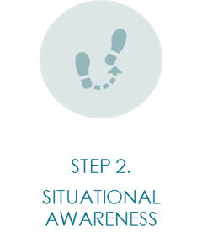
IV. Emergency planning process steps
Situational Awareness
Identify Threats and Hazards
Assess Risk

Slide 19
IV. Emergency planning process steps
Hazards - Natural
Meteorological - Flooding, Dam/Levee Failure, Severe Thunderstorm (Wind, Rain, Lightning, Hail), Tornado, Windstorm, Hurricanes and Tropical Storms, Winter Storm (Snow/Ice)
Geological - Earthquake, Tsunami, Landslide, Subsidence/Sinkhole, Volcano
Biological - Pandemic Disease, Foodborne Illnesses

Slide 20
IV. Emergency planning process steps
Hazards – Caused by Humans
Accidents - Workplace Accidents, Entrapment/Rescue (Machinery, Water, Confined Space, High Angle), Transportation Accidents (Motor Vehicle, Rail, Water, Air, Pipeline), Structural Failure/Collapse, Mechanical Breakdown
Intentional Acts - Labor Strike, Demonstrations, Civil Disturbance (Riot), Bomb Threat, Lost/Separated Person, Child Abduction, Kidnapping/Extortion, Hostage Incident, Workplace Violence, Robbery, Sniper Incident, Terrorism (Chemical, Biological, Radiological, Nuclear, Explosives), Arson, Cyber/Information Technology (Malware Attack, Hacking, Fraud, Denial of Service, etc.)

Slide 21
IV. Emergency planning process steps
Hazards - Technological
Information Technology - Loss of Connectivity, Hardware Failure, Lost/Corrupted Data, Application Failure
Utility Outage - Communications, Electrical Power, Water, Gas, Steam, Heating/Ventilation/Air Conditioning, Pollution Control System, Sewage System
Fire/Explosion - Fire (Structure, Wildland), Explosion (Chemical, Gas, or Process Failure)
Hazardous Materials - Hazardous Material Spill/Release, Radiological Accident, Hazmat Incident Off-site, Transportation Accidents, Nuclear Power Plant Incident, Natural Gas Leak Supply
Chain Interruption - Supplier Failure, Transportation Interruption

Slide 22
IV. Emergency planning process steps
Determine Operational Priorities
Set Goals and Objectives

Slide 23
IV. EMERGENCY PLANNING PROCESS STEPS
Determine Operational Priorities
Use information from the risk profile developed as part of the analysis process.
The planning team engages the senior official to establish how the hazard or threat would evolve in the jurisdiction and what defines a successful outcome for responders, disaster survivors, and the community.

Slide 24
IV. EMERGENCY PLANNING PROCESS STEPS
Set Goals and Objectives
Goals and objectives must be carefully crafted to ensure they support accomplishing the plan mission and operational priorities.
They must also clearly indicate the desired result or end-state they are designed to yield.

Slide 25
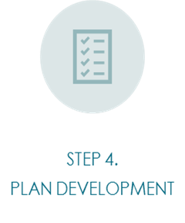
IV. Emergency planning process steps
Plan Development
Develop and Analyze Courses of Action
Identify Resources
Identify Information and Intelligence Needs

Slide 26
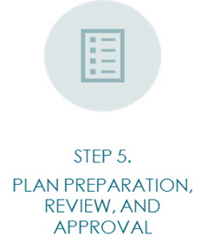
IV. Emergency planning process steps
Plan
Plan Preparation, Review, and Approval
Draft
Draft the written plan
Review
Review the plan
Approve and Disseminate
Approve and Disseminate the Plan

Slide 27
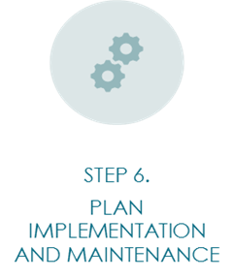
IV. Emergency planning process steps
Plan Implementation and Maintenance
Training
Practice and Exercise of the Plan
Review and Revise the Plan
Maintain the Plan

Slide 28
References
https://www.fema.gov/sites/default/files/2020-07/developing-maintaining-emergency-operations-plans.pdf
https://www.fema.gov/emergency-managers/national-preparedness/frameworks/recovery
https://www.fema.gov/sites/default/files/2020-04/CPG201Final20180525.pdf
https://www.fema.gov/sites/default/files/2020-06/fema_public-assistance-program-and-policy-guide_v4_6-1-2020.pdf
https://www.ecfr.gov/cgi-bin/text-idx?tpl=/ecfrbrowse/Title02/2cfr200_main_02.tpl

Slide 29
Questions?

Slide 30
Ben A. (Steve) Stevens III, CPA Director, Assurance Services Thomas Howell Ferguson P.A. CPAs 2615 Centennial Blvd., Ste. 200 Tallahassee, FL 32308 sstevens@thf-cpa.com Office: 850.668.8100 Cell: 850.554.1034

