Slide 1
Florida Department of Economic Opportunity
Florida Economic Outlook
Jimmy Heckman, Senior Economist
January 20, 2021
Notes:
At 10am this morning, the Florida Department of Economic Opportunity released November 2020 labor statistics for the state of Florida and its sub-state areas, including all Metropolitan Areas, counties, and large cities. These data were produced by the US Bureau of Labor Statistics through a Federal/State cooperative agreement with the DEO Bureau of Workforce Statistics and Economic Research and were collected through a combination of employer and household surveys, administrative records, and statistical modeling techniques.
This morning, I will walk you through the details of the data release. Starting with the household survey.
The Current Population Survey is used to estimate Florida’s unemployment rate, total labor force, and labor force participation rate under the Local Area Unemployment Statistics Program. Since these statistics are based on a survey of households, they capture information about individuals, not jobs, and they are calculated by place of residence, not place of work.

Slide 2
Bureau of Workforce Statistics and Economic Research
Our mission is to produce, analyze and deliver labor statistics
to improve economic decision-making
Employment data are the state’s most important economic indicators
Data collected under Federal/State Cooperative Statistical Programs
Comparable nationwide for all states, counties and metro areas
Collected through a combination of employer surveys, modeling and administrative records
Notes:
Florida’s seasonally adjusted unemployment rate in November 2020 was 6.4 percent.
This represented 651,000 jobless individuals out of a labor force of 10,146,000.
Florida’s November 2020 unemployment rate was equal to the revised October 2020 rate and up 3.6 percentage points from the November 2019 rate.

Slide 3
Better Decision Making
WSER
Federal Agencies
Media
CareerSource FL Network
Education
Public
Businesses
DEO
Elected Officials
Other State Agencies
Economic Development Councils
Local and State Workforce Development Boards
Economic Development Decision-Makers
Employers / Job Seekers
Education / Public Assistance Planners
Career Counselors / Teachers / Students
Economists / Policy Makers
Elected Officials
Media
Notes:
Florida’s seasonally adjusted unemployment rate in November 2020 was 6.4 percent.
This represented 651,000 jobless individuals out of a labor force of 10,146,000.
Florida’s November 2020 unemployment rate was equal to the revised October 2020 rate and up 3.6 percentage points from the November 2019 rate.

Slide 4
Statistical Programs
Quarterly Census of Employment and Wages (QCEW) - Produces employment and wages by industry based on all employers covered by reemployment assistance.
Current Employment Statistics (CES) - Produces employment, hours and earnings by industry based on a sample of employers.
Occupational Employment Statistics (OES) - Produces employment and wages by occupation based on a sample of employers.
Local Area Unemployment Statistics (LAUS) - Produces labor force, employment, unemployment and unemployment rates based on a survey of households and a statistical model.
Employment Projections (EP) - Produces annually eight year employment projections for all industries and occupations using QCEW, OES and CPS data.
Notes:
Florida’s seasonally adjusted unemployment rate in November 2020 was 6.4 percent.
This represented 651,000 jobless individuals out of a labor force of 10,146,000.
Florida’s November 2020 unemployment rate was equal to the revised October 2020 rate and up 3.6 percentage points from the November 2019 rate.

Slide 5
Florida’s November 2020 Labor Force Statistics
Labor Force: 10,146,000
Up 49,000 (+0.5%) over the month | Down 277,000 (-2.7%) over the year
Employment: 9,494,000
Up 41,000 (0.4%) over the month | Down 633,000 (-6.3%) over the year
Unemployment: 651,000
Up 7,000 (+1.1%) over the month | Up 354,000 (+119.2%) over the year
Source: Florida Department of Economic Opportunity, Bureau of Workforce Statistics and Economic Research; Local Area Unemployment Statistics (LAUS) Program.
Notes:
Florida’s seasonally adjusted unemployment rate in November 2020 was 6.4 percent.
This represented 651,000 jobless individuals out of a labor force of 10,146,000.
Florida’s November 2020 unemployment rate was equal to the revised October 2020 rate and up 3.6 percentage points from the November 2019 rate.

Slide 6
Florida’s November 2020 Labor Force Statistics
Unemployment Rates By County
November 2020; Not Seasonally Adjusted
Source: Florida Department of Economic Opportunity, Bureau of Workforce Statistics and Economic Research; Local Area Unemployment Statistics (LAUS) Program.
Notes:
Florida’s seasonally adjusted unemployment rate in November 2020 was 6.4 percent.
This represented 651,000 jobless individuals out of a labor force of 10,146,000.
Florida’s November 2020 unemployment rate was equal to the revised October 2020 rate and up 3.6 percentage points from the November 2019 rate.

Slide 7
Florida’s Nonagricultural Payroll Employment
Total Jobs: 8,588,200
Up 4,000 (+less than 0.1%) over the month | Down 418,500 (-4.6%) over the year
Private Sector Jobs: 7,506,800
Up 9,800 (+0.1%) over the month | Down 372,800 (-4.7%) over the year
Source: Florida Department of Economic Opportunity, Bureau of Workforce Statistics and Economic Research; Current Employment Statistics (CES) Program.
Notes:
Job creation data for Florida is derived from the Current Employment Statistics, or CES, survey conducted by the U.S. Bureau of Labor Statistics. The CES survey collects data from up to 20,000 Florida businesses and establishments each month to measure jobs by industry across the state. Since these statistics are based on a survey of employers, they measure counts of jobs, not individuals, and they capture characteristics of employers such as industry and place of work.
Total Nonagricultural Employment grew to 8,588,200 jobs in November 2020, up 4,000 jobs, or less than 0.1 percent percent, from October 2020.
This figure is down 418,500 jobs from a year ago, an over-the-year decline of 4.6 percent.
Florida’s Private-Sector Nonagricultural Employment was 7,506,800 jobs in November 2020, up 9,800 jobs or 0.1 percent from October 2020.
Total private employment was down 372,800 jobs from November 2019. This is an over-the-year decline of 4.7 percent.

Slide 8
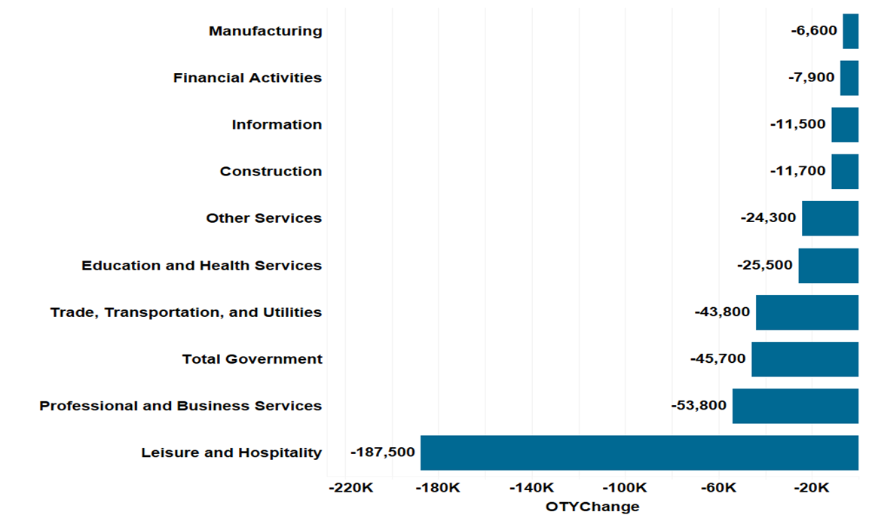
Payroll Employment by Industry
Top Industries in Florida by Change in Employment
November 2019 to November 2020
Source: Florida Department of Economic Opportunity, Bureau of Workforce Statistics and Economic Research; Current Employment Statistics (CES) Program.
Notes:
Florida’s seasonally adjusted unemployment rate in November 2020 was 6.4 percent.
This represented 651,000 jobless individuals out of a labor force of 10,146,000.
Florida’s November 2020 unemployment rate was equal to the revised October 2020 rate and up 3.6 percentage points from the November 2019 rate.

Slide 9
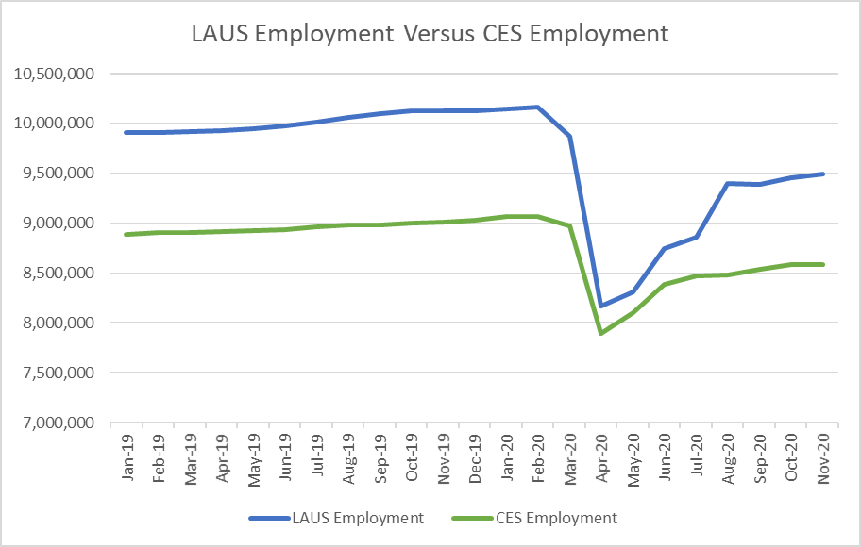
LAUS Employment Versus CES Employment
Source: Florida Department of Economic Opportunity, Bureau of Workforce Statistics and Economic Research;
Notes:
There are differences in what is included in the employment estimates in these two data series. LAUS includes self-employed, agricultural workers as well as unpaid workers who worked 15 hours or more in family-operated enterprises and workers who are absent from work without pay during the reference week while the CES does not include any of these categories of workers. These factors can contribute to different fluctuations on a monthly basis.
Remember it is better to look at longer term trends than just a few months. As of November 2020 the LAUS employment level is at 93.4 percent of what it was in February 2020 and CES is at 94.7 percent. These two series are on similar recovery tracks.
Typically the CES employment is lower than LAUS employment by about 11 percent. In the months of April to July 2020, the gap got smaller, anywhere from 2 to 4 percent, then in November 2020 was back to 10 percent.

Slide 10
Since February 2020…
Payroll Jobs:
Labor Force:
-3.0%
-5.3%
Unemployment Rate:
+3.6%
Jobless Claims:
2.7 Million
Prime Age Employment:
Jobless Claims:
-3.7%
-20.7%
Notes:
Florida’s seasonally adjusted unemployment rate in November 2020 was 6.4 percent.
This represented 651,000 jobless individuals out of a labor force of 10,146,000.
Florida’s November 2020 unemployment rate was equal to the revised October 2020 rate and up 3.6 percentage points from the November 2019 rate.

Slide 11
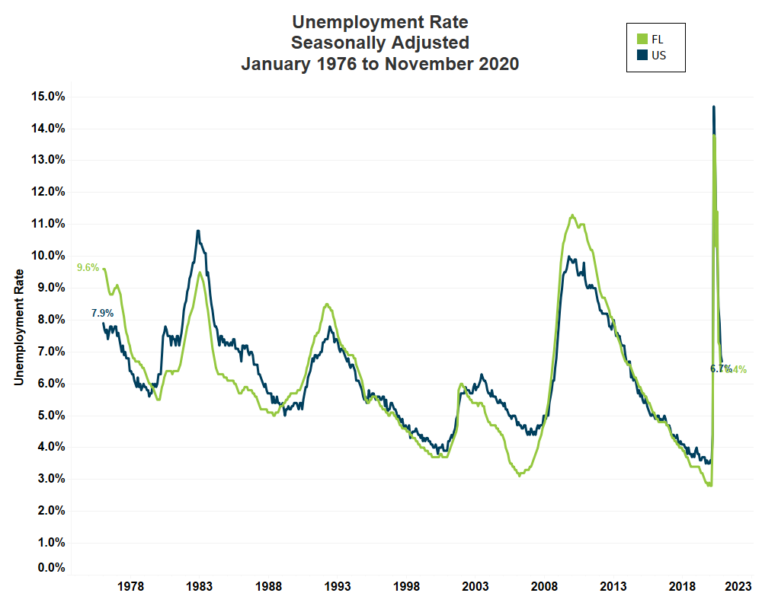
Unemployment Rates
Source: Florida Department of Economic Opportunity, Bureau of Workforce Statistics and Economic Research, U.S. Bureau of Labor Statistics.
Notes:
Florida’s seasonally adjusted unemployment rate in November 2020 was 6.4 percent.
This represented 651,000 jobless individuals out of a labor force of 10,146,000.
Florida’s November 2020 unemployment rate was equal to the revised October 2020 rate and up 3.6 percentage points from the November 2019 rate.

Slide 12
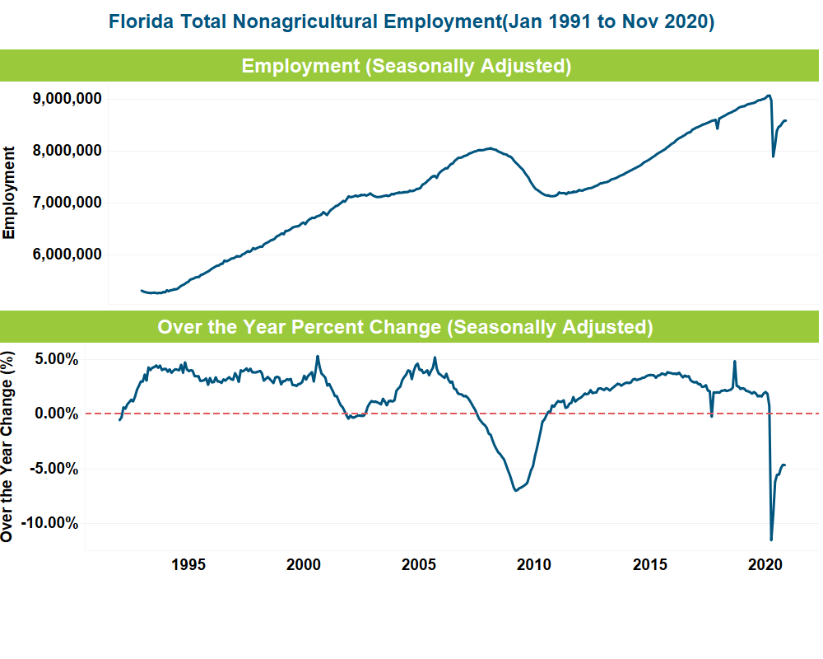
Payroll Job Growth
Total Nonagricultural Jobs (Florida; Seasonally Adjusted)
Source: Florida Department of Economic Opportunity, Bureau of Workforce Statistics and Economic Research; Current Employment Statistics (CES) Program.
Notes:
Florida’s seasonally adjusted unemployment rate in November 2020 was 6.4 percent.
This represented 651,000 jobless individuals out of a labor force of 10,146,000.
Florida’s November 2020 unemployment rate was equal to the revised October 2020 rate and up 3.6 percentage points from the November 2019 rate.

Slide 13
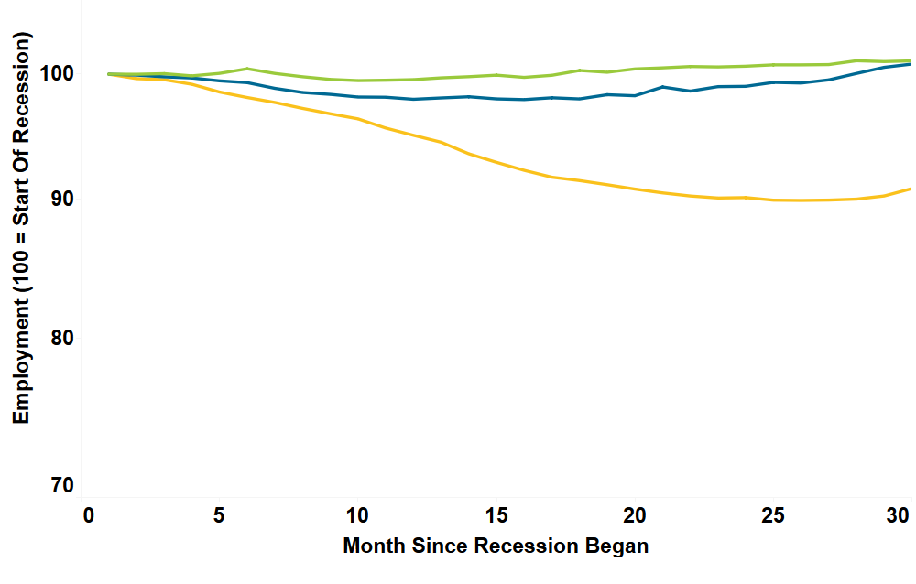
Historical Recession Trajectories
Total NonAgricultural Employment
(Florida; Seasonally Adjusted)
Dot Com Bubble (March 2001)
Early 1990s Recession (July 1990)
Great Recession (December 2007)
Source: Florida Department of Economic Opportunity, Bureau of Workforce Statistics and Economic Research.
Notes:
Florida’s seasonally adjusted unemployment rate in November 2020 was 6.4 percent.
This represented 651,000 jobless individuals out of a labor force of 10,146,000.
Florida’s November 2020 unemployment rate was equal to the revised October 2020 rate and up 3.6 percentage points from the November 2019 rate.

Slide 14
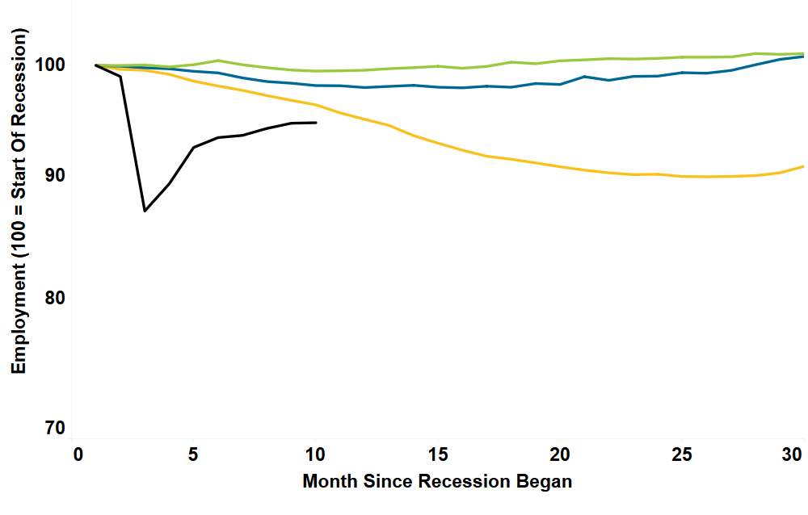
Historical Recession Trajectories
Total NonAgricultural Employment
(Florida; Seasonally Adjusted)
Dot Com Bubble (March 2001)
Early 1990s Recession (July 1990)
Great Recession (December 2007)
COVID-19 Recession (February 2020)
Source: Florida Department of Economic Opportunity, Bureau of Workforce Statistics and Economic Research.
Notes:
Florida’s seasonally adjusted unemployment rate in November 2020 was 6.4 percent.
This represented 651,000 jobless individuals out of a labor force of 10,146,000.
Florida’s November 2020 unemployment rate was equal to the revised October 2020 rate and up 3.6 percentage points from the November 2019 rate.

Slide 15
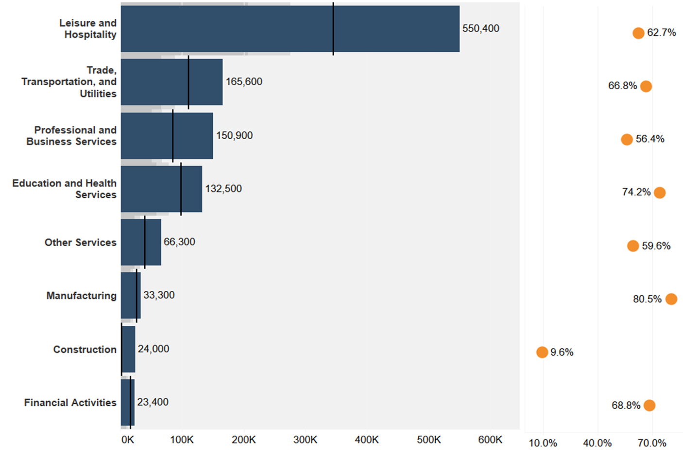
Industries Have Recovered Differently
Total NonAgricultural Employment
(Florida; Seasonally Adjusted)
Jobs Recovered
Jobs Lost
Source: Florida Department of Economic Opportunity, Bureau of Workforce Statistics and Economic Research; Current Employment Statistics (CES) Program.
Notes:
Florida’s seasonally adjusted unemployment rate in November 2020 was 6.4 percent.
This represented 651,000 jobless individuals out of a labor force of 10,146,000.
Florida’s November 2020 unemployment rate was equal to the revised October 2020 rate and up 3.6 percentage points from the November 2019 rate.

Slide 16
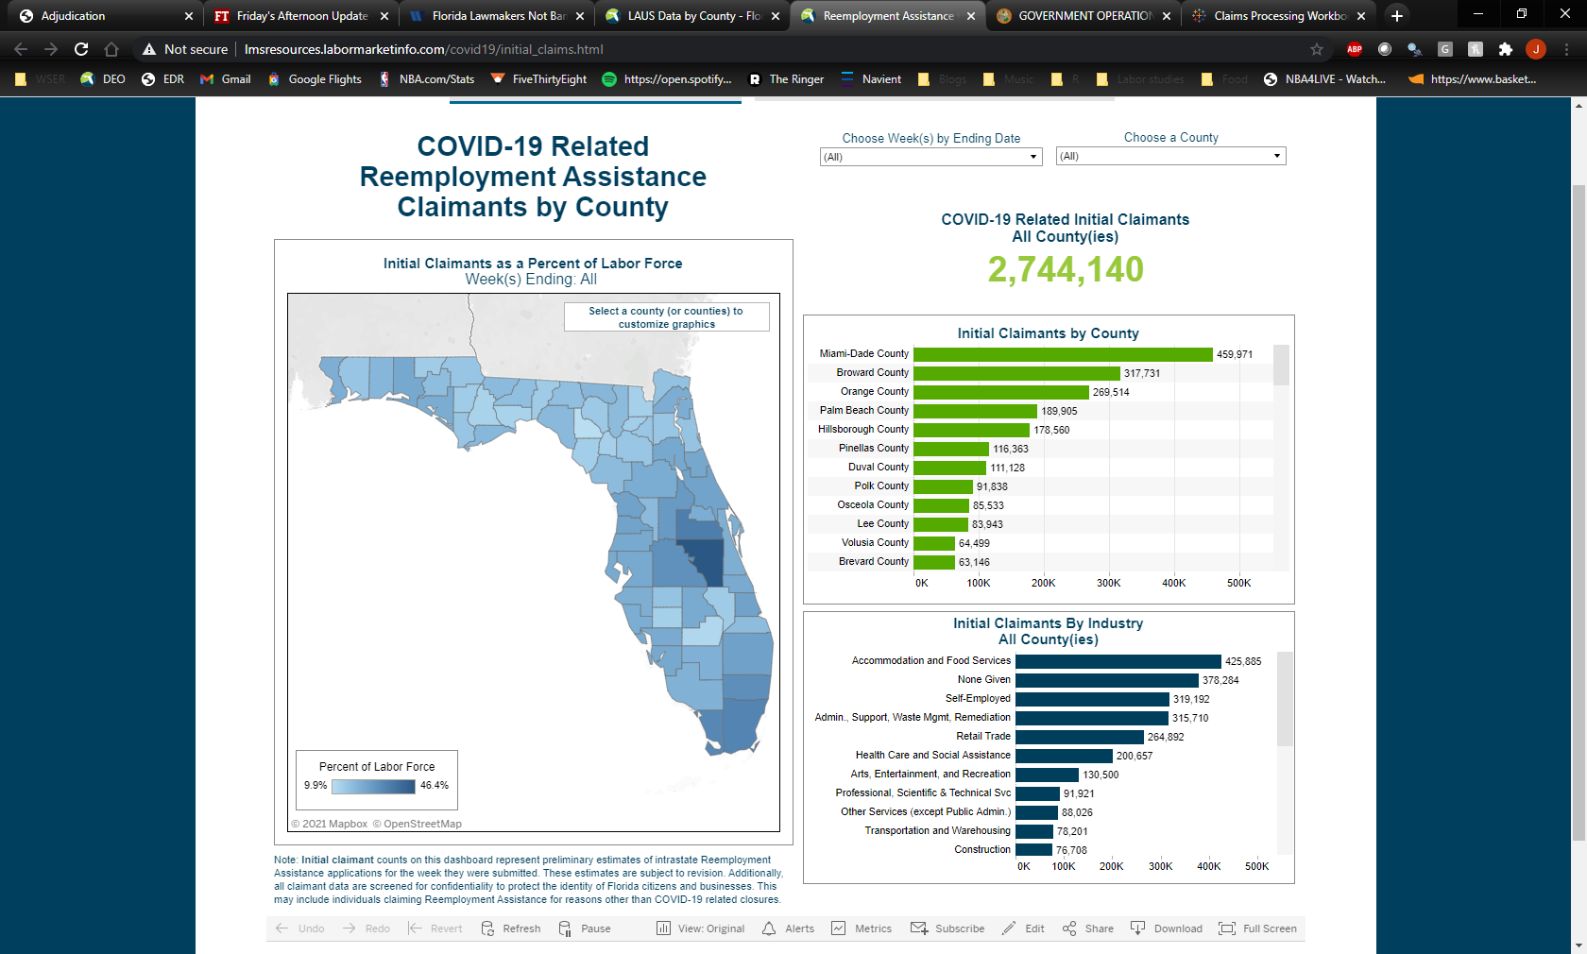
Jobless Claims
Notes:
Florida’s seasonally adjusted unemployment rate in November 2020 was 6.4 percent.
This represented 651,000 jobless individuals out of a labor force of 10,146,000.
Florida’s November 2020 unemployment rate was equal to the revised October 2020 rate and up 3.6 percentage points from the November 2019 rate.

Slide 17
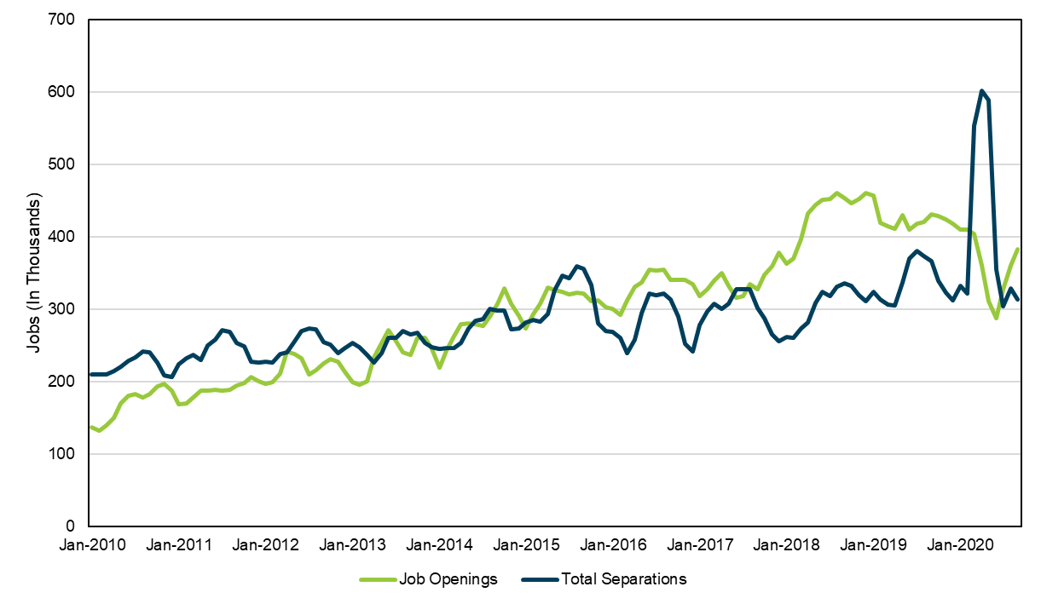
Labor Turnover
Job Openings vs Total Separations
Florida; Seasonally Adjusted
Source: U.S. Bureau of Labor Statistics, Job Openings and Labor Turnover Survey (JOLTS)
Notes:
Florida’s seasonally adjusted unemployment rate in November 2020 was 6.4 percent.
This represented 651,000 jobless individuals out of a labor force of 10,146,000.
Florida’s November 2020 unemployment rate was equal to the revised October 2020 rate and up 3.6 percentage points from the November 2019 rate.

Slide 18
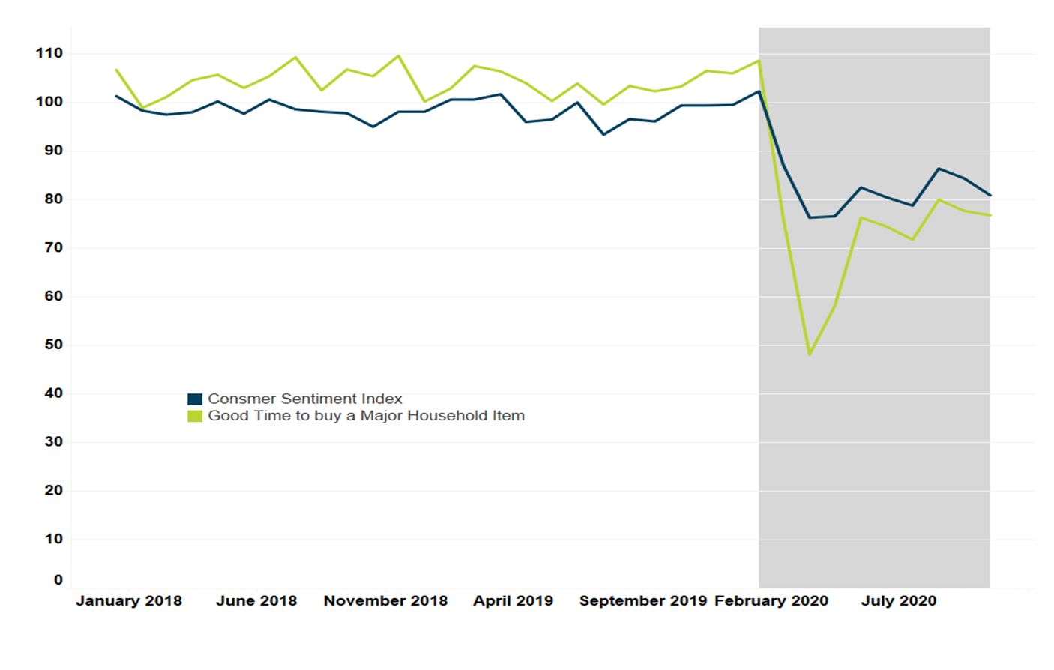
Consumer Sentiment
Florida Consumer Sentiment Index
(Seasonally Adjusted)
Source: University of Florida, Bureau of Economic and Business Research (BEBR).
Notes:
Florida’s seasonally adjusted unemployment rate in November 2020 was 6.4 percent.
This represented 651,000 jobless individuals out of a labor force of 10,146,000.
Florida’s November 2020 unemployment rate was equal to the revised October 2020 rate and up 3.6 percentage points from the November 2019 rate.

Slide 19
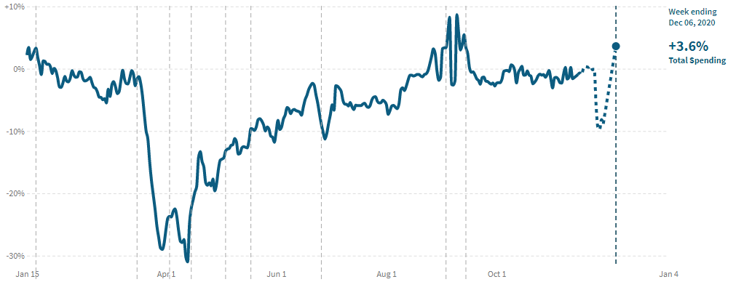
Consumer Spending
In Florida, as of December 6, 2020, total spending by consumers increased by 3.6% compared to January 2020
Notes:
Florida’s seasonally adjusted unemployment rate in November 2020 was 6.4 percent.
This represented 651,000 jobless individuals out of a labor force of 10,146,000.
Florida’s November 2020 unemployment rate was equal to the revised October 2020 rate and up 3.6 percentage points from the November 2019 rate.

Slide 20
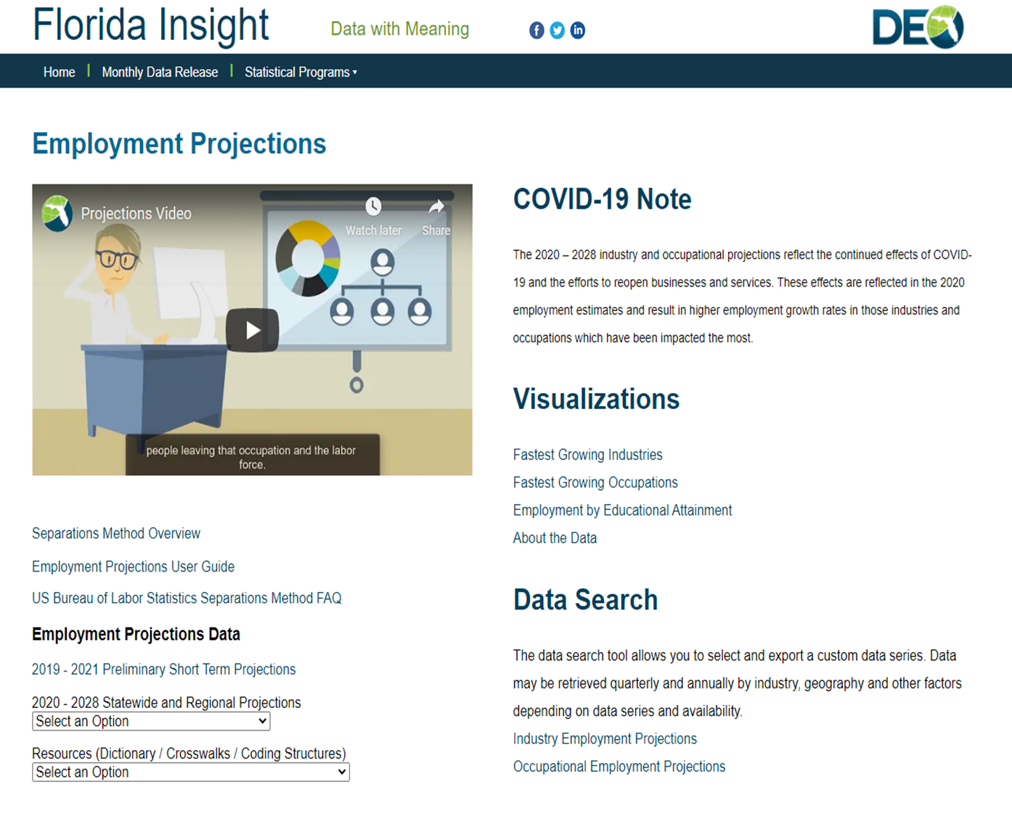
Employment Projections
Notes:
The 2020 – 2028 industry and occupational projections are now available on the Employment Projections page on FloridaInsight.org. The projection tables are available for the state and for each of the 24 Local Workforce Development Areas.
To account for the impacts on employment due to COVID-19, the employment projections were enhanced using data from the Current Employment Survey (CES) program. These effects are reflected in the 2020 employment estimates and result in higher employment growth rates in the industries and occupations which have been impacted the most.

Slide 21
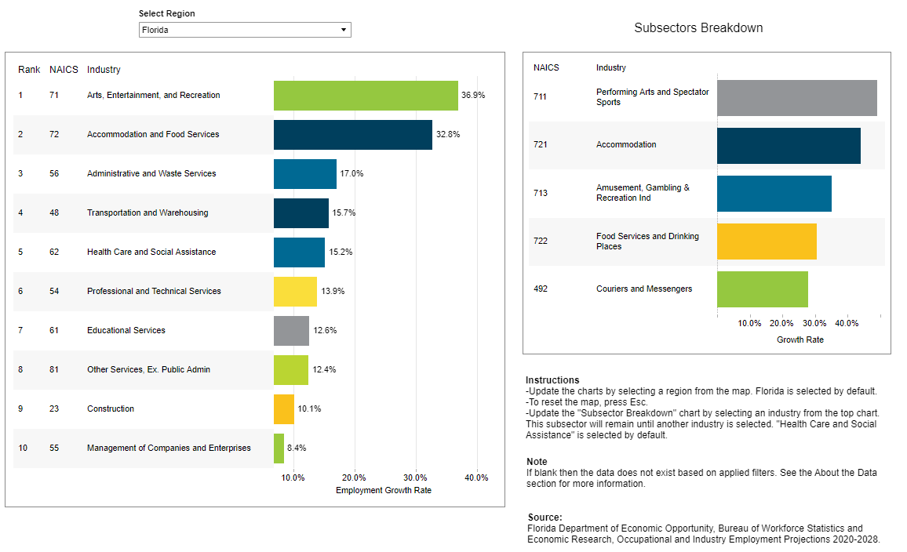
2020-2028 Top Industries by Projected Growth
Notes:
The Performing Arts and Spectator Sports Industry is projected to have the fastest employment growth between 2020 and 2028 with a growth rate of 49.1%, followed by the Accommodation (43.9%) and the Amusement, Gambling, and Recreation (35.1%) industries.
The Food Services and Drinking Places industry is projected to gain the most new jobs between 2020 and 2028 with 218,014 jobs, followed by the Administrative and Support Services (102,829) and the Ambulatory Health Care Services (95,850) industries.
The Nurse Practitioners occupation is projected to have the fastest employment growth between 2020 and 2028 with a growth rate of 51.9%, followed by Restaurant Cooks (47.6%) and Massage Therapists (37.6%).
The Combined Food Preparation and Serving Workers, Including Fast Food occupation is projected to gain the most new jobs between 2020 and 2028 with 58,393 jobs, followed by Waiters and Waitresses (53,204) and Restaurant Cooks (46,054).

Slide 22
Where Can I Get All Of This Information?
Our Websites:
http://floridajobs.org/workforce-statistics
http://floridajobs.org/wser-home
Other Sources:
www.bls.gov
Core programs
Business Employment Dynamics
www.census.gov
American Community Survey
Economic Census
Quarterly Workforce Indicators
Notes:
The Performing Arts and Spectator Sports Industry is projected to have the fastest employment growth between 2020 and 2028 with a growth rate of 49.1%, followed by the Accommodation (43.9%) and the Amusement, Gambling, and Recreation (35.1%) industries.
The Food Services and Drinking Places industry is projected to gain the most new jobs between 2020 and 2028 with 218,014 jobs, followed by the Administrative and Support Services (102,829) and the Ambulatory Health Care Services (95,850) industries.
The Nurse Practitioners occupation is projected to have the fastest employment growth between 2020 and 2028 with a growth rate of 51.9%, followed by Restaurant Cooks (47.6%) and Massage Therapists (37.6%).
The Combined Food Preparation and Serving Workers, Including Fast Food occupation is projected to gain the most new jobs between 2020 and 2028 with 58,393 jobs, followed by Waiters and Waitresses (53,204) and Restaurant Cooks (46,054).

Slide 23
Questions?
Notes:
The Performing Arts and Spectator Sports Industry is projected to have the fastest employment growth between 2020 and 2028 with a growth rate of 49.1%, followed by the Accommodation (43.9%) and the Amusement, Gambling, and Recreation (35.1%) industries.
The Food Services and Drinking Places industry is projected to gain the most new jobs between 2020 and 2028 with 218,014 jobs, followed by the Administrative and Support Services (102,829) and the Ambulatory Health Care Services (95,850) industries.
The Nurse Practitioners occupation is projected to have the fastest employment growth between 2020 and 2028 with a growth rate of 51.9%, followed by Restaurant Cooks (47.6%) and Massage Therapists (37.6%).
The Combined Food Preparation and Serving Workers, Including Fast Food occupation is projected to gain the most new jobs between 2020 and 2028 with 58,393 jobs, followed by Waiters and Waitresses (53,204) and Restaurant Cooks (46,054).

