Slide 1
Session T106
A Day in the Life of a Non-Profit: Using Accounting to Support Those Who Count on You
APRIL 29, 2025

Slide 2
Session T106
Session Title: A Day in the Life of a Non-Profit: Using Accounting to Support Those Who Count on You
Session Description: Every day non-profits serve and have meaningful impacts for communities across our country. During this session, you will learn about a very special non-profit called Horton’s Kids that serves families in Southeast, DC, and how finance and accounting activities are so integral to the success of non-profits such as Horton’s Kids. Horton’s Kids was built on the idea that dedicated service can change lives, and with the current dynamic environment in the federal grants domain, now more than ever, non-profits including Horton’s Kids need to apply innovative approaches to executing their finance, accounting, and other administrative activities.
Learning Objectives:
Obtain an understanding of the type of funding sources and expenses for a non-profit and how they are accounted for.
Obtain an understanding of the impact of federal grants on a non-profit.
Obtain an understanding of the grant lifecycle for a non-profit: apply, execute, report, and audit.
Obtain an understanding of the application of indirect costs for grants for a non-profit and the importance of the indirect amount.
Presenter: Andrew Hullinger, CFO, Horton’s Kids
Moderator: Joshua Shapiro, Vice President, Ascella Technologies, Inc.

Slide 3

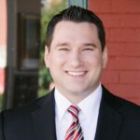
Andrew Hullinger
CFO
Horton’s Kids
andrew@hortonskids.org
Speaker
Josh Shapiro
Vice President
Ascella Technologies, Inc. (Ascella)
joshua.shapiro@ascellatech.com
Moderator

Slide 4
AGENDA
Introductions
Overview of Horton’s Kids
What is a non-profit?
What are the types of funding sources and expenses for a non-profit and how are they accounted for?
Impact of federal grants on a non-profit
The grant lifecycle for a non-profit: apply, execute, report, and audit
Application of indirect costs for grants for a non-profit and the importance of the indirect amount
Q&As

Slide 5
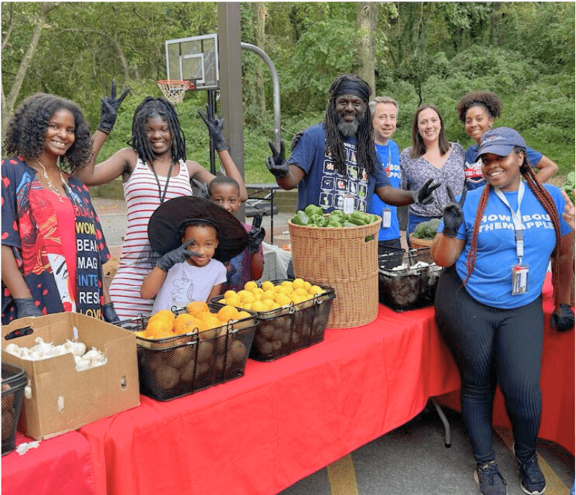

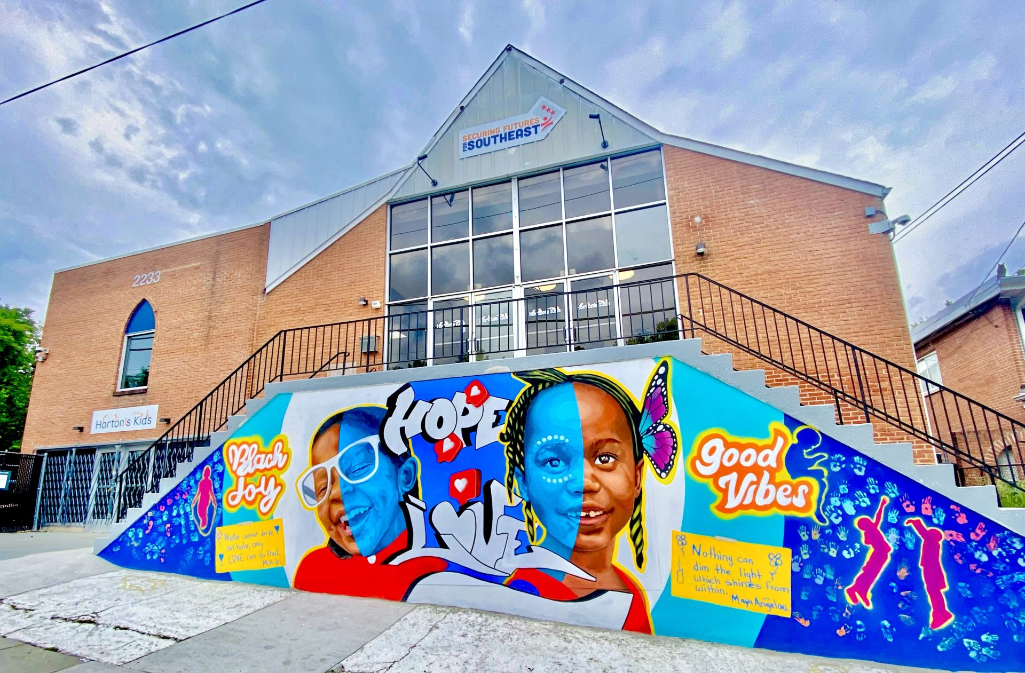
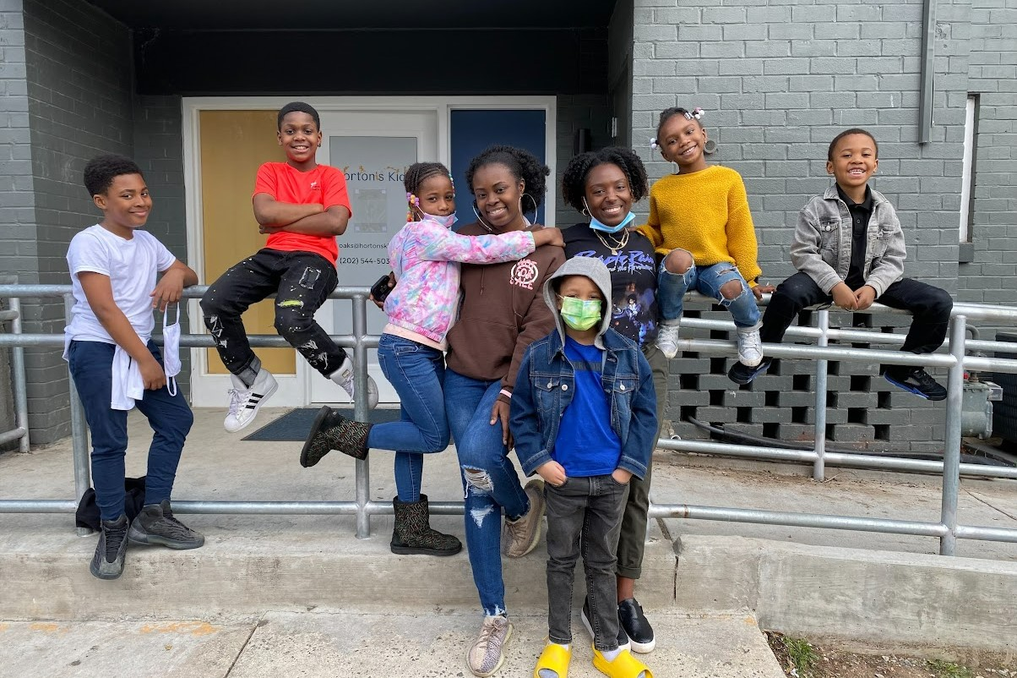

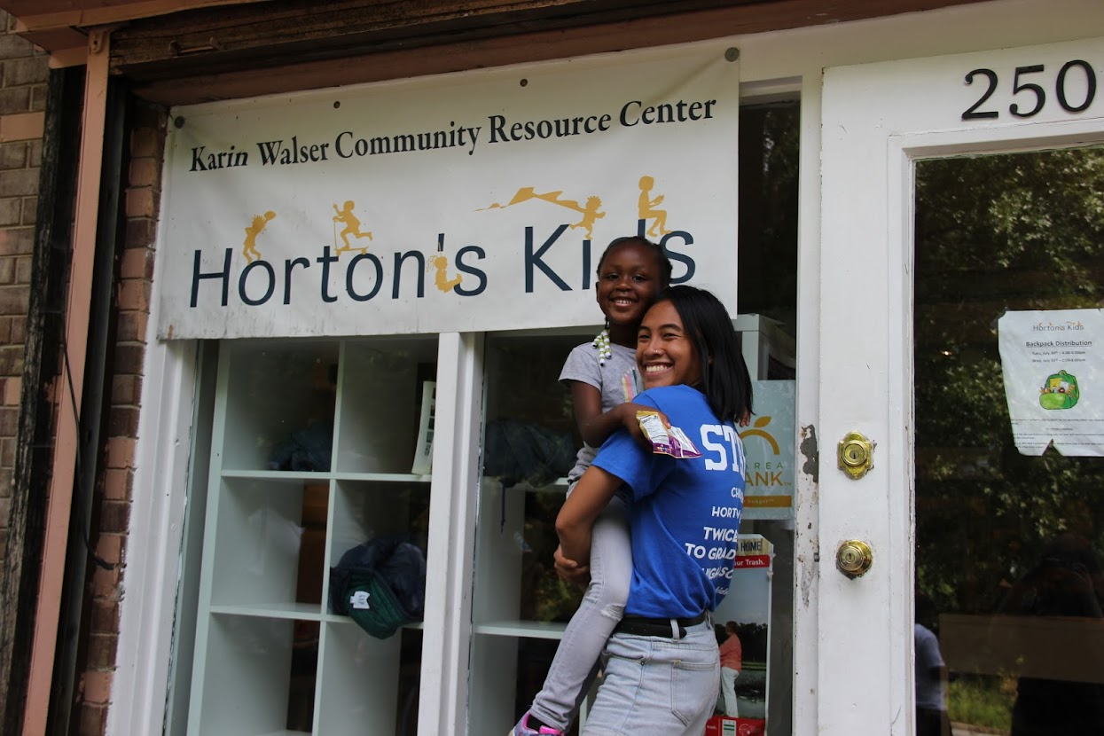
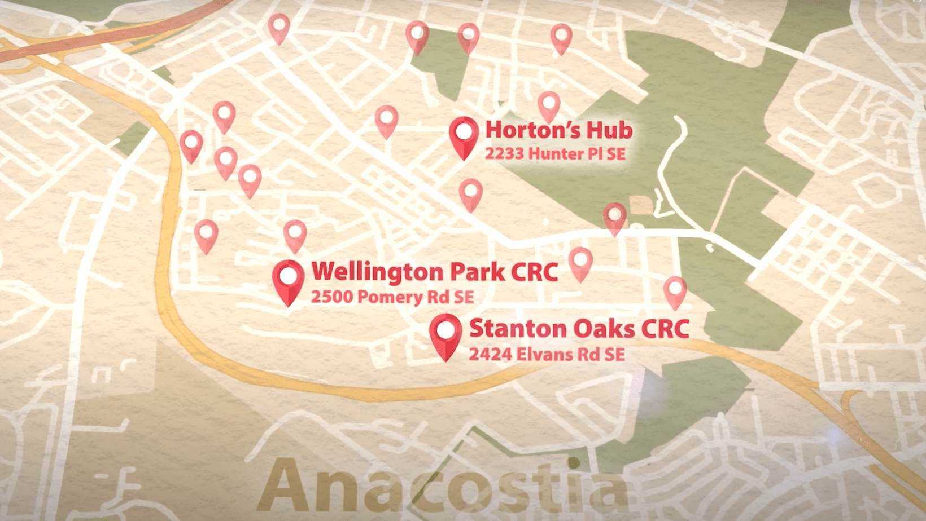

Slide 6

https://www.youtube.com/embed/MRjDYywUQYg?si=7wVhFidX6-1K2_pb&amp;start=0;stop=362&rel=0
https://www.hortonskids.org/about/

Slide 7
Characteristics of a non-profit organization
Legally defined – IRS determination
Must demonstrate a public benefit – Mission-centric
Tax-exempt
Shareholders vs. Stakeholders – Invest in ourselves.
Typically funded by grants and donations.
Reliance on Volunteers.
No margin, no mission.

Slide 8
FY24 Funding Sources ($ in 000’s)
Total = $5,806

Slide 9
FY24 expenditures ($ in 000’s)
$0.77 of every $1.00 spent goes directly to programs.
Cost of fundraising is $0.14 per $1.00 raised.
Total = $5,641

Slide 10
Program Services expenditures ($ in 000’s)
Total = $4,350

Slide 11
Program Services expenditures ($ in 000’s)
Total = $4,350

Slide 12
Restricted vs unrestricted revenues
Total = $5,806

Slide 13
Restricted Giving ($ in 000’s)
Total = $2,563

Slide 14
Grant life-cycle
Apply
Implement and Execute
Program and Financial Reporting
Compliance Monitoring / Audit
Inform, Advise, and Support
Grant cycle can be 1-year or multi-year
Not mandatory for each grant, but very important for those that require this step
Most grants are reimbursement-style. Don’t get the money until you can show that you have incurred costs.
Reporting can be monthly, quarterly, or annual. Are we having the desired impact?

Slide 15
Importance of Indirects
Organization could not function without:
Finance (accounting, payroll, a/p, a/r, cash management)
Human Resources (recruiting, training, employee relations, benefits management)
Information Technology (infrastructure, MSP, internet)
Occupancy (loan costs, housekeeping, maintenance, utilities)
Insurance (liability, property and auto, cyber, worker’s comp, etc)

Slide 16
How can people help?
https://www.hortonskids.org/get-involved/

Slide 17
THANK YOU

