Slide 1
WELCOME
Fraud 2025 Technical Committee

Slide 2
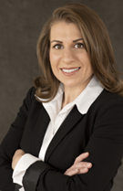
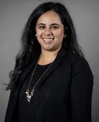
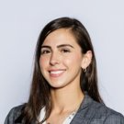
Private: Ruba Elbasha Partner, Defense & Security Financial Management Practice Leader Guidehouse
Technical Committee Co-Chairs
State/Local:
Arushi Thakorlal, CGFM
Deputy City Auditor
City of Seattle, WA
Federal:
Kathleen R. Sedney
Former Assistant Inspector General for Audits,
Inspections, and Evaluations,
U.S. Dept. of Interior, OIG

Slide 3
Fraud 2024 Snapshot: Total Attendance: 867 (467 in-person / 400 virtual) 50% Feds, 15% State/Local, 30% Private (include exhibitors)

Slide 4
Fraud 2024 Evaluation Results

Slide 5
Please rate your overall satisfaction with Fraud 2024
Answer Choices | In-Person | Virtual
Excellent | 58% | 52%
Very Good | 36% | 33%
Good | 4% | 11%
Fair | 2% | 3%
Poor | 0% | 1%
Notes:
98%/97%

Slide 6
Would you recommend this training event to your colleagues?
Answer Choices | In-Person | Virtual
Yes | 100% | 94%
No | 0% | 6%

Slide 7
Please rate the overall quality and value of the educational program, speakers and session topics.
Answer Choices | In-Person | Virtual
Excellent | 58% | 54%
Very Good | 36% | 32%
Good | 6% | 9%
Fair | 0% | 5%
Poor | 0% | 0%
Notes:
98/97

Slide 8
The educational topics were relevant to me and my job.
Answer Choices | In-Person | Virtual
Strongly Agree | 56% | 58%
Agree | 42% | 36%
Neutral | 2% | 5%
Disagree | 0% | 1%
Strongly Disagree | 0% | 0%
Notes:
93/88

Slide 9
Speaker Sessions | Session Ratings
F105 - Improving Program Integrity in Federal Health Programs | 5
T108 - Assessing Fraud Risk for Cyber Threats to Internal Controls | 5
F114 - Closing Plenary Session: The Whistleblower Dilemma: Justice or Loyalty? | 4.95
T111 - Fraud & Deepfakes Driven by GenAI | 4.89
F103 - CFO Survey Debrief | 4.75
F113 - Building a Comprehensive Fraud Risk Management Program: Lessons from HUD’s Experience | 4.75
T106 - Strengthening Fraud Prevention: Key Lessons from Covid-19 Grant Programs | 4.73
T113: Elevating Fraud Prevention Excellence: Harnessing Organizational Development and High-Performance Teams | 4.68
F106 - Synergy Between Audit & Investigation Teams Enhances Compliance | 4.67
F107 - Testing IT & Cybersecurity Controls in Financial Statement Audits | 4.66
Top 10 Sessions
Notes:
93/88

Slide 10
Technical Committee Duties
Submit session ideas via call for proposal portal (emailed on 6/16)
Unlimited submission; include session title, description, learning objectives, key takeaways, speaker names (optional)
Review and score session proposals
Identify & recruit government sector subject-matter panelists
Coordinate session
Speak or moderate

Slide 11
Submission Guidelines
Session Titles: Use exciting, catchy, engaging session titles; five words or less
Session Descriptions: Use active voice for an effective and interesting description; total 50-75 words, or three to five (3-5) sentences
Learning Objectives: What attendees will know or be able to do by the end of your session
Key Takeaways: 3-4 bullet points that summarizes the important points of your session; recommendations/next steps
Field of Study: Based on NASBA CPE catalog

Slide 12
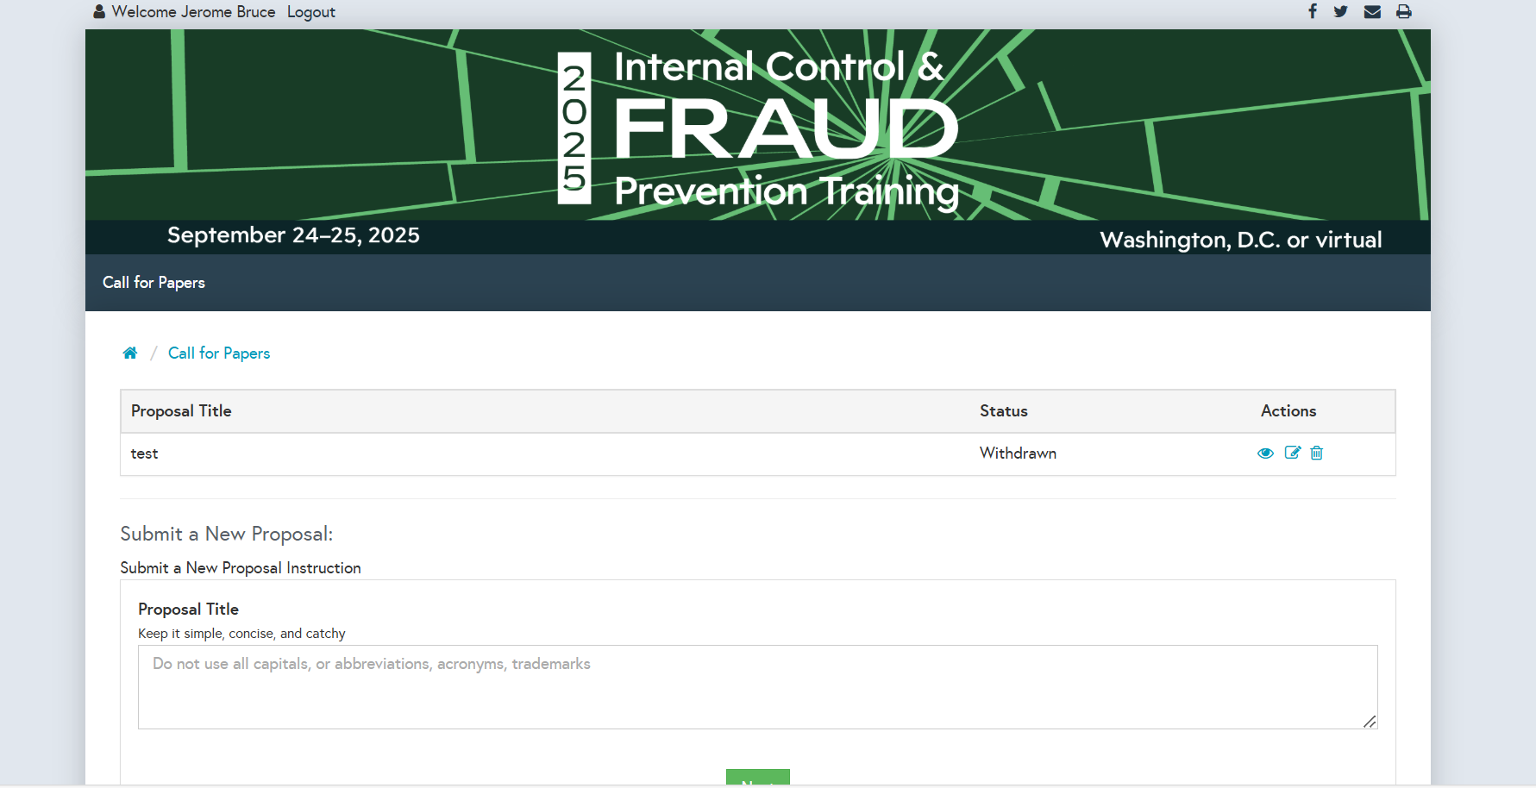

Slide 13
June 12 Co-chairs kick off call
June 24 Technical committee members first conference call
June 16-July 18 Submit potential sessions with brief description, key takeaways, & potential speakers
July 21-31 Review and grade submitted sessions
August 5-6 Co-chairs review & approve final agenda
August 7 Session approval notices sent
Aug. 7-Sept. 19 Confirm speakers and finalize session titles/descriptions (resource site)

Slide 14
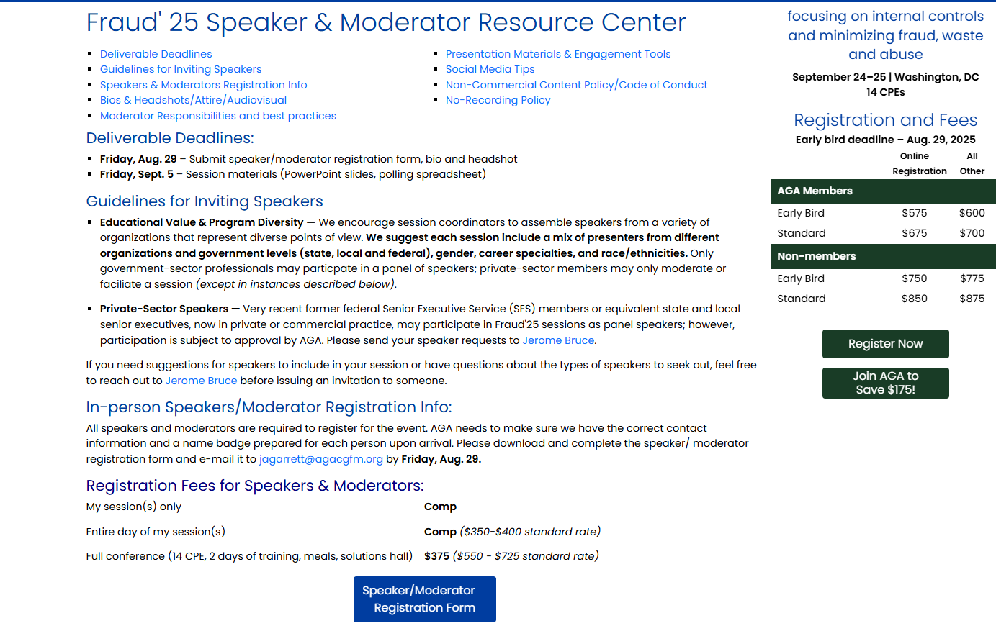

Slide 15
Engagement Ideas
Use AGA’s app and audience response system (Q&A, Polling, Games)
Allow Q&A at the end
Know your audience (review pre-registered attendee list)
Storytelling format, offer real life examples/best practices
Practice with your panelists so everyone is aware of the flow
Engage! Don’t just inform.

Slide 16
Fraud 2025 Co-Chairs Meeting Notes:
Sessions on Green Book and Yellow Book updates
Effects of executive orders and financial statement consolidation
Internal controls during reduced workforce
Fraud prevention outlook amid DOGE; how are we combatting Fraud?
How are we monitoring risk with a reduced workforce
What can we learn from the private sector industry? Best practices etc - what can government learn from private industry in navigating internal control, fraud prevention, and risk management?
Session on risk appetite; have a technology showcase of private and government tools
Effectively using AI to find solutions on problems/issues - identifying fraud and predicting risk
Continuous risk assessment and risk tolerance – using data to adjust tolerance levels
How to motivate the workforce with reduced and lost talent - with widespread retirements, layoffs, and burnout, how can agencies keep teams engaged?

Slide 17
Questions? Session ideas? Staff contacts: Jerome Bruce (jbruce@agacgfm.org) Jennifer Garrett (jgarrett@agacgfm.org) THANK YOU!

