Slide 1
Technology
Transformation
Summit
November 16^{th,} 2023
&
HUD’s Assurance Leap
Innovate. Iterate. Mitigate.

Slide 2
#TTS23

Slide 3
How
#TTS23

Slide 4
How
#TTS23

Slide 5
#TTS23

Slide 6
Internal and external benefits realized
HUD Program Offices
US
Taxpayers
Department of Housing and Urban Development
Office of Chief Financial Officer
All Federal Agencies
Recipients of Federal Programs
Internal
External
HUD’s Assurance Leap

Slide 7
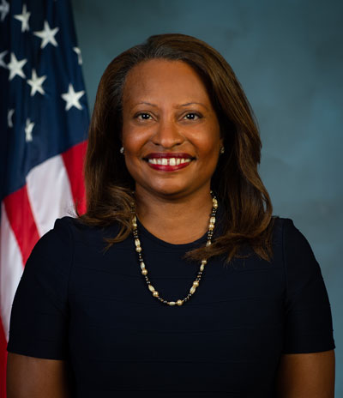
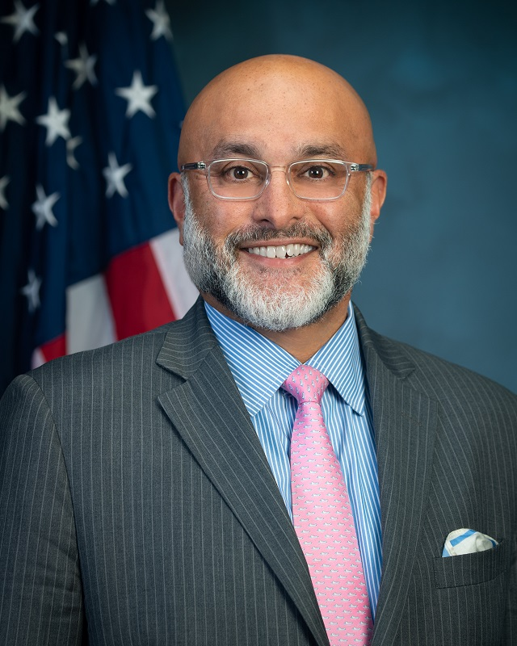
THANK YOU
We share our deepest gratitude to HUD’s leadership
Adrianne Todman
Vinay Singh

Slide 8
THANK YOU
Big thanks to Danielle Burrell, LaVerne Merrill, Anthony Smith and the OCFO Support Team

